Slide 1
Improving Machine Translation Quality with Automatic Named Entity Recognition
Bogdan Babych
Centre for Translation Studies
University of Leeds, UK
Department of Computer Science
University of Sheffield, UK
bogdan@comp.leeds.ac.uk
Anthony Hartley
Centre for Translation Studies
University of Leeds, UK
a.hartley@leeds.ac.uk

Slide 2
Overview
Problems of Named Entities (NEs) for MT
Experiment set-up
  Segmentation of the MT output
  Scoring scheme
Results of the experiment
Discussion
  Improving MT with IE techniques
Conclusions and future work

Slide 3
Problems of NEs for MT
NEs are the weak point for many MT systems
Distinct linguistic properties of proper nouns and different translation strategies for NE
“NE internal” errors:
  Proper / common noun disambiguation errors
  Errors in morphosyntactic categories of NEs
“NE external” errors in the context of NEs:
  Word sense disambiguation errors
  Errors in morphosyntactic features in NE context
  Segmentation errors

Slide 4
Translation strategies for NEs
Language-dependent strategies
  Eastern Slavonic languages: person names are transcribed with Cyrillic characters
Strategies dependent on a type of NE
  [Newmark, 1982: 70-83]: organisation names are often left untranslated
  Languages with Cyrillic writing system: organisation names are often left in original Roman orthography
    E.g.: 4 articles on international economy from BBC Russian site: Roman-script NEs cover 6% of the total 1000 tokens

Slide 5
Proper / common disambiguation errors
  English: “Ray Rogers”
  MT ProMT E-R: “Луч Rogers”
  (‘A ray (beam of light) Rogers’)
  English: “Bill Fisher”
  MT ProMT E-R : “Выставить счёт Рыбаку”
  MT ProMT E-F : “Facturez le Pêcheur”
  (‘(To) send a bill to a fisher’)
  English: “Jeff Levy”
  MT Systran E-F : “prélèvement de Jeff”
  (‘Jeff’s imposing of a tax’)

Slide 6
Contextual changes around unrecognised NEs
Errors in morphosyntactic categories
  English: “… they have been flying in United cockpits”
  E-R MT: “… они летали в Объединенных кабинах”
  (‘they have been flying in united (joined) cockpits’)
Segmentation errors
  English: “Eastern Airlines executives notified union leaders …”
  E-R MT: “Восточные исполнители авиалиний уведомили профсоюзных руководителей…”
  (‘Oriental executives of the Airlines notified …')

Slide 7
Compound errors -- combining:
“NE internal” errors and errors in the context of NEs
Lexical disambiguation errors and errors in morphosyntactic disambiguation / segmentation
  English: “In Ford-UAW talks…”
  E-R MT: “В Броде - UAW говорит”
  (‘In a ford (shallow place) - UAW is talking’)

Slide 8
Information Extraction (IE) technology
IE: from unrestricted text to a database
  specific subject domain (e.g. satellite launches)
  predefined template with fields to be filled
IE tasks:
  NE recognition
  Co-reference resolution
  Word sense disambiguation
  Template element filling
  Scenario template filling
  Summary generation

Slide 9
NE recognition in IE
NE recognition is specifically addressed and benchmarked (DARPA MUC6 & MUC7 competitions)
Manually annotated “gold standard” available
Highly accurate
  leading IE systems achieve F-score 80-90%
  performance is higher and less dependent on a subject domain (compared to Scenario Template Filling)
Available under GPL: NE recognition module ANNIE in Sheffield’s GATE system

Slide 10
Using NE recognition for MT
GATE-ANNIE system allows automatic annotation of NEs in English texts
MT systems accept Do-Not-Translate (DNT) lists
  acceptable translation strategy for many organisation names in certain language pairs
Suggestion: if NE recognition is more accurate for IE systems, then general MT quality will improve (compared to the baseline performance)
  NE-Internal changes are predictable (DNT strategy)
  Changes in the context of NEs are more interesting and more difficult to predict

Slide 11
Experiment set-up
Purpose: evaluating morphosyntactic changes in the context of NEs after DNT-processing
Corpus:
  30 texts (news articles) from MUC6 evaluation set
  (11,975 tokens, 510 NE occurrences, 174 NE types)
  GATE “responses” -- NE recognition output file generated by GATE-1 for MUC6 competition
  (Precision - 84%; Recall - 94%; F-measure - 89.06%)
MT systems:
  E-R ProMT 98; E-F ProMT 2001; E-F Systran 2000

Slide 12
Experiment set-up (contd.)
Stage 1: Automatic generation of DNT lists from GATE-1 annotation
Stage 2: Generating translations for 3 systems
  Baseline translation (without a DNT list)
  DNT-processed translation
Stage 3: Automatic segmentation of translations into NE-internal and NE-external zones
Stage 4: Manual scoring of NE-external differences

Slide 13
Segmentation algorithm
Annotated NEs in the English original are looked up in the DNT-processed translation
Strings between found NEs are then looked up in the baseline translation
If a string is not found, it is highlighted (signaling a difference in the context of the NE)
  Result: NE-internal and NE-external zones in the baseline translation are separated
  NE-external differences are highlighted
  No complex alignment

Slide 14
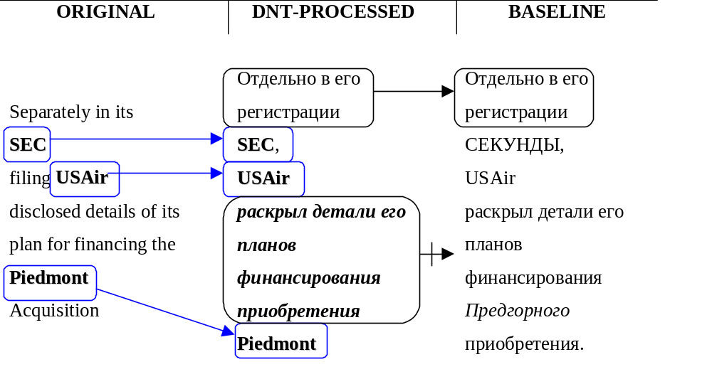
Segmentation algorithm (contd.)

Slide 15
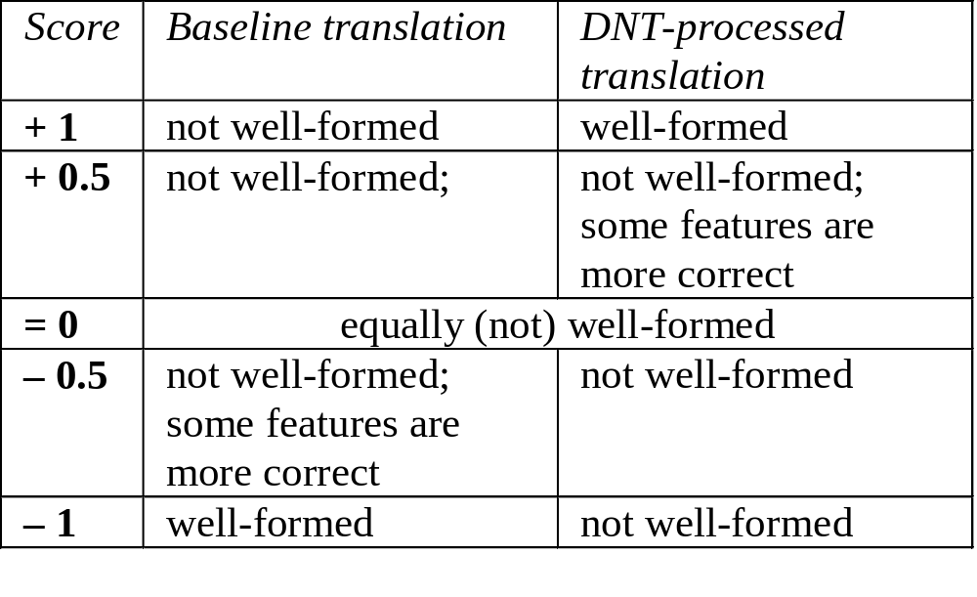
Scoring scheme
Evaluating morphosyntactic well-formedness

Slide 16
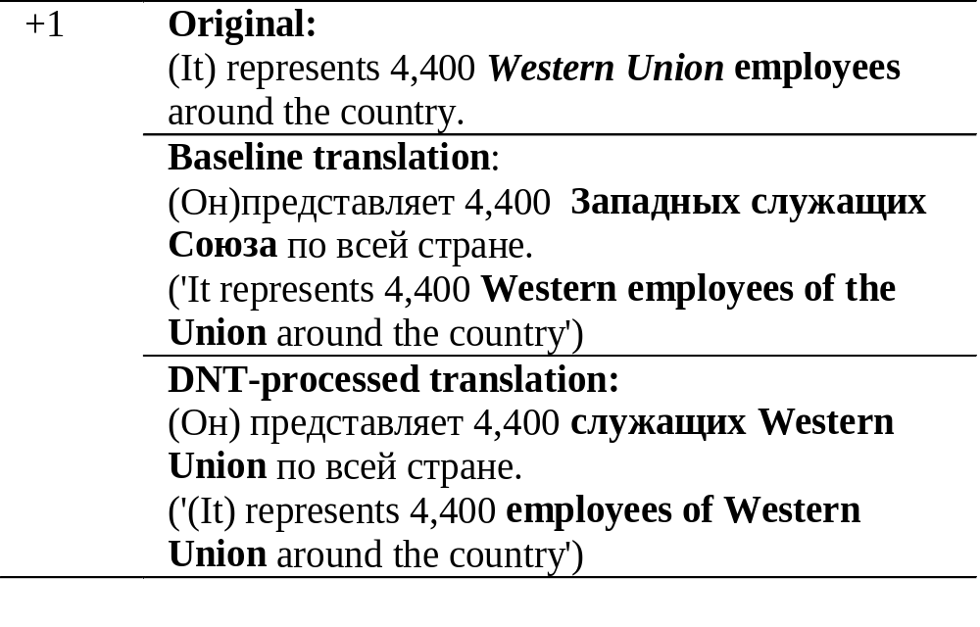
Scoring examples: +1 score

Slide 17
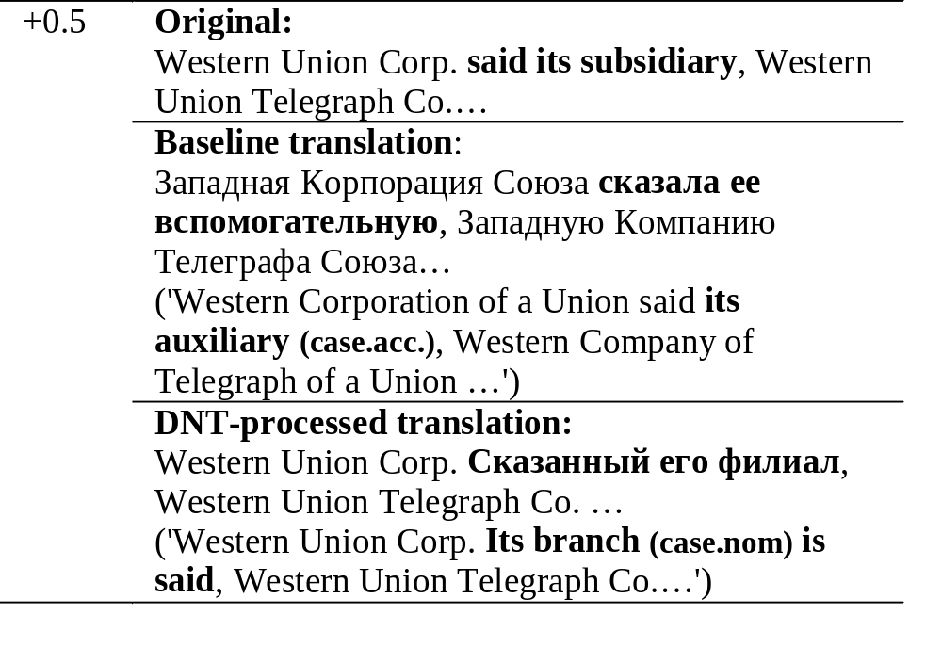
Scoring examples: +0.5 score

Slide 18
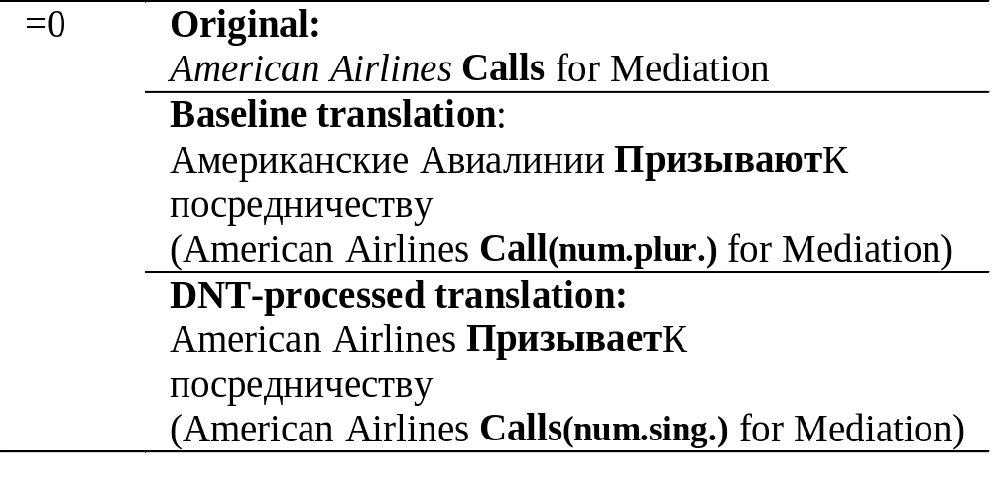
Scoring examples: =0 score

Slide 19
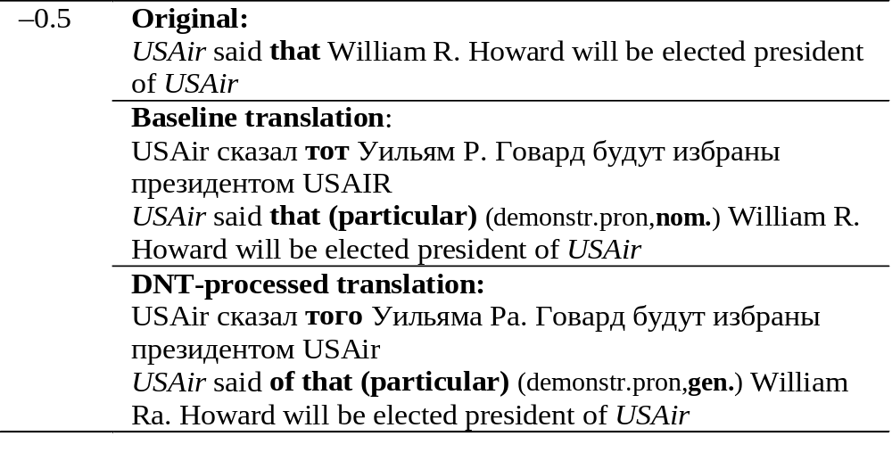
Scoring examples: -0.5 score

Slide 20
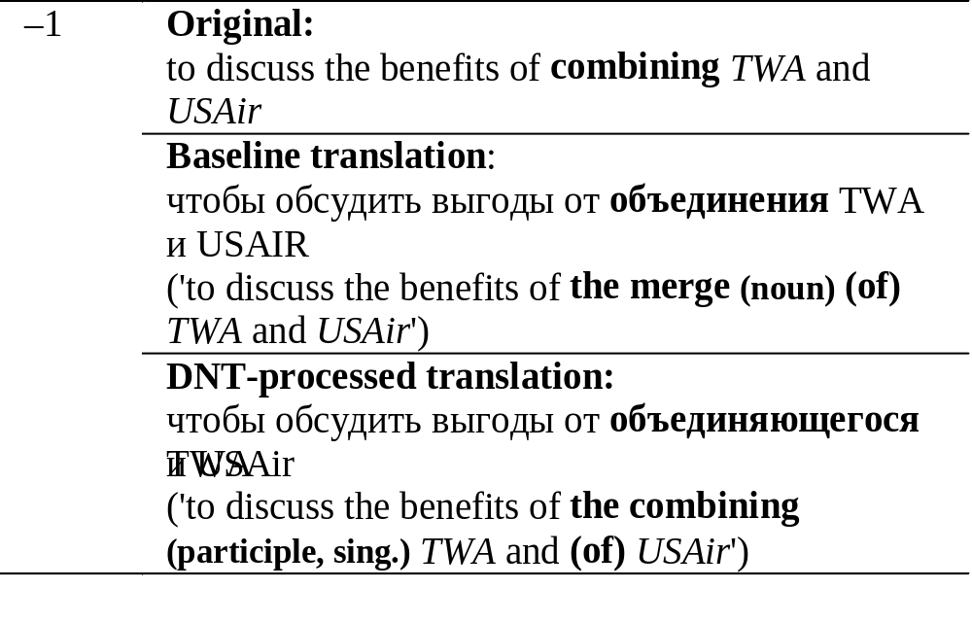
Scoring examples: -1 score

Slide 21
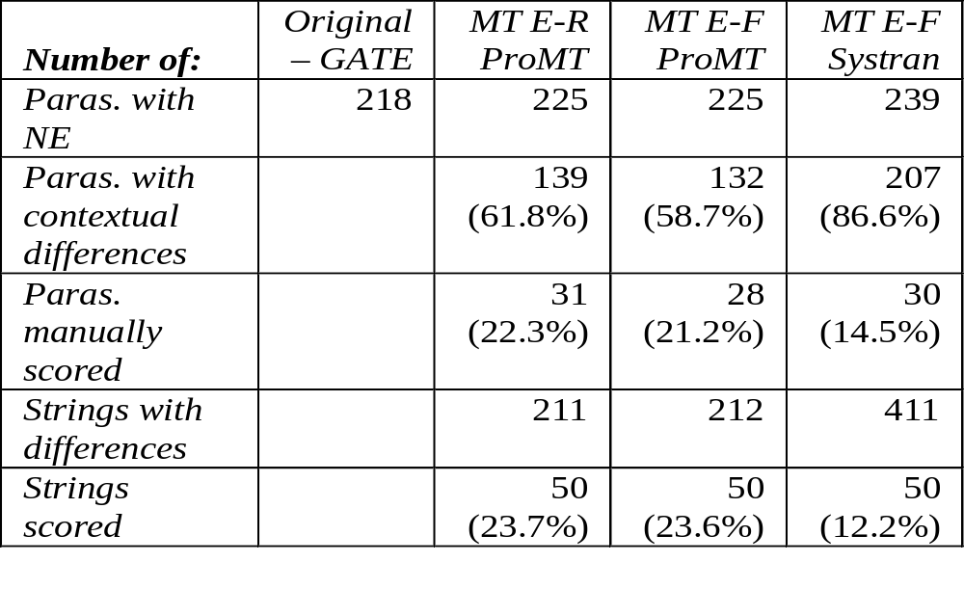
Manually scored part of the corpus
50 highlighted strings for each MT system
Gain score: Overall score / Scored differences

Slide 22
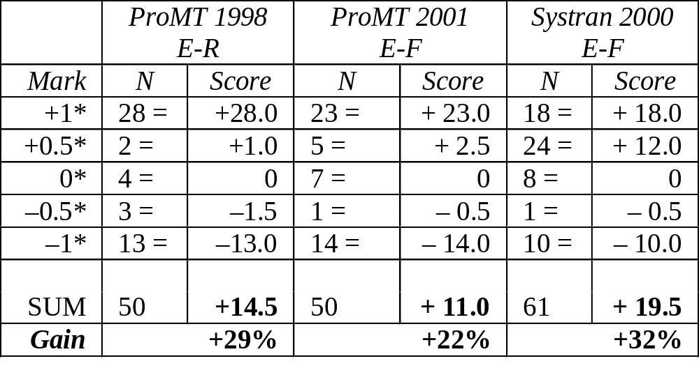
Results of the experiment

Slide 23
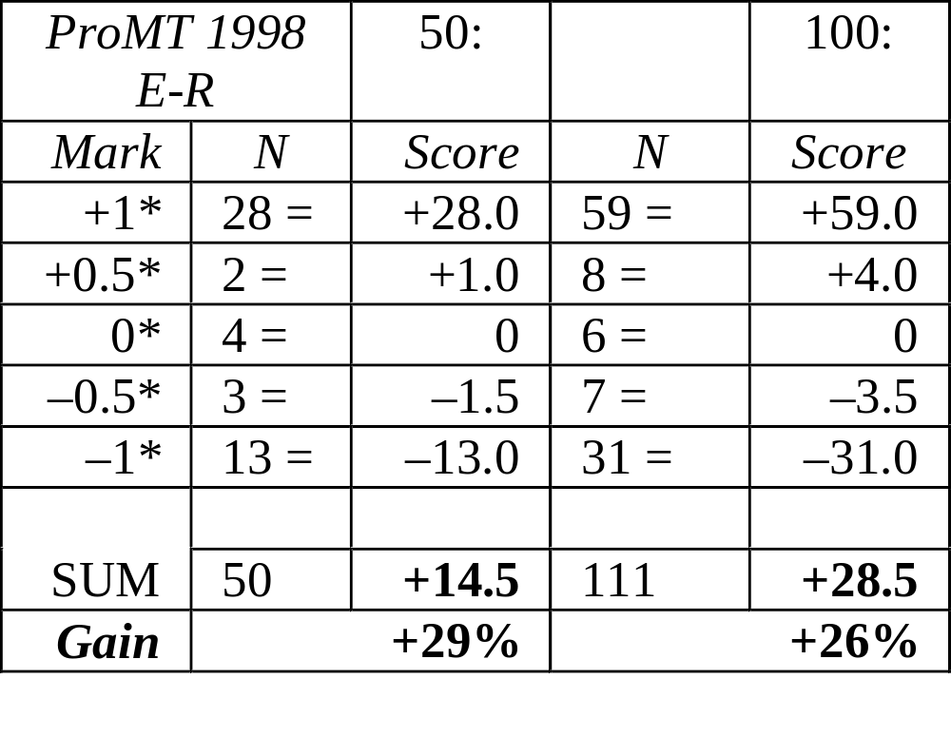
Results for additional 50 strings...

Slide 24
Improvement in the context of NEs
Aspects of improvement:
  morphosyntactic features and categories
  word sense disambiguation
  word order and syntactic segmentation
Consistency in improvement
  for both languages
  for all MT systems

Slide 25
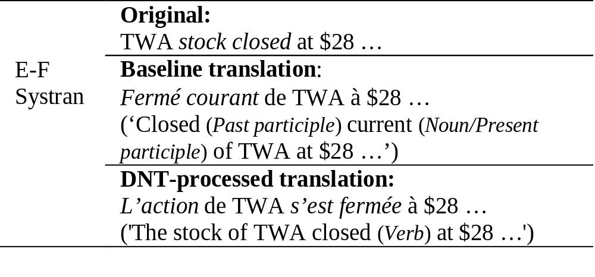
Examples of improvement

Slide 26
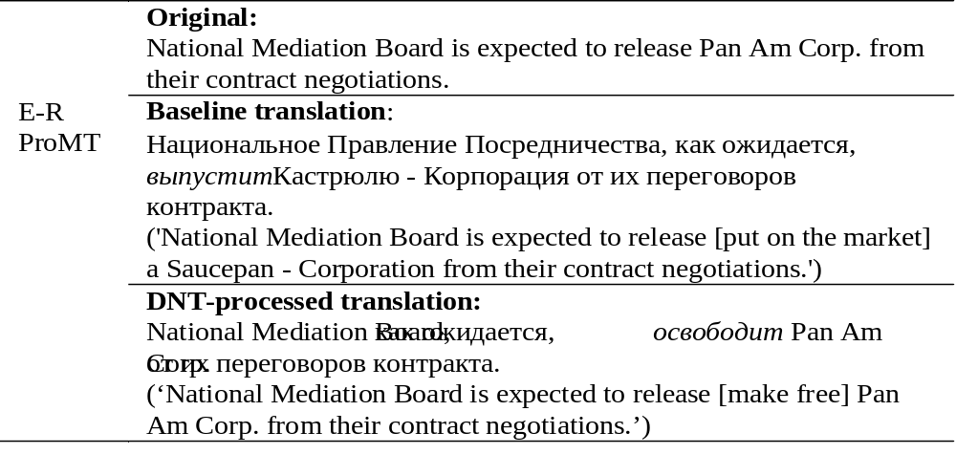
Examples of improvement:2

Slide 27
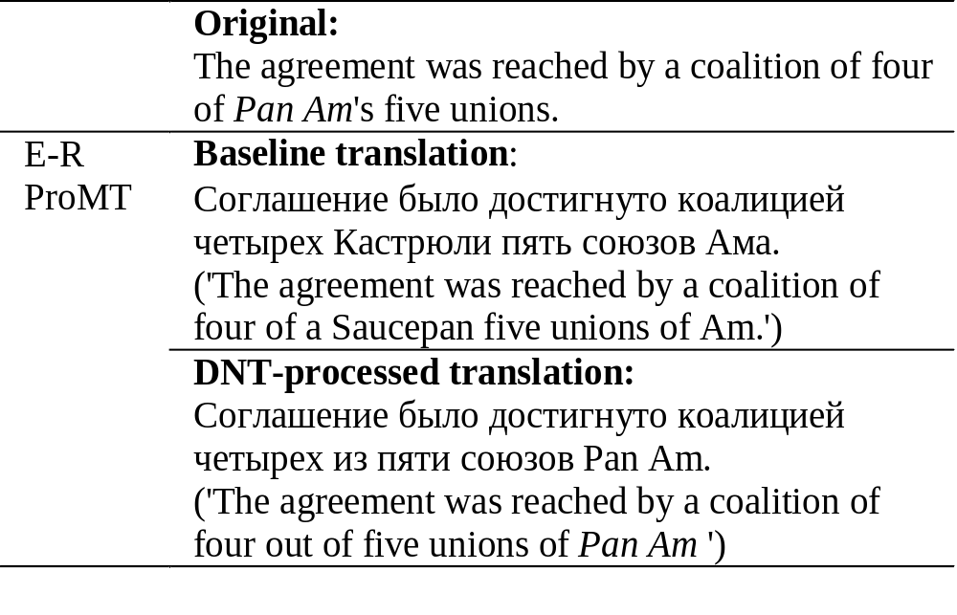
Improvement: languages and systems

Slide 28
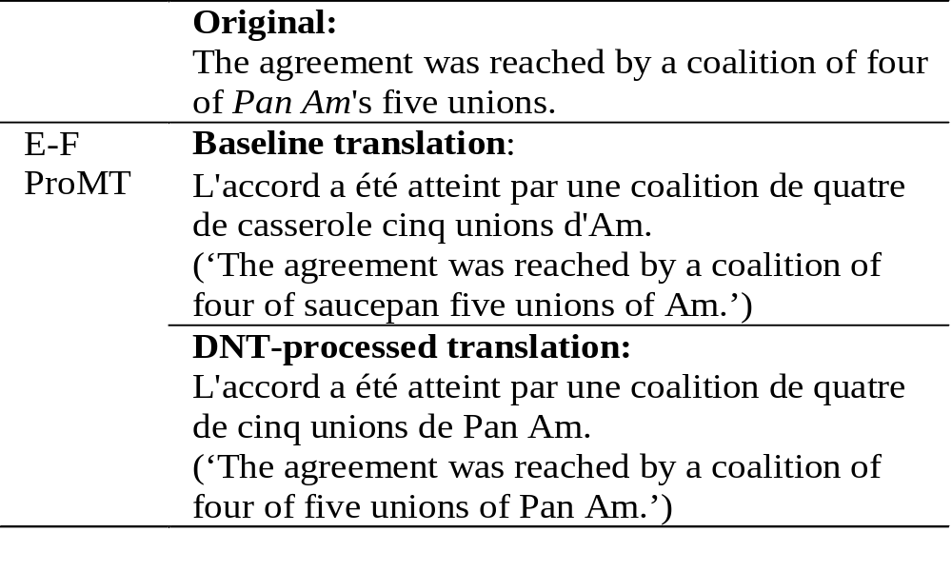
Improvement: languages and systems:2

Slide 29
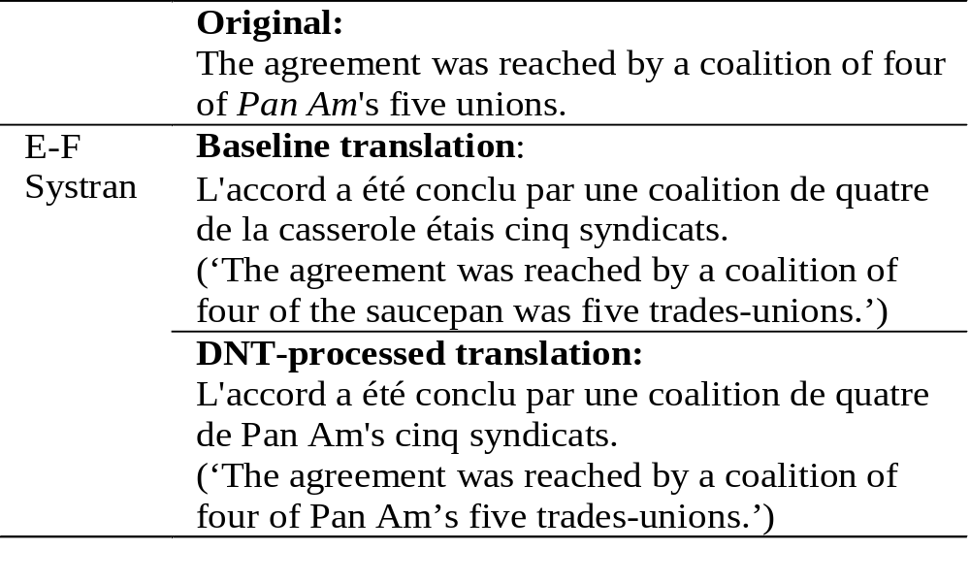
Improvement: languages and systems:3

Slide 30
Discussion
Different aspects of MT quality are interdependent
  improvements on one level help other levels
IE techniques target specific tasks also necessary for the SL analysis stage in MT
  NE recognition
  co-reference resolution
  word sense disambiguation
MT can benefit from clearly defined evaluation procedures for specific IE tasks

Slide 31
Conclusions and Future Work
NE recognition within IE framework improves not only treatment of NEs by MT, but also boosts the overall MT quality:
  morphosyntactic and lexical well-formedness
  features of the wider context of NEs
Future work: harnessing other focused technologies for MT
  co-reference resolution
  word sense disambiguation
  evaluating the baseline performance of MT systems

