Slide 1
Alternatives to rule-based MT: statistical and example-based MT
Lecture 25/04/2005
MODL5003 Principles and applications of machine translation
  slides available at: http://www.comp.leeds.ac.uk/bogdan/

Slide 2
1. Overview
Classification of approaches to MT
Limitations of rule-based methods. Data-driven methods in Speech and Language Technology
Parallel corpora and issues of automatic alignment
Statistical Machine Translation: early experiments and integration of linguistic knowledge
Example Based Machine Translation: metaphor of automatic translation memory and perspectives

Slide 3
2. Classification of approaches to MT
How MT is built? | What information is used?
 | Rule-based MT | Data-driven MT: SMT and EBMT
Direct | ~ “Systran” | ~ “Candide”, “Language Weaver”
Transfer | ~ “Reverso” | ?
Interlingua | ~ “EUROTRA” | ?

Slide 4
Rule-based vs. Data-driven approaches
Rule-based MT | Data-driven MT
use formal models of our knowledge of language, linguistic intuition of developers Problems: expensive to build; require precise knowledge, which might be not available | use “machine learning” techniques on large collections of available texts; "let the data speak for themselves" Problems: language data are sparse high-quality data are also expensive

Slide 5
3. Limitations of rule-based methods
Cost too high
    many linguists needed to write rules
Lack of adequate knowledge
    (monolingual and contrastive)
  E.g., aspect: in Germanic vs. Slavonic
Vin chytav knyzhku he read_{(PST.IMPERF)} book_{(ACC)} | He was reading a book
Vin prochytav knyzhku he read_{(PST.PERF)} book_{(ACC)} | He read (finished reading) a book

Slide 6
… no direct mapping: systematic vs. non-systematic
Nexaj vin chytaje let he reads_{(NON-PAST.IMPERF)} | Let him read
Nexaj vin prochytaje X let he read_{(NON-PAST.PERF)} X | Have him read X
Zhenshchina vyshla iz doma Woman came-out of house_{(GEN)} | The woman came out of the house
Iz doma vyshla zhenshchina Of house_{(GEN)} came-out woman | A woman came out of the house
Zhenshchina vyshla íz domu Woman came-out of house_{(GEN-2)} | The woman came out of her house

Slide 7
Alternative: data-driven methods
Principle: using existing translations as a prime source of information for the production of new ones (Kay, 1997, HLT survey, p. 248)
Large amounts of data contain essential knowledge for making a functional system
  Large amount of data; processing power available
  Data-driven models rectify the lack of explicit linguistic knowledge:
    the knowledge can be retrieved and used automatically

Slide 8
…data-driven methods (contd.)
translating English word not into French
  frequencies of translations in a parallel corpus (Hutchins, Somers, 1992, p. 321)
English not | French ne (0.460)… pas (0.469) ne (0.460)… plus (0.002) ne (0.460)… jamais (0.002) non (0.024) pas du tout (0.003) faux (0.003)

Slide 9
…data-driven methods (contd.)
machine-learning algorithms are language-independent
Data-driven approaches:
  account for typical phenomena systematically
  compare productivity of different structures in texts from different domains / genres

Slide 10
4.Parallel&comparable corpora and automatic alignment
Data sources
  Parallel corpora
    richer in translation equivalents, more difficult to get
  Comparable corpora
    Multilingual texts in the same domain
    larger, but equivalents sparse and less identifiable
Tasks
  Retrieving equivalents “on the fly”
  Creating wide-coverage dictionaries and grammars

Slide 11
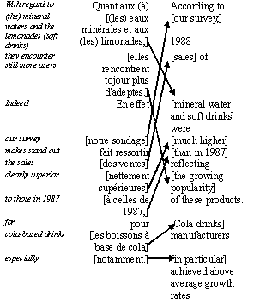
Alignment

Slide 12
Alignment: sentence level
90% of sentences have 1:1 alignment;
the rest: 1:2; 2:1; 1:3; 3:1, etc.
The example above is 2:2 alignment:
    content of the second Fr sentence occurs in the first En sentence
Order of sentences can change
Techniques
  length-based alignment (Gale and Church, 1993)
  cognates (Church, 1993)
  lexical methods (Kay and Röscheisen, 1993)

Slide 13

Alignment: word level
association measures (Church and Gale, 1991)
  differences between the observed and expected values
iterative sentence-word alignment
  re-computing word alignment based on its results for sentence alignment (Brown et al., 1990)

Slide 14
Problems of retrieving translation equivalents
Non-literal translation, change of perspective
  low level alignment is not possible
  Obligatory “loss” of information
    “The Danish flair and verve saw them beat France twice in 1908”
    “Le sens du jeu et la créativité des Danois a raison des Français à deux reprises en 1908.”
    (lit.: The feeling of the play and the creativity of the Danes are right for the French twice in 1908)
Disambiguation information in context
  "wearing" (clothes): 5 different words in Japanese

Slide 15
… change of perspective: example
  “Bayern began with the verve which saw them come from behind to defeat Celtic FC a fortnight ago.”
  Гости, две недели назад одержавшие волевую победу над "Селтиком", с первых минут завладели инициативой.
  lit.: Guests, who two weeks ago gained a strong-willed victory over “Celtic”, from the first minutes took the initiative
Can we extract any translation equivalents?

Slide 16
Limitations of parallel corpora: learning “transfer”?
Finding equivalents is not sufficient
Need to find motivation for translation transformations
  Иную позицию заняли Франция и Германия.
  (lit.: A different stand _{(Acc.)} took France and Germany _{(Nom.)}
  * France and Germany took a different stand.
  A different stand was taken by France and Germany
Currently: learning linked to particular words

Slide 17
Limitations of parallel corpora
How MT is built? | What information is used?
 | Rule-based MT | Data-driven MT: SMT and EBMT
Direct | ~ “Systran” | ~ “Candide”, “Language Weaver”
Transfer | ~ “Reverso” | <???>
Interlingua | ~ “EUROTRA” | <???>

Slide 18
Balancing competing translation equivalents?
  В комнате установилась мертвая тишина.
  lit.: In the room established itself deathly silence
  * A deathly silence descended upon the room.
  The room turned deathly silent.
  В комнате установилась мертвая тишина. Она была вызывающей.
  (lit.: In the room established itself deathly silence. It/[she]=the silence was defiant.)
  A deathly silence descended upon the room. It was defiant.
  * The room turned deathly silent. It was defiant

Slide 19
5. Statistical MT
Cryptography metaphor for MT
  noisy channel model
    English message transformed into French
    How to recover what English speaker had in mind?
Warren Weaver’s memorandum, July 1949
Tackling obvious problems of ambiguity
  knowledge of cryptography, statistics, information theory, logic and language universals

Slide 20
Statistical MT since 90's
An experimental pure statistical system at IBM (Brown et al., 1990)
Used the corpus of Canadian Hansard
  (records of parliamentary debates in French and English
  40,000 pairs of sentences, 800,000 words in each
Evaluated by translating from French into English: limited vocabulary (1000 most frequent English words); 73 sentences:
  exact – 5%; exact + alternative + different – 48% (the rest – "wrong and ungrammatical")
No prior linguistic knowledge was applied

Slide 21
IBM experiment: evaluation
exact: Ces amendements sont certainment nécessaires
  Hansard: These amendments are certainly necessary
  IBM: These amendments are certainly necessary
alternative: C'est pourtant très simple
  Hansard: Yet it is very simple
  IBM: It is still very simple
different: J'ai reçu cette demande en effet
  Hansard: Such a request was made
  IBM: I have received this request in effect
wrong: Permettez que je donne un exemple à la Chambre
  Hansard: Let me give the House one example
  IBM: Let me give an example in the House
ungrammatical: Vous avez besoin de toute l'aide disponible
  Hansard: You need all the help you can get
  IBM: You need the whole benefits available

Slide 22

Behind the Statistical MT technology
Warren Weaver's "cryptography" approach
  French sentence is viewed as "encoded" English sentence, which was converted from English into French by some "noise" on its way to the reader.
  The model allows associating French and English sentences with certain numerical scores, so different "translation candidates" can be compared

Slide 23
Behind the Statistical MT (contd.)
The Language Model generates an English sentence
  is trained on English monolingual corpus, measures how "natural", "fluent" is English sentence
  Frequencies in the corpus of 2-word, 3-word… N-word sequences – N-grams -- found in the output sentence are multiplied together
Little John was looking for his toy box… The box was in a pen

Slide 24
Behind the Statistical MT (contd.)
The Translation Model estimates what can be the translation of an English sentence
  French words which are not translations of English words have low scores
  Trained on the aligned corpus
    how "faithful", "adequate" is the resulting English sentence to the French sentence
    frequencies of translations of French words in parallel corpus are multiplied
“defeat → поражение (loss)
“defeat → победа (victory)
  its defeat of last night; their FA Cup defeat of last season; last season’s defeat of Durham
  their defeat of last season’s Cup winners

Slide 25
Behind the Statistical MT (contd.)
Decoder: balances the 2 models
  finds En sentence which is most likely to have given rise to Fr sentence
  Salvadoran President condemned the terrorist killing of Attorney General Alvarado.
  Сальвадорский президент осудил убийство террориста Генерального прокурора Alvarado.
  lit.: Salvadoran president condemned the killing of a terrorist Attorney General Alvarado
terrorist killing = killing of a terrorist (presumably, by analogy to “tourist killing” or “farmer killing”); not killing by terrorists
“just pretending to be a terrorist killing war machine”

Slide 26
Problems for "pure" SMT
No notion of phrases:
  to go -- aller; farmers -- les agriculteurs
Non-local dependencies:
  Language models works with "fixed window" of 2, 3… N words, but more distant words can be grammatically related: E.g., 2-gram model cannot distinguish ungrammatical sentences:
What do you say?
* What do you said?
What have you said?
* What have you say?

Slide 27
6. Example-based MT (EBMT)
More linguistically-oriented
EBMT (Sato & Nagao 1990), 3 stages: (Example quoted by Somers, lecture at Leeds, 2003)
  identify corresponding translation fragments (align)
  retrieval: match fragments against example database
  adaptation: recombine fragment into target text
    Translation Memory can be viewed as a specific case of EBMT without the adaptation stage
    Linguistic knowledge about word order, agreement, etc. is captured automatically from examples

Slide 28
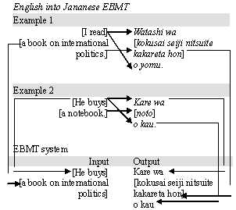
Stages of EBMT

Slide 29
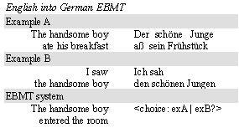
“Boundary friction" in EBMT
Issue: finding "safe points of example concatenation“

Slide 30
Open issues in EBMT
Representation and Retrieval
  Granularity of examples:
    the longer the passages, the lower the probability of a complete match,
    the shorter the passages, the greater the probability of ambiguity and… boundary friction
  Complexity of storing formats
    strings, part-of-speech annotation, multi-level annotation, trees…

Slide 31
Open issues in EBMT (contd.)
Storing similar examples as a single generalised example
  resembles traditional transfer rules Discovering generalised patterns automatically.
    John Miller flew to Frankfurt on December 3rd.
    <1stname> <lastname> flew to <city> on <month> <ord>.
    <person-m> flew to <city> on <date> .
    Dr Howard Johnson flew to Ithaca on 7 April 1997

Slide 32
Open issues in EBMT (contd.)
Adaptation (recombination)
  (Somers, EBMT as CBR): A solution retrieved from the stored case is almost never exactly the same as a new case.
  There is a need of adapting the existing examples to a new input

Slide 33
Syntactic & semantic match
Input:
  When the paper tray is empty, remove it and refill it with paper of the appropriate size.
Syntactic match:
  When the bulb remains unlit, remove it and replace it with a new bulb
Semantic match:
  You have to remove the paper tray in order to refill it when it is empty.

Slide 34
Adaptation-guided retrieval (Collins, 1998:31)
Knowing how "literal" or "distant" is the translation from the original in examples
  examples require different strategies for adaptation
2 criteria for retrieval of examples
  the closeness of the match between the input text and the example
  the adaptability of the example
    relationship between the representations of the example and its translation
    "literal" translations are easier to adapt
good examples vs. bad examples
    easy to retrieve but difficult to adapt, etc.

Slide 35
Adaptation-guided retrieval (contd.)
Ottawa abolira la très impopulaire taxe à la consommation sur les produits et les services (TPS), de type TVA, instaurée par les conservateurs, | Ottawa will abolish the very unpopular consumption tax on products and services (TPS), of the VAT type introduced by the Conservatives.
et la remplacera par une autre taxe "plus équitable". Lit: [and replace it by another ,"more equitable" tax] | It will be replaced by another, "more equitable" tax. // LESS ADAPTIVE!

Slide 36
MT: where we are now?
The prima face case against operational machine translation from the linguistic point of view will be to the effect that there is unlikely to be adequate engineering where we know there is no adequate science. A parallel case can be made from the point of view of computer science, especially that part of it called artificial intelligence. (Kay, 1980: 222).
… If we are doing something we understand weakly, we cannot hope for good results. And language, including translation, is still rather weakly understood. (Kettunen, 1986: 37)

Slide 37
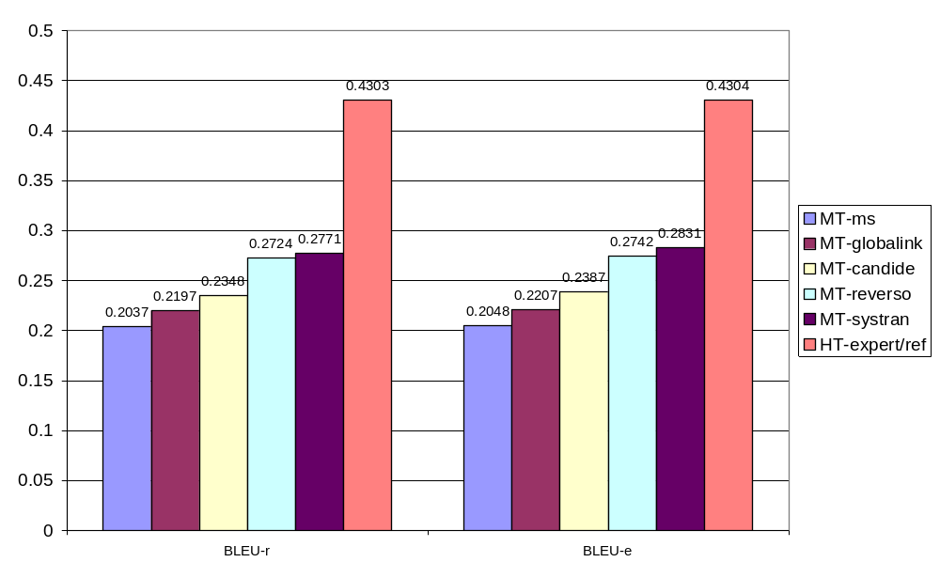
BLEU scores for MT and Human Translation

Slide 38
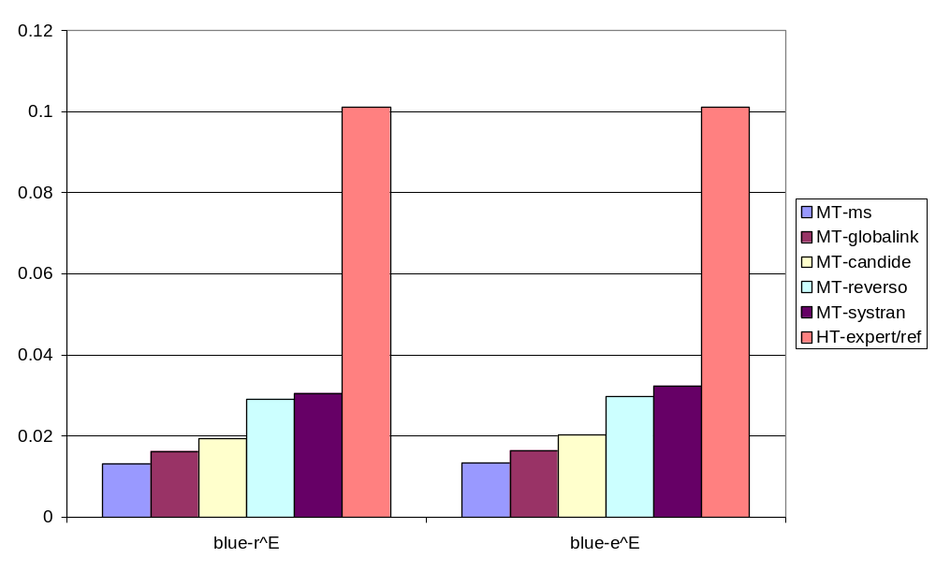
Estimation of effort to reach human quality in MT

Slide 39
Information extraction for MT
Salvadoran President condemned the terrorist killing of Attorney General Alvarado
  Perpetrator: terrorist
  Human target: Attorney General Alvarado
Salvadoran president condemned the killing of a terrorist Attorney General Alvarado
  Perpetrator: [UNKNOWN]
  Human target: terrorist Attorney General Alvarado

Slide 40
MT: way forward?
Too much data is not good either: competition of equivalents
  Accessing information on the text level
  There is no data like more data vs. “intelligent processing” approaches
“Not the power to remember, but its very opposite, the power to forget, is a necessary condition for our existence”. (Saint Basil, quoted in Barrow, 2003: vii)

