Slide 1
Automatic methods of MT evaluation
Lecture 20/03/2006
MODL5003 Principles and applications of machine translation
  Bogdan Babych <bogdan@comp.leeds.ac.uk>

Slide 2
Overview
Aspects of MT evaluation
Text Quality evaluation
Advantages / disadvantages of automatic techniques
Methods of automatic evaluation
Validation of automatic scores
Challenges
Recent developments

Slide 3
1. Aspects of MT evaluation (1)
(Hutchins & Somers, 1992:161-174)
Text quality
      (important for developers, users and managers);
Extendibility
      (developers)
Operational capabilities of the system
      (users)
Efficiency of use
      (companies, managers, freelance translators)

Slide 4
Aspects of MT evaluation (2)
Text Quality
  can be done manually and automatically
  central issue in MT quality…
Extendibility = architectural considerations:
  adding new language pairs
  extending lexical / grammatical coverage
  developing new subject domains:
    “improvability” and “portability” of the system

Slide 5
Aspects of MT evaluation (3)
Operational capabilities of the system
  user interface
  dictionary update: cost / performance, etc.
Efficiency of use
  is there an increase in productivity?
  the cost of buying / tuning / integrating into the workflow / maintaining / training personnel
  how much money can be saved for the company / department?

Slide 6
2. Text quality evaluation (TQE) – issues 1/2
Quality evaluation vs. error identification / analysis
Black box vs. glass box evaluation
Error correction on the user side
  dictionary updating
  do-not-translate lists, etc.

Slide 7
2. Text quality evaluation (TQE) – issues 2/2
Multiple quality parameters & their relations
    fidelity (adequacy)
    fluency (intelligibility, clarity)
    style
    informativeness…
Are these parameters completely independent?
    Or is intelligibility a pre-condition for adequacy or style?
Granularity of evaluation different for different purposes
    individual sentences; texts; corpora of similar documents; the average performance of an MT system

Slide 8
3. Advantages of automatic evaluation
Low cost
Objective character of evaluated parameters
reproducibility
comparability
  across texts: relative difficulty for MT
  across evaluations

Slide 9
& Disadvantages …
need for “calibration” with human scores
interpretation in terms of human quality parameters is not clear
do not account for all quality dimensions
  hard to find good measures for certain quality parameters
reliable only for homogeneous systems
  the results for non-native human translation, knowledge-based MT output, statistical MT output may be non-comparable

Slide 10
4. Methods of automatic evaluation
Automatic Evaluation is more recent: first methods appeared in the late 90-ies
  Performance methods
    Measuring performance of some system which uses degraded MT output
  Reference proximity methods
    Measuring distance between MT and a “gold standard” translation

Slide 11
4.1 Performance methods
A pragmatic approach to MT: similar to performance-based human evaluation
  “…can someone using the translation carry out the instructions as well as someone using the original?” (Hutchins & Somers, 1992: 163)
Different from human performance evaluation
  1. Tasks are carried out by an automated system
  2. Parameter(s) of the output are automatically computed

Slide 12
… automated systems used & parameters computed
parser (automatic syntactic analyser)
  Computing an average depth of syntactic trees
    (Rajman and Hartley, 2000)
Named Entity Recognition system (a system which finds proper names, e.g., names of organisations…)
  Number of extracted organisation names
Information Extraction
  filling a database: events, participants of events
  Computing ratio of correctly filled database fields

Slide 13
Performance-based methods: an example 1/2
Open-source NER system for English (ANNIE) www.gate.ac.uk
    the number of extracted Organisation Names gives an indication of Adequacy
  ORI: … le chef de la diplomatie égyptienne
  HT: the <Title>Chief</Title> of the <Organization>Egyptian Diplomatic Corps </Organization>
  MT-Systran: the <JobTitle> chief </JobTitle> of the Egyptian diplomacy

Slide 14
Performance-based methods: an example 2/2
count extracted organisation names
the number will be bigger for better systems
  biggest for human translations
other types of proper names do not correspond to such differences in quality
  Person names
  Location names
  Dates, numbers, currencies …

Slide 15
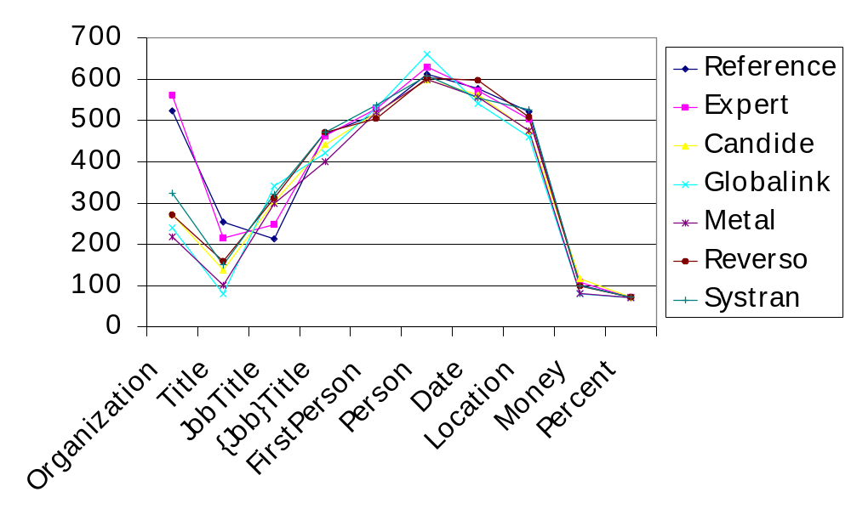
NE recognition on MT output

Slide 16
Performance-based methods: interpretation
built on prior assumptions about natural language properties
  sentence structure is always connected;
  MT errors more frequently destroys relevant contexts than creates spurious contexts;
  difficulties for automatic tools are proportional to relative “quality” (the amount of MT degradation)
Be careful with prior assumptions
  what is worse for the human user may be better for an automatic system

Slide 17
Example 1
ORI : “Il a été fait chevalier dans l'ordre national du Mérite en mai 1991”
HT: “He was made a Chevalier in the National Order of Merit in May, 1991.”
MT-Systran: “It was made <JobTitle> knight</JobTitle> in the national order of the Merit in May 1991”.
MT-Candide: “He was knighted in the national command at Merite in May, 1991”.

Slide 18
Example 2
Parser-based score: X-score
Xerox shallow parser XELDA produces annotated dependency trees; identifies 22 types of dependencies
  The Ministry of Foreign Affairs echoed this view
    SUBJ(Ministry, echoed)
    DOBJ(echoed, view)
    NN(Foreign, Affairs)
    NNPREP(Ministry, of, Affairs)

Slide 19
Example 2 (contd.)
a hearing that lasted more then 2 hours
  RELSUBJ(hearing, lasted)
a public program that has already been agreed on
  RELSUBJPASS(program, agreed)
to examine the effects as possible
  PADJ(effects, possible)
brightly coloured doors
  ADVADJ(brightly, coloured)
X-score = (#RELSUBJ + #RELSUBJPASS – #PADJ – #ADVADJ)

Slide 20
4.2 Reference proximity methods
Assumption of Reference Proximity (ARP):
  “…the closer the machine translation is to a professional human translation, the better it is” (Papineni et al., 2002: 311)
Finding a distance between 2 texts
  Minimal edit distance
  N-gram distance
  …

Slide 21
Minimal edit distance
Minimal number of editing operations to transform text1 into text2
  deletions (sequence xy changed to x)
  insertions (x changed to xy)
  substitutions (x changed by y)
  transpositions (sequence xy changed to yx)
Algorithm by Wagner and Fischer (1974).
Edit distance implementation: RED method
  Akiba Y., K Imamura and E. Sumita. 2001

Slide 22
Problem with edit distance: Legitimate translation variation
ORI: De son côté, le département d'Etat américain, dans un communiqué, a déclaré: ‘Nous ne comprenons pas la décision’ de Paris.
HT-Expert: For its part, the American Department of State said in a communique that ‘We do not understand the decision’ made by Paris.
HT-Reference: For its part, the American State Department stated in a press release: We do not understand the decision of Paris.
MT-Systran: On its side, the American State Department, in an official statement, declared: ‘We do not include/understand the decision’ of Paris.

Slide 23
Legitimate translation variation (LTV) …contd.
to which human translation should we compute the edit distance?
is it possible to integrate both human translations into a reference set?

Slide 24
N-gram distance
the number of common words (evaluating lexical choices);
the number of common sequences of 2, 3, 4 … N words (evaluating word order):
  2-word sequences (bi-grams)
  3-word sequences (tri-grams)
  4-word sequences (four-grams)
  … N-word sequences (N-grams)
N-grams allow us to compute several parameters…

Slide 25
Proximity to human reference (1)
MT “Systran”: The 38 heads of undertaking put in examination in the file were the subject of hearings […] in the tread of "political" confrontation.
Human translation “Expert”: The 38 heads of companies questioned in the case had been heard […] following the "political" confrontation.
MT “Candide”: The 38 counts of company put into consideration in the case had the object of hearings […] in the path of confrontal "political."

Slide 26
Proximity to human reference (2)
MT “Systran”: The 38 heads of undertaking put in examination in the file were the subject of hearings […] in the tread of "political" confrontation.
Human translation “Expert”: The 38 heads of companies questioned in the case had been heard […] following the "political" confrontation.
MT “Candide”: The 38 counts of company put into consideration in the case had the object of hearings […] in the path of confrontal "political."

Slide 27
Proximity to human reference (3)
MT “Systran”: The 38 heads of undertaking put in examination in the file were the subject of hearings […] in the tread of "political" confrontation.
Human translation “Expert”: The 38 heads of companies questioned in the case had been heard […] following the "political" confrontation.
MT “Candide”: The 38 counts of company put into consideration in the case had the object of hearings […] in the path of confrontal "political."

Slide 28
Matches of N-grams
MT
Omissions
False hits
HT
True hits

Slide 29
Matches of N-grams (contd.)
 | MT + | MT –
Human text + | true hits | omissions | → recall (avoiding omissions)
Human text – | false hits
 | ↓ precision (avoiding false hits)

Slide 30
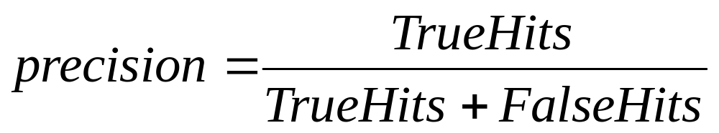

Precision and Recall
Precision = how accurate is the answer?
  “Don’t guess, wrong answers are deducted!”
Recall = how complete is the answer?
  “Guess if not sure!”, don’t miss anything!

Slide 31
NE recognition on MT output

Slide 32
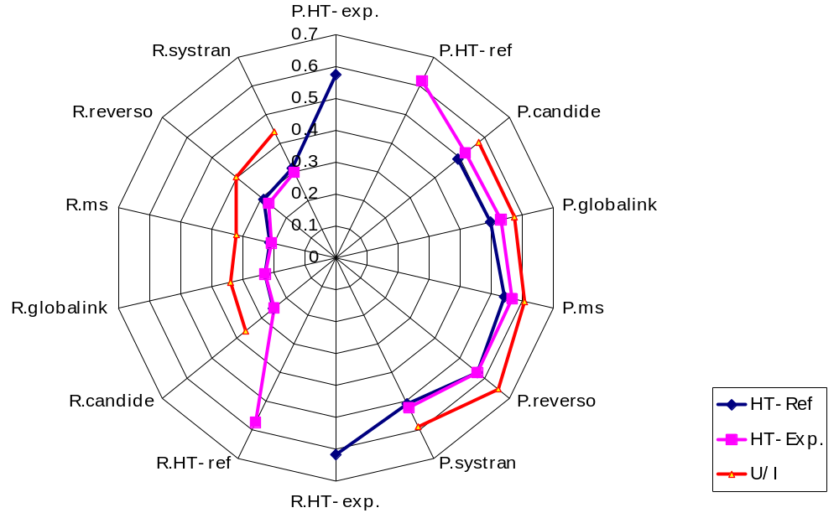
Precision (P) and Recall (R): Organisation names

Slide 33
N-grams: Union and Intersection
Union Intersection
    ~Precision ~Recall

Slide 34
Translation variation and
N-grams
N-gram distance to multiple human reference translations
Precision on the union of N-gram sets in HT1, HT2, HT3…
    N-grams in all independent human translations taken together with repetitions removed
Recall on the intersection of N-gram sets
    N-grams common to all sets – only repeated N-grams! (most stable across different human translations)

Slide 35
Human and automated scores
Empirical observations:
  Precision on the union gives indication of Fluency
  Recall on intersection gives indication of Adequacy
    Automated Adequacy evaluation is less accurate – harder
Now most successful N-gram proximity --
  BLEU evaluation measure (Papineni et al., 2002)
    BiLingual Evaluation Understudy

Slide 36
BLEU evaluation measure
computes Precision on the union of N-grams
accurately predicts Fluency
produces scores in the range of [0,1]
Usage:
  download and extract Perl script “bleu.pl”
  prepare MT output and reference translations in separate *.txt files
  Type in the command prompt:
    perl bleu-1.03.pl -t mt.txt -r ht.txt

Slide 37
BLEU evaluation measure
Texts may be surrounded by tags:
  e.g.: <DOC doc_ID="1" sys_ID="orig"> </DOC>
different reference translations:
  <DOC doc_ID="1" sys_ID="orig">
  <DOC doc_ID="1" sys_ID="ref2">
  <DOC doc_ID="1" sys_ID="ref3">
paragraphs may be surrounded by tags:
  e.g.: <seg id="1"> </seg>

Slide 38
5. Validation of automatic scores
Automatic scores have to be validated
  Are they meaningful,
    whether of not predict any human evaluation measures, e.g., Fluency, Adequacy, Informativeness
Agreement human vs. automated scores
  measured by Pearson’s correlation coefficient r
    a number in the range of [–1, 1]
    –1 < r < –0.5 = strong negative correlation
    0.5 < r < +1 = strong positive correlation
    –0.5 < r < 0.5 no correlation or weak correlation

Slide 39
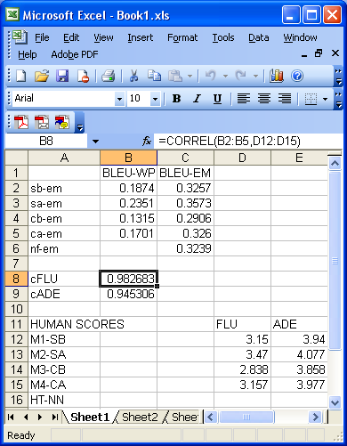
Pearson’s correlation coefficient r in Excel

Slide 40
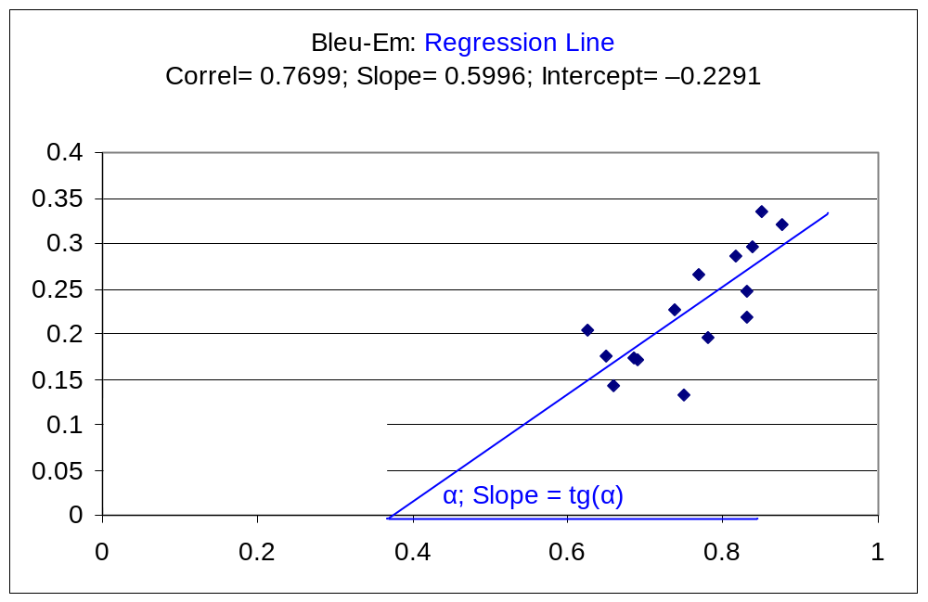
HumanSc = Slope * AutomatedSc + Intercept

Slide 41
6. Challenges
Multi-dimensionality
  no single measure of MT quality
  some quality measures are harder
Evaluating usefulness of imperfect MT
  different needs of automatic systems and human users
    human users have in mind publication (dissemination)
    MT is primarily used for understanding (assimilation)

Slide 42
7. Recent developments: N-gram distance
paraphrasing instead of multiple RT
more weight to more “important” words
  relatively more frequent in a given text (Babych, Hartley, ACL 2004)
relations between different human scores
accounting for dynamic quality criteria

Slide 43
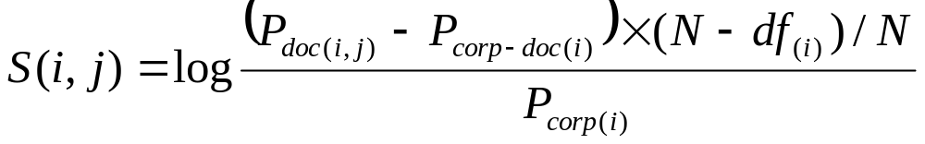
“Salience” weighting
ft_{i.j} – frequency of w_{i} in a document_{j}
df_{i} – number of documents in a collection w_{i}
N – total number of documents in a collection
Term frequency / inverse document frequency
    tf.idf(i,j) = (1 + log (tf_{i,j})) log (N / df_{i})
“Salience” score

Slide 44
Proximity to human reference (3)
MT “Systran”: The 38 heads of undertaking put in examination in the file were the subject of hearings […] in the tread of "political" confrontation.
Human translation “Expert”: The 38 heads of companies questioned in the case had been heard […] following the "political" confrontation.
MT “Candide”: The 38 counts of company put into consideration in the case had the object of hearings […] in the path of confrontal "political."

Slide 45
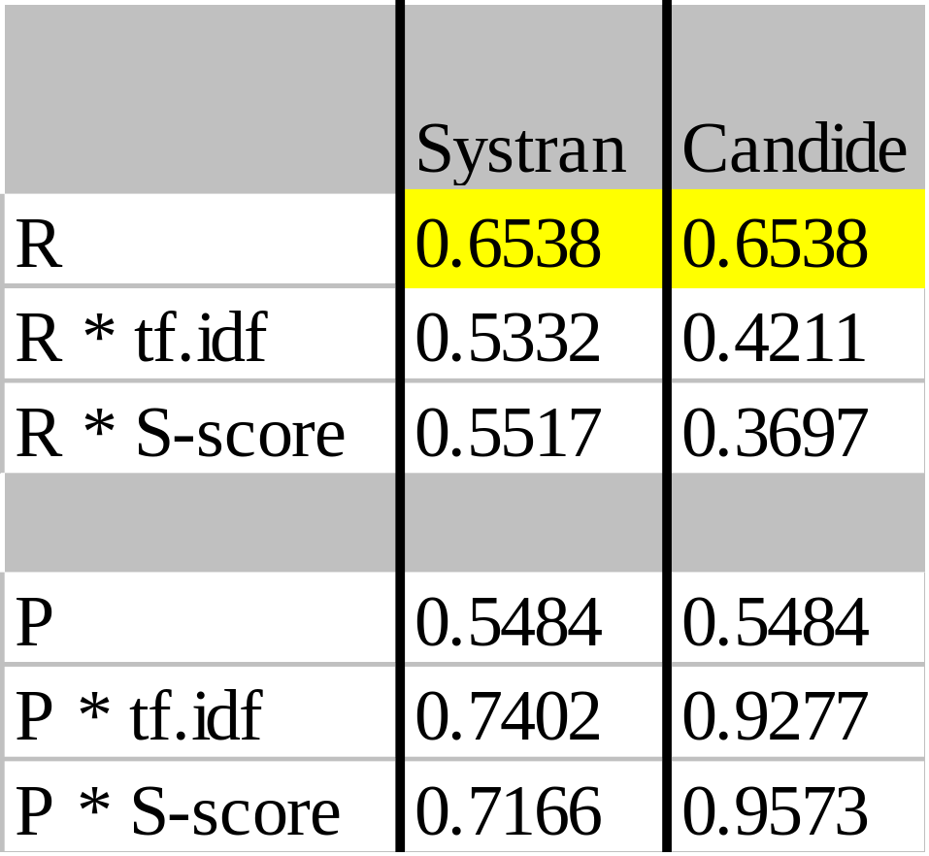
IE-based MT evaluation: analysis of improvement
Systran: higher term frequency weights:
  heads tf.idf=4.605;S=4.614
  confrontation tf.idf=5.937;S=3.890
Candide: less salient unigrams
  case tf.idf=3.719;S=2.199
  had tf.idf=0.562;S=0.000

Slide 46
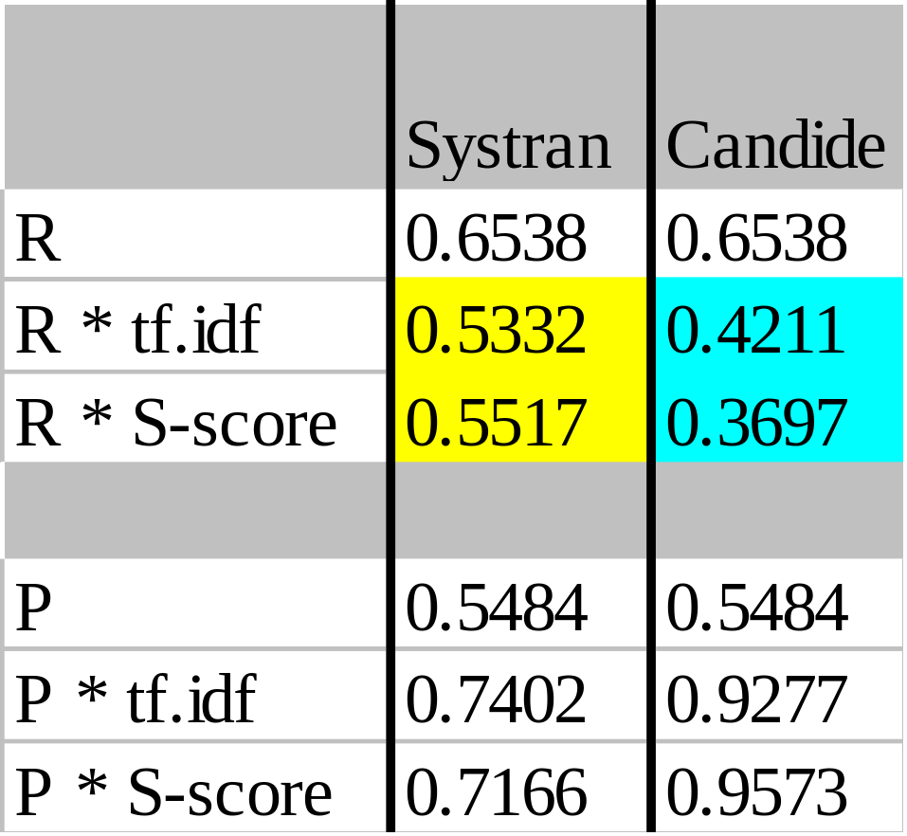
IE-based MT evaluation: analysis of improvement
Systran: higher term frequency weights:
  heads tf.idf=4.605;S=4.614
  confrontation tf.idf=5.937;S=3.890
Candide: less salient unigrams
  case tf.idf=3.719;S=2.199
  had tf.idf=0.562;S=0.000

