Slide 1
Alternatives to rule-based MT: statistical and example-based MT
Lecture 24/04/2006
MODL5003 Principles and applications of machine translation
slides available at: http://www.comp.leeds.ac.uk/bogdan/

Slide 2
1. Overview
Classification of approaches to MT
Limitations of rule-based methods
    Data-driven methods in Speech and Language Technology
Parallel corpora
    issues of automatic alignment
Statistical Machine Translation:
    early experiments and integration of linguistic knowledge
Example Based Machine Translation:
    metaphor of automatic translation memory and perspectives
Fundamental Limitations and Perspectives

Slide 3
2. Classification of approaches to MT
How MT is built? | What information is used?
 | Rule-based MT | Data-driven (SMT,EBMT)
Direct | ~ “Systran” | ~ “Candide”, “Language Weaver”
Transfer | ~ “Reverso” | ?
Interlingua | ~ “EUROTRA” | ?

Slide 4
Rule-based vs. Data-driven approaches
Rule-based MT | Data-driven MT
use formal models of our knowledge of language, linguistic intuition of developers Problems: expensive to build; require precise knowledge, which might be not available | use “machine learning” techniques on large collections of available texts; "let the data speak for themselves" Problems: language data are sparse high-quality data also expensive

Slide 5
3. Limitations of rule-based methods
Cost too high
    many linguists needed to write rules
Lack of adequate knowledge
    (monolingual and contrastive)
  E.g., aspect: in Germanic vs. Slavonic
Vin chytav knyzhku he read_{(PST.IMPERF)} book_{(ACC)} | He was reading a book
Vin prochytav knyzhku he read_{(PST.PERF)} book_{(ACC)} | He read (finished reading) a book

Slide 6
… no direct mapping: systematic vs. non-systematic
Nexaj vin chytaje let he reads_{(NON-PAST.IMPERF)} | Let him read
Nexaj vin prochytaje X let he read_{(NON-PAST.PERF)} X | Have him read X
Zhenshchina vyshla iz doma Woman came-out of house_{(GEN)} | The woman came out of the house
Iz doma vyshla zhenshchina Of house_{(GEN)} came-out woman | A woman came out of the house
Zhenshchina vyshla íz domu Woman came-out of house_{(GEN-2)} | The woman came out of her house

Slide 7
Alternative: data-driven methods
Principle: using existing translations as a prime source of information for the production of new ones (Kay, 1997, HLT survey, p. 248)
Large amounts of data contain essential knowledge for making a functional system
  Large amount of data; processing power available
  Data-driven models rectify the lack of explicit linguistic knowledge:
    the knowledge can be retrieved and used automatically

Slide 8
…data-driven methods (contd.)
translating English word not into French
  frequencies of translations in a parallel corpus (Hutchins, Somers, 1992, p. 321)
English not | French ne (0.460)… pas (0.469) ne (0.460)… plus (0.002) ne (0.460)… jamais (0.002) non (0.024) pas du tout (0.003) faux (0.003)

Slide 9
… a potential problem
Information remains implicit
  Raw data doesn’t add to our knowledge about language
  Automatically acquired & automatically used
Future: extract interpretable rules, linguistic generalisations
  Aim at compact reusable representations
  Readable by human editors

Slide 10
…data-driven methods (contd.)
machine-learning algorithms are language-independent
Data-driven approaches:
  account for typical phenomena systematically
  compare productivity of different structures in texts from different domains / genres

Slide 11
4.Parallel&comparable corpora and automatic alignment
Data sources
  Parallel corpora
    richer in translation equivalents, more difficult to get
  Comparable corpora
    Multilingual texts in the same domain
    larger, but equivalents sparse and less identifiable
    Genuinely written by native speakers, no “Translationese”
Tasks for MT developers
  Retrieving equivalents “on the fly”
  Creating wide-coverage dictionaries and grammars

Slide 12
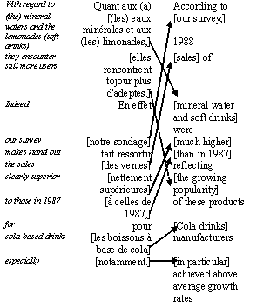
Alignment

Slide 13
Alignment: sentence level
90% of sentences have 1:1 alignment;
the rest: 1:2; 2:1; 1:3; 3:1, etc.
The example above is 2:2 alignment:
    content of the second Fr sentence occurs in the first En sentence
Order of sentences can change
Techniques
  length-based alignment (Gale and Church, 1993)
  cognates (Church, 1993)
  lexical methods (Kay and Röscheisen, 1993)

Slide 14

Alignment: word level
association measures (Church and Gale, 1991)
  differences between the observed and expected values
iterative sentence-word alignment
  re-computing word alignment based on its results for sentence alignment (Brown et al., 1990)

Slide 15
Alignment: problems
[Maria] [no] [daba una bofetada] a [la] [bruja] [verde]
[Mary] [did not] [slap] [the] [green] [witch]
Or:
[Maria] [no] [daba una bofetada] a [la] [bruja] [verde]
[Mary] [did] [not] [slap] [the] [green] [witch]
  Non-segmental sub-components of meaning are aligned

Slide 16
Problems of retrieving translation equivalents
Non-literal translation, change of perspective
  low level alignment is not possible
  Obligatory “loss” of information
    “The Danish flair and verve saw them beat France twice in 1908”
    “Le sens du jeu et la créativité des Danois a raison des Français à deux reprises en 1908.”
    (lit.: The feeling of the play and the creativity of the Danes are right for the French twice in 1908)
Disambiguation information in context
  "wearing" (clothes): 5 different words in Japanese

Slide 17
… change of perspective: example
  “Bayern began with the verve which saw them come from behind to defeat Celtic FC a fortnight ago.”
  Гости, две недели назад одержавшие волевую победу над "Селтиком", с первых минут завладели инициативой.
  lit.: Guests, who two weeks ago gained a strong-willed victory over “Celtic”, from the first minutes took the initiative
Can we extract any translation equivalents?
“Adaptability” of aligned examples

Slide 18
Limitations of parallel corpora: learning “transfer”?
Finding equivalents is not sufficient
Need to find motivation for translation transformations
  Иную позицию заняли Франция и Германия.
  (lit.: A different stand _{(Acc.)} took France and Germany _{(Nom.)}
  * France and Germany took a different stand.
  A different stand was taken by France and Germany
Currently: learning linked to particular words

Slide 19
Limitations of parallel corpora
How MT is built? | What information is used?
 | Rule-based MT | Data-driven: SMT, EBMT
Direct | ~ “Systran” | ~ “Candide”, “Language Weaver”
Transfer | ~ “Reverso” | <???>
Interlingua | ~ “EUROTRA” | <???>

Slide 20
Balancing competing translation equivalents?
  В комнате установилась мертвая тишина.
  lit.: In the room established itself deathly silence
  * A deathly silence descended upon the room.
  The room turned deathly silent.
  В комнате установилась мертвая тишина. Она была вызывающей.
  (lit.: In the room established itself deathly silence. It/[she]=the silence was defiant.)
  A deathly silence descended upon the room. It was defiant.
  * The room turned deathly silent. It was defiant

Slide 21
5. Statistical MT
Cryptography metaphor for MT
  “noisy channel” model
    English message transformed into French
    How to recover what English speaker had in mind?
Warren Weaver’s memorandum, July 1949
Tackling obvious problems of ambiguity
  knowledge of cryptography, statistics, information theory, logic and language universals

Slide 22

Behind Statistical MT technology
Warren Weaver's "cryptography" approach
  French sentence is viewed as "encoded" English sentence, which was converted from English into French by some "noise" on its way to the reader.
  The model allows associating French and English sentences with certain numerical scores, so different "translation candidates" can be compared

Slide 23
Fundamental formula of SMT
Assume we translate into English
Find probability of an English word given a foreign word : P(e|f)
Don’t do this directly,
  or the system will simply select the most frequent English word for a foreign word
P(e|f) = ( P(f|e) * P(e) ) / P(f)
argmax P(e|f) = argmax P(f|e) * P(e)

Slide 24
Statistical MT since 90's
An experimental pure statistical system at IBM (Brown et al., 1990)
Used the corpus of Canadian Hansard
  (records of parliamentary debates in French and English
  40,000 pairs of sentences, 800,000 words in each
Evaluated by translating from French into English: limited vocabulary (1000 most frequent English words); 73 sentences:
  exact – 5%; exact + alternative + different – 48% (the rest – "wrong and ungrammatical")
No prior linguistic knowledge was applied

Slide 25
IBM experiment: evaluation
exact: Ces amendements sont certainment nécessaires
  Hansard: These amendments are certainly necessary
  IBM: These amendments are certainly necessary
alternative: C'est pourtant très simple
  Hansard: Yet it is very simple
  IBM: It is still very simple
different: J'ai reçu cette demande en effet
  Hansard: Such a request was made
  IBM: I have received this request in effect
wrong: Permettez que je donne un exemple à la Chambre
  Hansard: Let me give the House one example
  IBM: Let me give an example in the House
ungrammatical: Vous avez besoin de toute l'aide disponible
  Hansard: You need all the help you can get
  IBM: You need the whole benefits available

Slide 26
Decoding in SMT
Maria no dio una bofetada a la bruja verde
Mary not give a slap to the witch green
did not a slap by green witch
no slap to the
did not give to
the
slap the witch

Slide 27
Decoding in SMT
Maria no dio una bofetada a la bruja verde
Mary not give a slap to the witch green
did not a slap by green witch
no slap to the
did not give to
the
slap the witch
Finding best path in the space of translations for phrases
“Costs” for re-ordering words and phrases

Slide 28
Problems for "pure" SMT
No notion of phrases:
  to go -- aller; farmers -- les agriculteurs
Non-local dependencies:
  Language models works with "fixed window" of 2, 3… N words, but more distant words can be grammatically related: E.g., 2-gram model cannot distinguish ungrammatical sentences:
What do you say?
* What do you said?
What have you said?
* What have you say?
Solution: “Syntactic-based SMT”

Slide 29
6. Example-based MT (EBMT)
More linguistically-oriented
EBMT (Sato & Nagao 1990), 3 stages: (Example quoted by Somers, lecture at Leeds, 2003)
  identify corresponding translation fragments (align)
  retrieval: match fragments against example database
  adaptation: recombine fragment into target text
    Translation Memory can be viewed as a specific case of EBMT without the adaptation stage
    Linguistic knowledge about word order, agreement, etc. is captured automatically from examples

Slide 30
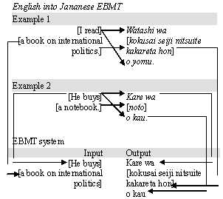
Stages of EBMT

Slide 31
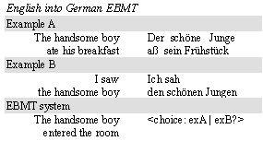
“Boundary friction" in EBMT
Issue: finding "safe points of example concatenation“

Slide 32
Open issues in EBMT
Representation and Retrieval
  Granularity of examples:
    the longer the passages, the lower the probability of a complete match,
    the shorter the passages, the greater the probability of ambiguity and… boundary friction
  Complexity of storing formats
    strings, part-of-speech annotation, multi-level annotation, trees…

Slide 33
Open issues in EBMT (contd.)
Storing similar examples as a single generalised example
  resembles traditional transfer rules Discovering generalised patterns automatically.
    John Miller flew to Frankfurt on December 3rd.
    <1stname> <lastname> flew to <city> on <month> <ord>.
    <person-m> flew to <city> on <date> .
    Dr Howard Johnson flew to Ithaca on 7 April 1997

Slide 34
Open issues in EBMT (contd.)
Adaptation (recombination)
  (Somers, EBMT as CBR): A solution retrieved from the stored case is almost never exactly the same as a new case.
  There is a need of adapting the existing examples to a new input

Slide 35
Syntactic & semantic match
Input:
  When the paper tray is empty, remove it and refill it with paper of the appropriate size.
Syntactic match:
  When the bulb remains unlit, remove it and replace it with a new bulb
Semantic match:
  You have to remove the paper tray in order to refill it when it is empty.

Slide 36
Adaptation-guided retrieval (Collins, 1998:31)
Knowing how "literal" or "distant" is the translation from the original in examples
  examples require different strategies for adaptation
2 criteria for retrieval of examples
  the closeness of the match between the input text and the example
  the adaptability of the example
    relationship between the representations of the example and its translation
    "literal" translations are easier to adapt
good examples vs. bad examples
    easy to retrieve but difficult to adapt, etc.

Slide 37
Adaptation-guided retrieval (contd.)
Ottawa abolira la très impopulaire taxe à la consommation sur les produits et les services (TPS), de type TVA, instaurée par les conservateurs, | Ottawa will abolish the very unpopular consumption tax on products and services (TPS), of the VAT type introduced by the Conservatives.
et la remplacera par une autre taxe "plus équitable". Lit: [and replace it by another ,"more equitable" tax] | It will be replaced by another, "more equitable" tax. // LESS ADAPTIVE!

Slide 38
7. MT: where we are now?
The prima face case against operational machine translation from the linguistic point of view will be to the effect that there is unlikely to be adequate engineering where we know there is no adequate science. A parallel case can be made from the point of view of computer science, especially that part of it called artificial intelligence. (Kay, 1980: 222).
… If we are doing something we understand weakly, we cannot hope for good results. And language, including translation, is still rather weakly understood. (Kettunen, 1986: 37)

Slide 39
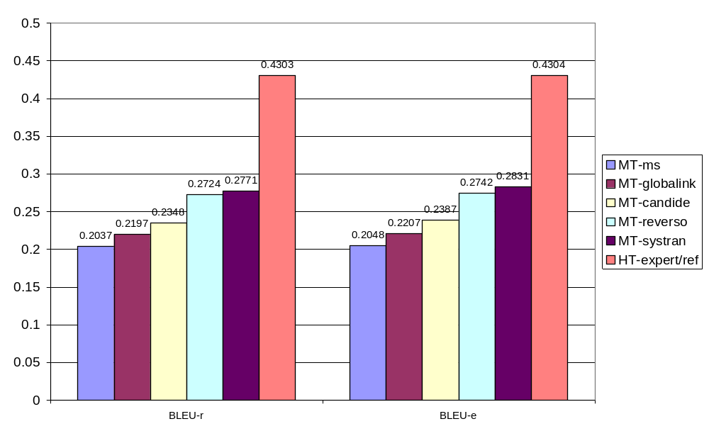
BLEU scores for MT and Human Translation

Slide 40
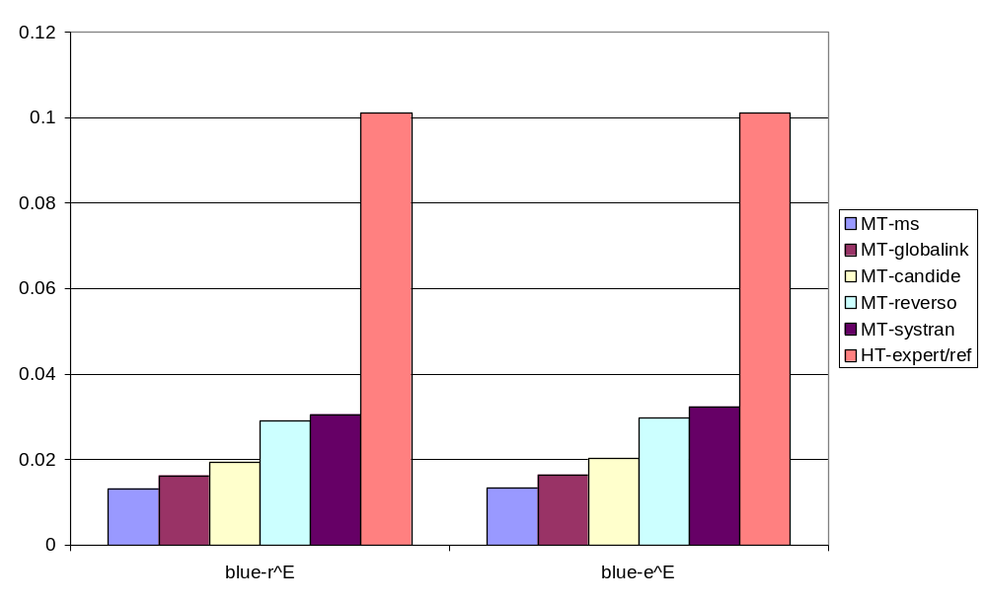
Estimation of effort to reach human quality in MT

Slide 41
Limitations of the state-of-the-art MT architectures
Q.: are there any features in human translation which cannot be modelled in principle (e.g., even if dictionary and grammar are complete and “perfect”)?
MT architectures are based on searching databases of translation equivalents, cannot
    invent novel strategies
    add / removing information
    prioritise translation equivalents
      trade-off between fluency and adequacy of translation

Slide 42
Problem 1: Obligatory loss of information: negative equivalents
ORI: His pace and attacking verve saw him impress in England’s game against Samoa
    HUM: Его темп и атакующая мощь впечатляли во время игры Англии с Самоа
    HUM: His pace and attacking power impressed during the game of England with Samoa
ORI: Legout’s verve saw him past world No 9 Kim Taek-Soo
    HUM: Настойчивость Легу позволила ему обойти Кима Таек-Соо, занимающего 9-ю позицию в мировом рейтинге
    HUM: Legout’s persistency allowed him to get round Kim Taek-Soo

Slide 43
Problem 2: Information redundancy
Source Text and the Target Text usually are not equally informative:
  Redundancy in the ST: some information is not relevant for communication and may be ignored
  Redundancy in the TT: some new information has to be introduced (explicated) to make the TT well-formed
    e.g.: MT translating etymology of proper names, which is redundant for communication :
      “Bill Fisher” => “to send a bill to a fisher”

Slide 44
Problem 3: changing priorities dynamically (1/2)
Salvadoran President-elect Alfredo Christiani condemned the terrorist killing of Attorney General Roberto Garcia Alvarado
SYSTRAN:
    MT: Сальвадорский Избранный президент Алфредо Чристиани осудил убийство террориста Генерального прокурора Роберто Garcia Alvarado
    MT(lit.) Salvadoran elected president Alfredo Christiani condemned the killing of a terrorist Attorney General Roberto Garcia Alvarado

Slide 45
Problem 3: changing priorities dynamically (2/2)
PROMT
    Сальвадорский Избранный президент Альфредо Чристиани осудил террористическое убийство Генерального прокурора Роберто Гарси Альварадо
However: Who is working for the police on a terrorist killing mission?
    Кто работает для полиции на террористе, убивающем миссию?
    Lit.: Who works for police on a terrorist, killing the mission?

Slide 46
Fundamental limits of state-of-the-art MT technology (1/2)
“Wide-coverage” industrial systems:
    There is a “competition” between translation equivalents for text segments
MT: Order of application of equivalents is fixed
Human translators – able to assess relevance and re-arrange the order
    An MT system can be designed to translate any sentence into any language
    However, then we can always construct another sentence which will be translated wrongly

Slide 47
Fundamental limits of state-of-the-art MT technology (2/2)
Correcting wrong translation: terrorist killing of Attorney General = killing of a terrorist (presumably, by analogy to “tourist killing” or “farmer killing”); not killing by terrorists
= Introducing new errors
    “…just pretending to be a terrorist killing war machine…”
    “… who is working for the police on a terrorist killing mission…”
    “…merged into the "TKA" (Terrorist Killing Agency), they would … proceed to wherever terrorists operate and kill them…”,

Slide 48
… Summary
We can design a system which correctly translates any particular sentence between any two languages
Once such system is designed we can always come up with a sentence in the SL which will be translated wrongly into the TL

Slide 49
Translation: As true as possible, as free as necessary
“[…] a German maxim “so treu wie möglich, so frei wie nötig” (as true as possible, as free as necessary) reflects the logic of translator’s decisions well: aiming at precision when this is possible, the translation allows liberty only if necessary […] The decisions taken by a translator often have the nature of a compromise, […] in the process of translation a translator often has to take certain losses. […] It follows that the requirement of adequacy has not a maximal, but an optimal nature.” (Shveitser, 1988)

Slide 50
MT and human understanding
Cases of “contrary to the fact” translation
ORI: Swedish playmaker scored a hat-trick in the 4-2 defeat of Heusden-Zolder
MT: Шведский плеймейкер выиграл хет-трик в этом поражении 4-2 Heusden-Zolder.
  (Swedish playmaker won a hat-trick in this defeat 4-2 Heusden-Zolder)
In English “the defeat” may be used with opposite meanings, needs disambiguation:
    “X’s defeat” == X’s loss
    “X’s defeat of Y” == X’s victory

Slide 51
Why we need human / artificial intelligence in translation
    “X’s defeat” == X’s loss
    “X’s defeat of Y” == X’s victory
ORI: Swedish playmaker scored a hat-trick in the 4-2 defeat of Heusden-Zolder
Vs
  … its defeat of last night
  … their FA Cup defeat of last season
  … their defeat of last season’s Cup winners
  … last season’s defeat of Durham

Slide 52
… MT and human understanding
MT is just an “expert system” without real understanding of a text…
  What is real understanding then?
  Can the “understanding” be precisely defined and simulated on computers?

Slide 53
Comparable corpora & dynamic translation resources
Translations can be extracted from two monolingual corpora using a bilingual dictionary
  No smoking ~ DE: Rauchen verboten
  DE: In diesem Bereich gilt die Flughafenbenutzungsordung ~
  ?* Airport user’s manual applies to this area
  RU: Ischerpyvajuwij otvet ~ ?* Irrefragable answer
ASSIST Project, Leeds and Lancaster, 2007

Slide 54
Information extraction for MT
Salvadoran President condemned the terrorist killing of Attorney General Alvarado
  Perpetrator: terrorist
  Human target: Attorney General Alvarado
Salvadoran president condemned the killing of a terrorist Attorney General Alvarado
  Perpetrator: [UNKNOWN]
  Human target: terrorist Attorney General Alvarado

Slide 55
MT: way forward?
Too much data is not good either: competition of equivalents
  Accessing information on the text level
  There is no data like more data vs. “intelligent processing” approaches
“Not the power to remember, but its very opposite, the power to forget, is a necessary condition for our existence”. (Saint Basil, quoted in Barrow, 2003: vii)

