Slide 1
Using collocations from comparable corpora to find translation equivalents
Serge Sharoff, Bogdan Babych, Anthony Hartley
Centre for Translation Studies
University of Leeds
{s.sharoff,b.babych,a.hartley}@leeds.ac.uk

Slide 2
Outline
1. Introduction
  Problems in finding translation equivalents
  Corpora and tools used
2. Methodology for finding translation equivalents
  Basic steps for collocations
  Construction of the MWE database
  An extension for single words
3. Results
  Evaluation
  Legitimate translation variation
  Future work

Slide 3
Outline
1. Introduction
  Problems in finding translation equivalents
  Corpora and tools used
2. Methodology for finding translation equivalents
  Basic steps for collocations
  Construction of the MWE database
  An extension for single words
3. Results
  Evaluation
  Legitimate translation variation
  Future work

Slide 4
What are translation equivalents?
Terminology: ignitron=Ignitron=игнитрон
General lexicon: исчерпывающий ответ=irrefragable answer
strong: 57 subentries in Oxford Russian Dictionary (ORD), but no strong feeling, field, opposition, sense, voice
Parallel corpora are not always available: strong voice: 16 in Europarl vs. 46 in the BNC
Comparable corpora for terminology: (Dagan, Church, 1997; Bennison, et al, 2000), but not for words from the general lexicon
Comparable corpora for translators: absolutely vs. assolutamente, but not a procedure for finding equivalents

Slide 5
The problems we address
  Hospital admission can prove a particularly daunting experience.
  I did all the cleaning, cooking and kept his books in order, which was no mean feat.
The problem of finding a bridge between two comparable corpora
Main steps
  1. Generalising source contexts in SL
  2. Translating generalisations using bilingual MRDs and generalising them
  3. Filtering suggestions down to what occurs in TL

Slide 6
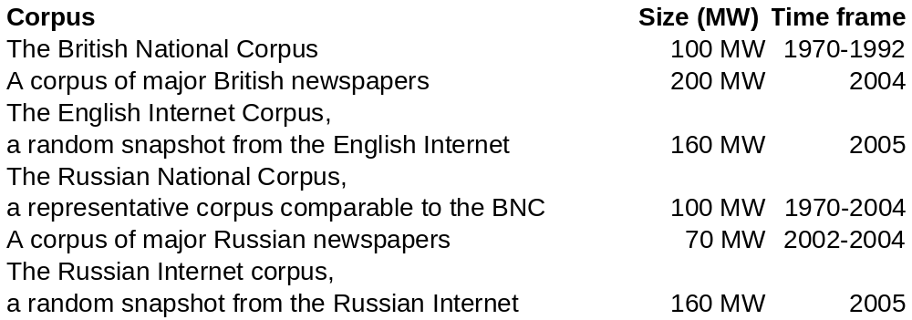
Corpora and tools used
Databases of multiword expressions
IMS Corpus Workbench (Christ, Evert)
Distributional similarity classes (Rapp)
Oxford Russian Dictionary from OUP

Slide 7
Outline
1. Introduction
  Problems in finding translation equivalents
  Corpora and tools used
2. Methodology for finding translation equivalents
  Basic steps for collocations
  Construction of the MWE database
  An extension for single words
3. Results
  Evaluation
  Legitimate translation variation
  Future work

Slide 8
Step 1: Generalising contexts
Distributional similarity list: Θ(s₀) = s₁, . . . , s_{N}
Simcluster S(s₀) (words with intersecting similarity lists) ∀w ∈ S(s₀) ⇔ w ∈ Θ(s₀)&w ∈ ∪Θ(s_{i} )
  strong ~ powerful, weak, strength, potent, heavy, good, overwhelming, intense, robust, tough, weaken, compelling, fierce
  experience ~ knowledge, opportunity, life, encounter, skill, feeling, reality, sensation, dream, vision, learning, perception, learn

Slide 9
Step 2: Translating generalisations
Full translation class: TF = S(T(S(s₀)))
Reduced translation class: TR = S(T(s₀)) + T(S(s₀))
  опыт (experience; experiment) ~ ability, acquire, aptitude, capability, capacity, competence, courage, evidence, experience, experiment, expertise, feasibility, flair, hypothesis, ingenuity, intelligence, investigation, knowledge, laboratory, learning, method, opportunity, perception, qualification, rat, research, skill, stamina, statistical, strength, study, talent, technique, test, training, vision.

Slide 10
Step 3: finding MWEs in TL
Cartesian product of translation classes produced for words in the query
Filtering them against MWEs really occurring in corpora
четкая программа (‘precise programme’) ~
  clear idea (486)
  detailed plan (247)
  right idea (123)
  detailed proposal (112)
  detailed work (109)
  detailed research (108)
  clear policy (88)
  clear strategy (83)
  clear plan (70)
  right policy (64)
  right strategy (52)

Slide 11
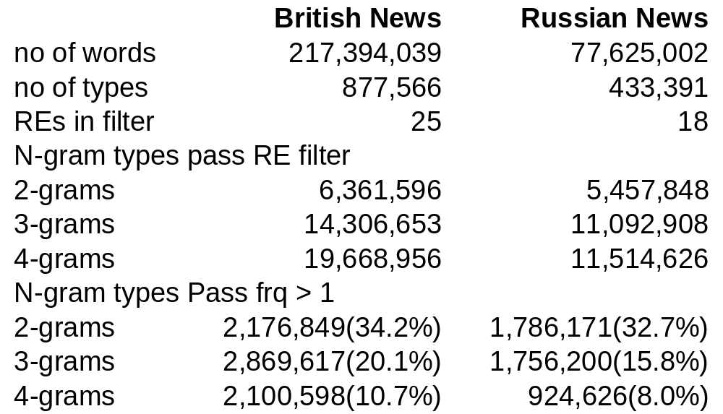
Building the MWE database
permissive vs. prudent filtering (Manning, Schütze, 1999)
weapon~NN of~IN mass~JJ,
Filter: ~IN ~JJ$

Slide 12
An extension for single words
1. Produce two sets of 5 best LL collocates for the immediate left and right contexts of the search expression
2. Produce TR classes for the search expression and its best collocates
3. Combine TR classes separately for the left and right context
4. Intersect the set of right collocates in the left class with the set of left collocates in the right class

Slide 13
Outline
1. Introduction
  Problems in finding translation equivalents
  Corpora and tools used
2. Methodology for finding translation equivalents
  Basic steps for collocations
  Construction of the MWE database
  An extension for single words
3. Results
  Evaluation
  Legitimate translation variation
  Future work

Slide 14
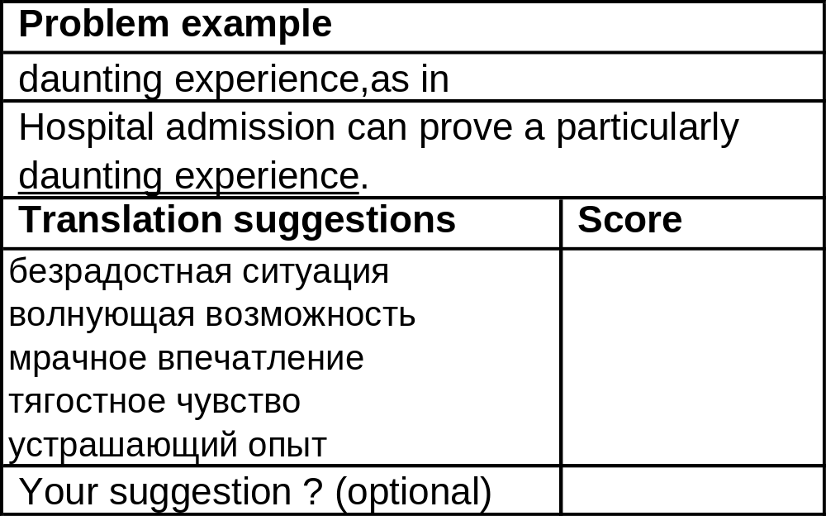
Questionnaire

Slide 15
The scoring system
5 = The suggestion is an appropriate translation as it is.
4 = The suggestion can be used with some minor amendment (e.g. by turning a verb into a participle)
3 = The suggestion is useful as a hint for another, appropriate translation (e.g. suggestion elated cannot be used, but its close synonym exhilarated can)
2 = The suggestion is not useful, even though it is still in the same domain (e.g. fear is proposed for a problem referring to hatred)
1 = The suggestion is totally irrelevant

Slide 16
Equivalents for unseen cases
  Patrick West recently claimed that Britain’s extravagant mourning for Princess Diana and Holly and Jessica was ’recreational grief’. Maybe we also suffer from recreational fear.
спортивный интерес (lit. ‘sports interest’, leisure interest)
Some translators see more solutions in a context
Not a competition with dictionaries, but solutions for genuinely difficult cases

Slide 17
Future work
Disambiguation of simclasses:
  union ~ federation, strike, trade, worker, soviet, employer, organization, miner, communist, russia, republic, cosatu, confederation
ASSIST semantic classes (232 categories):
  I1.1- = Money: lack; (bankrupt, beggar, impoverished, unpaid)
  A5.1- = Evaluation: bad (abject, abysmal, bastard, crap)
Finding clusters for language pairs
Methods from EBMT/SMT

