Slide 1
Machine Translation
– What’s the use?
Tony Hartley
  University of Leeds, UK
  Centre for Translation Studies
  http://www.leeds.ac.uk/cts/

Slide 2
What is ‘Machine Translation’?
Machine Translation (MT) is the attempt to automate all, or part of the process of translating from one human language to another.
La traduction automatique (MT) est la tentative d'automatiser tout, ou la partie du processus de traduction d'une langue humaine à un autre.
[Promt – Reverso]
La traduction automatique (la TA) est la tentative d'automatiser tous, ou une partie du processus de la traduction d'une langue humaine à l'autre.
[Systran – Premium Pro]

Slide 3
What is ‘Machine Translation’?
Machine Translation (MT) is the attempt to automate all, or part of the process of translating from one human language to another.
La traduction automatique (MT) est la tentative d'automatiser tout, ou la partie du processus de traduction d'une langue humaine à un autre.
[Promt – Reverso]
La traduction automatique (la TA) est la tentative d'automatiser tous, ou une partie du processus de la traduction d'une langue humaine à l'autre.
[Systran – Premium Pro]

Slide 4
How fast?
If it takes a human translator 1 working day to translate 2,500 words, how long does it take an MT system to translate 500 words?
A: 5 seconds

Slide 5
How fast?
If it takes a human translator 1 working day to translate 2,500 words, how long does it take an MT system to translate 500 words?
A: 5 seconds | B: 50 seconds

Slide 6
How fast?
If it takes a human translator 1 working day to translate 2,500 words, how long does it take an MT system to translate 500 words?
A: 5 seconds | B: 50 seconds
C: 5 minutes

Slide 7
How fast?
If it takes a human translator 1 working day to translate 2,500 words, how long does it take an MT system to translate 500 words?
A: 5 seconds | B: 50 seconds
C: 5 minutes | D: 50 minutes

Slide 8
How fast?
If it takes a human translator 1 working day to translate 2,500 words, how long does it take an MT system to translate 500 words?
A: 5 seconds | B: 50 seconds
C: 5 minutes | D: 50 minutes

Slide 9
So prove it …

Slide 10
MT – a futile exercise?
History provides no better example of the improper use of computers than machine translation.
(Kay 1980 ‘The proper place of men and machines in translation’ Xerox, Palo Alto)
FAHQT […] is surely a worthy ideal and one which has attracted a regrettably small number of linguists and computer scientists. Even if it is never achieved, it provides an incomparable matrix in which to study the workings of human language.
It is hoped that [the translator’s amenuensis] will be built with taste by people who understand languages and computers well enough to know how little it is they know.

Slide 11
Some other questions …
Why is it hard?
How does it work?
What is it useful for?
Can we improve it?
How do you tell how good it is?

Slide 12
Why is it hard? 1/2
Ambiguous words
  ‘light’: ‘lumière’, ‘allumer’, ‘clair’, ‘léger’ …
Resolution may need only a simple syntactic context
  I light the light light
  J’allume la lumière claire
… or sophisticated world knowledge
  The troops fired at the women and they fell
  Les soldats ont tiré sur les femmes et ils/elles sont tombé(e)s

Slide 13
Why is it hard? 2/2
Ambiguous phrases
  Clever boys and girls go to school
Resolution may need a wider context of general knowledge
   Les garçons habiles et les filles vont à l’école
   Les garçons et les filles habiles vont à l’école
  Pregnant women and children have priority
   Les femmes enceintes et les enfants sont prioritaires
   Les femmes et les enfants enceints sont prioritaires

Slide 14
MT – a major enterprise
A Manhattan project could produce an atomic bomb, and the heroic efforts of the sixties could put a man on the moon, but even an all-out effort on the scale of these would probably not solve the translation problem.
(Martin Kay, 1982)

Slide 15
Some other questions …
Why is it hard?
How does it work?
What is it useful for?
Can we improve it?
How do you tell how good it is?

Slide 16
How does it work?
Empirical, corpus-based methods
  Statistical
  EBMT
Rule-based methods
  Transfer
  Interlingua
Hybrid methods

Slide 17
Empirical, corpus-based methods
Require a corpus of previously translated texts
  Aligned in parallel, segment by segment
  Typical of the target text type and subject field
For example, the Canadian Hansard – bilingual record of parliamentary debates

Slide 18
Statistical approaches 1/2
Translation Model
  Probability that a given SL word is translated by a given TL word (in the corpus)
  French: ‘the’ > ‘le’ 0.610 / > ‘la’ 0.178
(Target-)Language Model
  Probabilities of sequences of TL words (in the corpus)
Language Model orders the ‘bag’ of words given by the Translation Model

Slide 19
Statistical approaches 2/2
Models are sensitive to the training corpus
Canadian Hansard is widely used for English / French
  ‘hear’ is translated as ‘bravo’ with a probability of 0.992
  It is only translated about half the time …

Slide 20
EBMT
The EB in EBMT stands for …
A: European Bank | B: Entropy-Biased
C: Example-Based | D: Extremely Basic

Slide 21
EBMT
The EB in EBMT stands for …
 | B: Entropy-Biased
C: Example-Based

Slide 22
EBMT
The EB in EBMT stands for …
 | B: Entropy-Biased
C: Example-Based

Slide 23
EBMT – the basic intuition
Translation of new text is done by analogy with previous, similar translations
Three stages
  Matching of ST candidate segments / sentences in database
  Alignment of the parts of the TT segment to use
  Recombination of the TT parts to form a whole target text

Slide 24
Matching – word-based
“Classical” approach found in Nagao (1984):
Input
He eats potatoes .
Sulphuric acid eats iron .
Matches
☺
A man eats vegetables . Hito wa yasai o taberu.
☺
Acid eats metal . San wa kinzoku o okasu.
Result
Kare wa jagaimo o
taberu.
Ryūsan wa tetsu o
okasu.

Slide 25
Matching – use of thesaurus
Japanese A no B examples
yōka no gogo the afternoon of the eighth
kaigi no mokuteki the subject of the conference
kaigi no sankaryō the application fee for the conference
kyōto-de no kaigi a conference in Kyoto
isshukan no kyuka one week’s holiday
mittsu no hoteru three hotels
kyōto-e no densha the Kyoto train
*
*
tōkyō-de no kenyukai
a workshop in Tokyo
kyōto-e no shinkansen
the Kyoto bullet-train

Slide 26
Alignment of common elements
Die Gefahrenstellen befinden sich in mit Triebschnee beladenen Rinnen und Mulden sowie hinter Geländekuppen aller Expositionen oberhalb von rund 2400 m.
Les endroits dangereux se situent dans les creux et les couloirs chargés de neige soufflée ainsi que derrière les croupes du terrain quelle que soit l'orientation des pentes, au-dessus de 2400 m environ.
In Graubünden befinden sich die Gefahrenstellen an Steilhängen aller Expositionen oberhalb von rund 2000 m.
Dans les Grisons, les endroits dangereux se situent sur les pentes raides quelle que soit leur orientation, au-dessus de 2000 m environ.
In den übrigen Gebieten liegen die Gefahrenstellen an Steilhängen der Expositionen West über Nord bis Südost oberhalb rund 2000 m, im südlichen Wallis
oberhalb rund 2400 m.
Dans les autres régions, les zones dangereuses se situent sur les pentes raides exposées depuis l'ouest jusqu'au sud-est en passant par le nord,
au-dessus de 2000 m environ et dans le sud du Valais au-dessus de 2400 m environ.
Die Gefahrenstellen befinden in den nördlichen Voralpen an Steilhängen in den übrigen Gebieten in mit Triebschnee beladenen Rinnen und Mulden aller Expositionen oberhalb von rund 2200 m.
Dans le nord des Préalpes, les endroits dangereux se situent sur les pentes raides et dans les autres régions il y a lieu de se méfier des creux et des couloirs chargés de neige soufflée quelle que soit l'orientation des pentes,
au-dessus de 2200 m environ.

Slide 27
Recombination – boundary friction 1/2
Input: The handsome boy entered the room
Matches:
The handsome boy ate his breakfast.
I saw the handsome boy.
Der schöne Junge aß sein Frühstück
Ich sah den schönen Jungen.

Slide 28
Recombination – boundary friction 2/2
He buys a book on politics
Matches
He buys a notebook. Kare wa nōto o kau.
He buys a pen. Kare wa pen o kau.
I read a book on politics. Watashi wa seiji nitsuite kakareta hon o yomu.
She wrote a book on politics. Kanojo wa seiji nitsuite kakareta hon o kaita.
Result
Kare wa o kau.
wa seiji nitsuite kakareta hon o

Slide 29
Rule-based methods – Transfer
IntermedRep
SL
Transfer
IntermedRep
TL
Bilingual Knowledge
SL Monolingual TL
Knowledge
Analysis
Generation
Input Sentences
Output Sentences

Slide 30
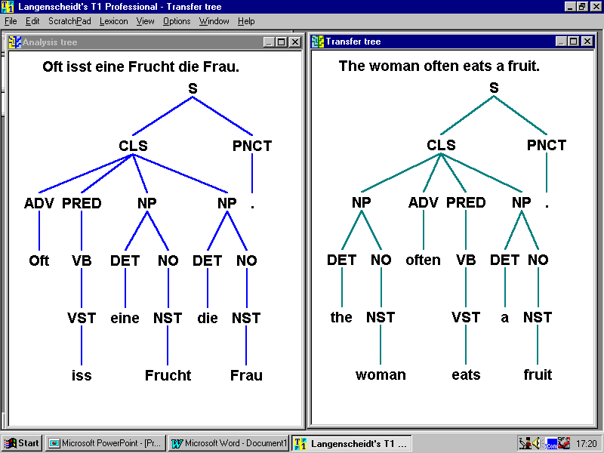
Transfer representations

Slide 31
Transfer Modules

Slide 32
Transfer Modules (n * n-1)
+ n*2 analysis / synthesis

Slide 33
Rule-based methods – Interlingua
Neutral
InterLing Rep
SL Monolingual TL
Knowledge
Analysis
Generation
Input Sentences
Output Sentences

Slide 34
Interlingua n*2 modules

Slide 35
Some other questions …
Why is it hard?
How does it work?
What is it useful for?
Can we improve it?
How do you tell how good it is?

Slide 36
How widely is MT used?
Free online MT
    Every day, portals like Altavista and Google process
    nearly ten million requests for automatic translation.
(Van der Meer 2003 LISA Newsletter XII)
Commercial MT
    SMART Communications Inc., NY: up to 1m pages per month
    European Commission: 739,000 pages in 2002
    255,000 pages post-edited into polished translations
    SAP AG: 3-5m words per year in each of 6 language pairs, for internal use and external publication
    Microsoft Research: up to 1m words per month
  (Elliott 2003 Survey of MT users)

Slide 37
Texts translated by companies using MT
12
10
8
Number of respondents
6
4
2
0
legal docs
technical docs
emails
patents
user manuals
memos
web pages
medical docs
scientific docs
financial docs
calls for tender
software strings
tourist/travel info
business letters
newspaper articles
academic papers
instruction booklets
internal company docs

Slide 38
Texts translated by single users of MT (non-commercial use)
4
3
Number of respondents
2
1
0
web pages
emails
legal docs
patents
memos
medical docs
user manuals
financial docs
technical docs
scientific docs
business letters
calls for tender
software strings
academic papers
tourist/travel info
newspaper articles
internal company docs
instruction booklets

Slide 39
Language pairs translated by MT users
12
10
8
Number of respondents
6
4
2
0
Eng-Fr
Eng-Jap
Eng-Fin
Eng-Rus
Eng-Viet
Fr-Eng
Jap-Eng
Port-Eng
Fin-Eng
Eng-De
Eng-Ital
Eng-Grk
Viet-Eng
Eng-Span
Eng-Port
Eng-Dan
Eng-Ch
Eng-Nor
De-Eng
Ital-Eng
Chin-Eng
Eng-Dutch
Eng-Swed
Span-Eng

Slide 40
Even ‘crummy’ MT creates its own demand …
Filtering | Discard / retain (relevant, not relevant, don’t know)
Detection | Sort by topic of interest
Triage | Sort within a topic by relevance
Extraction | Identify persons, locations, organisations, times, dates …
Gisting | Summarise according to amount of information preserved

Slide 41
What is it useful for?
利用者「 」は，独立行政法人通信総合研究所に対し，「日英新聞記事対応付けデータ」の利用に際し以下の条件に反しないことを誓約致します．
A user " " pledges not to be contrary to the following condition on the occasion of the use of "the newspaper account data for Japanese-English" to the independent administrative institution Communications Research Laboratory.

Slide 42
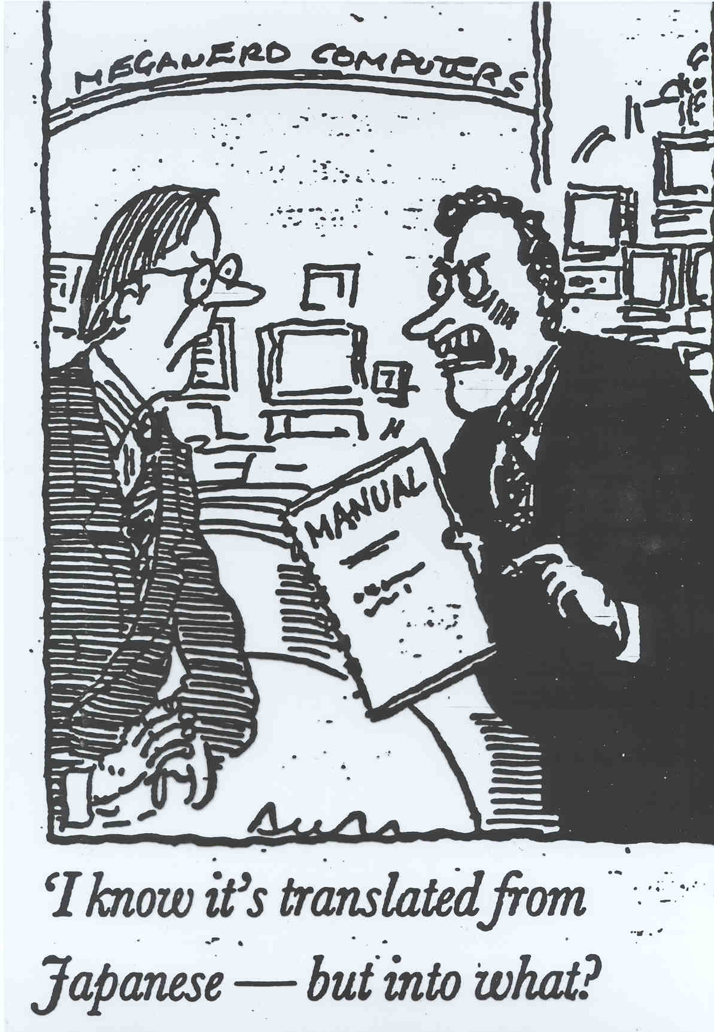
Notes:
Back to limitations ...

Slide 43
Good for poetry?
Beware the Jabberwock, my son!
The jaws that bite, the claws that catch!
Beware the Jubjub bird, and shun the frumious Bandersnatch!
Prenez garde du Jabberwock, mon fils!
Les mâchoires qui mordent, les griffes qui attrapent!
Prenez garde de l'oiseau de Jubjub, et l'évitez le Bandersnatch $$FRUMIOUS!

Slide 44
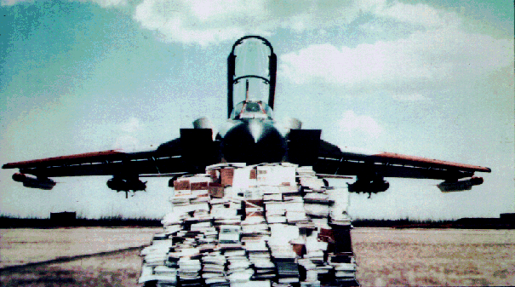
TechDoc – maybe …
Notes:
Here is a British Aerospace Tornado aircraft B-11 with a pile of its maintenance manuals.
Aircraft maintenance manuals come in 2 forms:
first-line: used on or at the aircraft itself
second-line: used away from the aircraft (e.g., in the hangar)
The pile you see here is only the first-line manuals. If the second-line manuals were added to this pile, it would be 4 times as big.
These manuals must be constantly maintained and revised.
And the manuals you see here are only for 1 language!
So how to tackle this problem?
Let’s first look at traditional methods for multilingual documentation and what they provide.

Slide 45
Some other questions …
Why is it hard?
How does it work?
What is it useful for?
Can we improve it?
How do you tell how good it is?

Slide 46
Improving MT by first doing Named Entity (NE) recognition
The problem illustrated
    ORI: The agreement was reached by a coalition of four of Pan Am's five unions.
    MT: L'accord a été conclu par une coalition de quatre de la casserole étais cinq syndicats.
The solution
    ORI: TWA stock closed at $28 …
    MT: Fermé courant de TWA à $28 …
    MT+NE: L’action de TWA s’est fermée à $28 …

Slide 47
Some other questions …
Why is it hard?
How does it work?
What is it useful for?
Can we improve it?
How do you tell how good it is?

Slide 48
Translation evaluation
– why is it hard?
Spell-cjhecking has a gold standard
Grammar-checking do too
But a gold standard in translation … ???

Slide 49
What’s the purpose?
There are no absolute standards of translation quality but only more or less appropriate translations for the purpose for which they are intended.
(Sager 1989: 91)

Slide 50
Who evaluate for?
Stakeholders: investors, developers, vendors,
managers, translators
Feasibility Can it be done?
Internal Do the parts work?
Usability Can I actually use it?
Operational Is it worth it?
Comparison Is that system better than this?
Declarative Does it translate well?

Slide 51
What data?
Test suites
    Sets of sentences to systematically test cross-linguistic differences
    Small, simplified lexicon
    Artificially constructed
    Cf translation for language learning
Corpora
    Sets of texts representing user’s interests
    Naturally occurring
    Cf translation as a communicative act

Slide 52
Which aspects?
Emphasis on relationship ST– TT
    Fidelity
    Accuracy
    Cf equivalence-based theories of translation
Emphasis on internal characteristics of TT
    Fluency
    Intelligibility
    Cf function-based theories of translation

Slide 53
What metrics?
Rating usefulness by performance
Assessing intelligibility by Cloze test
Rating fluency on an n-point scale
Rating adequacy an n-point scale
Fluency and fidelity/adequacy are strongly correlated
(e.g. Carroll 1966, Nagao 1985, DARPA 1994)

Slide 54
Example: Fluency evaluation (DARPA 1994)
_______________________________________
It is a (the hitotoki) that probably holds out in the organ ____
It takes a piano such as the year that the oldest daughter
entered into an elementary school and I, and it caused to
study the piano at 2 people with one’s second daughter. ____
It looks at does the exercise of the girl friend plural, and when
I also probably plays the piano.together with this child quality is
said, it decided. ____
____________________________________________________________________
5 Excellent 4 Good 3 Fair 2 Poor 1 Very poor

Slide 55
Example: Adequacy evaluation (DARPA 1994)
______________________________________________________________________________
[Funeral Service for Michael Jordan’s Father] ____ Funeral service for the father of Michael Jordan
[Family and close friends of American basketball ____ The family and the near the star of
Star Michael Jordan gathered together on Sunday] the American basket-ball Michael
Jordan develop are gathered Sunday
[for a memorial service for Jordan’s father, James.] ____ for a funeral service to the memory of
his/her/its father James.
_____________________________________________________________________________________
5 All meaning expressed in the source fragment appears in the translation fragment
Most of the source fragment meaning is expressed in the translation fragment
Much of the source fragment meaning is expressed in the translation fragment
Little of the source fragment meaning is expressed in the translation fragment
1 None of the meaning expressed in the source fragment is expressed in the translation fragment

Slide 56
Any questions? …

Slide 57
