Slide 1

Experimental research on Machine Translation in Translation Studies curriculum
Module “Principles and Applications of Machine Translation”
Centre for Translation Studies
FACULTY OF ARTS
Bogdan Babych
b.babych@leeds.ac.uk

Slide 2
Overview
Collaborative translation workflow and modern Machine Translation (MT)
Relevance on teaching MT in translation studies curriculum
Module structure: professional skills and ‘intellectual adventure’
Research & impact in students’ projects

Slide 3
Collaborative translation workflow and modern Machine Translation
Problem: Finding a proper place of MT in translation workflow
From early days to the ‘big data’ era: industry & teaching
Answer for evolving MT technology & industrial demand
    MT useful in a range of scenarios (controlled language, closely-related languages)
    Human translation outperforms MT, MT always needs to be checked
    MT usefulness increases with time: cannot afford to stay skeptical
Two converging industrial and technological trends
    Demand for high-volume collaborative translation & strict deadlines
    Increasing MT output quality with new tech developments + datasets
New generation: respond to technological MT paradigm shift

Slide 4
… converging tendencies: industrial demand and improvements in MT
Large-volume multilingual projects
    Localization, product documentation & global release deadlines, style guidelines, terminology consistency within & across projects
    Require ‘weapon-grade’ technology support: content, TMs + (increasingly) computational linguistic technologies
Steady evolution of MT (what skeptics might have missed)
    Improvements in usability, coverage, domains & translation directions
    New ways of integrating MT into professional translation workflow: MT API in TMs + customization and terminology support
    Collaborative translation platforms with interactive & off-line MT
    Monolingual and parallel corpus support, post-editing feedback loop, project-specific engine tuning

Slide 5
Technological developments in MT: translation quality improvements
For translators and students: awareness of tools & resources for developing modern high-quality wide-coverage MT
    Architectures, new ‘training’ and runtime decoding methods, models
      word-based → phrase-based → hierarchical, syntax-based, neural MT, hybrid MT (RBMT→SMT, e.g., Systran; SMT→RBMT)
    Systematic linguistic improvements with other NLP technologies: Named Entity recognition; MWEs, WordNet, WSD, LVCs, agreement…
    System customization and tuning on task-specific MT evaluation scores, terminology extraction & management, domain adaptation
    Leveraging shared and open-source TMs: domain-specific training
    Fast MT development for under-resourced languages
Result: measurable improvements: time, cost, consistency and fitness for purpose

Slide 6
Module “Principles & Application of MT” for MA TS students
1sem (spring), 15-credit, elective
“Research-lead; informing future research; impact-driven”
    Students Should be able to:
      Understand capabilities & limitations of MT systems for different translation scenarios; be able to use the potential of MT technology for optimizing the workflow in their translation projects
      Work in the rapidly changing technological MT landscape in future,
        follow new developments and literature MT
        assess their impact on translation workflow
        understand and exploit synergies between MT and other CAT tools, e.g., take advantage of MT customization and domain adaptation capacities for own projects and tasks

Slide 7
Students’ research component in MT module
Rapidly-changing industrial landscape with no ready answers to future project needs in professional context
    E.g., system evaluation &comparison, MT integration into the workflow
    In future will need to set up experiments to systematically find answers relevant for a specific purpose, translation project, or organization
Research component in taught classes and assessment
    Teaching methods, techniques and tools for experimental research
    Assessment: an experimental case study on MT evaluation, improvement, workflow design etc. within a theoretical framework
    Session on principles of experiment design
    One-to-one tutorial on students’ individual projects

Slide 8
MT module structure
Theoretical linguistic and computational issues in MT
    MT architectures, system combination, productivity of MT in workflow
    Unresolved issues and future developments
Usage scenarios for imperfect MT output, post-editing, controlled language, sublanguage
Customizing Rule-based, Statistical and hybrid MT
    Dictionary update, terminology extraction and management: Systran
    Domain adaptation & translation corpus training
Human and automated methods of evaluating MT quality
    Error analysis schemes, system improvement, concordance evaluation
    Calibration of automated scores, automated error analysis

Slide 9
MT module: professional relevance and intellectual adventure
Research skills for modern professional context …
… + Academically rewarding intellectual adventure:
    MT development vs. evaluation: ‘there will be no good engineering where there is no good science’ (M.Kay)
        Evaluation as a way to understand what we do not know about translation, feeding back into MT development cycle.
Perspectives for students’ research path
    Final-year dissertation
    MA(Res) and PhD projects
Impact component: actual or potential value for NGOs, volunteer translation groups, translation companies.

Slide 10
Students’ projects
Experimental study + 2000 words report
    For ‘distinction’ – innovative, make a potential contribution to state-of-the-art MT evaluation research (methodology, approach, but not necessarily the material or results)
      Describe at a level suitable for publication / presentation
      Follow the structure of research papers in the area of MT
      Include references to recent publications in journals and conferences proceedings on the relevant topics
    Systematic analysis of the material, e.g., corpus-based + linguistic interpretation or insights & discussion with linguistic examples
    Structured feedback (external examiner liked it!)

Slide 11
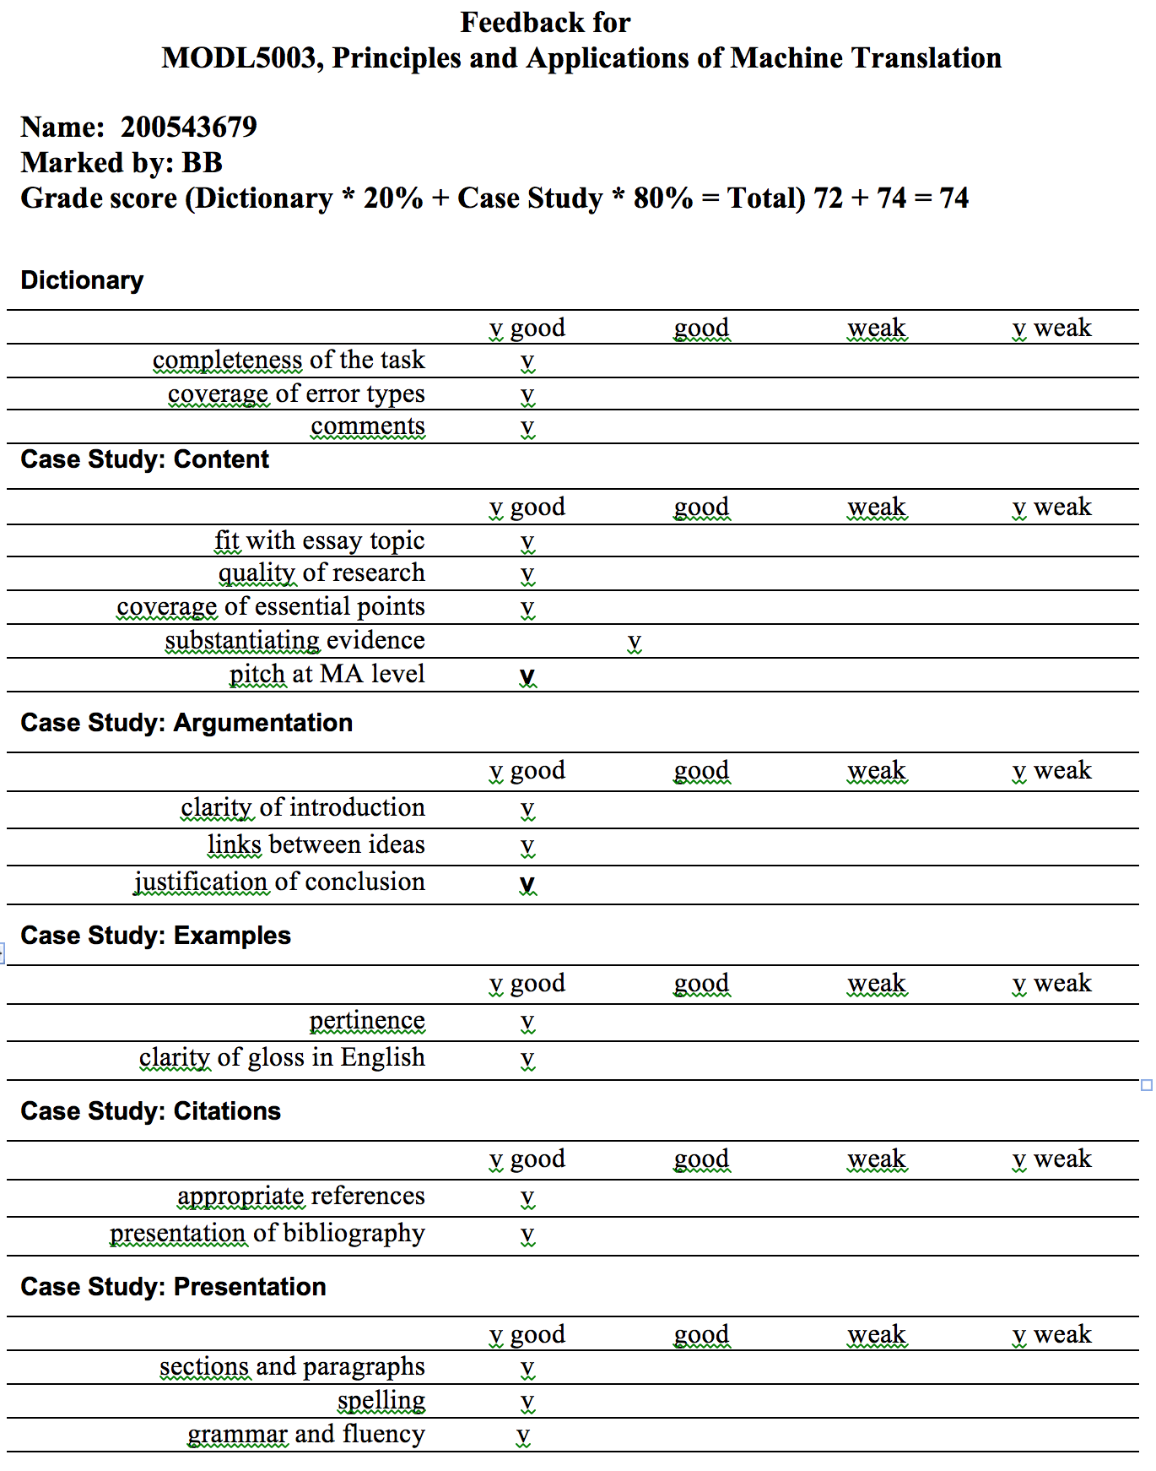
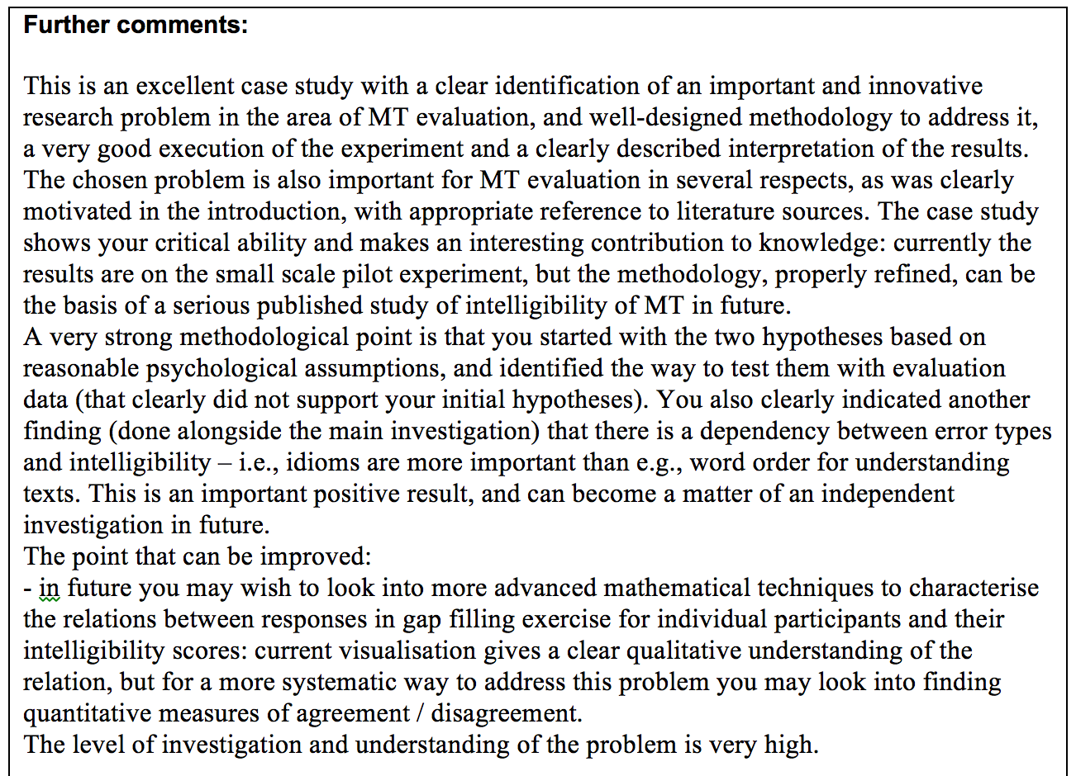
Module feedback

Slide 12
How technical?
Students with humanities background
Module introduces experiment design and data analysis techniques, but no technical pre-requisites
Exploits synergies of computational linguistic methods with knowledge of the professional translators’ workflow.
New generation of technologically aware translators ?
    Translators who collaborate with CAT engineering teams
    Who define and create the next generations of MT and CAT tools, which would be more capable and useful for professional translators

Slide 13
Students projects and results
  Impact of segmentation methods for Chinese text on accuracy of automated BLEU evaluation
    Res: character-based segmentation better correlates with human scores
  Designing a controlled language for drafting Spanish language loan overviews at Kiva for automated translation into English
    Outcome: Rules for non-specialists and effect on MT quality (adequacy)
    Tested with non-for-profit organization
  Comparative error analysis on the output of rule-based and statistical machine translation systems before and after the implication of a Spanish Control Language
  An investigation into the potential for human evaluation of Machine Translation to be objective

Slide 14
Students projects and results
  An exploration of the predictability of human evaluation scores of machine translation system output from automated evaluation scores across varied text types
  Evaluating Error Analysis Results From MT Systems across Genres
  Relation between pre-editing and quality of translation
  Declarative evaluation of MT in legal domain
  Analysis of the feasibility of using Systran 7 and Google Translate for translation of a literary text, with consequent evaluation of application of MT in this field
  Creation of new grammatical controlled language rules for French through error analysis and self-evaluation of machine translation quality
  The Use of Controlled Language for Improving the Translation of Scientific Texts by Systran

Slide 15
Students projects and results
  Human Evaluation of Machine Translated Patient Information Leaflets (PILs)
  Using the BLEU evaluation metric to determine the suitability of rule-based compared with statistical MT systems in the translation of medical texts
  Comparative analysis of task-based vs. Proximity-based evaluation methodologies
  Setting up an MT evaluation framework for a translation company, an MT development team, etc.
  Automated MT evaluation methods: current limitations and future prospects.
  Designing human evaluation experiment for FEMTI framework
  Use of error analysis and test suites for general-purpose MT systems

Slide 16


