Slide 1
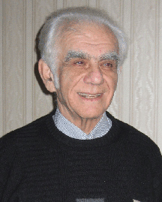


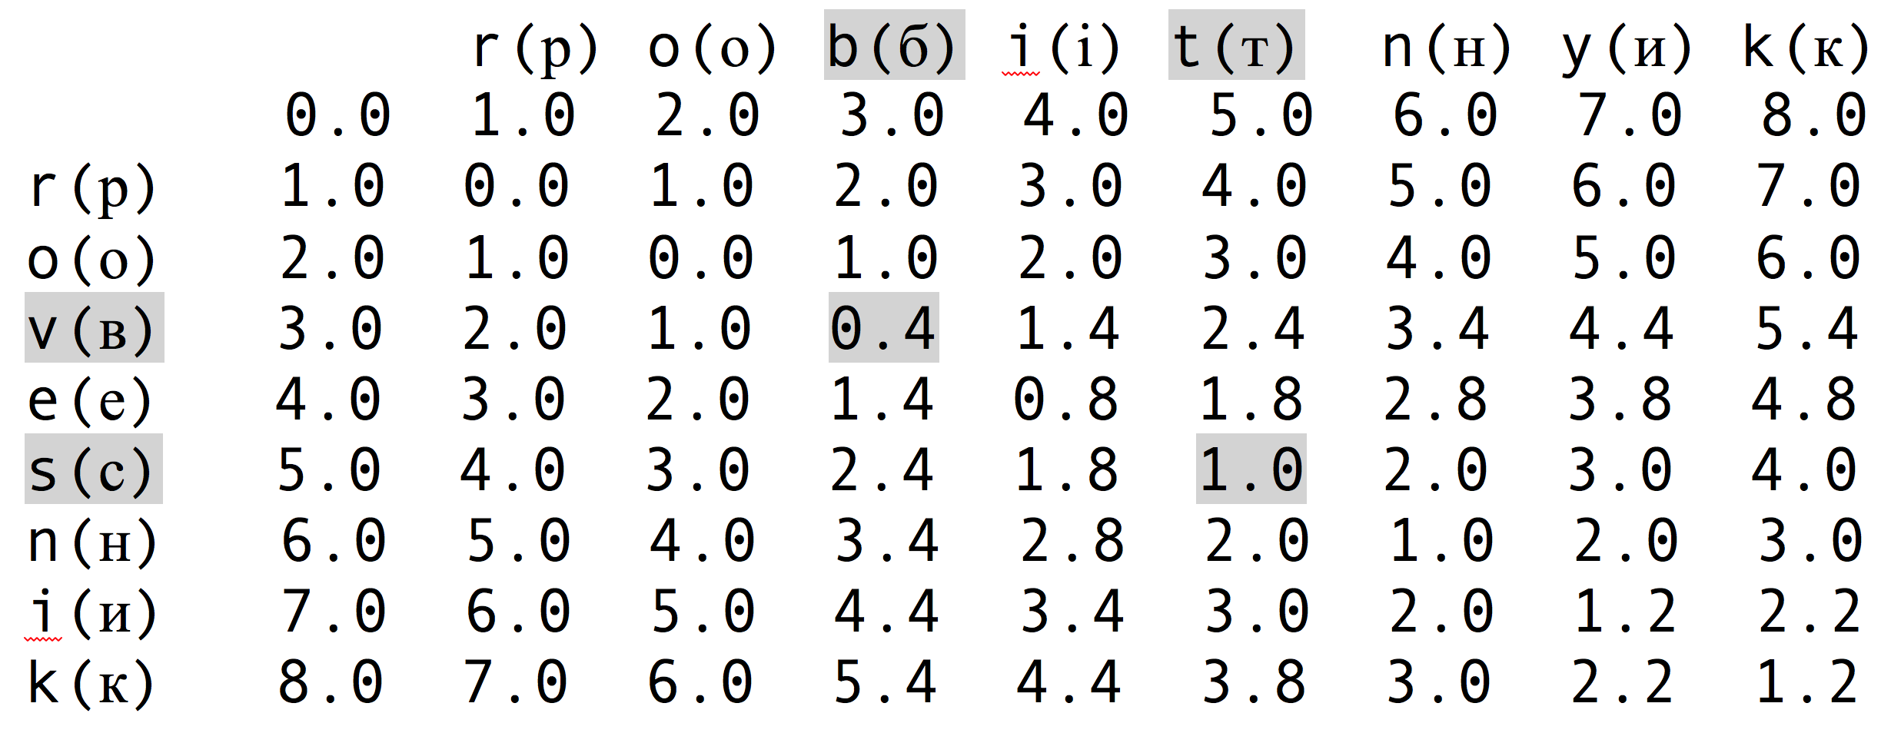
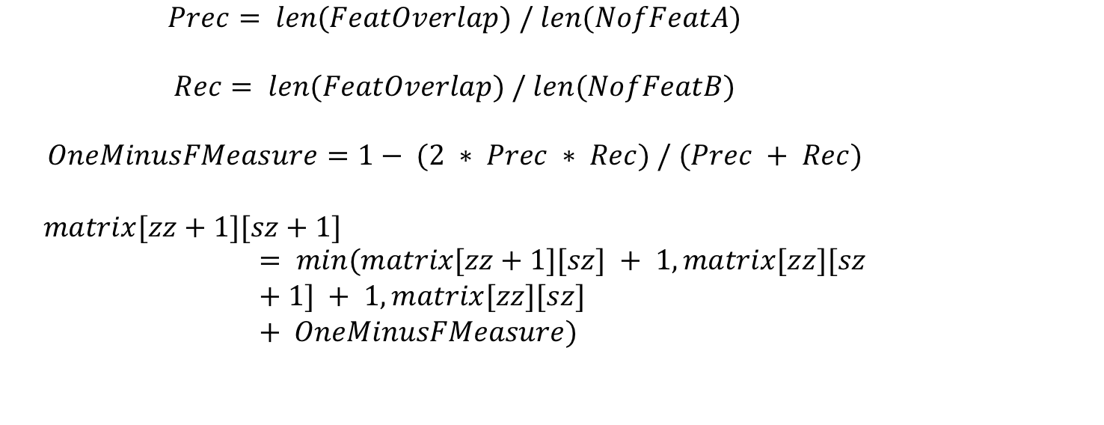
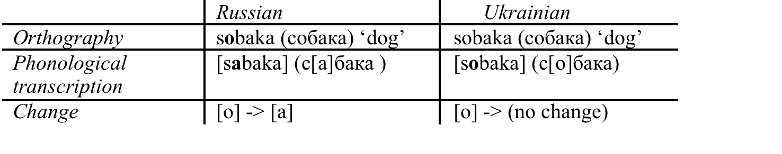
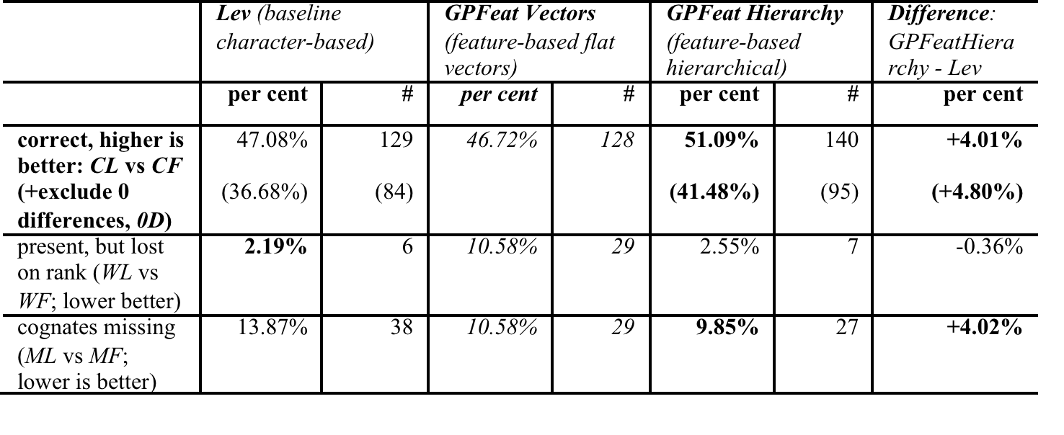
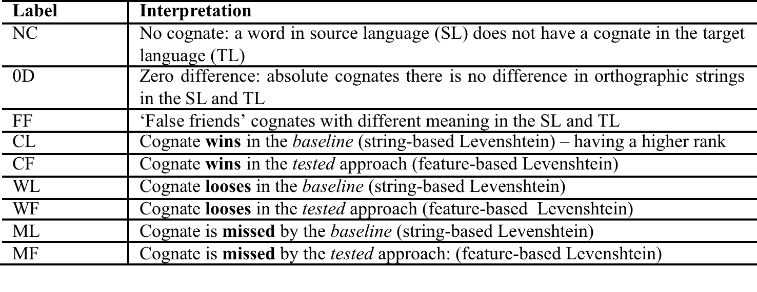
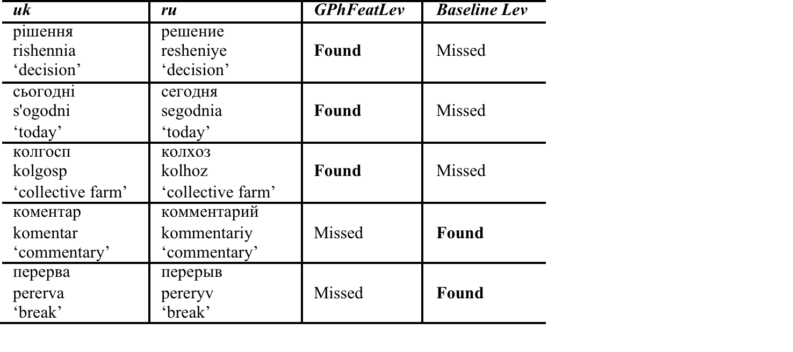
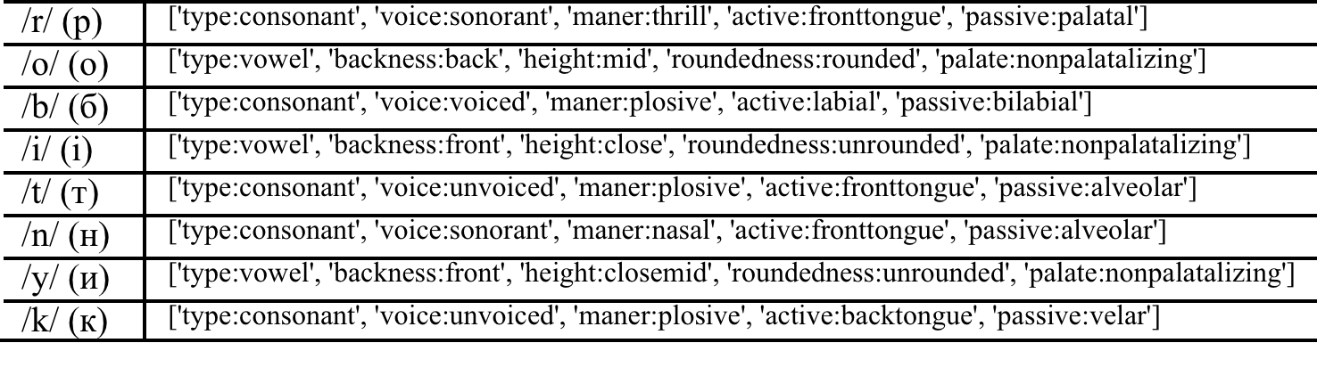
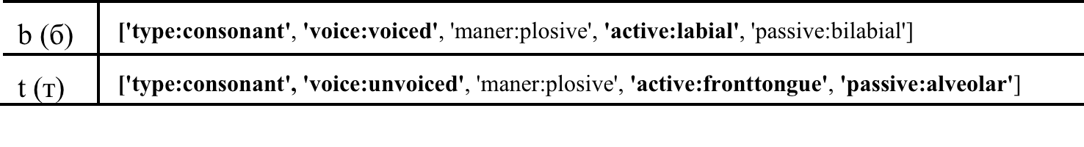
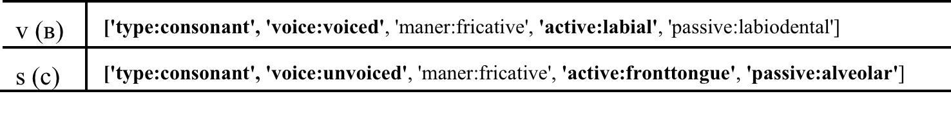
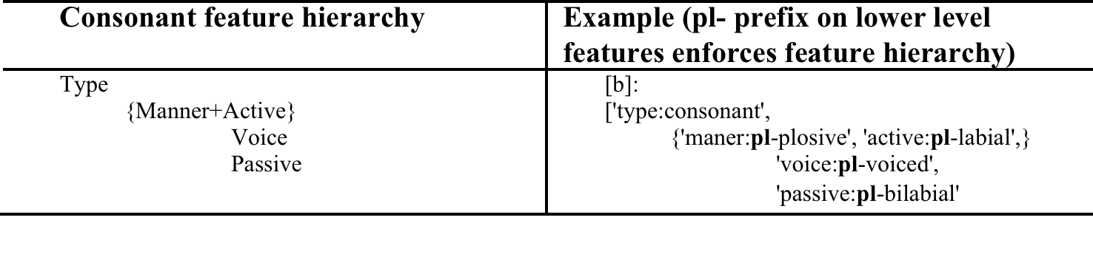
Graphonological Levenshtein Edit Distance:
Application for Automated Cognate Identification
Bogdan BABYCH (b.babych@leeds.ac.uk)
Centre for Translation Studies, University of Leeds
Overview
Evaluation framework: Automated cognate identification for MT
A method of calculating a modified Levenshtein edit distance between phonologically-aware character strings
Evaluation on the task of automated cognate identification from non-parallel (comparable) corpora
Motivation: finding translation equivalents for the ‘long tail’ of cognate lexicon from non-parallel corpora
approach works best for cognate languages
applies across writing systems (ua,ru, pl)
Principle: editing character feature hierarchies for strings
informed by acoustic & articulatory feature structures of phonemes behind characters;
calculating intuitively more meaningful distances
Other applications: robust transliterations, identification of distorted spelling, modelling phonetic variation in morphological paradigms, dialectological distortion models, tracking historical changes in closely-related languages
HyghTra project http://hyghtra.eu/ : Rapid creation of hybrid MT systems around Lingenio’s RBMT architecture
new translation directions
under-resourced languages,
closely related, or ‘cognate’ languages
Spanish &Portuguese, German & Dutch, Ukrainian &Russian
Task: automating cognate identification from non-parallel comparable corpora for dictionary creation
Closely-related languages have high cognate overlap: ua/ru ≈ 60% cognate lexicon (higher in low-frequency range = ‘long tail’), with ≈ 2% ‘false friends’ (cognates with different meaning) which generate noise
Applications for RBMT/Hybrid MT: Cognate candidates presented to the developer for manual check
Productivity depends on metric quality
Comparing parameters of the candidate lists
Applications for SMT:
ACCURAT (Pinnis et al., 2012): equivalents from comparable corpora reduce the number of out-of-vocabulary words in SMT for under-resourced languages
Methodology
Monolingual corpora 250M for Ukrainian and 200M for Russian news PoS tagged and lemmatised.
Frequency dictionaries created for lemmas; Frequency threshold applied
Edit distances for pairs of lemmas in a Cartesian product of the two dictionaries automatically calculated using baseline and phonological Levenshtein measure.
Pairs with edit distances below an established threshold retained as candidate cognates
Levenshtein edit distance normalised by the length of the longest word <=0.36, (36% of edits per character)
Candidate cognates filtered by part-of-speech codes
Cognates with different PoS not ranked
Candidate cognates filtered by frequency bands
TL candidates not ranked if beyond the threshold of the SL candidate:
Candidates not to have frequency difference of several orders of magnitude
Candidate cognate lists are ranked by the increasing values of the edit distance
Pronunciation does matter, e.g.:
recognition of proper names by native speakers mispronounced in other languages
V.Levenshtein (1935- )[
], not […
]
Previous work
Development of the Graphonological Levenshtein metric
Levenshtein edit distance: number of insertions, deletions & substitutions of characters to convert a string into another
1. Feature vectors vs. feature hierarchies
Counter-intuitive results for feature vector cognates
Result of matching irrelevant features
{robitnyk = ‘worker’ } ≠ {rovesnik = ‘of the same age’}
Solution: matching hierarchical representations of features
Features at the top of the hierarchy have to match first
to allows lower level features to match
no match if higher level features are different
Hierarchy encoded as prefixes on feature vectors
non-matching higher levels prevent from matching at the lower levels
e.g., [pl-voiced] will not match before [plosive, labial] match
Applications for fuzzy string matching
Extension for modelling dialectological variation:
phonological edit distance for comparing word pronunciation in dialects (Nerbonne & Heeringa, 1997; Sanders and Chin, 2009) using vectors of acoustic /articulatory features, proposed by (Jakobson et al., 1958) – examples of phonemes:
[Acoustic Type]: vowel [a]| sonant [r]| consonant [s]
[Manner of articulation]: plosive [b] | fricative [s]
[Active articulation]: labial [b] | front-tongue [s] | mid-tongue [r] | back-tongue [k]
[Passive articulation]: bilabial [b] | labiodental [v] | palatal [j] | velar [k] | alveolar [s]
[Frontness]: front [i] | central [y] | back [a]
[Height]: open [a] | mid [e] | close [i]
Each word is (1) phonologically transcribed; (2) each character gets internal structure: represented as a vector of features; (3) edit distance computed between strings of phonological feature vectors
2. Combining features
3. Graphemes’ phonological structure
Computation is symmetric, independent of order
Metric operates directly on orthography, without transcription
Exploiting historic and morphological principles of orthography
Evaluation annotation scheme
Errors
Affects substitution operation: lower cost if phonemes share some phonological features
to make it “…possible to take into account the affinity between sounds that are not equal, but are still related to …show that 'pater' and 'vader' are more kindred then 'pater' and 'maler'.” (Nerbonne & Heeringa, 1997:2)
Problems with phonological edit distance
Evaluation framework needed for metric development
Task-based evaluation: success in applications (cognate identification, robust transliteration)
Different optimization parameters for applications
Are feature vectors sufficient or more complex hierarchical representations needed?
Phonetic features of complex phonemes (diphthongs)
Integrating edits of individual features into the calculation of a coherent distance measure
Euclidian vs. Manhattan distance, etc…
Evaluation results
Conclusions
Graphonological edit distance developed and evaluated in task-based framework (automated cognate identification)
Potential applications beyond cognate identification
Robust language processing
Defence and security
Morphology induction and modelling morphonological variation
Interaction of historical changes
Resources (feature sets + scripts) released on http://corpus.leeds.ac.uk/bogdan/phonologylevenshtein/
Baseline Lev outperforms feature vector metric
Hierarchical feature metric outperforms Baseline Lev +4%

