Slide 1
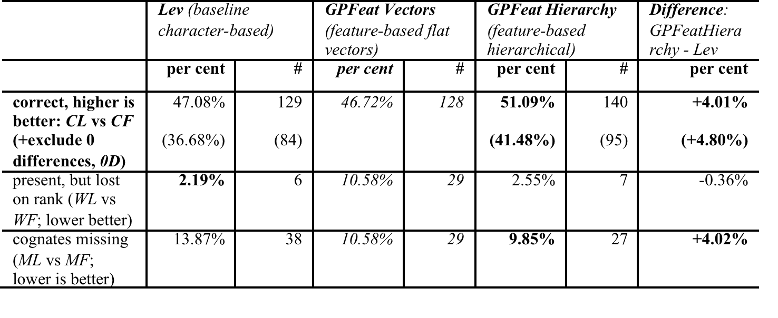
Development and evaluation of phonological models
for cognate identification
Bogdan BABYCH
Centre for Translation Studies, University of Leeds, UK
b.babych@leeds.ac.uk
Approach
Previous work
Problem of feature engineering
Development and evaluation framework
Evaluation results
Conclusions
Levenshtein r
Graphonological edit distance developed and evaluated in task-based framework (automated cognate identification)
Potential applications beyond cognate identification
Robust language processing
Defence and security
Morphology induction and modelling morphonological variation
Interaction of historical changes
Resources (feature sets + scripts) released on http://corpus.leeds.ac.uk/bogdan/phonologylevenshtein/

