Slide 2
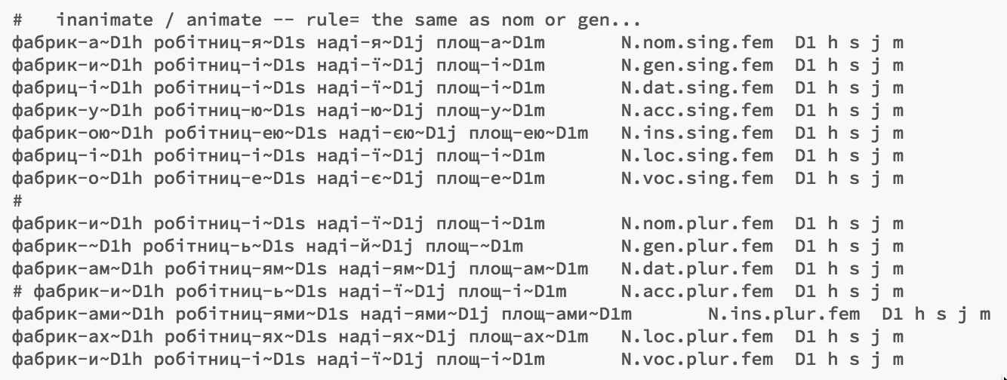
Example: inflection tables
inflection table for фабрика (‘fabryka’, factory), etc.
input
рука (‘ruka’, hand)

Slide 3
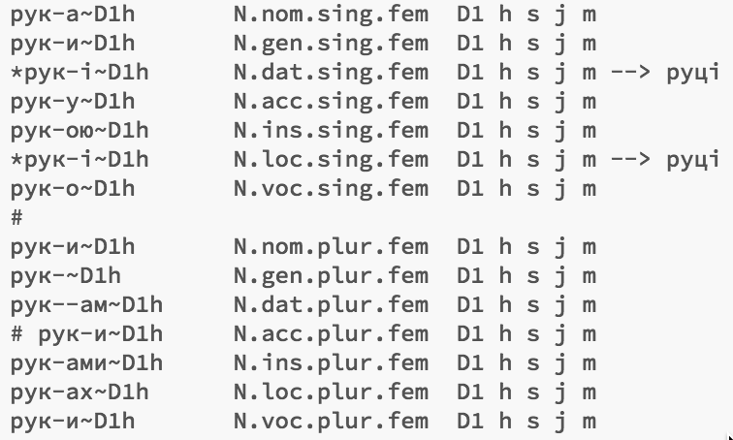
Example: inflection tables
рук|а (‘ruka’, hand)

Slide 4
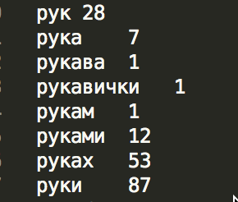
For each token:
рук|а (‘ruka’, hand)
1. try splitting with every inflection
2. For each split:
generate word-form hypotheses from infl. table:
3. verify hypotheses
in corpus +? distortion
4. Found 7 forms + 2 forms with distortion = Paradigm confirmed

Slide 5
Example: inflection tables

Slide 6
Example: inflection tables
Paradigm
confirmed

