Slide 1
Enterprise Programming 2 Lesson 08: MicroServices
Bogdan Marculescu

Slide 2
Goals
Learn what MicroServices are, and where/when you need to use them
Understand the concept of Load Balancing
Understand the role played by API Gateways

Slide 3
The Monolith
Single enterprise application containing everything
Eg, single WAR deployed on a Wildfly/Glassfish server
Note: can still be divided in packages/modules, but the packaged “executable” will just be a single file (eg WAR or JAR)
On non-trivial systems, can easily be more than 1 million lines of code
Extremely common
Most enterprise systems developed until the 2010-2015 years are monoliths

Slide 4
Monolith Hell
Lot of issues with monolith applications
What happens when new developer joins the team?
Understanding 1 million lines of code will take time before becoming productive
What if for some specific task you need a different technology?
Eg, Python, NodeJS, etc.
How to scale if some functionality is highly used?
Need to deploy the whole monolith on many machines, even if you just need a small subset

Slide 5
Monolith Hell (cont.)
What if you need to update/fix a single functionality?
Need to redeploy the whole monolith on all the machines
What if a single functionality is buggy?
Might take down the whole monolith application
What if your technology stack becomes obsolete?
Rewrite whole monolith is not viable
Adding new functionalities in a new technology stack might conflict with current stack in the monolith
Etc. Etc.

Slide 6
MicroServices to the Rescue
MicroServices are an architectural pattern to address some of the issues in monolith applications
No Silver Bullet
MicroServices are not the answer to all problems, and they have their own set of issues
EXTREMELY popular in industry in the last few years
If you are going to work as a backend developer, most likely you will end up dealing with REST in a microservice architecture

Slide 7
MicroServices in a Nutshell
Divide your system in independent components, ie services
Each component should be compilable and deployable on its own
Typically, but not necessarily, they are RESTful web services
How many components?
“Two Pizza” rule: a team shouldn’t be bigger than what 2 pizzas could feed
Actual rule coming from Amazon, a pioneer in microservices
Not uncommon having applications made by hundreds of components
Communications should be programming/OS agnostic
Eg, JSON/XML over HTTP

Slide 8
Fallacies of Distributed Computing
The network is reliable.
Latency is zero.
Bandwidth is infinite.
The network is secure.
Topology doesn't change.
There is one administrator.
Transport cost is zero.
The network is homogeneous.
https://en.wikipedia.org/wiki/Fallacies_of_distributed_computing

Slide 9
Benefits: Easy To Understand
A new engineer will start working on just one component
Understanding a single component (e.g., a RESTful web service) is easier than trying to figure out how a whole monolith works
Easier to test/debug, as can execute in isolation
Would still need to mock interactions though, eg with WireMock

Slide 10
Benefit: More Robust
If one component is failing/buggy, can shut it down in isolation until fixed
All the other hundreds of components will still be up and running
Of course, functionalities will be reduced and some will be missing
Application should still work, although in a “degraded mode”
Make sure to avoid communications with missing service, eg Circuit Breaker with Hystrix

Slide 11
Benefit: Language Agnostic
As components are independent, they can be written in different languages
Java, C#, Python, NodeJS, Ruby, etc.
Less worries about the future
If in 10 years your technology stack dies, for new components can easily switch to a new language/framework
Can easily experiment
Eg, for a new component you can try something different, like C#, Scala or NodeJS
Extremely important when evaluating new technologies/frameworks

Slide 12
Benefit: Scale on Demand
Not all components will be used/access equally
Some are just for functionalities that are seldom used
Highly used components can be replicated/deployed on several servers
Just need to deploy extra instances of components you need
Want more running instances on different machines of components that use more CPU
This can be fully automated
Eg, reduce number of running instances of components that are seldom used

Slide 13
Benefit: Safer Deployment
Can deploy components in isolation
Eg replace version X with version X+1
If something goes wrong with X+1, you just need to rollback that single component
Less risky then deploying a whole monolith…

Slide 14
No Silver Bullet
In engineering, there is never a solution that fits all problems
MicroServices have their own issues
Lot of benefits, but do not blindly follow hypes
Needed for large systems. For small systems, monolith can be a better solution
What a 3rd year student can do on their own or in a group of few students over a couple of months is by definition “small”…

Slide 15
Drawback: Computation Overhead
Communications between different components are more expensive than in a monolith
Eg, HTTP over TCP
Even if running on same machine
Lot of un/marshaling to/from JSON/XML
A direct Java call in same JVM is far much cheaper…

Slide 16
Drawback: Complex setup
No more 1 single WAR/JAR, you have (for example) 500 now…
Can’t use simple script to deploy/start the whole application
Need special tools, e.g. Kubernetes or Docker-Compose

Slide 17
Drawback: Atomicity
Some actions have to be atomic
Eg, sequences of operations should all pass or all fail
Eg, can only buy an item if still present in warehouse and credit transaction does not fail, and those can be implemented in different components
In single application, easier to ensure atomicity
Eg, think of transactions to a database
Recall ACID: Atomicity, Consistency, Isolation and Durable
In a distributed system (even if running on the same server machine), much harder to implement reliable atomicity

Slide 18
Drawback: Testing
Yes, you can test components in isolation, but then have to mock away all inter-component interactions
Eg, using WireMock
Starting, stopping and cleaning up 500 components is more difficult than a single monolith

Slide 19
The 12 Factor App
“The twelve-factor app is a methodology for building software-as-a-service apps” (https://12factor.net/)
Codebase
One codebase tracked in revision control, many deploys
Dependencies
Explicitly declare and isolate dependencies
Config
Store config in the environment
Backing services
Treat backing services as attached resources

Slide 20
Build, release, run
Strictly separate build and run stages
Processes
Execute the app as one or more stateless processes
Port binding
Export services via port binding
Concurrency
Scale out via the process model
Disposability
Maximize robustness with fast startup and graceful shutdown
Dev/prod parity
Keep development, staging, and production as similar as possible
Logs
Treat logs as event streams
Admin processes
Run admin/management tasks as one-off processes

Slide 21
Containers and Orchestration

Slide 22
A Single Component
Typically, but not necessarily, a RESTful web service
Language does not matter
Issue when dealing with different languages
How to deploy, start/stop different components?
How to guarantee that a component can run in different servers?
Even if Java is highly portable, still need to make sure same version of JRE is installed on all the servers
Subtle differences between OSs and internal configurations
Need Immutable Delivery

Slide 23
Deploy Operating System (OS) Images
Do not limit to just package a JAR or WAR file
Create a whole image of an OS, including all needed software
Eg the version of JRE that you need
Virtual Machines
Do not install the OS image on the server, but rather run it in a virtual box
Different tools enable this
Eg, VirtualBox from Oracle
Eg, Parallels if you need to run Windows on a Mac

Slide 24
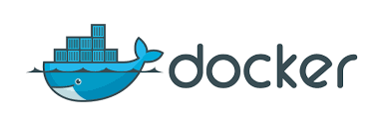
Docker to the Rescue
Virtualization technology
Create OS images, on top of a predefined one
Eg a predefined image could be a Linux distribution with the latest version of JRE installed
Large catalog online of existing base images
When building a component, instead of creating a JAR/WAR file, it will create a Docker image

Slide 25
Orchestration
You might have 100s of services, with Docker
How to start all of them?
How to stop them?
How to automatically restart a service that crashed?
How to automatically spin more instances of highly used services?
How to automatically kill instances of seldom used services?
Etc.

Slide 26
Container Cluster Manager Frameworks
Open-source tools: eg Kubernetes and Mesos
Allow you to easily deploy and monitor Docker containers on different servers
Kubernetes created at Google, and used internally for their systems
Note: we will not use such tools in this course, but you need to know about them
We will use Docker-Compose to start a static set of Docker images, without automated scaling or failure restart handling

Slide 27
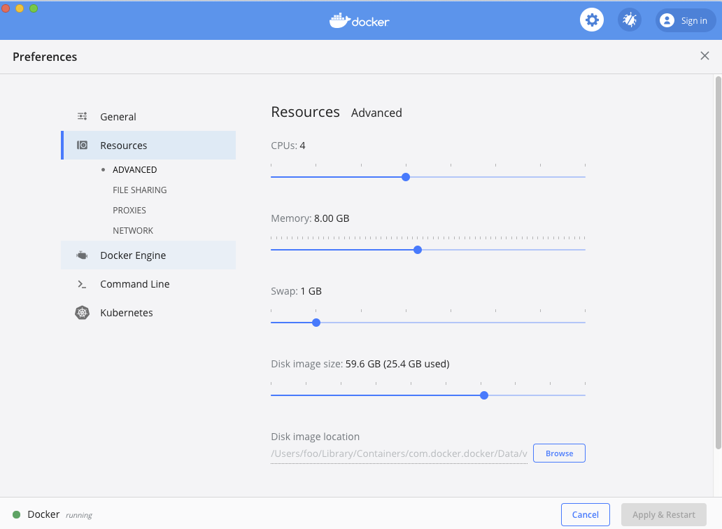
Resource Consumption
We are going to run several Docker instances on the same machine
Need to give Docker enough CPUs and RAM
Alpine images: bareboned OS versions with minimal memory footprints

Slide 28
Microservice Components

Slide 29
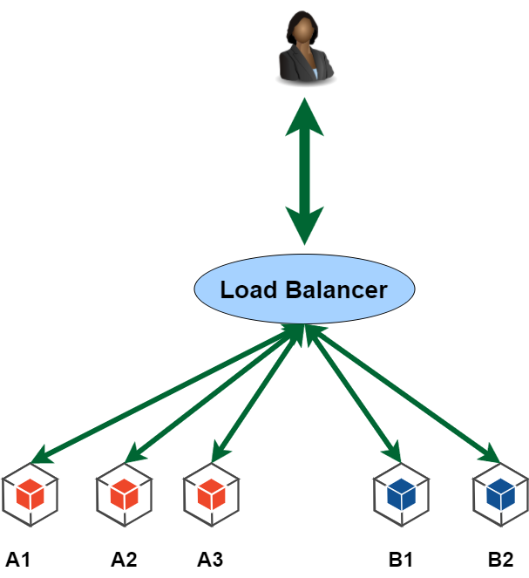

Slide 30
Load Balancing
Different technique, eg Round Robin
At each request, forward to next instance, and once all are asked once, next one is from the beginning as in a ring, ie 1-2-3-1-2-3-1-2-3-1-…
ESSENTIAL that the communication protocol is stateless
2 successive calls might end up in 2 different running instances of the same service
State has to be handled externally, eg in a database
Note: if in a web application you have state (and you run several instances) like stateful EJBs and session JSF beans, then need to configure load balancer to remember session mapping (eg, based on cookies). In a REST API, just avoid internal state.

Slide 31
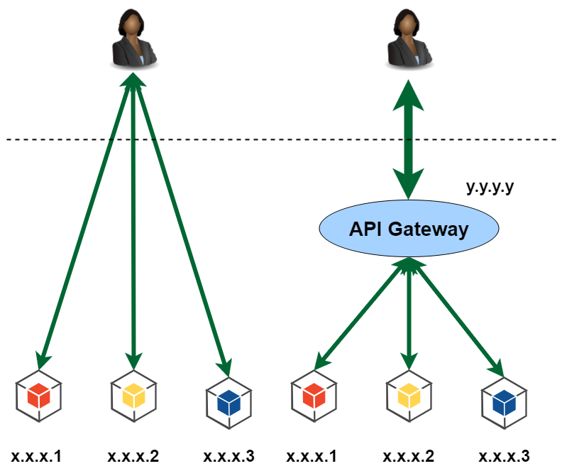

Slide 32
API Gateway
Client might need to interact with hundreds of services
Keeping track of them in the client is far too complex, and expose internal details of the microservice system (which might change)
One single entry point, which will forward to the right REST service
Positive: much easier to write clients, less coupling
Negative: one point of failure, possible bottleneck

Slide 33

Inter-Service Communications
When service X needs something from service Y, if REST service, can just do a HTTP call to it
Y provides the information, and X just asks for it directly
Y is passive, it is X that starts the communication

Slide 34
Inter-Service (cont.)
What if X and Z are waiting for some events to happen in Y?
Y a service representing a game
X is service showing stats/info of a user
Z is service representing a “score board”
Using REST API, I have two options
1) X and Z do continuous pulls (ie GET), eg every 10 seconds, to see if any change in Y (eg, has a new game finished?)
Very bad, highly inefficient
2) Y starts communication, and sends (ie POST) data to X and Z
Not scalable, Y has to know about all possible services interested in its data

Slide 35
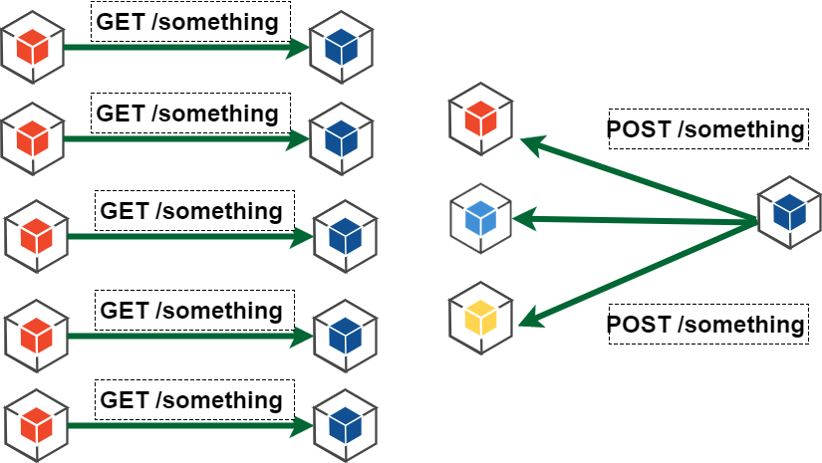

Slide 36
Message Broker
A broker (which will be a running process) will receive/forward messages
A service that wants to publish some information, will create a topic on the broker, and then send messages to it
this is independent from HTTP, using a specific protocol defined by the broker
Clients will register with the broker for one or more topics, and then will asynchronously receive all messages sent to those topics
Think about sending an email to a mailing list…
Broker can guarantee delivery: messages can be saved to disk, and clients can receive messages sent before they contacted the broker (useful if some clients had to restart, or previous network issues)

Slide 37
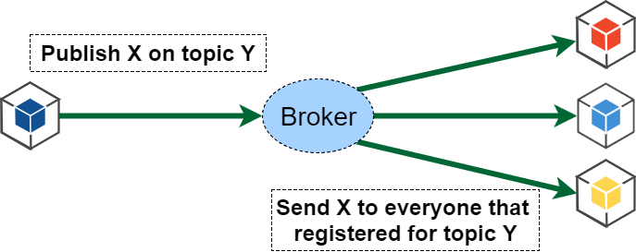
Eg, Y is “New Game/Match Is Finished”, and X is the detailed info of such game/match, eg the ID, who won, etc.

Slide 38
Message-Oriented Middleware (MOM)
Different broker tools, in different programming languages
ActiveMQ, RabbitMQ, Qpid, SonicMQ, etc.
Different protocols as well
OpenWire, Stomp, AMQP, etc.
A broker can support several protocols, and translate/bridge one to the others
Advanced Message Queuing Protocol (AMQP)
Language agnostic, can connect Java to NodeJS and C#
Very (most?) popular MOM
Another popular one is Kafka, but that is technically just a distributed log system

Slide 39
RabbitMQ
Written in Erlang
Implementing AMQP
It is the MOM we will use in this course
We will start it with Docker
We will look at its details in a later class, not here

Slide 40
Service Discovery
How does service X know the IP address of Y, if X wants to communicate with Y (eg, a REST call)?
Hardcoding the IP address of Y in X is not a viable option…
Service Registry: a process/component that keeps track of the IP addresses of all running services
X will ask the service registry for the IP address of Y
IP address should not be hardcoded
Different approaches for communications with registry and IP registration

Slide 41
The Service Discovery (SD) will be a running process
All services will need to know the IP address or hostname of SD
Services will have a name, e.g. A, B and C
When service A starts, it will contact SD and states that it is running on given IP address
It will then receive the IP addresses of all other current registered services
Note: if a service is replicated, there will be different IP addresses for the same service name
this is also one of the reasons why we are not using DNS here
If services leave or join, SD will inform all registered services about it, ie at each topology change
To know if service is still reachable, need to send an heartbeat every N seconds (eg 30s)

Slide 42
Client-Side Load Balancer
A single load-balancer (LB) for all communications would be a major bottleneck
Still need it for the API Gateway, but what about service-to-service communications?
Client-side LB: not centralized, each service (including Gateway) is responsible to do the LB on each request
But to do that, need to know the IP addresses of replicas of each single service… easy, ask the Service Discovery!

Slide 43
Single Load Balancer: Inefficient
User makes a request, going through Gateway
Needs to be routed to 1 of the 2 instances of service A
To complete the request, A needs to get data from B, and so make a request to 1 of the 4 instances of B
If always doing routing through Load Balancer, it becomes a bottleneck

Slide 44
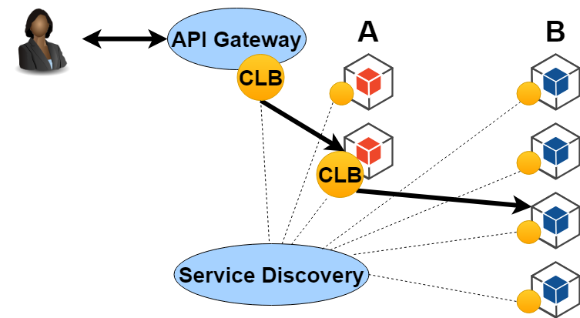
With Client-Side Load Balancers
Same scenario as before
But, now, the instance of A (let’s call it A1) asked by the Gateway knows IP addresses of all instances of B
A1 will decide to which of the 4 instances of B to ask to, each time choosing a different one (if Round-Robin)

Slide 45
One-to-one communication, what if server is down?
If destination is down, all next messages to it are wasted until the server is up again
If client tries several times to connect, then you end up flooding and congesting the network with pointless messages
Would be better to wait a bit, before trying to reconnect to the destination
If messages are saved, and resent when destination is up, you do not want to send all the stored messages at the same time (otherwise destination could go down again)

Slide 46
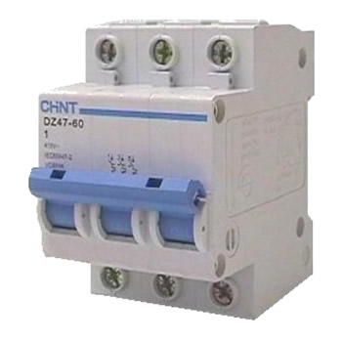
Circuit Breaker
If too many connections to a server fail, stop ALL future attempt at connecting
Can use a library to wrap each call to external services
Once the circuit breaker is on after several failures, it will periodically check if the server comes up again. If so, all communications are restored

Slide 47
Databases
Services like REST APIs should be stateless
Can restart/stop at any time, and scale horizontally by replicated instances
State saved in databases, running in separated processes
How many databases?
Services need to evolve (and be updated) independently… so each should have their own databases
Replica instances of a same service will use the same database

Slide 48
Security: Different Virtual Networks
Instances of A should only access own db, and not the one of B instances
For security, could have separated VNs
A can speak with B though, as on a same VN
Multihoming: access to 2 or more networks

Slide 49

Spring Cloud
SC provides support for many common tools used in cloud applications
It provides wrappers to abstract from the actual used tools, and/or provide own implementations
API Gateway: own SC Gateway
Service Discovery: Consul
Load-balancing: own implementation
Netflix stack: was very popular in the past (eg, Zuul, Eureka, Hystrix and Ribbon), with direct support in SC, but mainly deprecated nowadays

Slide 50
Docker

Slide 51
How to Use Docker?
First you need to install it
https://store.docker.com/
Note: if you are using Windows, Home Edition might not be enough. You would need a better version, like the Educational one, which you should be able to freely get from school
To run existing images, you just need to type commands from a shell terminal (eg, GitBash)
When you are writing your own projects, you need to create configuration files
Dockerfile: specify how to build an OS image
docker-compose.yml: for handling multi-images
Then, use docker and docker-compose commands from the command line

Slide 52
Docker Examples
https://docs.docker.com/get-started/
https://hub.docker.com/r/docker/whalesay/
docker run docker/whalesay cowsay boo
This will install the image “docker/whalesay”, and run it with input “cowsay boo”
First time you run it, the “docker/whalesay” image will be downloaded

Slide 53
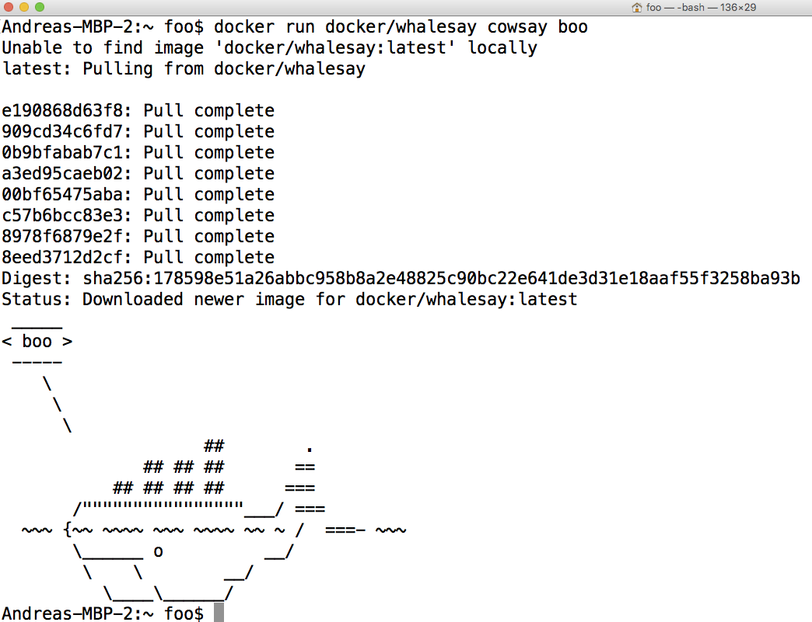

Slide 54
Custom Images
Extend existing images to run the applications you develop
Just need to create a text file called “Dockerfile”
FROM: specify the base OS image
RUN: execute commands in the virtual OS to set it up, like installing programs or create files/directories
CMD: the actual command for your application
ENV: define an environment variable
COPY: take a file X from your hard-disk, and copy it over to the Docker image at the given path Y
When Docker image runs, it can access X at path Y, even when you deploy the image on a remote server
Note, there is also an ADD option. Do NOT use it (ie, not recommended, as having side-effects besides adding files)
WORKDIR: specify the working directory for the executed commands
Think about it like doing “cd” to that folder, so all commands/files are relative to that folder, and you do not need to specify full path
# are comments

Slide 55
Docker Commands
docker build -t <name> .
Create an image with name <name>, from the Dockerfile in the current “.” folder
docker run <name>
Run the given image
docker ps
Show running images
docker stop <id>
Stop the given running image. Note: an image can be run in several instances, with different ids
In IntelliJ, you can also install “Docker integration” plugin

Slide 56
Networking
When you run a server on your local host, it will open a TCP port, typically 80 or 8080
A server running inside Docker will open the same kind of ports, but those will not be visible from the host OS
You need to explicitly make a mapping from host to guest ports
Ex.: docker run –p 80:8080 foo
When we do a connection on localhost on port 80, it will be redirected to 8080 inside Docker

Slide 57
CTRL-C
When running Docker (eg “docker run”) in a terminal, you can use CTRL-C to stop it
On Windows/GitBash it might happen that the image still run in background
Use “docker ps” to check if indeed the case
Use “docker stop <id>” to stop an image manually
If you have Docker images running in the background, that can be a problem if they use TCP ports

Slide 58
Docker Compose
Used to start a series of docker images
All services will share the same default virtual network, so can connect to each other
Configurations in a file called docker-compose.yml
docker-compose up
start all images in docker-compose.yml in current directory
docker-compose down
shut down the running instances
Note docker and docker-compose are two different programs

Slide 59
docker-compose.yml
services
define a list of services. The name of each service will be used by virtual DNS to resolve their IP addresses
build
define how a service is built. Could be an existing image (eg Postgres) or a local dockerfile
ports
specify which ports to “open”, and then can be accessed from host machine. Eg you usually would open a port for the Gateway
depends_on
there can be many services to boot. Can define a dependency ordering, eg boot databases first before the services using those

Slide 60
Code Examples

Slide 61
microservice/discovery/docker-compose.yml
A “consumer” that GET data from a “producer”
“producer” has 3 running instances
Client-side load-balancing
Consumer
Discovery
Producer A
Producer B
Producer C

Slide 62
microservice/gateway/docker-compose.yml
3 instances of same “service” accessing a “Postgres” DB
A “frontend” using such services
Client-side load-balancing
All behind a “gateway”
Gateway
Discovery
Frontend
Service A
Service B
Service C
Postgres

Slide 63
Conclusion
MicroServices are extremely important and common in industry
Aimed at large systems, that need to be maintained for years
think of Amazon, Netflix, Google, etc.
No Silver Bullet
For small systems, monoliths are better
Challenge: understand the benefits of microservices when all your school projects are actually “tiny” (even your BSc project)

Slide 64
Git Repository Modules
NOTE: most of the explanations will be directly in the code as comments, and not here in the slides
advanced/microservice/discovery/*
advanced/microservice/gateway/*
Study Microservices From Design to Deployment.

