Slide 1
Enterprise Programming 2 Lesson 04: Wrapped Responses, Errors and Pagination
Bogdan Marculescu

Slide 2
Goals
Understand the concept of Wrapped Responses, and how it helps in logging/debugging of errors
Understand and tune how Spring deals with uncaught exceptions and bean validation
Understand how to enable Pagination with Links when dealing with requests retrieving large amounts of data

Slide 3
Wrapped Responses

Slide 4
Errors
HTTP request can fail due to a 4xx or 5xx error
But what was the reason?
How to tell the user that a 400 was due to an invalid query parameter s/he provided?
Not so great solution: provide an error message as a HTML body payload
Why not so great? Need to marshal payloads in different ways based on status code…
ie JSON when OK, and HTML when errors

Slide 5
JSON Wrapped Response
{
“code”: 200,
“status”: “SUCCESS”,
“data”: {foo:4, bar:”a”}
“message”: null
}
{
“code”: 400,
“status”: “ERROR”,
“data”: null,
“message”: “Invalid query parameter x”
}

Slide 6
Wrapping
Instead of returning a payload directly in the HTTP body of the response, wrap it in a JSON object
The payload will be in a field called “data”
If there is any error, then “data” will be null, with a field “message” explaining reason, ie the error message
Can also have fields for the status of the response (eg success vs failure/error)

Slide 7
Benefits
Error message, if any, is part of the response body, easy to access
Unmarshaling of HTTP response payload from JSON regardless of success or failure/error
ie, success and error responses have the same JSON structure
Very limited overhead

Slide 8
Standard
How to specify which fields to use in a wrapped response?
This is not part of HTTP, nor something discussed in REST
There is no “standard”
Could use your own format for your APIs
Or use some existing specification like JSend
https://labs.omniti.com/labs/jsend

Slide 9
Errors/Validation In Spring

Slide 10
Validation
In JEE, we have seen how @annotation constraints could be put on the inputs of EJB beans
same way as on JPA @Entity
In Spring, we can do the same, which can be useful when handling query parameters
But Spring does not do validation by default, needs to be activated with @Validated
org.springframework.validation.annotation.Validated

Slide 11
Exceptions
When an exception is thrown and not caught, Spring creates a 500 HTTP response
exceptions in your code will not crash the whole server…
When using Wrapped Responses, the format used by Spring might be different from ours, so we might want to override it
Might be cases in which we want to manually throw exceptions, which should results in 400 responses with our Wrapped format

Slide 12
Overriding Spring Defaults
To change how Spring deals with exceptions, we can create a bean tagged with @ControllerAdvice, extending ResponseEntityExceptionHandler
Can have different exception handlers by using annotation @ExceptionHandler on different methods

Slide 13
Pagination

Slide 14
Amount of Data
Example: GET /news
Return all news in database, marshalling into JSON
But what if the database has 2 billion news???
You do not want to return terabytes of data for a single GET…
It would end up in a easy to exploit Denial-Of-Service (DOS) attack

Slide 15
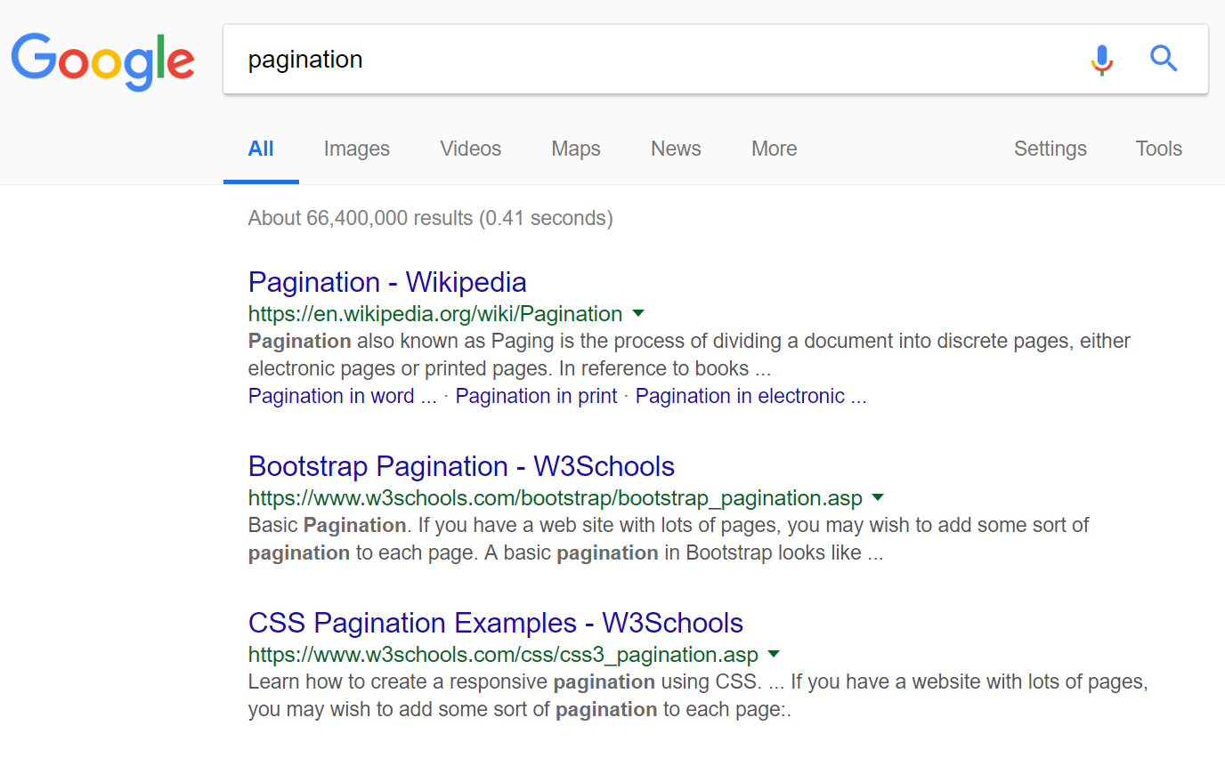

Searches

Slide 16
Page
Instead of billions of elements, just return a single Page
A Page will contain n elements (eg 10 or 20) from the collection
It will have information on the previous and the next page
If you want, can iterate over the whole collection by checking one page at a time, following the next links

Slide 17
Two Types of Pagination
Offset Pagination
likely the most common
can jump directly to a specific page
VERY INEFFICIENT, unless limited to read only a few pages from start
issues when database is manipulated while iterating over it
Keyset Pagination
most efficient
bit more complex to implement
can’t jump directly to a specific page, without reading previous pages
not a problem if we just care of “next” page, or jumps ahead of only few pages (eg 5-10)

Slide 18
Efficiency
Assume for example 100 millions items in database
Pages of small fixed size, eg n=20
Data is sent through 3 steps
Client
(eg, browser)
HTTP
Your Application
(eg, SpringBoot)
TCP
Database Process
(eg Postgress)
OS
Permanent Storage
(eg, hard-drive)

Slide 19
Ordering
To iterate over collection of data in deterministic order, data must be sorted, eg with ORDER BY in SQL
Sorting MUST be done on database, and NOT in the application
otherwise need to send all data to the application
Client
(eg, browser)
HTTP
Your Application
(eg, SpringBoot)
TCP
Database Process
(eg Postgress)
OS
Permanent Storage
(eg, hard-drive)
20
20
100M
SORTING

Slide 20
Offset Pagination

Slide 21
Offset/Limit
When dealing with large collections, need a way to specify the boundaries of a Page
Example: GET /news?offset=40&limit=10
Offset: given the collection sorted like an array, this would be the starting index i
Limit: starting from the offset, how many elements to return

Slide 22
Offset in SQL
SQL has direct support for OFFSET and LIMIT
Eg: select * from News ORDER BY id desc LIMIT 20 OFFSET 0
LIMIT: how many rows to return
OFFSET: how many rows to skip before returning data
Page: defined by OFFSET and LIMIT
1st page: LIMIT 20 OFFSET 0
2nd page: LIMIT 20 OFFSET 20
3rd page: LIMIT 20 OFFSET 40
etc.

Slide 23
Why Inefficient?
Database Process
(eg Postgress)
OS
Permanent Storage
(eg, hard-drive)
100M
To read page N, need to know the previous N-1 pages to skip
To be able to sort, database has to keep a buffer of size OFFSET+LIMIT (which represent all pages till N)
Have to read all data (eg 100M rows), but for sorting no need to keep in RAM all of that, as at most returning LIMIT rows
If sorting on descending ID, only need to keep track of highest K=OFFSET+LIMIT ids
if when reading new row out of 100m, no need to store it in RAM if id smaller than the smallest in current K buffer

Slide 24
Reading Pages
First page is fast: only 20 rows in RAM, which are fast to sort
Nth page requires a buffer of 20*N, which needs to be sorted to determine the first N-1 pages to skip
recall that sorting has complexity O(n log n)
Last page? Database (eg Postgres) has to keep in RAM 100m rows, and sort them, to decide which are the first n-1 pages to skip
if reading first page could take just a few milliseconds, reading last page could take minutes…
The higher the page number, the slower it will be

Slide 25
Ex. Reading Page 3
OFFSET=40, LIMIT=20
Only need a buffer B of size 60, and sort 60 elements
If in current B the lowest id is X, then ignore all elements read from storage with id lower than X, as anyway impossible it will be part of the top 60
Even if returning top 40-59, still need to determine which are the top 0-39 ☹
Database Process
(eg Postgress)
OS
Permanent Storage
(eg, hard-drive)
100M
Top 0-39 elements (ie page 1 and 2)
Top 40-59 elements (ie page 3)
RAM

Slide 26
Problem: Database Modifications
Question: what if, after reading Page 1, someone else does a DELETE of an element in first page?
Answer: an element will skipped when reading Page 2
Eg, assume page size n=3, and someone removes id 8
Page 1
Page 2
Page 3
Reading Page 1: <9,8,7>
9 | 8 | 7 | 6 | 5 | 4 | 3 | 2 | 1 | 0
Deleting value 8
Reading Page 2: <5,4,3>
Value 6 was skipped…
9 | 7 | 6 | 5 | 4 | 3 | 2 | 1 | 0

Slide 27
Links
Client
(eg, browser)
HTTP
Your Application
(eg, SpringBoot)
20
Database data will be converted into JSON, to send over HTTP to the client
To access the next/previous pages, client could compute the needed offsets/limits
Or, we could just provide valid URLs in the JSON responses with “links” to those pages
This is an instance of HATEOAS
Hypermedia as the Engine of Application State
Easier to navigate

Slide 28
dto = { “list”: [ … ], //the actual payload
“rangeMin”: 40,
“rangeMax”: 49, //so, 10 element pages
“totalSize”: 66400000,
“_links”:[
“next”: {“href”: “/news?offset=50&limit=10”},
“self”: {“href”: “/news?offset=40&limit=10”},
“previous” : {“href”: “/news?offset=30&limit=10”},
]
}

Slide 29
Standard
There is no official standard to define pages and links
In the past, there were some attempts like HAL, but they look like abandoned

Slide 30
Keyset Pagination

Slide 31
Goal: Performance
Given a page of size N, cost of reading it should be constant
ie, reading last page should not take much, much more time than first
Deleting items in read pages should not impact the reading of the next pages

Slide 32
SQL WHERE on Last Read Item
Assume sorting by ID in descending order
Page 1: select * from News ORDER BY id desc LIMIT 3
Page 2: select * from News ORDER BY id desc LIMIT 3 WHERE id < 7
7 is the id of lowest item in previous page
Page 3: select * from News ORDER BY id desc LIMIT 3 WHERE id < 4
Page 1
Page 2
Page 3
9 | 8 | 7 | 6 | 5 | 4 | 3 | 2 | 1 | 0

Slide 33
Downside
To read page N, we first must read the previous N-1 pages, to know lowest id of page N-1
can’t jump directly to a specific page, but no problem if we iterate over them in order
Need to keep track of last read item
all of its columns involved in the ORDER BY, more on this later…

Slide 34
Benefit 1: Performance
Example, N=20, reading Page 501
Assume read all previous pages, where X is lowest id in Page 500
Keep buffer B of only size 20
No need to keep track of top 1-1000, as “WHERE id < X” takes care of it
Database Process
(eg Postgress)
OS
Permanent Storage
(eg, hard-drive)
100M
Top 1000-1019 elements (ie page 501)
RAM

Slide 35
Benefit 2: Data Consistency
Question: what if, after reading Page 1, someone else does a DELETE of an element in first page?
Answer: no problem!
Eg, assume page size N=3, and someone removes id 8
Due to “WHERE id < 7”, the value 6 is not skipped when reading Page 2
Page 1
Page 2
Page 3
Reading Page 1: <9,8,7>
9 | 8 | 7 | 6 | 5 | 4 | 3 | 2 | 1 | 0
Deleting value 8
Reading Page 2: <6,5,4>
Value 6 is NOT skipped…
9 | 7 | 6 | 5 | 4 | 3 | 2 | 1 | 0
Page 2
Page 3

Slide 36
Multi-Column Ordering
There might be different ways to order data
eg, posts in a discussion forum sorted in chronological order
Ordering MUST be deterministic and strict
no 2 elements must be equal for the ordering relations
otherwise, multiple SELECTs on different pages could give inconsistent results if the actual returned values are in different order when equivalent
Given some properties (eg Time) which do not guarantee strictness (ie 2 or more elements with same value), can sort by a unique second parameter (eg, the primary key) when ties

Slide 37
Example
Books sorted only by YEAR in the ORDER BY
Asking for first page twice could give 2 totally different sets
reading 2nd page then could lead to re-read some rows while skipping some others
SELECT * from Book order by YEAR desc limit 3
YEAR | ID
2019 | 3
2019 | 5
2019 | 1
2019 | 7
1969 | 9
YEAR | ID
2019 | 1
2019 | 5
2019 | 3
SELECT
YEAR | ID
2019 | 5
2019 | 7
2019 | 1
SELECT

Slide 38
Fixing Ordering
If ordering is strict, then 2 SELECTs will have exactly same result
SELECT * from Book order by YEAR desc, ID desc limit 3
YEAR | ID
2019 | 3
2019 | 5
2019 | 1
2019 | 7
1969 | 9
YEAR | ID
2019 | 7
2019 | 5
2019 | 3
SELECT

Slide 39
What About 2nd Page?
IF WHERE only based on YEAR, we could lose data when iterating
WHERE must be based on all columns in the ORDER BY
SELECT * from Book order by YEAR desc, ID desc limit 3 where YEAR < 2019
The row <2019,1> would be wrongly skipped
YEAR | ID
2019 | 3
2019 | 5
2019 | 1
2019 | 7
1969 | 9
SELECT
YEAR | ID
1969 | 9

Slide 40
Fix: Handle Matches in WHERE
Last element in first page: <2019,3>
Page 2: SELECT * from Book order by YEAR desc, ID desc limit 3 where YEAR < 2019 or (YEAR = 2019 and ID < 3)
YEAR | ID
2019 | 3
2019 | 5
2019 | 1
2019 | 7
1969 | 9
SELECT
YEAR | ID
2019 | 1
1969 | 9

Slide 41
JSON Marshalling
In dto, can simply have a “next” link URL
Need 2 query parameters to keep track of last item in current page
dto = {
“list”: [ … ], //the actual payload
“next”: “/books?keysetId=3&keysetYear=2019”
}

Slide 42
Data Expansion

Slide 43
Expansion
A “news” might have a list of “comments”
A “news” might also have a list of “users” that liked it
When retrieving a single item, might not want to download as well the hundreds/thousands of other items related to it
As returning those lists can be very expensive, can have special query parameters to choose if downloaded or not
Eg.: GET /news?expand=NONE (no lists)
Eg.: GET /news?expand=COMMENTS (include comments)

Slide 44
Tradeoff
Option 1: never return those lists
But, then, need further HTTP calls to retrieve those lists if needed
Option 2: create “expand” query parameters to control what returned
Good: can return everything needed in a single HTTP request
Bad: needs to implement all the needed cases manually
GraphQL: a selling point compared to REST is its ability to exactly specify what to return
we will see GraphQL later in the course

Slide 45
Git Repository Modules
NOTE: most of the explanations will be directly in the code as comments, and not here in the slides
advanced/rest/wrapper
advanced/rest/rest-dto
advanced/rest/exception-handling
advanced/rest/rest-exception
advanced/rest/pagination-offset
advanced/rest/pagination-keyset-gui-v2
Study relevant sections in RESTful Service Best Practices
Study relevant sections in RFC-7230 and RFC-7231

