Slide 1
Enterprise Programming 2 Lesson 05: 3xx Redirection, Conditional Requests and Caching
Bogdan Marculescu

Slide 2
Goals
Understand 3xx HTTP redirections
Understand how to make conditional requests in HTTP to improve performance
Understand how HTTP deals with caches
both public and private caches

Slide 3
3xx Redirection

Slide 4
3xx Status Code
They represent redirection
You ask for a resource at URI X, but then the server tells you should rather go to URI Y
“where” to go will be specified in the Location header
… or operation on X is completed, and result is visible at Y
Example in a browser: how to tell the client to automatically go to homepage after a successful login on the login page?
assuming HTML forms, and no JavaScript

Slide 6
Messy Standard
The HTTP standard is a mess when it comes to 3xx status codes
ie, lot of ambiguities and undefined behavior
eg, see http://insanecoding.blogspot.no/2014/02/http-308-incompetence-expected.html
You should use redirection when needed, but keep it minds that different clients might have different, strange behaviors
The main issue is on how HTTP methods could be changed
eg, in previous example, a POST was redirected into a GET

Slide 7
Permanent Redirection
You ask for X, but server tells you that now it is permanently moved to Y
A client, if it follows redirects automatically, will do a new request to Y
From now on, every time you ask for X, the client would rather call for Y directly, and never use X again
as the redirection is permanent, there is no point in asking for X, you can just go directly for Y

Slide 8
Temporary Redirection
You ask for X, but server tells you that now it is temporarily moved to Y
A client, if it follows redirects automatically, will do a new request to Y
Every time you ask for X, the client will still ask for X, and ignore the previously obtained Ys
as the redirection is temporary, each time you ask for X you could get a different Y’

Slide 9
3xx Codes for RESTful APIs
301: Permanent redirection, but use it only for GET
unless you like random surprises, like clients transforming a PUT into a GET
302: change from POST to GET
important for HTML forms, but arguably no need in a REST API
304: For cache control
eg no need to retrieve resource, as the one in cache is still valid
307: Temporary redirection
308: Permanent redirection, for methods other than GET
note: many client libraries will not follow such redirect automatically, so do not rely too much on it

Slide 10
Conditional Requests

Slide 11
GET The Same Data
It is not uncommon to do GET on the same endpoints, several times
Eg, think of home pages of sites you visit often
google.com, facebook.com, etc.
You still need to make a GET, but then could save on bandwidth if server says previous response is still valid
and so not provide payload in HTTP response body
However, need to save previous response somewhere, eg a cache

Slide 12
Response Validity
2 ways to specify validity, using HTTP Headers
Last-modified: tells when the resource was last modified
the clock is based on the server, NOT the client
ETag: a unique string identifier representing the current status of the resource
if the state of the resource changes, then the ETag should change as well
could be computed as a hash of the response
if based on a JPA entity, could use its @Version (if any)

Slide 13
Last-Modified
Usually easy to compute
But need to be stored somewhere on the server
eg, an extra column in the database tables
Issue: HTTP Date resolution is based on seconds
if several updates in the same second, might lose the most recent ones

Slide 14
ETag
As being a unique identifier, it is more precise than Last-Modified
But not always easy to define what to use as unique identifier for a resource
A hash can be used (eg MD5), but there is always the risk of a potential collision
albeit probability should be very low

Slide 15
Conditional GET Requests
HTTP Headers If-None-Match and If-Modified-Since
If-None-Match: send the previously obtained ETag. Should get new payload only if ETag on server has changed
If-Modified-Since: send the previously obtained Last-Modified timestamp. Should get new payload only if new update on server has happened
If server sends no payload because resource has not changed, then status code is 304

Slide 16
Conditional Changes
You might want to do a POST/PUT/PATCH only if the state on server has not changed
A GET followed by a PUT would be two different requests, NOT done atomically
someone else might have modified the state between the GET and PUT
If the PUT is based on data read by GET, and you want to abort the PUT if someone else changed the state, you can have a conditional request

Slide 17
Cont. Conditional POST/PUT/PATCH
If-Match: do the change operation only if the ETag does match. Will use/send ETag from a previous GET
If-Unmodified-Since: do the change operation only if the timestamp was not changed. Will use/send Last-modified value from a previous GET
If on the server those checks fail, the server will send a 412 Precondition Failed, and the operation is NOT executed

Slide 18
HTTP Caches

Slide 19
Caching
With conditional GET requests, we might avoid re-downloading a resource if not changed on server
Still need to save such resource locally, in a so called cache
Can see a cache like a glorified Map data-structure
eg, key being the ETag, and value being the downloaded resource
But, even if having a cache, still need to pay a round-trip of HTTP request
ie, even if getting a 304 with no body payload, still have to do a GET request

Slide 20
Freshness
What about using cache WITHOUT doing a conditional GET on server?
How can we know that the resource is still fresh and was not changed on server?
Server can explicitly tell us for how long a resource is fresh, using the Cache-Control HTTP header
Max-age: number of seconds that the client is safe to reuse a downloaded resource without a new conditional GET
eg, Cache-Control: max-age=30

Slide 21
How To Set Max-age?
It depends on the context…
Eg. forecast application: maybe computing forecast every hour, so Max-age till the next update
Eg. static files like HTML/JS/CSS/IMG/etc.: if you deploy new version of your app no more than once a day, then can have something like max-age=86400
there are 86400 seconds in 1 day
etc.

Slide 22
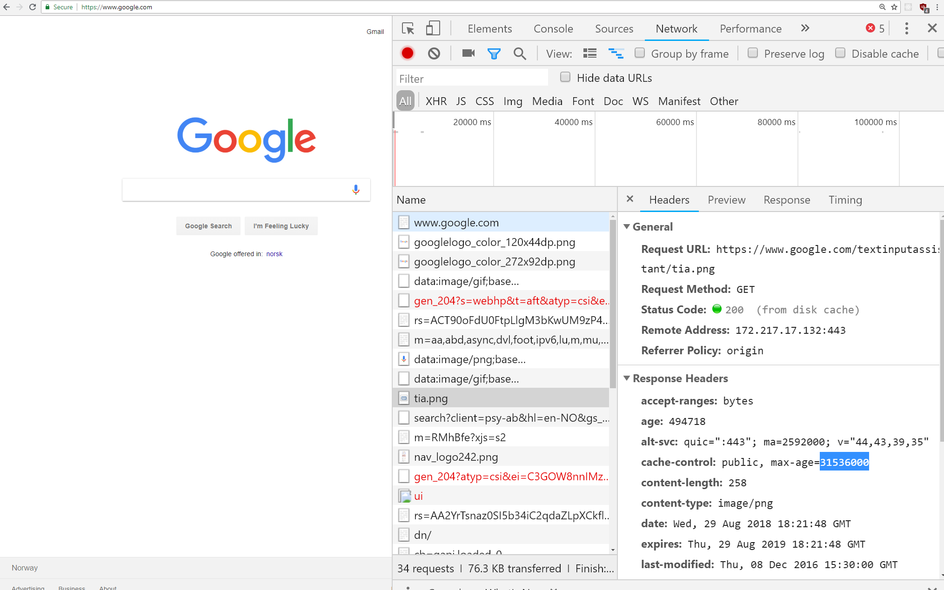
Ex.: tia.png cached for 1 year

Slide 23
Cache Invalidation
Assume you give a Max-age of 1 week
Resources will be cached on each client for 1 week
What if, within that week, you want to make an update?
eg, you find out there was a serious bug which led to create invalid resources
In HTTP, there is no way to tell client to invalidate its cache ☹
If the invalidation for resource X is really critical, only thing you can do is to put X in a different URL, and have all links pointing to the new URL
So, old cached URL would not be used any longer
Note: this might become quite expensive, as need to update all existing links in your whole app. So, not something to do often…

Slide 24
Public HTTP Caches

Slide 25


HTTP Cache
Web Service
Can put a HTTP Proxy Cache in front of your services. Requests go through the actual Web Service only if it was not in the cache

Slide 26
Why?
First client will trigger whole computation, but all followings will access directly from public cache on first request
HTTP Cache
Web Service
GET /foo
GET /foo
Compute
Response
Cache result

Slide 27

Second and Following Requests
No computation on Web Service, as results were cached in the Public Proxy HTTP Cache
HTTP Cache
Web Service
GET /foo
Response

Slide 28
Adding Cache Control Headers
HTTP Cache
Web Service
Even if client does not use any cache control, the Public Cache can still add those when communicating with the web service
GET /foo
GET /foo
If-None-Match: …
If-Modified-Since: …
No payload
With payload
304
200

Slide 29
Controlling Public Caches
s-maxage: for how long a resource stored in public cache can be considered fresh
Example: Cache-Control: max-age=60, s-maxage=300
1 minute for private cache (eg in browser) and 5 minutes for public cache
Why having different values for public and private caches?
depends on the context…

Slide 30
Ex. Cache-Control: max-age=0, s-maxage=600
This means a response will never be considered fresh in the private cache, but will be fresh for 10 minutes on public cache
Each client will always have to do a conditional GET request
max-age=0 does NOT mean that it cannot be cached, just that we need to validate each time with a conditional GET
we do not save the GET request, but could save on no-payload if 304
On public cache, we save for 10 minutes, so we avoid computing response and doing conditional GETs for 10 minutes but for first request

Slide 31
First Request
HTTP Cache
Web Service
GET /foo
GET /foo
With payload
ETag: …
Cache-Control: max-age=0,
s-maxage=600
With payload
ETag: …
Cache-Control: …
200
200

Slide 32
Second Request from Same Client
HTTP Cache
Web Service
GET /foo
If-None-Match: …
No need to connect to Web Service, because cache is valid for 10 minutes
No payload
304

Slide 33
Third Request from Different Client
HTTP Cache
Web Service
GET /foo
No need to connect to Web Service, because cache is valid for 10 minutes
With payload
ETag: …
Cache-Control: …
200

Slide 34
So???
Cache-Control: max-age=0, s-maxage=600
Good: avoid re-computing responses
eg, business logic and access to database done only once for first request
Bad: clients still need to do conditional GET requests, and cannot use directly the local cache without validating with server first
Good: cache invalidation, we can manually reset Public Cache whenever we want, as we have full control on it

Slide 35
Other Cache Control Settings
public: response can be cached
private: can be cached only in a private cache, not public
no-cache: can be cached, but each time ask for validation
e.g., no-cache and max-age=0 would be equivalent
no-store: never ever cache the response
note: some systems wrongly treat no-cache as it was a no-store, and that is the reason why often you see max-age=0 instead of no-cache
must-revalidate: under certain conditions, caches “might” return stale, non-fresh values. Make sure to avoid those special cases
proxy-revalidate: same as above, but for public caches

Slide 36
Git Repository Modules
NOTE: most of the explanations will be directly in the code as comments, and not here in the slides
advanced/rest/redirect
advanced/rest/conditional-get
advanced/rest/conditional-change
advanced/rest/cache
Study relevant sections in RFC-7230, RFC-7231, RFC-7232 and RFC-7234

