Slide 1
Book Library
The Book Library application version 1.0 is designed to allow librarians to manage books and clients.
It allows only the librarians to log in and then select clients, insert new clients and view their current books. The application does not use a database but has the ability to save the content on disk and load content form disk.
It was implemented and tested on Windows Operating System and it requires java JDK 1.5 or higher installed.
Additional features will be added in the next versions.

Slide 2
The Book Library application version 1.0 is designed to allow librarians to manage books and clients.
It allows only the librarians to log in and then select clients, insert new clients and view their current books. The application does not use a database but has the ability to save the content on disk and load content form disk.
It was implemented and tested on Windows Operating System and it requires java JDK 1.5 or higher installed.
Additional features will be added in the next versions.

Slide 3
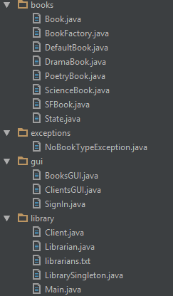
Book Library – packet structure :

Slide 4

Classes

Slide 5
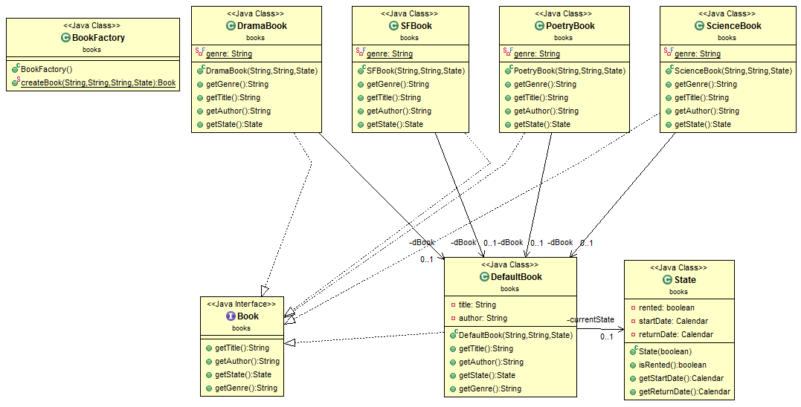

Slide 6
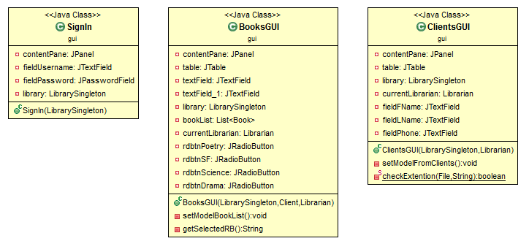

Slide 7
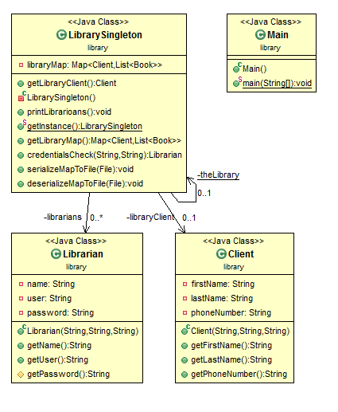

Slide 8
As stated previously, current software version of the Book Library application is version number 1.0.
Future versions target the following features:
Integrating a database.
Performance enhancement
E-mail notifications

