Slide 1

Spark SQL

Slide 2
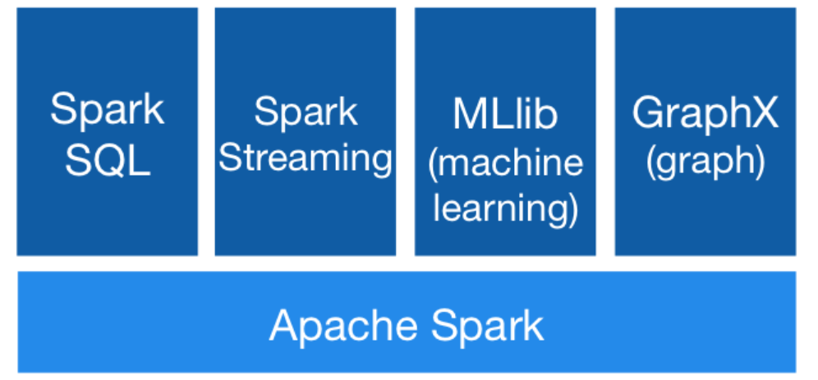
Spark modules

Slide 3
What is Spark SQL?
Module for structured data processing
Provides more information about the structure of both the data and the computation being performed
Uses structure to perform extra optimizations
Works with a variety of datasources: JSON, Hive, Parquet etc.
Can be used as is (SQL code) or with Dataset API

Slide 4
Dataset API
Dataset = distributed collection of data
Has the benefits of RDD (strong typing, lambda functions)
Has the benefits of Spark SQL optimized engine

Slide 5
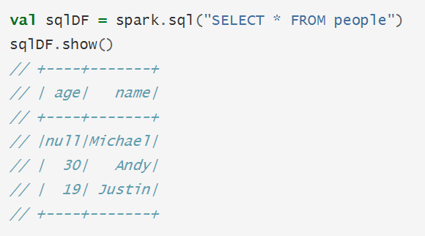
Dataframe
Dataframe = Dataset organized into named columns
Similar to a relational table
Dataframe = Table
Dataset = Row
Dataframe = Dataset[Row] in Scala

Slide 6
Coding exercises
Spark SQL with Dataframes operations
Spark SQL with SQL queries
Structured streaming with Spark SQL

