Slide 1

Create a twitter developer account

Slide 2
Twitter
You need to:
  Create a twitter developer account;
  Create a twitter app;
  Save for later use:
    Consumer API Keys;
    Access token
    Access token secret

Slide 3
Twitter account setup
Q&A
Start from
  https://developer.twitter.com/en/apply-for-access
This follows course: https://www.udemy.com/course/apache-spark-with-scala-hands-on-with-big-data so you can mention that whenever when you’re asked how you’re going to use Twitter data.

Slide 4
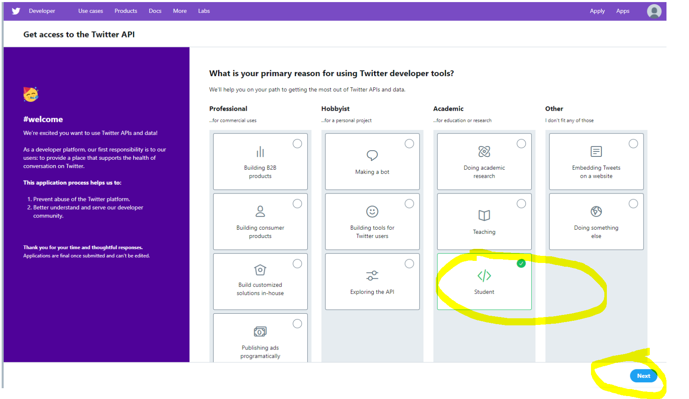
Twitter account setup – step 1
Q&A

Slide 5
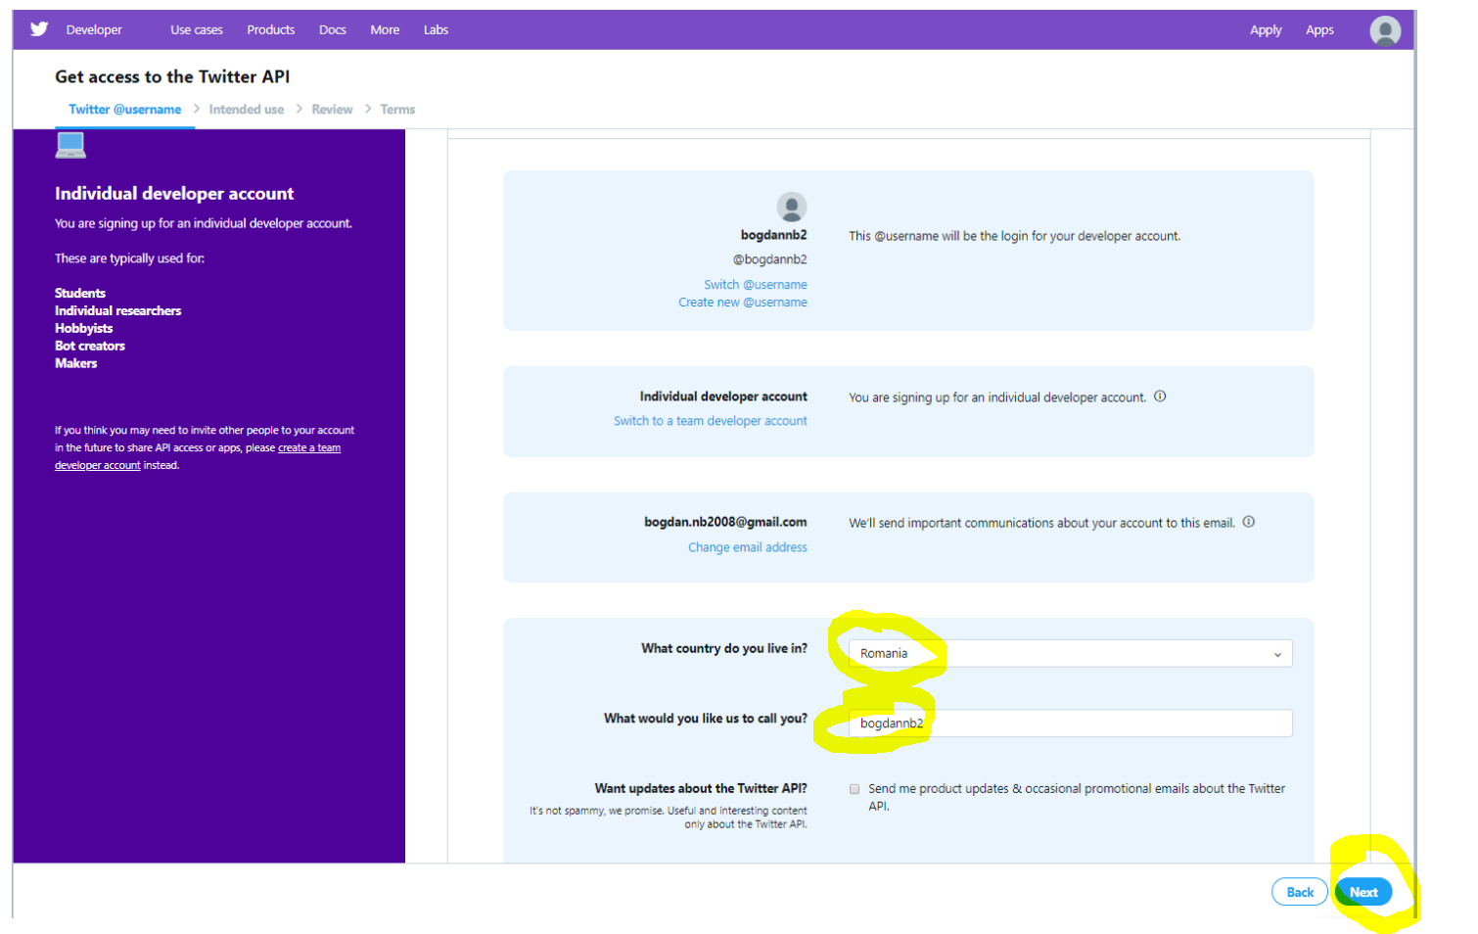
Twitter account setup – step 2
Q&A

Slide 6
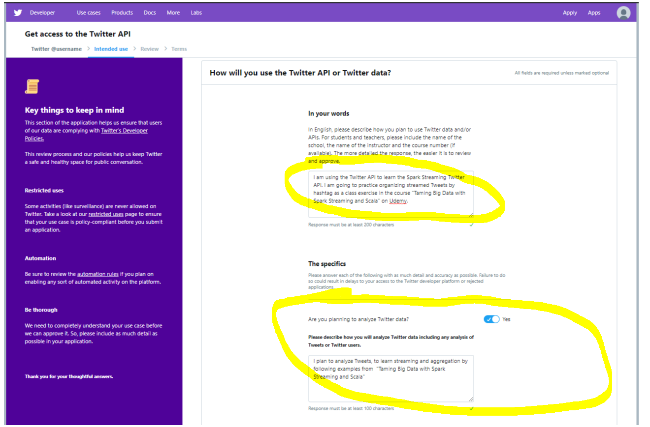
Twitter account setup – step 3
Q&A

Slide 7
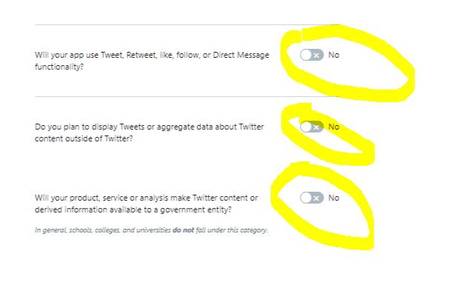
Twitter account setup – step 3.2
Q&A

Slide 8
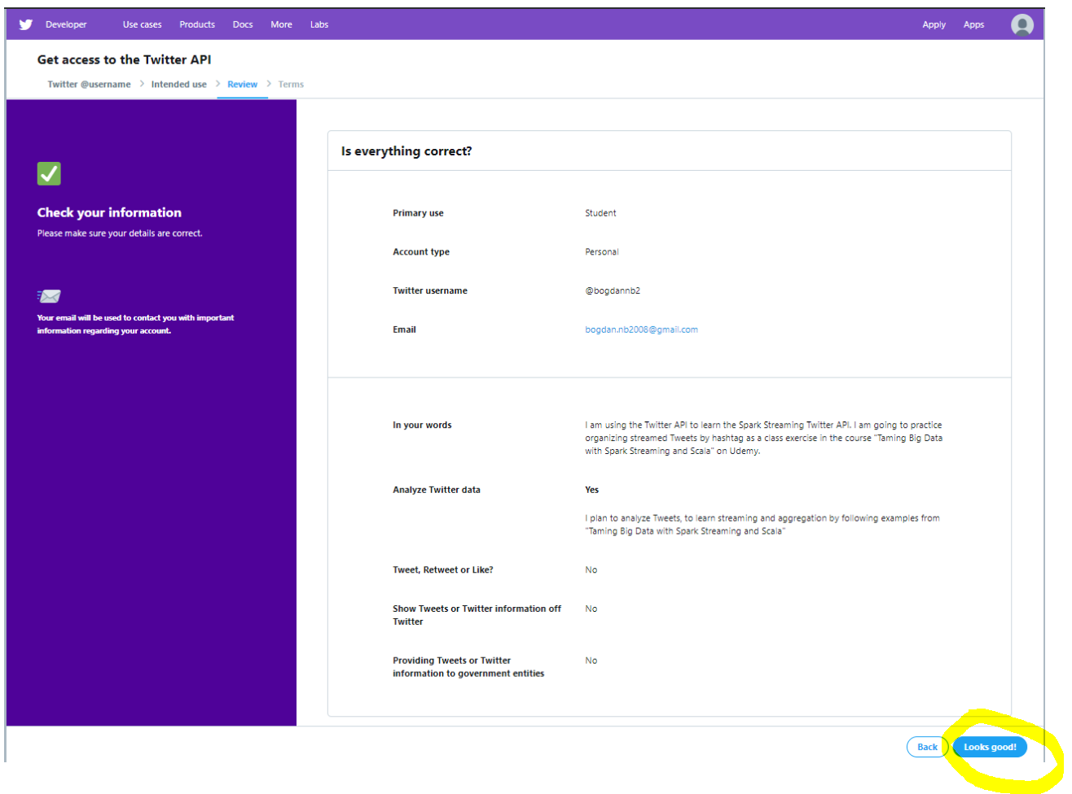
Twitter account setup – step 4
Q&A

Slide 9
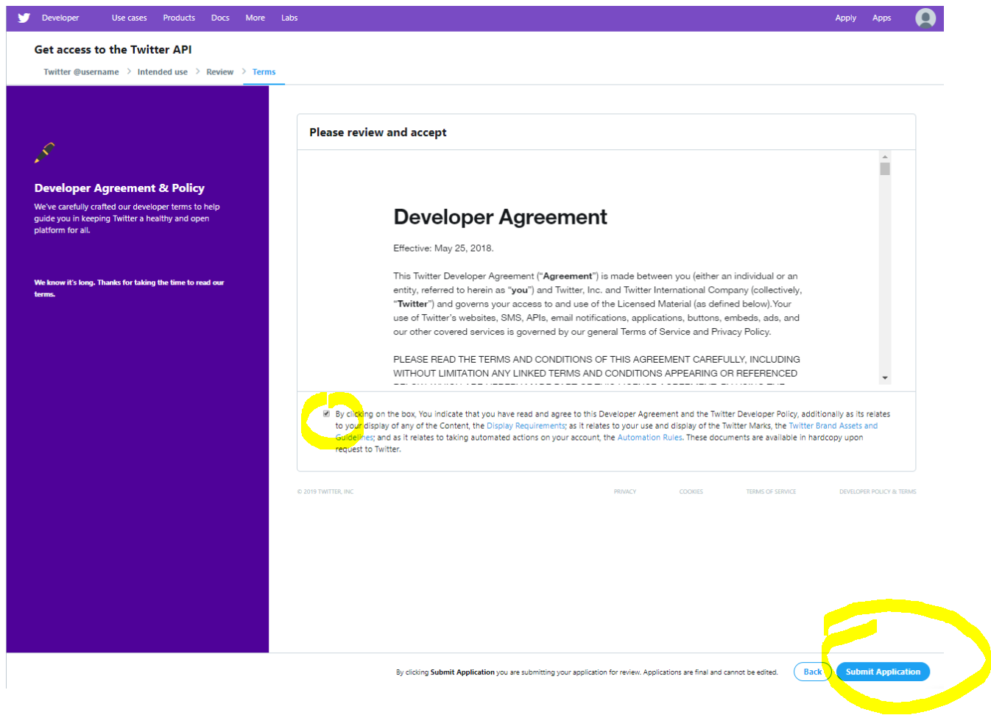
Twitter account setup – step 5
Q&A

Slide 10
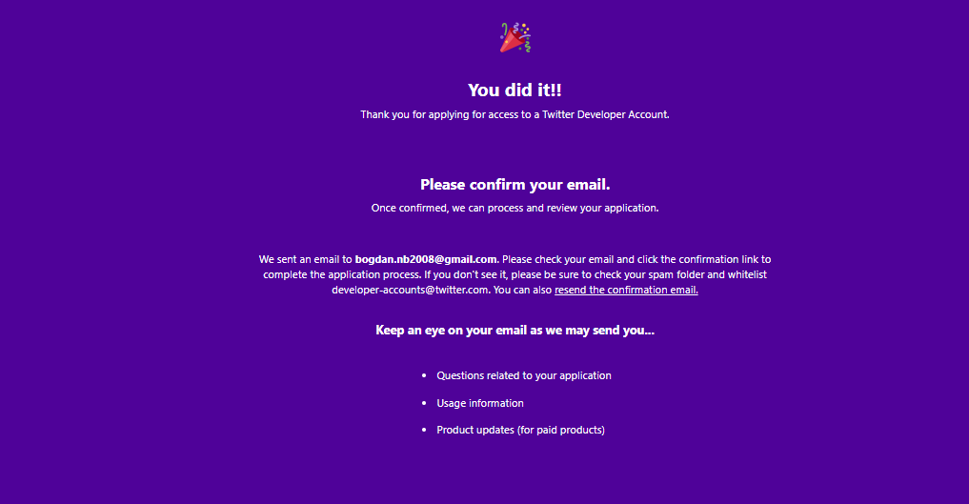
Twitter account setup – step 6
Q&A

Slide 11
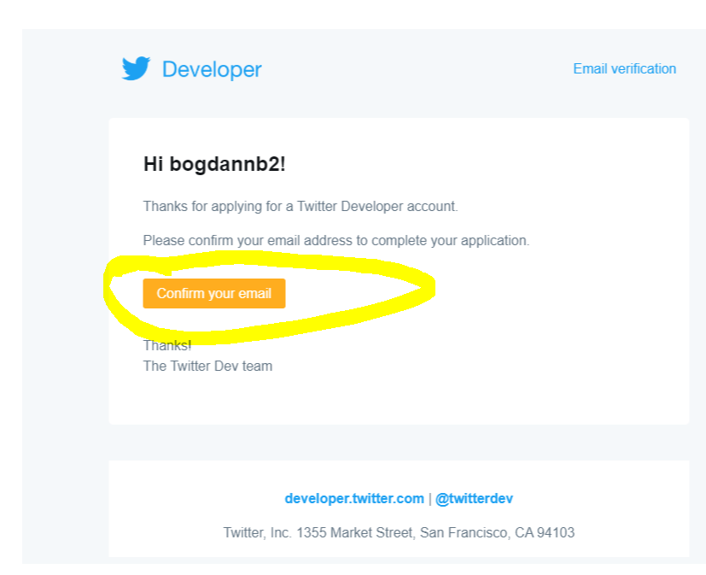
Twitter account setup – step 7
Q&A

Slide 12
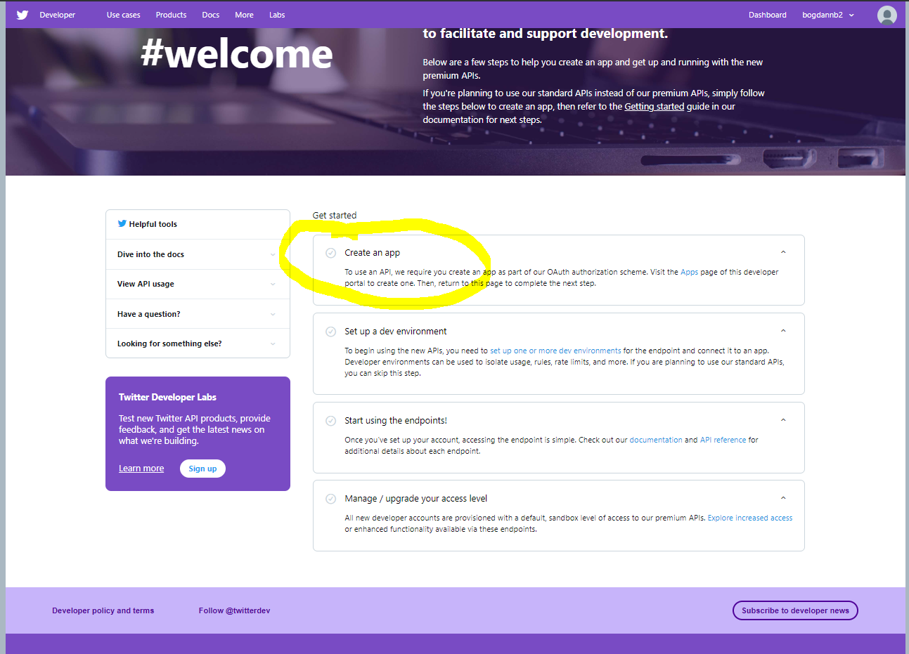
Twitter account setup – step 8
Q&A

Slide 13
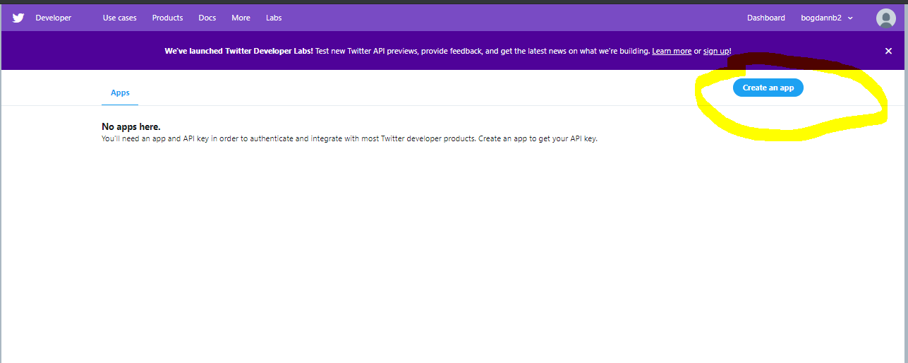
Twitter account setup – step 9
Q&A

Slide 14
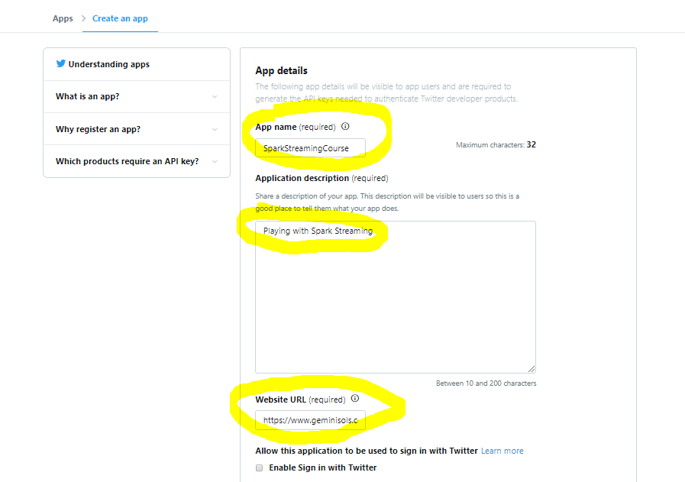
Twitter account setup – step 10
Q&A

Slide 15
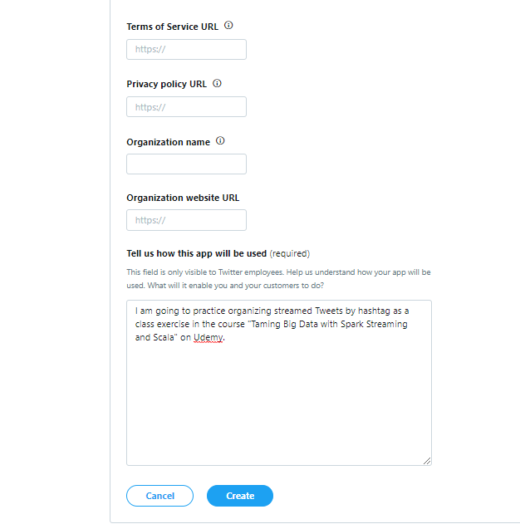
Twitter account setup – step 10.2
Q&A

Slide 16
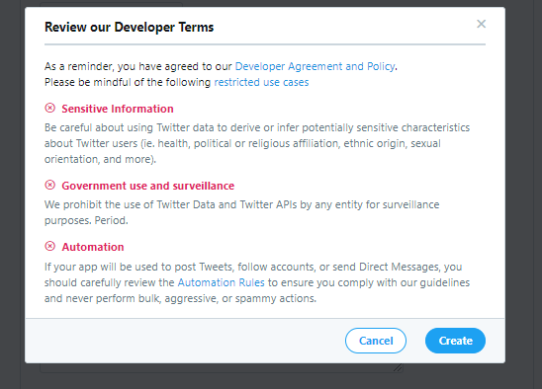
Twitter account setup – step 11
Q&A

Slide 17
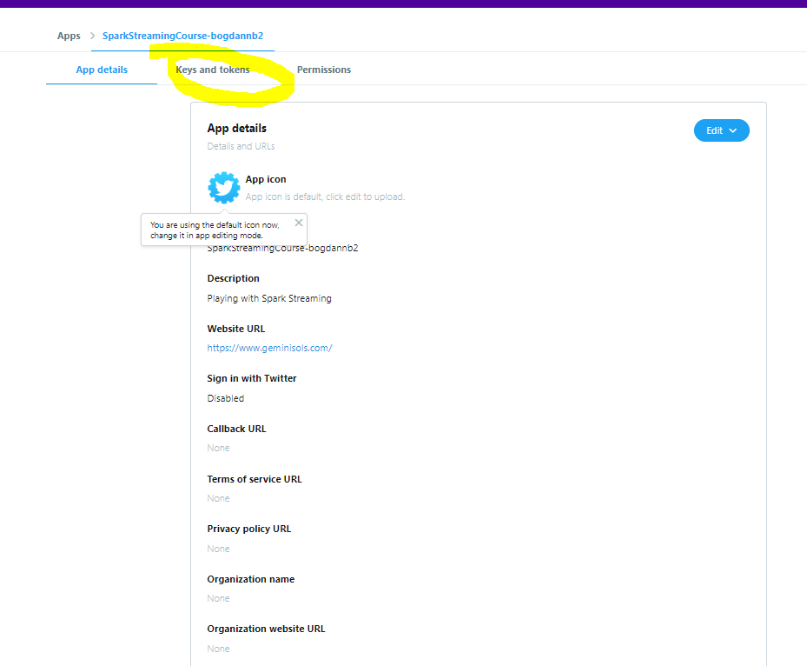
Twitter account setup – step 12
Q&A

Slide 18
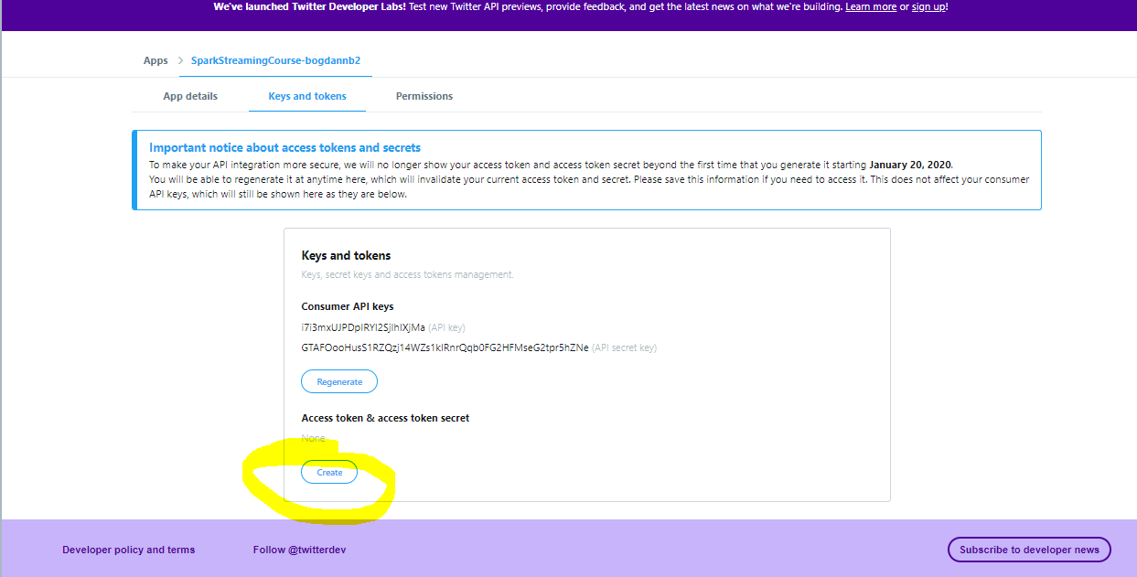
Twitter account setup – step 13
Q&A

Slide 19
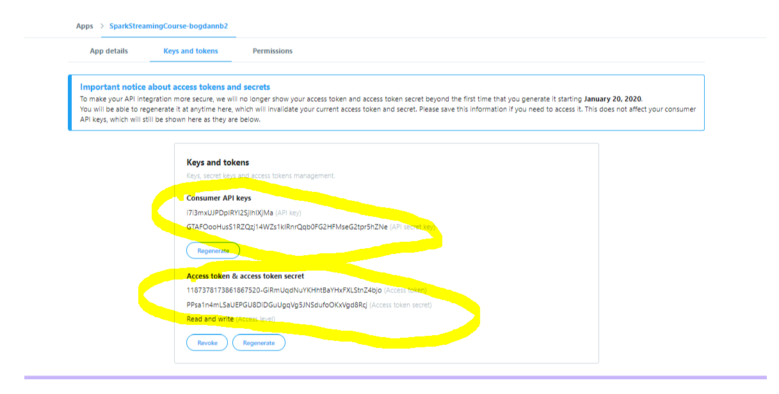
Twitter account setup – step 14
Q&A

Slide 20
Twitter account setup
Q&A
You’re done! Great job!
Thanks for your patience!
  Save for later use (from latest screen):
    Consumer API Keys;
    Access token
    Access token secret

