Slide 1

Running Spark in production

Slide 2
Spark Submit
spark-submit from Spark’s bin directory
spark-submit is a unified interface for all supported cluster managers:
Spark standalone
Apache Mesos
Yarn
Kubernetes
See more under https://spark.apache.org/docs/latest/cluster-overview.htm

Slide 3
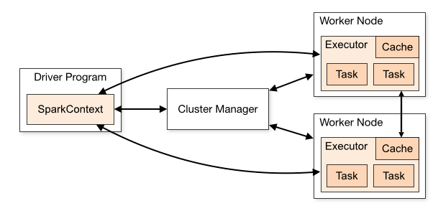
Architecture

Slide 4
Packaging
Before running you need to package your application
Create an uber jar (fat jar)
Spark and Hadoop should be provided as dependencies
We will use the spark examples for running on Gemini cluster

Slide 5
Using spark examples
Best way to start is using official examples
git clone https://github.com/apache/spark.git
git checkout branch-2.4 => for Spark 2.4 with Scala 2.11
export MAVEN_OPTS="-Xmx3000m" && mvn -DskipTests clean package
OR
Package using your IDE which should haven Maven embedded
Link: https://github.com/apache/spark/tree/branch-2.4 -> let’s review as well the pom.xml

Slide 6
Launching apps
./bin/spark-submit \
--class <main-class> \
--master <master-url> \
--deploy-mode <deploy-mode> \
--conf <key>=<value> \
... # other options
<application-jar> \
[application-arguments]

Slide 7
Local example
C:\spark\bin\spark-submit.cmd \
--class org.apache.spark.examples.SparkPi \
--master local[8] \
<path_to_project>/scala_spark_course/4_Spark_Production/original-spark-examples_2.11-2.4.5-SNAPSHOT.jar
1000
https://blog.codecentric.de/en/2016/04/calculating-pi-apache-spark/

Slide 8
Gemini cluster
All documentation is under https://gitlab.com/bigdata-practice-gemini-solutions/gemini-hadoop-cluster
Raise your hand if you want access to the documentation
Spark Standalone cluster: http://192.168.7.50:8080/
Yarn web ui: http://192.168.7.50:8088/cluster

Slide 9
Gemini cluster
Connect to cluster:
ssh user@192.168.7.50
Run using Yarn cluster manager:
spark-submit --class org.apache.spark.examples.SparkPi --master yarn spark/examples/jars/spark-examples_2.11-2.4.3.jar 100
Run using Spark Standalone cluster manager:
spark-submit --class org.apache.spark.examples.SparkPi --master spark://nodemaster:7077 spark/examples/jars/spark-examples_2.11-2.4.3.jar 100

Slide 10
Deploy mode & supervise
Default deploy mode is client
Cluster: --deploy-mode cluster
https://jaceklaskowski.gitbooks.io/mastering-apache-spark/yarn/#:~:targetText=Deploy%20modes%20are%20all%20about,the%20Spark%20application%20in%20YARN).
-- supervise -> driver is automatically restarted if it fails.
Other options, see also https://spark.apache.org/docs/latest/submitting-applications.html
--executor-memory 20G
--total-executor-cores 100

Slide 11
Running locally vs Gemini cluster
C:\spark\bin\spark-submit.cmd \
--class org.apache.spark.examples.SparkPi \
--master spark://192.168.7.50:7077 \
<path_to_project>/scala_spark_course/4_Spark_Production/original-spark-examples_2.11-2.4.5-SNAPSHOT.jar
100
Your machine needs to be discoverable from network

Slide 12
Where to go from here?
List of courses
https://digitaldefynd.com/best-apache-spark-courses
Spark Streaming
https://geminisols.udemy.com/course/taming-big-data-with-spark-streaming-hands-on
Functional Programming in Scala Specialization:
https://www.coursera.org/specializations/scala
Set of 5 courses including a Capstone project
Big Data Analytics using Spark:
https://www.edx.org/course/big-data-analytics-using-spark

Slide 13
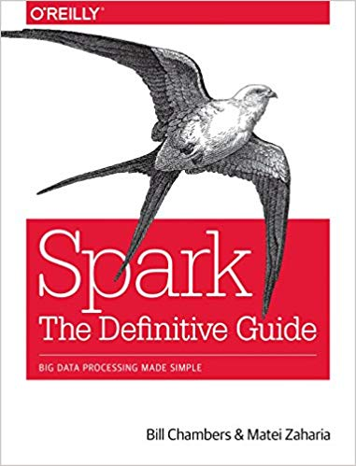
Where to go from here?
https://www.amazon.com/Spark-Definitive-Guide-Processing-Simple-ebook/dp/B079P71JHY
The internals of Apache Spark book available online:
https://jaceklaskowski.gitbooks.io/mastering-apache-spark/spark-architecture.html

