Slide 1

Spark Streaming with Clickstream

Slide 2
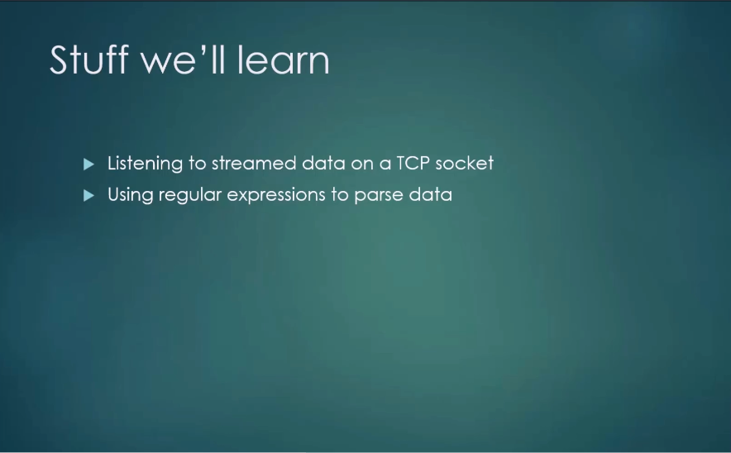
Spark Streaming

Slide 3
Spark Streaming
Install nmap utilities for Windows from utils folder
Nmap was downloaded from https://nmap.org/download.html

Slide 4
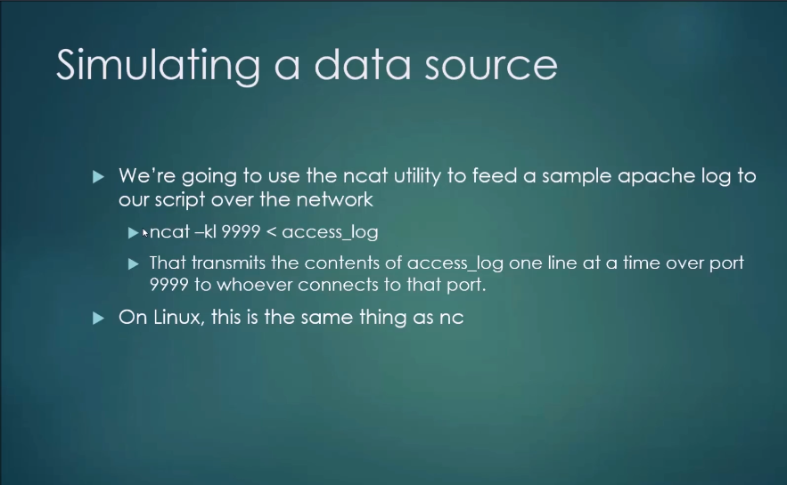
Spark Streaming

Slide 5
Exercise
Read data from network (from a port)
LogParser.scala

Slide 6
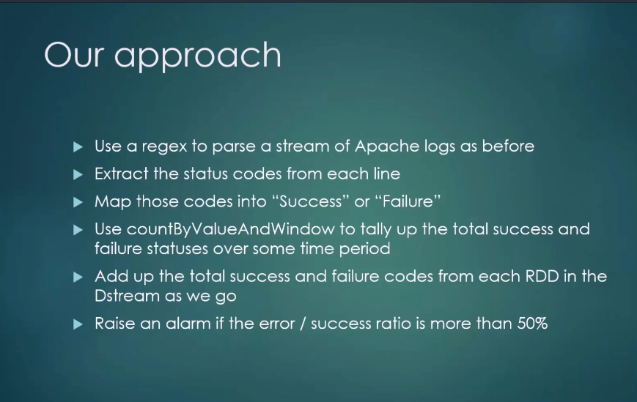
Exercise
LogAlarmer.scala

Slide 7
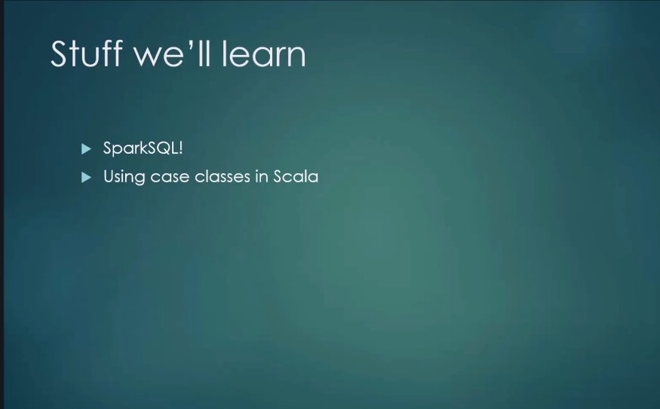
Spark SQL

Slide 8
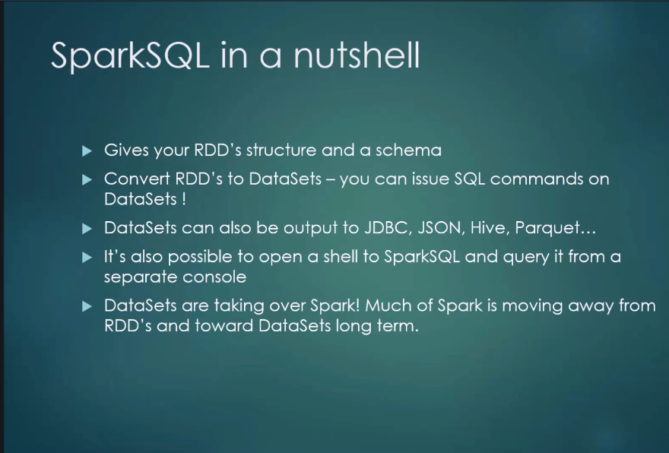
Spark SQL

Slide 9
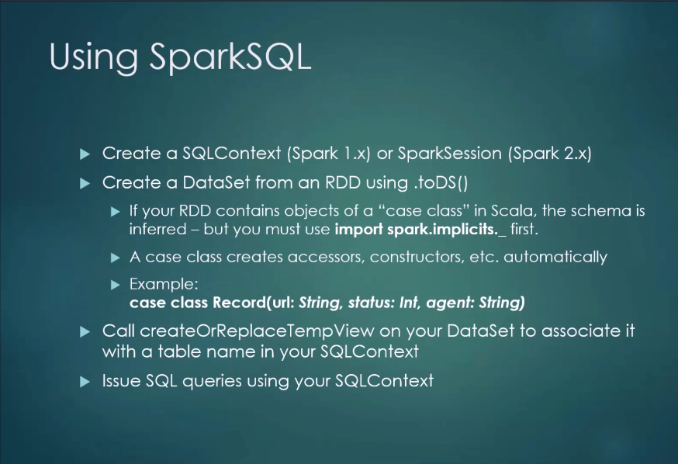
Spark SQL

Slide 10

Spark SQL

Slide 11
Exercise
Spark Streaming with Spark SQL
Exercise

Slide 12
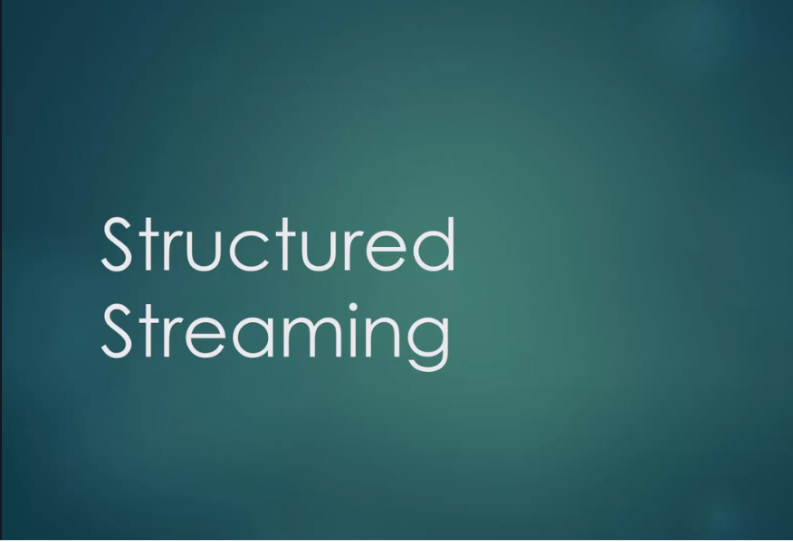
Structured Streaming

Slide 13
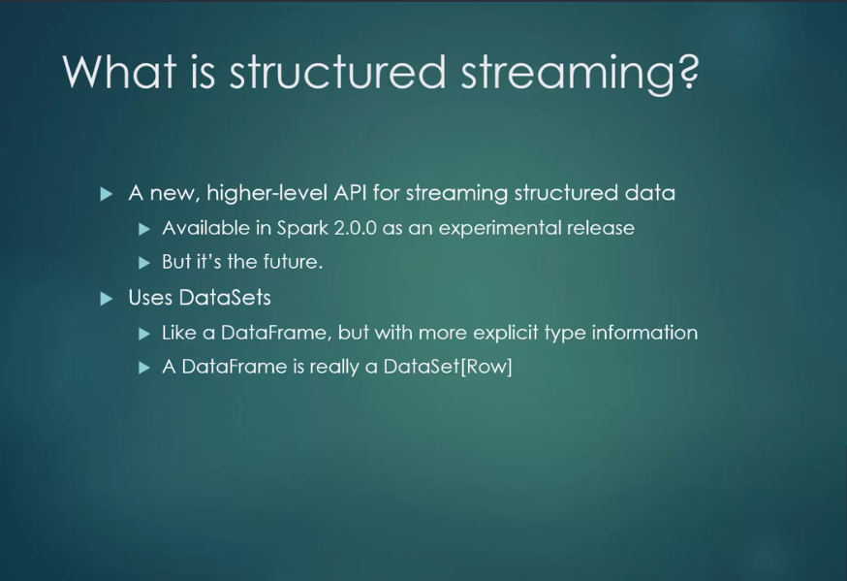
Structured Streaming

Slide 14
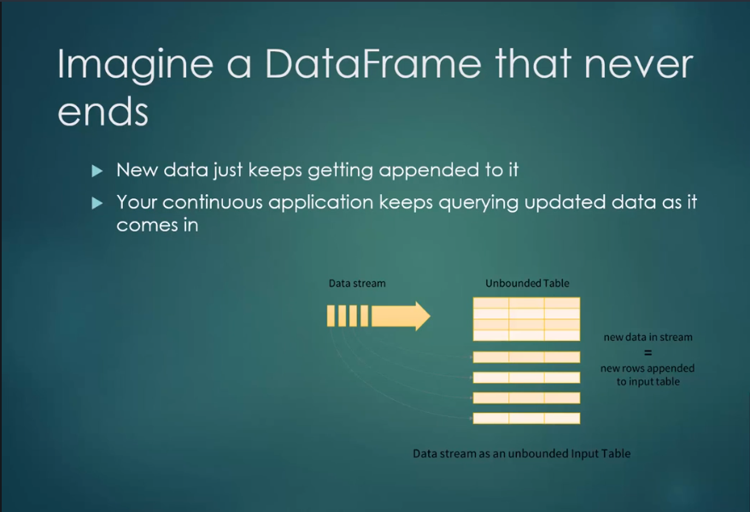
Structured Streaming

Slide 15
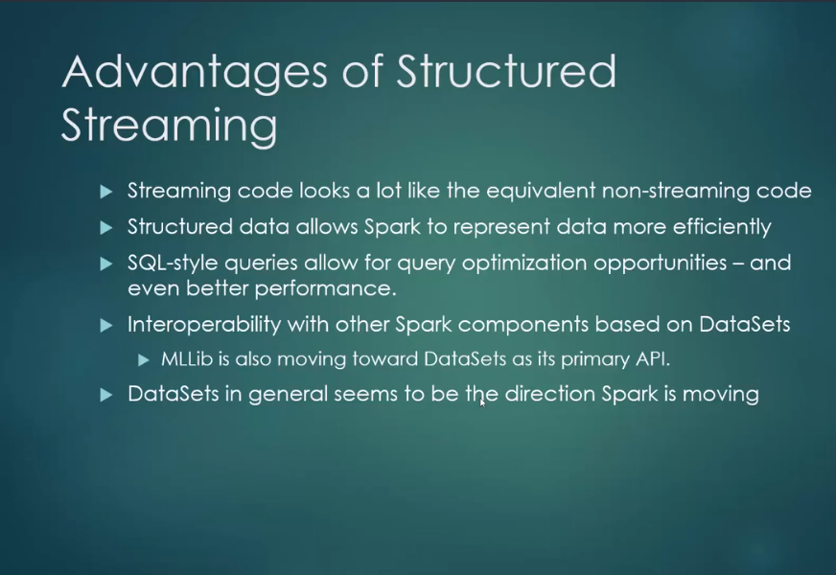
Structured Streaming

Slide 16
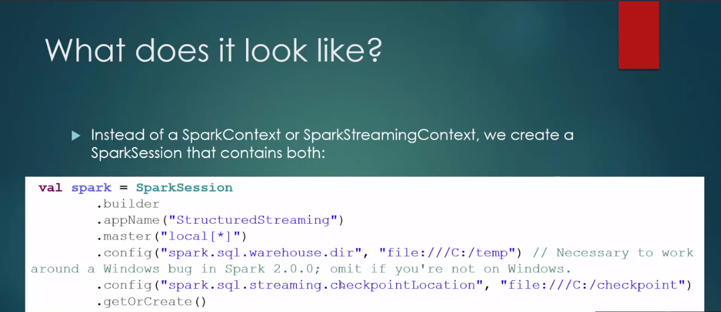
Structured Streaming

Slide 17
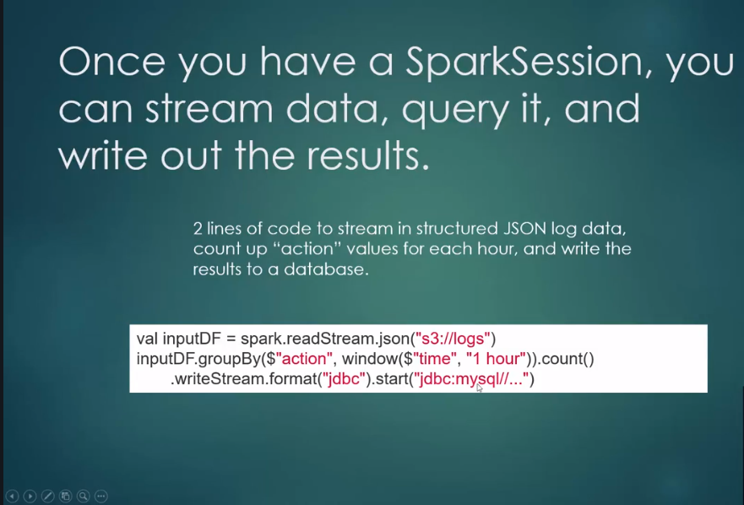
Structured Streaming

Slide 18
Structured Streams
Exercise
StructuredStreaming

