Slide 1

Spark integration with other systems

Slide 2
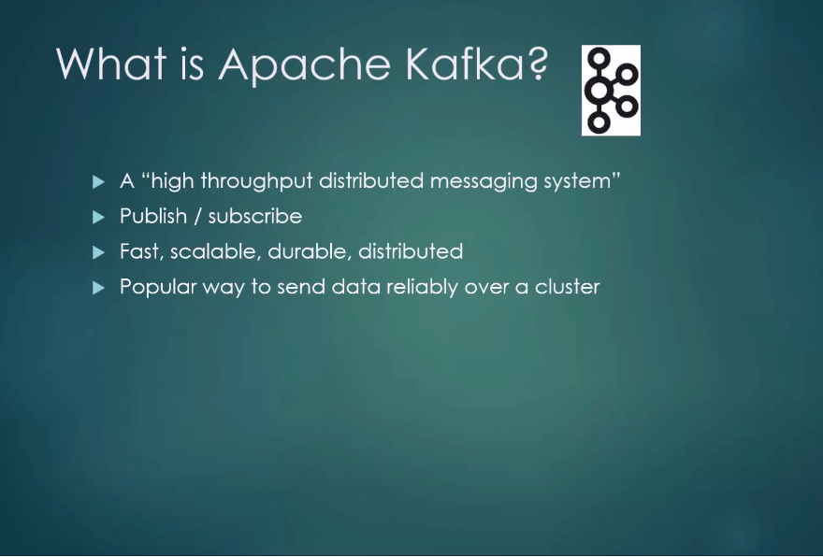
Apache Kafka

Slide 3
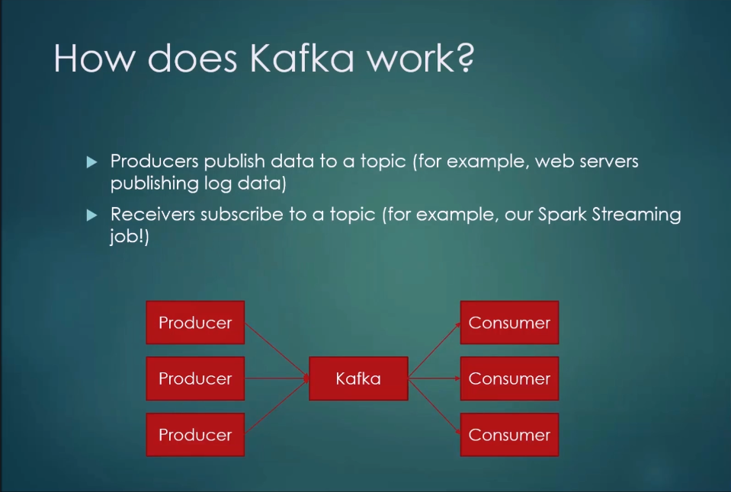
Apache Kafka

Slide 4
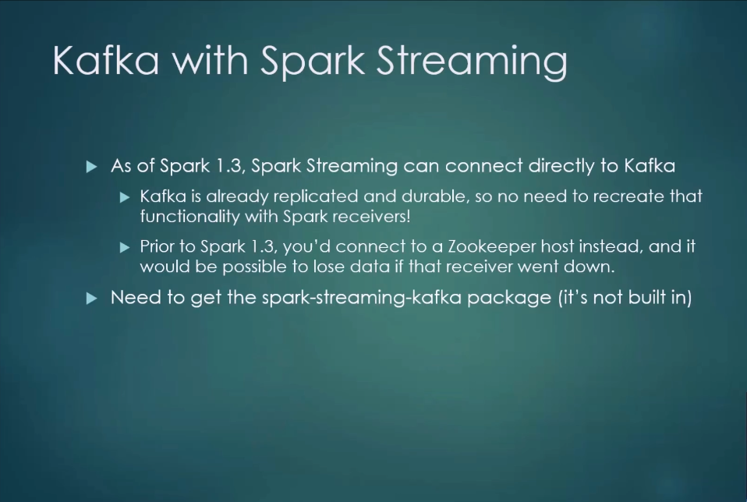
Apache Kafka

Slide 5
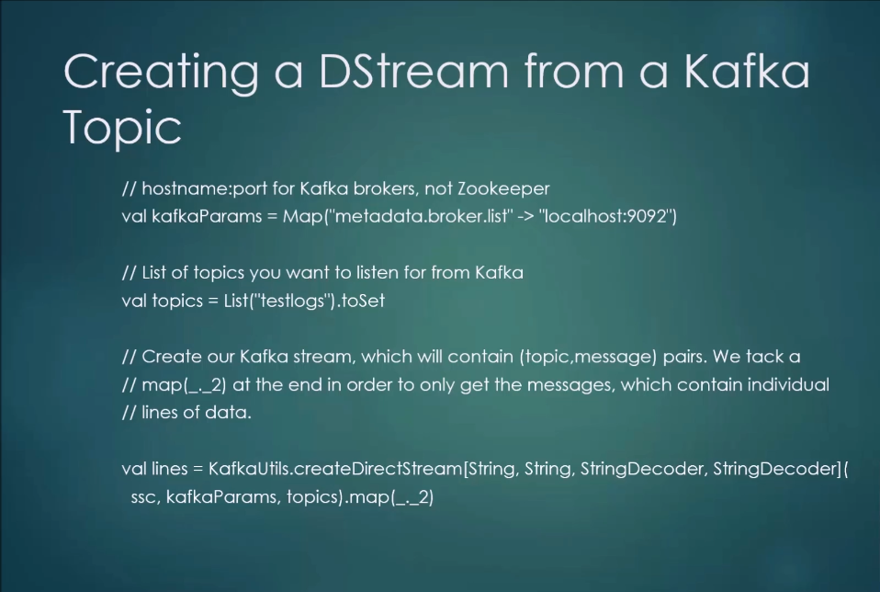

Slide 6
Hands on coding
Let’s look at the code KafkaExample.scala

