Slide 1
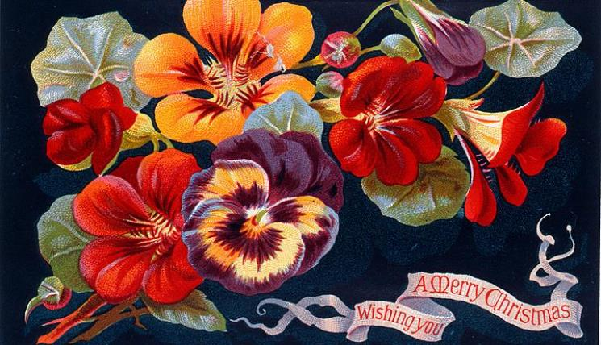
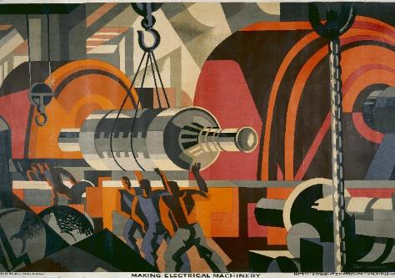

Collaborative Experimentation
Research Software Prototyping for Co-Learning and Exploration in Cultural Heritage
Notes:
Thank you for coming and giving up some time to hear about my project
Today I just want to introduce myself and the project, and ask you all to think a bit about
where its value might be for you
how text analysis could enhance search for purposes that you care about
Very much hoping that this project can be useful for you, the intention is that everyone should be getting something of value out of it
So for today I’ll do a general project introduction
And spend some time demonstrating some text analysis techniques
And leave some time to discuss potential themes or questions to explore with these techniques
Do feel free to ask questions as I go, I think its better to have a conversation than to just talk at you

Slide 2
What is an RLUK/TNA Professional Fellowship?
Per https://www.rluk.ac.uk/professional-fellowships/:
“Focus on a professional-practice question”
“Contribute to a wider piece of work”
“Facilitate shared learning between RLUK & TNA members”
Two weeks of residency with partner institution
Total of 10% of time for one year, including 2 weeks of residency
Notes:
To begin at the beginning, this project is an RLUK/TNA Professional Fellowship
These fellowships advertise themselves as being:
To explore a professional practice question
To contribute to a wider piece of work
To facilitate shared learning between RLUK and TNA.
In this case, the project is to experiment with engaging a multidisciplinary group to explore digital possibilities in cultural heritage, through the medium of digital techniques to explore Wellcome’s collection of digitised texts. But I’ll come back to that.
A project with a short-term residency with a partner institution
So a staff member at an RLUK library will do a residency at The National Archives and vice versa
The residency can be split into multiple visits, as we are doing here
It’s quite a small project -- 10% of time for a year, so works out at a couple of days a month.

Slide 3
Who am I?
Research Software Engineer in the Digital Research Team at The National Archives (4 years)
Historical Research MA (1 year)
Software Engineer at a microchip designer (16 years)
Unfinished “social robotics” PhD (3 years)
Robots as therapeutic tools for autistic children
Computing with Psychology BSc (3 years)
Notes:
Latterly I’m a Research Software Engineer at TNA. I’m relatively new to digital humanties or cultural heritage types of projects. I’m kind of a generalist, even within software
Contributions I’ve made at TNA have included:
User interface for a visual search project
Designing and running a crowdsourcing project
Data wrangling with the outputs of a couple of crowdsourcing projects
So taking collections of transcriptions or annotations of records, cleaning them up and converting them into a form that’s suitable for analysis.
Currently I’m doing:
Supervising some work around digital training for humanists
More data wrangling and other contributions for a digital workshop around the 1980s HIV awareness campaign
So there’s a bit of a theme around digital collaboration, outreach and training this year
These projects are all very digital, but tend to involve working with people from a range of disciplines, within TNA and with cultural heritage & academic partners
So that’s where I am now, but I’ve done some other things.
A few years ago the stars aligned in such a way that I was able to spend a year on a Historical Research MA
History was kind of my first love, and I’m generally curious about theory and practice of history
A year almost entirely away from digital!
I knew I wanted to investigate 18th-century-ish charlatans as part of a broader interest in truth, belief and performance
But a surprise along the way was that I became interested in medical history more generally
Which is part of the reason I was keen to do a collaboration with Wellcome
So I have more of a history background than most software engineers
But it’s just a year of postgrad study and whatever background reading I can fit in
But most of my career was at a particular tech company, doing a range of software things
So although I am very fond of history and the humanities, I feel kind of like a tourist in that world
Software, and software engineer ways of thinking are quite deeply embedded in my mind
One consequence of this is that I sometimes don’t realise I’m using technical language or making sciency assumptions
So please do stop me and ask for an explanation if something that I say seems unclear or wrong
Could be down to STEM-ish assumptions, could just be a technical term getting lost in translation
Either way, helpful to flag these things up
Especially please do that if anything I’m saying today is hard to follow, it’ll help us to establish common ground
And I also very much don’t want to lose you along the way
Then going further back, I did most of a PhD on a project investigating the use of robots as therapeutic tools for autistic children, which wound up being partly about simple machine vision and partly about nonverbal interaction and social use of space, and my undergraduate degree was in Computing with Psychology.
So technology is a thread throughout, but there are pieces of other disciplines – so I’m a generalist.
Which perhaps explains why I’m here with a project about interdisciplinary collaboration, and hopefully means I’m well placed to communicate across disciplinary boundaries.
It does also mean I’m likely to get things wrong, or at least not sufficiently nuanced – for the most part, my knowledge is more broad than deep.
Worth bearing in mind when I tell you something outside of your own area of expertise. I’m likely to be right to a point, but probably do not know the whole story.

Slide 4
What is the project? (1) Interdisciplinary collaboration
Exploring and learning together
Led by digital exploration, but guided by input from as wide a range of specialisms as we can assemble
In the form of workshops organised around discussion of digital artefacts
Notes:
So that’s all well and good, but what is the actual project?
It has two parts
The main goal of the project is to explore interdisciplinary working
There are questions being asked in cultural heritage, and in the humanities more broadly, about the role of software engineers
Where do we fit, how can we collaborate with GLAM and humanities practioners for research and other projects
How do we work together to discover where digital methods can be valuable, how do we investigate that value
How do we develop digital skills in a new area
This includes me -- I will be learning about text mining techniques as I work on the project
I have some general understanding of the techniques and how they work, but not yet practical experience of using them
The whole thing should be very hands-on, practical, concrete – learning by doing
Taking inspiration from the “agile” movement in software engineering, I’ll come back each month with a digital thing that I’ve made
Assuming that you come back -- I’ll show you the thing, we’ll explore it a bit together, discuss what does and doesn’t work and what would be good to do next
It’ll likely be much less slides and much more demonstration after today
Repeat that in cycles for a while, then I’ll spend a week on-site to develop a prototype in a more directly collaborative fashion

Slide 5
What is the project? (2) Text mining to discover sources
The interdisciplinary collaboration needs something to explore
Wellcome Library has a large amount of OCR’d material
Offers traditional catalogue search based on metadata
And an API, including some example notebooks
So: use these tools, and “text mining” techniques, to build a corpus of primary sources relevant to a specific theme
Notes:
So to collaborate in an interdisciplinary way, we need something to collaborate on and learn about
As I’m sure you know, Wellcome has digitised the text of a large amount of its library
There are all kinds of technologies for “mining” and otherwise analyzing text
Sometimes these are used to directly analyse the past e.g. how did the use of term x evolve over time
I’m a little wary of that approach, though I’m sure it has its place
What I’m more interested in, and what is perhaps more relevant for a library, is using that technology for search
In part because that means that you don’t have to trust the results
The technology is suggesting to you that these sources may be relevant
But it is up to you to make that determination by actually looking at them
So, using computational techniques to make a guess that this book, or this part of this book, is relevant to some particular theme
Based on the text of the book itself, rather than its classification in the catalogue
It’s somewhat based on the concept of Critical Search, developed by the self-identifying “cyborg historian” Jo Guldi
The intent is to present a list of books, or parts of books, that may be relevant to a particular theme
And just a note on the word “theme”, which I’m using for convenience
The project will need some specific “thing” to look for
My original intent was a specific research question – that would be nice and focused, but there is a bit of a risk that it will be too narrow to be of interest for everyone. We can certainly think a bit broader, if that is helpful.
We don’t have to identify the “thing” yet, but it is something to begin thinking about
So we should all come away with a better understanding of some text mining techniques and if/how they can be profitably used for search of your collection of text.

Slide 6
What is the project not?
I don’t intend to:
Produce any kind of finished product
Develop large amounts of new code
Develop new techniques
Chase the leading edge of technical developments
Though Retrieval Augmented Generation is tempting...
Notes:
10% of time for a year is really not much time
Especially if it involves writing new code from scratch
And especially the kind of polished code that can make a releasable user interface
So the intent is to use well-established tools and techniques
Easier to apply, easier to understand, better supported by tools and software libraries
Recently heard someone say that they’d like Digital Humanities to slow down, better understand applications for the techniques that exist rather than always chase the promise of the new shiny thing.
It sounded like a good idea to me
That said, there is obviously a lot of excitement (and concern) around large language models, e.g. ChatGPT
Particularly relevant here is Retrieval Augmented Generation, which involves training an LLM on a particular corpus, then asking it questions about that corpus
I currently don’t plan to use it, but I guess we’ll see
So the research interest here (apart from the larger experiment in collaborative exploration) comes in the application of established text mining methods to searching this library for texts about a particular theme
Also intend to go reasonably slowly, in small steps – I think that’s more realistic, better for learning
I’ll probably get the step size wrong at times, do tell me if I’m going too slow or too fast

Slide 7
Guiding Principles
Prototyping (Agile-ish, sprints)
Hacking (the good kind) & Re-use
KISS
Collaboration
Notes:
This slide might be a case of going too slowly, but just to emphasise these points
The idea is to focus on building prototypes and use those to give us a concrete focus for discussion
This is partly about the kind of “how to” learning that can only be gained through doing, trying things out, experimenting
But mostly that I think it is useful to have a concrete “thing” to centre discussion around
I think perhaps especially with interdisciplinary groups, it can be helpful to have a thing that we can all point at and poke to make clear what we are talking about
This has some roots in software development practice
In the early part of my career, we developed software according to a cycle of requirements gathering, design, implementation, testing, delivery
Customers or users were involved at the beginning, to define requirements, and at the end, when something was delivered
Users can sometimes be disappointed with what they get
Agile software methodologies brought in the idea of the sprint, which works in much shorter cycles
Often 2 – 4 weeks
Implement something, starting from requirements
Demonstrate it to customers at the end of the sprint
Iterate
I’m sure there must still be people developing according to the old model, but agile seems to have taken over a great deal of software development, so it must be doing something right.
So that’s prototyping. Hacking is a term with very many senses.
Outside of software-land it is often used in its sense of illegally breaking into a computer
Although “life hacks” picked up some currency for a while
But within software-land it has a range of meanings that revolve around exploring a problem by sitting down and kind of banging out code to solve it
It’s a good way to investigate a problem and play around with solutions, but also tends to result in a messy sort of program.
Which is what I intend to do here – quick code solutions to explore an idea, not well-written code that can be the basis of a tool... that’s a different kind of project.
Related to this is the idea of getting as far as possible with the text “as it is” – I might do one or two things to try to clean it up (e.g. looking for mistranscriptions), but part of the interest of this thing is seeing what we can do with even so-called “dirty” OCR. Ultimately it is just suggesting sources that may be of interest, so it does not have to be perfect.
I also intend to re-use as much as possible – re-use is considered a great virtue in software and the intent of the project is to pick up existing software and tools and apply that much more than to try to create new software
KISS is an old STEM acronym – “Keep It Simple, Stupid”. It’ll be important to avoid complications and keep things as simple as possible in order to make progress. For example, I can imagine experiments with dealing with text in different languages, but that’s likely to be an unprofitable diversion, so we’ll stick to English texts.
And finally collaboration – while I’m doing the experimentation and development, I don’t want to be doing it on my own, I want to be bringing in ideas from everyone who chooses to be involved.
It is essential that the project involve you and be useful for you
(While not making large demands on your time)
The project needs your input to get anywhere
And it makes no sense to ask for your input if you aren’t getting anything out of it

Slide 8
Timetable
1st May: Introduction
5th June: Possibilities
Early July: Classifications
September: ... (finer grains? visualisation? interfaces?)
October: One week of collaborative development
March: Wrap up
Notes:
Nothing is set in stone – this whole project is exploratory and I’m expecting it to evolve along the way
This slide shows the points of contact between us
And also some suggestions for a topic for each occasion
My intent is that these will be participatory: I’ll present some stuff, but there’ll also be some group activity, a topic for discussion or a tool to try out
May first is today, of course
During May I will do some initial work, ideally informed by today
Will bring the results of that back to you in early June to discuss and set some direction
Should be able to give some sense of the possibilities of these kinds of techniques
Should help a bit with narrowing down a theme and a technical direction
Based on that direction, will do some more focused work for July
I think this is likely to be about classifying texts according to the theme
And I think a good focus for that session could be to look at different kinds of human and machine ways of classifying text
Should also make a final decision about theme here
Then a break for summer, as that’s usually a difficult time to bring people together
September is a bit up in the air: I expect to focus on something of interest from the July session
Can make a guess that this will be about one of the things in brackets there:
Finer grains, in the sense of classifying parts of texts, or breaking classifications down into sub-classifications
Or visualisation: presenting graphical views of the text in some way that is useful for understanding how the texts relate to one another
Or interfaces: building a tool to allow folks to explore the texts themselves
The outcome from this session should be some focus for October, which is the big one
October
Spending a week on site here, to develop more collaboratively with interested individuals
It’s a bit difficult to predict at this stage exactly what that will be: but quite possibly at least one of the things from the September list
After that, I’ll do some writing up – expecting at least a report, a blog post and a tutorial as outputs. Then I’ll come back in March for a wrap-up session.

Slide 9
General Shape
Use catalogue data to identify a sub-corpus
Use tools to generate some initial visualisations for demonstration
Use keywords to find relevant text within the sub-corpus
Use e.g. topic modelling to search for other relevant texts
Use e.g. word embeddings to find relevant passages within relevant texts
Use the same technique to search more broadly across the corpus
Notes:
Regardless of the specific question, I think there is a general shape that is likely to apply:
Use catalogue data to identify a sub-corpus
Use tools to generate some initial visualisations for demonstration
Use keywords to find relevant text within the sub-corpus
Use e.g. topic modelling to search for other relevant texts
Use e.g. word embeddings to find relevant passages within relevant texts
Use the same technique to search more broadly across the corpus
But the specifics of how this general approach works out for a specific question with this specific collection should be interesting
There are some different directions we can take e.g. searching for finer-grained topics, searching parts of texts rather than whole texts

Slide 10
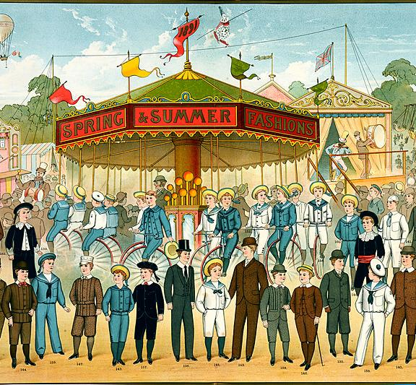
Text mining
Notes:
So that’s the introductory part
Now I’d like to talk more about text mining itself, mostly through demonstration, which should be a bit more fun than slides
That said, it will be a bit of a big sweep through a range of techniques and I’m a little worried that it might be a bit of an overload
For future sessions I want to go in small steps, and really explore one thing at a time in relation to some specific theme or question
For today it might be a bit abstract but it should give some idea of some of the things that are possible
Do feel free to ask questions as I go through this, I think actually that if its a bit more interactive it’ll work better for everyone
I’m happy to push buttons and try things out as we go
I tend to use terms like “text mining” and “text analysis” or “text analytically” kind of interchangeably
What I really mean is using digital analysis of the full text of documents
In this case, for the purpose of finding documents that relate to some particular research question
The most obvious means of doing this is to take documents that are known to be relevant
And try to find documents that are in some sense similar
So for example, if I am curious about what physicians have to say about charlatans, start with books or passages of text on this subject
And look for other text which is “similar”
There are an awful lot of techniques, and for any given technique there will be more than one algorithm, and we can run the algorithm with different parameters
So the “limited project” goal here is just to get some sense of the possibilities of some of these techniques

Slide 11
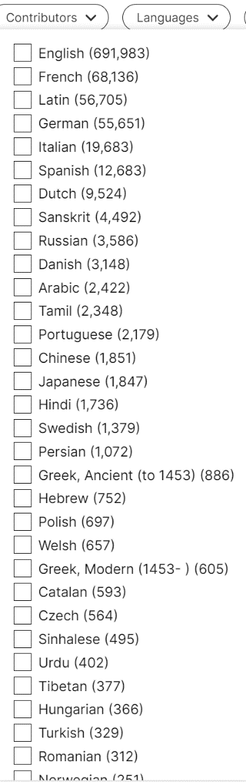
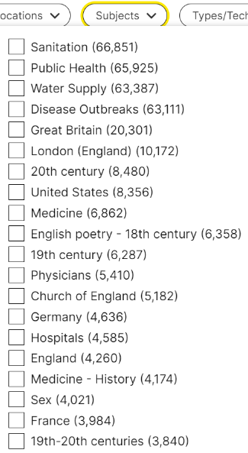
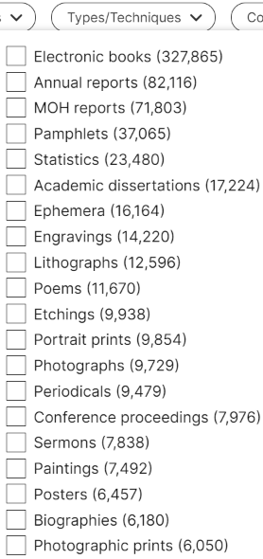
The Collection
Notes:
A few slides to begin with
The catalogue gives one view of the collection as a whole
But we are constrained to the hierarchy and categories as defined by the cataloguers
Which has pros and cons
The cataloguers are the experts on the connection and will have described it in a way that makes sense
It gets tricky when I’m looking for something that might not be exposed in that description
I can do keyword searches for particular things I’m interested in – but I’m then relying on my keywords appearing in catalogue descriptions. That’ll include the titles of texts, but I think that’s about all – the content of the text isn’t available to me through catalogue search.

Slide 12
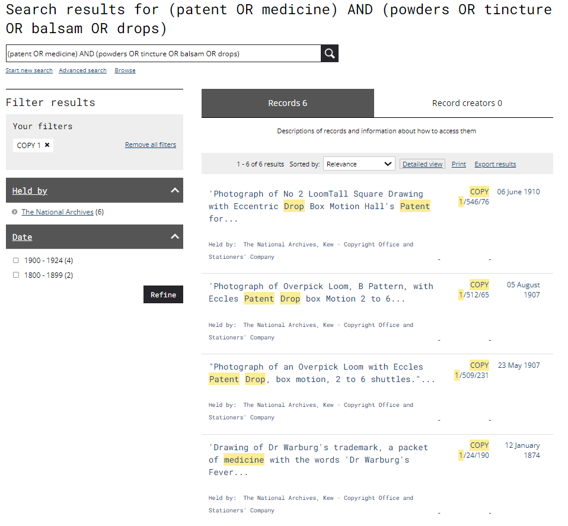
Search results: (patent OR medicine) AND (powders OR tincture OR balsam OR drops) | The National Archives
Notes:
So here are a few examples from my limited research experience.
Some of these examples may be naive – and also quite 18th century – but they are at least the real experiences of one student/occasional amateur researcher
This first one is actually just something I found myself doing at TNA a couple of weeks ago
Quite a fumbling search in TNA’s catalogue for copyright registrations relating to patent medicine.
I just wondered whether I might be able to find examples of trademarks or similar.
This is actually a contrived example to create an illustration for this slide.
I think probably there just aren’t many instances, but it illustrates some of the difficulties with keyword search
I started with “patent medicine” as my search term, which unsurprisingly got no results at all – too specific
But if I broadened to medicine I got a lot of results, mostly irrelevant
I played around briefly with terms that might be a bit more specific to medicines, such as “powders”, “tincture”, etc
But this continues to get lots of irrelevant results or, as in this contrived reconstruction, very few results – depending on exactly how I combine my keywords
I really need something more like a semantic search, or possibly a “more records that resemble this” search -- something that can look at the whole context of the piece of text and determine whether it is likely to be referring to the thing I am looking for, or just happens to contain a word from my search.

Slide 13
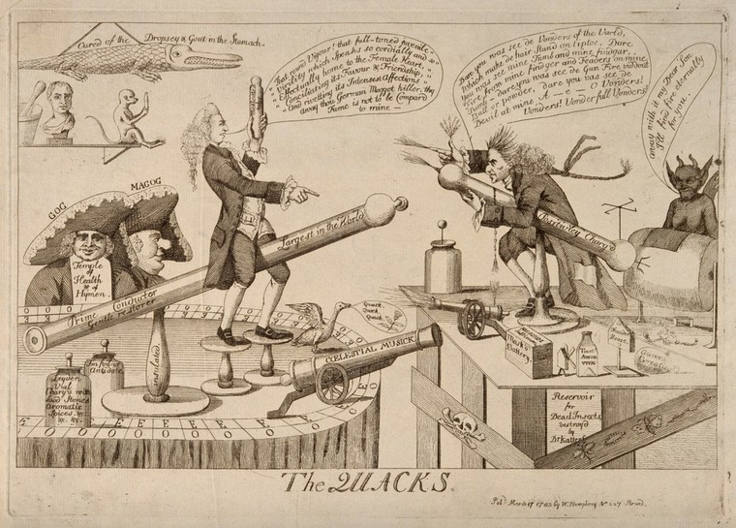
James Graham and Gustavus Katterfelto in combat using electrotherapy machines as weapons. Etching, 1783. | Wellcome Collection
Notes:
This is James Graham and Gustav Katterfelto, who I’ll call quack showmen of the late eighteenth century.
Katterfelto is an unusual (likely invented) name – it’s pretty easy to find information pertaining to Katterfelto and only Katterfelto using straightforward keyword searches. (There is also a racehorse called Katterfelto, but it doesn’t come up very much and its quick and easy to ignore those results.)
James Graham immediately looks like it might be a name that’ll crop up more, and actually one of the first things you learn when you start searching for him is that the name comes up a lot – it’s been a few years, but I think there was also a publisher called James Graham, so that James Graham tends to come up a lot when searching catalogues. A more advanced method of search that could use other context to find the right James Graham, or discard the wrong ones, would be helpful.
There are also a few sources that refer to James Graham briefly, while being predominantly about something else. These are easy to find because they are cited a lot in the scholarship on him, but it does make me wonder whether there is more material to be found on him, in more obscure sources that are primarily about something else. Certainly it seems likely (from my limited experience) that plenty of texts that are about some other subject will contain passages referring to irregular medical practitioners, which cannot be found in the catalogue.

Slide 14
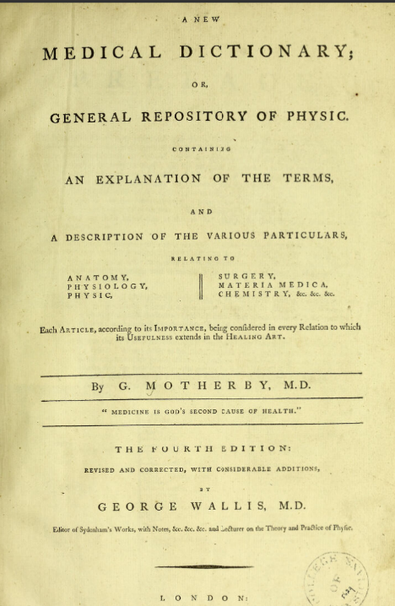
George Motherby’s medical dictionary
A new medical dictionary, or, General repository of physic : containing an explanation of the terms and a description of the various particulars relating to anatomy, physiology, physic, surgery, materia medica, chemistry, &c. &c. &c. : each article, according to its importance, being considered in every relation to which its usefulness extends in the healing art / by George Wallis. Source: Wellcome Collection.
Notes:
Finally, a slightly different case
I spent some time volunteering on a project where I was writing short definitions of diseases mentioned in a student’s lecture notes
There are a couple of ways digitised text helped with this
One was George Motherby’s medical dictionary. The main way to use this was via the index, but because it was digitised I was able to find additional references to particular terms outside of the main entry – or occasionally, find the right entry when it was listed under a different term. This kind of search isn’t comprehensive – if only because of OCR errors, I’m not likely to find every instance of a keyword. But it can be a helpful way to find additional examples.
Another was simply to search for references to the term in other sources, including in Wellcome’s catalogue. When this worked out, I could see a bunch of uses of a term in context, at around the right time, which could be helpful with understanding what it meant. But it was more effort than it needed to be to find and see all of those examples – an interface geared to showing me examples of a term in context would have been a very helpful thing.

Slide 15
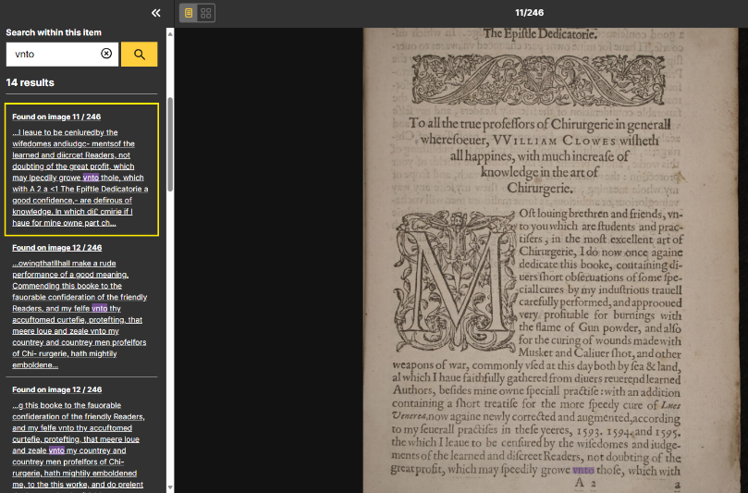

A profitable and necessarie booke... By William Clowes one of hir Maiesties chirurgions. 1596. Processed August 2018.
The Epiftle Dedkaffie; To all the true profeiTors of Chirurgerie in general! whereioeuer, VVilliam Clowes wiftieth all happities, with much increaie of knowledge in the art of p' â€¢ â– â€¢ â€¢â€¢ * â€¢ Chirurgerie. \ â€˜ If . . > â€ž r - * â™¦ " . j . i â– â€¢ â– â€¢ â– ' â– - â€˜r â€¢*><>. â€¢- r w â– ; â€˜ ' Â± - -A' Oft louing brethren and friends, vn- ro you which are ftudents and prac- tiiers, in the moft excellent art of Chirurgerie, I do now once againe dedicate this booke, containing diners fhort obieruations of fome ipe- ciall cures by my induftrious trauell carefully performed, and approoued very profitable for burnings with the flame of Gun powder, and alio for the curing of wounds made with Musket and Caliuer fhot, and other weapons of war, commonly vied at this day both by iea & land, al which I haue faithfully gathered from diuers reuerend learned Authors, befides mine owne ipeciall practiie: with an addition containing a fhcrt treatiie for the more ipeedy cure of Lucs Venerea,now againe newly corrected and augmented,according to my feuerall pradlifes in theie yeeres, 1593. 15^4. and 1595. the which I leaue to be ceniuredby the wifedomes andiudgc- mentsof the learned and diicrcet Readers, not doubting of the great profit, which may ipecdily growe vnto thole, which with A 2 a
IIF manifest: iiif.wellcomecollection.org/presentation/v2/b30343719
Image: https://wellcomecollection.org/works/s7sjuwds/items?canvas=11&query=vnto
Text: https://api.wellcomecollection.org/text/v1/b30343719
(Catalogue entry: https://wellcomecollection.org/works/s7sjuwds)
Notes:
Here are some examples of the kind of text we are looking at
Pretty old document, 1596. ALTO gives the processing date as August 2018.
If your eyes are up to it, you can see that the text recognition is far from perfect (though the really horrible bit I guess is bleed-through).
And you may see some common problems with older documents, I’ve highlighted a couple
Long s read as f
V read as u, and vice versa
This document also seems to read ‘s’ as ‘i’ a lot, I don’t know if that’s a common thing.
This presumably will be better with less old documents or more recent scans.
Left-hand image: https://wellcomecollection.org/works/s7sjuwds/items?canvas=11&query=vnto

Slide 16
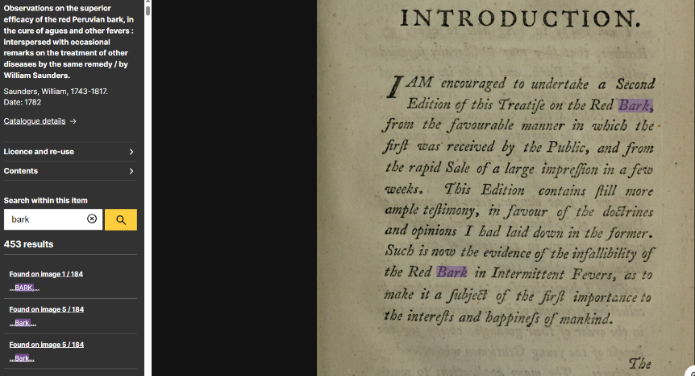
Observations on the superior efficacy of the red Peruvian bark, in the cure of agues and other fevers : interspersed with occasional remarks on the treatment of other diseases by the same remedy / by William Saunders. 1782. Processed May 2019.
INTRODUCTION. â€˜ J â€˜ ' *â€œ* â€¢- Â« * * : V â€¢ â€˜ J* n * â€™ . â– v * ,4 * v_ ' A f r JAM encouraged to undertake a Second Edition of this Treatife on the Red Bark, from the favourable manner in which the firf was received by the Public, and from the rapid Sale of a large imp ref ion in a few weeks* Phis Edition contains fill more ample tef-imonyy in favour of the dobirines and opinions I had laid down in the formerâ€¢ Such is now the evidence of the infallibility of the Red Bark in Intermittent Feversy as to \ ' * make it a fubjeB of the firf importance to the interefs and hafpinefs of mankind. The
IIF manifest: iiif.wellcomecollection.org/presentation/v2/b30792411
Image: https://wellcomecollection.org/works/rsru9bj8/items?canvas=5&query=bark
Text: https://api.wellcomecollection.org/text/v1/b30792411
(Catalogue entry: https://wellcomecollection.org/works/rsru9bj8)
Notes:
This document is about 200 years more modern and was scanned a year later.
“By eye” quality looks about the same, but I may be auto-correcting the older texts as I read.
Its actually quite tricky not to “auto-translate” a lot of OCR problems as you read
Has another horrible bit which I guess must be the bleed-through.

Slide 17
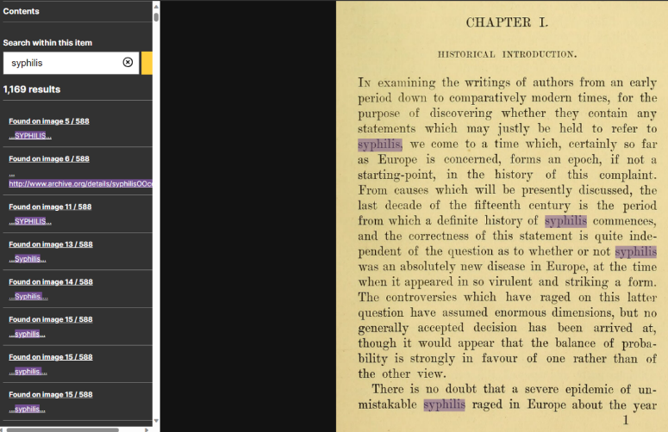
Syphilis / by Alfred Cooper. 1895. Processed August 2015.
CHAPTEE I, HISTORICAL INTEODUCTIOISr. In examining the writings of authors from an early period down to comparatively modern times, for the purpose of discovering whether they contain any statements which may justly be held to refer to syphilis, we come to a time which, certainly so far as Europe is concerned, forms an epoch, if not a starting-point, in the history of this complaint. From causes which will be presently discussed, the last decade of the fifteenth century is the period from which a definite history of syphilis commences, and the correctness of this statement is quite inde- pendent of the question as to whether or not syphilis was an absolutely new disease in Europe, at the time when it appeared in so virulent and striking a form. The controversies which have raged on this lattei^ question have assumed enormous dimensions, but no generally accepted decision has been arrived at, though it would appear that the balance of proba- bility is strongly in favour of one rather than of the other view. There is no doubt that a severe epidemic of un- mistakable syphilis raged in Europe about the year
IIF manifest: https://iiif.wellcomecollection.org/presentation/v2/b21047340
Image: https://wellcomecollection.org/works/tj4sgmq8/items?canvas=29&query=syphilis
Text: api.wellcomecollection.org/text/v1/b21047340
(Catalogue entry: https://wellcomecollection.org/works/tj4sgmq8)
Notes:
1895. Good OCR. It also doesn’t seem to be picking up the page number in the footer, though it did pick up similar features in the other two books.
Processing date is August 2015, so perhaps with older OCR tech than the previous ones.
So that’s the material we are working with
I will likely investigate cleaning up the text a bit, doing something like running a spell checker over it
But I don’t want to get too detained by text clean-up
Seeing what we can do easily with what we have is part of the project, I think

Slide 18
Typhus texts per Year
Notes:
I’ve made a corpus of text for demonstration purposes. This is text from Wellcome about "typhus". What I've done here is roughly:
Take a download of the catalogue data that Wellcome makes available
Search that download for the word 'typhus' to make a list of texts which have that word anywhere in that catalogue data.
Get a copy of every English-language text that has digitised text available
Discard all copies after 1829, which is an arbitrary date that makes the corpus cover a period of roughly 50 years
This slide shows the number of texts per year over the span of the corpus (with a couple of caveats I won’t go into). So quite gappy at the beginning, less so later.
Some years with multiple texts are likely multiple copies of the same text
Lots could have gone wrong here.
In particular, the search for "typhus" is quite simplistic – there is a good chance that I should be looking at the catalogue data in a more sophisticated way than just a full text search.
And almost certainly I should be looking for other terms as well to build up a corpus of texts about "typhus" in this period
e.g. terms like jail fever, jungle fever may be relevant
there may be particular authors I ought to look for
or references to particular places (Newgate Prison) or events (the Black Assizes), depending on how broadly I want to cast my net.
I will add that I am no expert on typhus or related diseases, I just happen to be reading a book about this at the moment, so it sprang to mind as something to search for.

Slide 19
Word Counts
Notes:
This is word counts, to give an idea of relative sizes
Most documents are quite short
Over half of the corpus is less than 5000 words
A few documents are very much larger

Slide 20

Voyant Tools
Notes:
Now I’ll use a tool called Voyant to demonstrate a few kinds of analysis
Voyant is a tool for playful exploration of these kinds of techniques
Voyant has some definite limitations. You can only configure it to a point, and it can be hard to get at the details of what it is doing in each analysis.
I don’t expect we’ll use it beyond the early stages of the project.
But I think it is helpful for getting a sense of the kinds of things that are possible.
Concern that it might be a bit too abstract at the moment, I think these things make a lot more sense when they’re being applied to a specific question.
Much easier to explore the strengths and limitations of a technique in a specific context, I think
So if this is too abstract, maybe that at least helps to make the point that it would be useful to have a specific theme or question to explore
[Demo]
I could show you more... but I think that’s plenty for now
It may be tricky at this moment in time to see where the relevance is, but that is why I want to do this in small steps, one or two techniques at a time, and with specific questions in mind.
Hopefully this has shown that there are a range of ways to work with full text to better understand a corpus
Though some of these ways seem very abstracted here, I think they can be made more concrete, with the right interface, with the right question, with some interpretation
I think that we can try exploring them together
I think with a specific question or theme in mind
And with some more bespoke representations that these generalised Voyant views
And going in smaller steps than this sort of generalised sweep
Then the application of the methods will be more clear and it will make more sense
And I think that we’ve earned a break before I ask us all to think about the kinds of questions that we can ask, or themes that we can explore

Slide 21
Exercise: Suitable themes or questions
Notes:
So I’ve demonstrated some techniques to give a flavour of some of what is out there. There is plenty more but there’s no sense in trying to cover it all.
I think all of this makes a lot more sense when we get down to applying techniques to exploring a particular theme or question. I think especially when that theme is relevant and meaningful for the people involved.
I’d like to do a little exercise at this point, to get us thinking about what would be a good theme or research question to investigate.
I have some thoughts about what makes a good question and a couple of examples.
And then I’d like us to discuss some possibilities for subjects that could be addressed by text mining and that are relevant or interesting for you
Not necessarily a commitment forever, but would be nice to have something to focus on between now and next month.

Slide 22
What makes a good question/theme?
Does not fit comfortably into the catalogue’s taxonomy
Not easily addressed by keyword search
Fragmentary passages
Not something that is likely to be main subject of a book
Or likely to be a lot of material that is not main subject
Benefits from many small examples, e.g. word senses
Well studied -- helps with evaluating results
Interesting for you & for Wellcome
Notes:
So here are some suggestions for what makes a good theme to search for using these types of methods. The overarching point is that it should be something hard to find with catalogue search. So:
Something that does not fit comfortably into the catalogue’s taxonomy
It is hard to think of a category for it
Or it fits into multiple categories, such that you get a lot of unwanted results along with what you are looking for
Something that isn’t easily addressed by keyword search
So if I type “charlatan” into the catalogue I’ll get a lot of hits
But I might not want all texts about theatre, secondary sources that discuss charlatans
Nor will I get cases where they are called “quacks” or “mountebanks” or “empirics” or encompassed within “irregulars”... the more ways there are of referring to something, the harder it is to think of all of the keywords
Fragementary passages
And I won’t find any text where charlatans are discussed but they are not mentioned in any of the metadata of the book
Something that benefits from many small examples can be a good use case
For example, if I want to understand the sense of a word at a particular place and time, gathering as many examples of that word as possible seems like a good way to go
And it really helps if the theme is something quite well understood
Helps us to have a sense of whether the sources we are finding are useful or not
You and Wellcome – i.e. for Wellcome and for your role within it

Slide 23
EG 1: Regular writing about charlatans
Initial corpus: Medical treatises by regulars
Justification
Metadata only identifies texts that primarily about charlatans
Scattered, sometimes lengthly, references are likely
Relates to: power structures & authority, everyone’s experience of health
Could expand into more general “regulars & irregulars”
Notes:
So here are a couple of examples. They tend to relate to my interests – we don’t have to be in the eighteenth century, it’s just where I gravitate to. Again, I’m not a historian, I might be getting some stuff wrong here.
For each one I’ve tried to identify:
An initial corpus of texts that can be found through catalogue searches or just knowledge of relevant sources
Reasons it makes a good example
Points it relates to in Wellcome’s Strategy Guide
For regular writing about charlatans, I would probably start by looking in “medical treatises by regulars” – though that is probably a large amount of the collection, so I might want to narrow it down to some cases that either explicitly mention charlatans, quacks etc in the catalogue, or that I happen to be aware of.
Reasons that it might be relevant [read from slide and then] --
For example, Clowes has a good rant about a charlatan in his “Briefe and necessarie treatise” on the great pox – so of course there is no hint in the catalogue that there are a few pages about some quack called Valentine (nor should there be)
Then points it relates to – power and authority, the authority of the regular, desire to regulate medical practice.
Everyone’s experience of health, a world in which medical knowledge was perhaps less deep and specialised and more widespread, a world in which there were many places to go for medical expertise other than the physicians
Charlatans may be a bit of a personal obsession... for broader interest for the group we could think in terms of a “regulars and irregulars” theme. There is plenty to explore here around medicines and materia medica, access to medicine, knowledge about medicine – doesn’t have to be charlatans.

Slide 24
EG 2: The concept of “typhus”
Initial corpus: Medical dictionaries, nosological texts
Justification
Wide range of examples for sense-making
Potentially vagueness in reference to “typhus”
Relates to: Power structures & authority, everyone’s experience of health, infectious disease, climate & health
Could pick many “concept of...” alternatives to typhus here
Notes:
“Typhus” in scare quotes because notions of disease and what they are evolve, making it tricky to use modern medical terms to refer to disease in the past.
To what extent are putrid fever, jail fever, camp fever etc etc all seen as the same thing? Are they differentiated at all? Any different symptoms, causes, etc etc?
Even if they are all the same thing, can we find additional sources in the debate around causation? In mapping out the understanding of the symptoms of the disease
For a “concept of...”, medical dictionaries and books about classification of disease may be a good starting point, but it does depend a bit on the exact question
I think when trying to make sense of terminology it is helpful to have as many “in context” examples as possible, and we may be able to build a corpus of examples through text mining
And concepts of disease seem a bit fuzzy, I think especially in the pre-modern period – some text mining techniques may be good for finding blocks of text that seem to be referring to the same thing, where keywords might fail
Power structures and authority – at least in the book I’ve been reading, the argument is made that a lot of the response to jail fever outbreaks had to do with fear of and thus regulation of poor bodies [Siena’s “Rotten Bodies”]
Everyone’s experience of health – fever outbreaks were a threat for everyone, especially people in perceived high risk areas, such as the vicinity of prisons
Obviously an infectious disease
And climate & health, in that it is/was linked to particular environmental conditions
Again, it’s just an example. Can swap in a variety of conditions here for other “concept of...” themes. Melancholy is one other possibility, and perhaps that ticks the “well studied area” box, too.

Slide 25
EG 3: Bad air
Initial corpus: Texts about spread/causation of disease in general.
Justification:
Likely referenced a lot in texts primarily about something else
Probably well studied
Relates to: Climate, infectious disease
Notes:
“Bad air” – not a great title, but thinking here about the idea of disease being spread through contaminated air
Getting (even further) from my comfort zone here, but as I understand it there is debate in the eighteenth century about disease being caused through bad air vs corrupt bodies and perhaps other possibilities
Initial corpus might be general texts, or could focus on one or a few diseases where this is especially relevant (typhus would be one)
I think again it’s probably discussed a lot in texts that are about other topics, because the transmission of disease is likely to come up a lot
And conceptual enough to be a bit hard to find
I think it’s probably well studied too
And I think fairly obviously relates to climate and infectious disease

Slide 26
Prompts
Subjects/themes where sources are fragmentary or invisible
What difficulties do you meet in catalogue searches?
Are there workarounds that you use? (e.g. non-public aids)
How would you like to be able to search?
Alternatively, what can’t you do with the catalogue now?
Are you working on something that this project might help with?
(But don’t put it on the critical path!)
Notes:
So here are some prompts for discussion. I’d appreciate any thoughts about any of this, including by other channels later.
Subjects/themes where sources are fragmentary or invisible
What difficulties do you meet in catalogue searches?
Are there workarounds that you use? (e.g. non-public aids)
How would you like to be able to search?
Alternatively, what can’t you do with the catalogue now?
Are you working on something that this project might help with?
Just on this one, you wouldn’t want to rely on this project to deliver anything critical, but piggybacking on something you’re already doing might help to use your time efficiently

Slide 27
Parting Questions
How could this project be useful for you?
What theme(s) would benefit from a “text mining search”?
What theme(s) would be of interest to you?
Notes:
That third question is both “you as an individual” and “you, Wellcome Collection more broadly”

Slide 28
The End

