Slide 1
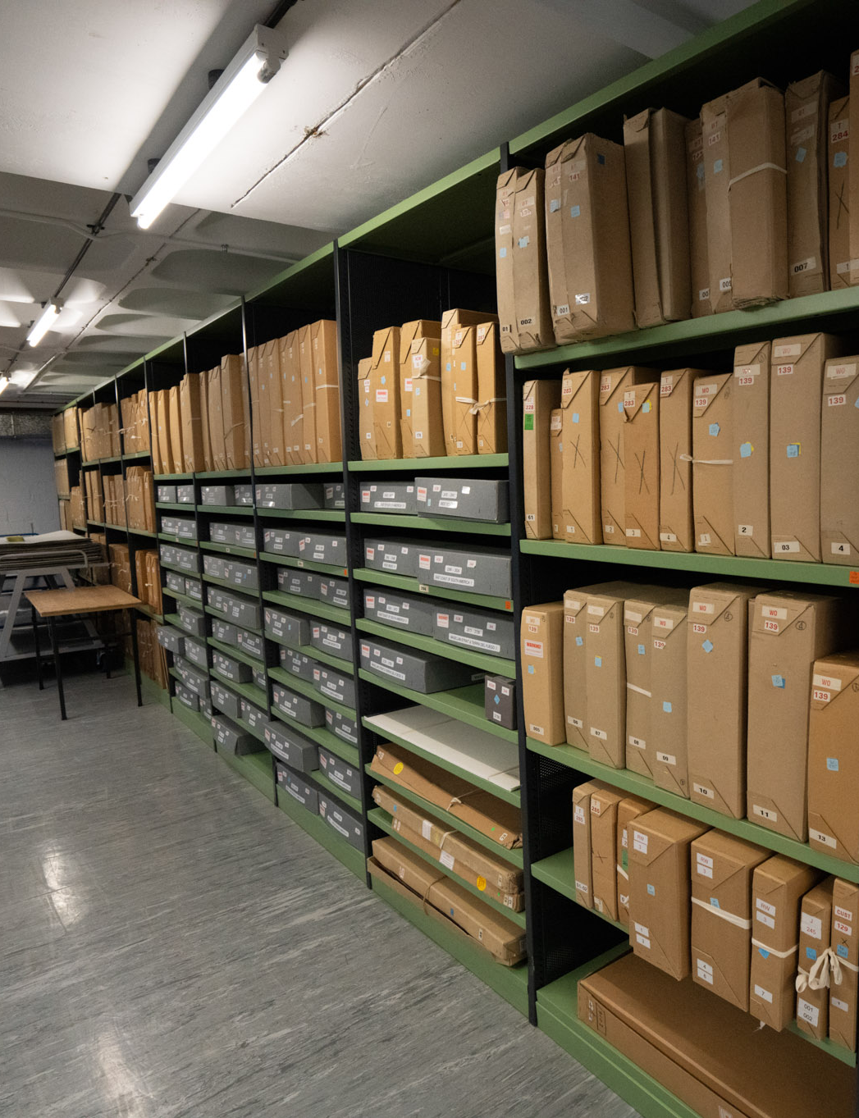
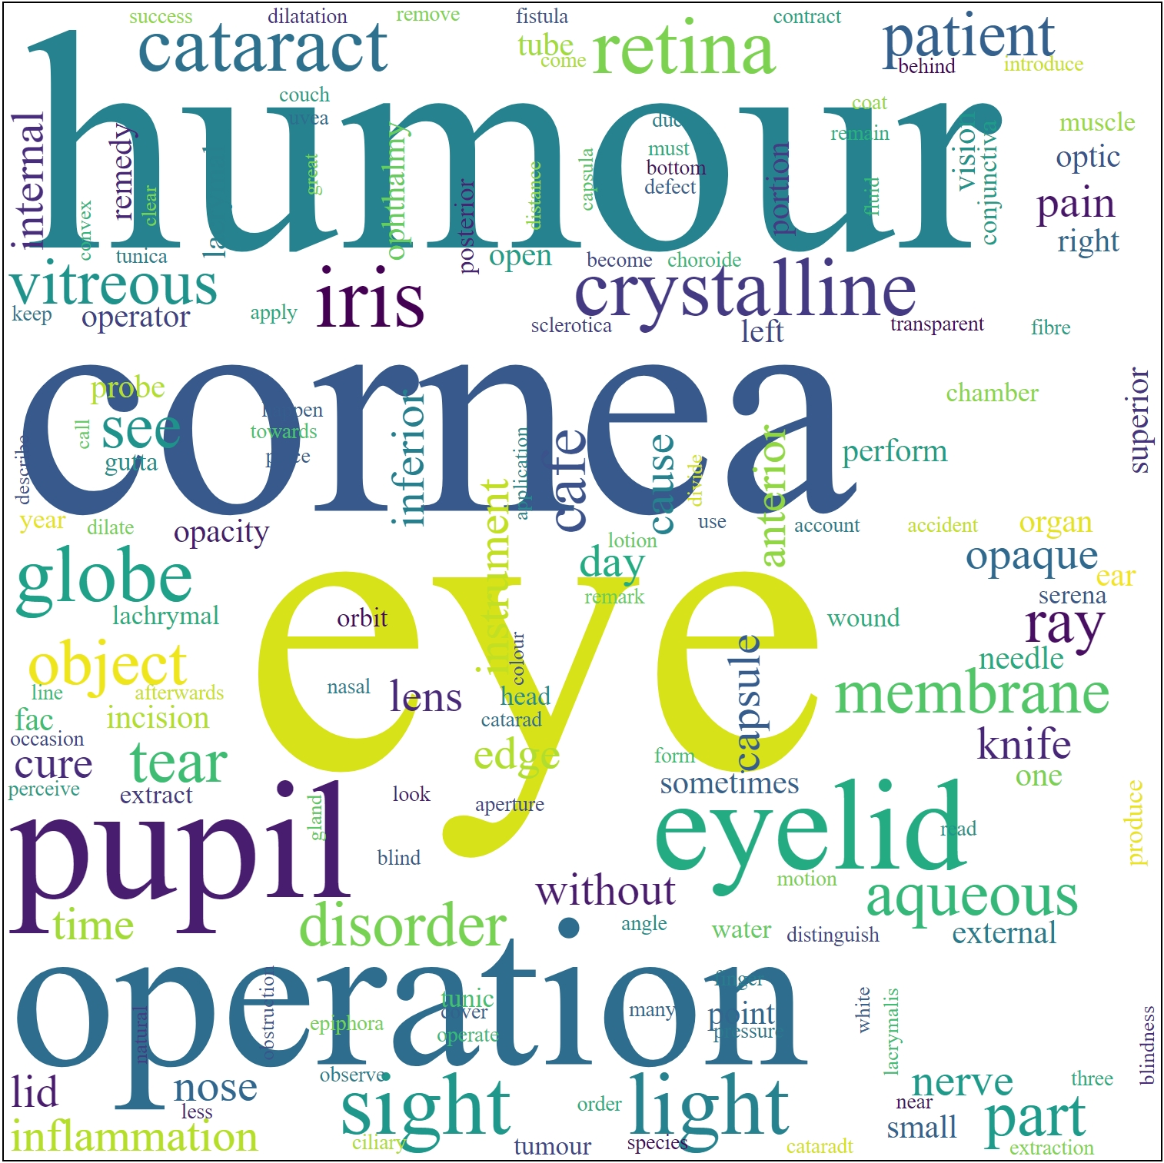
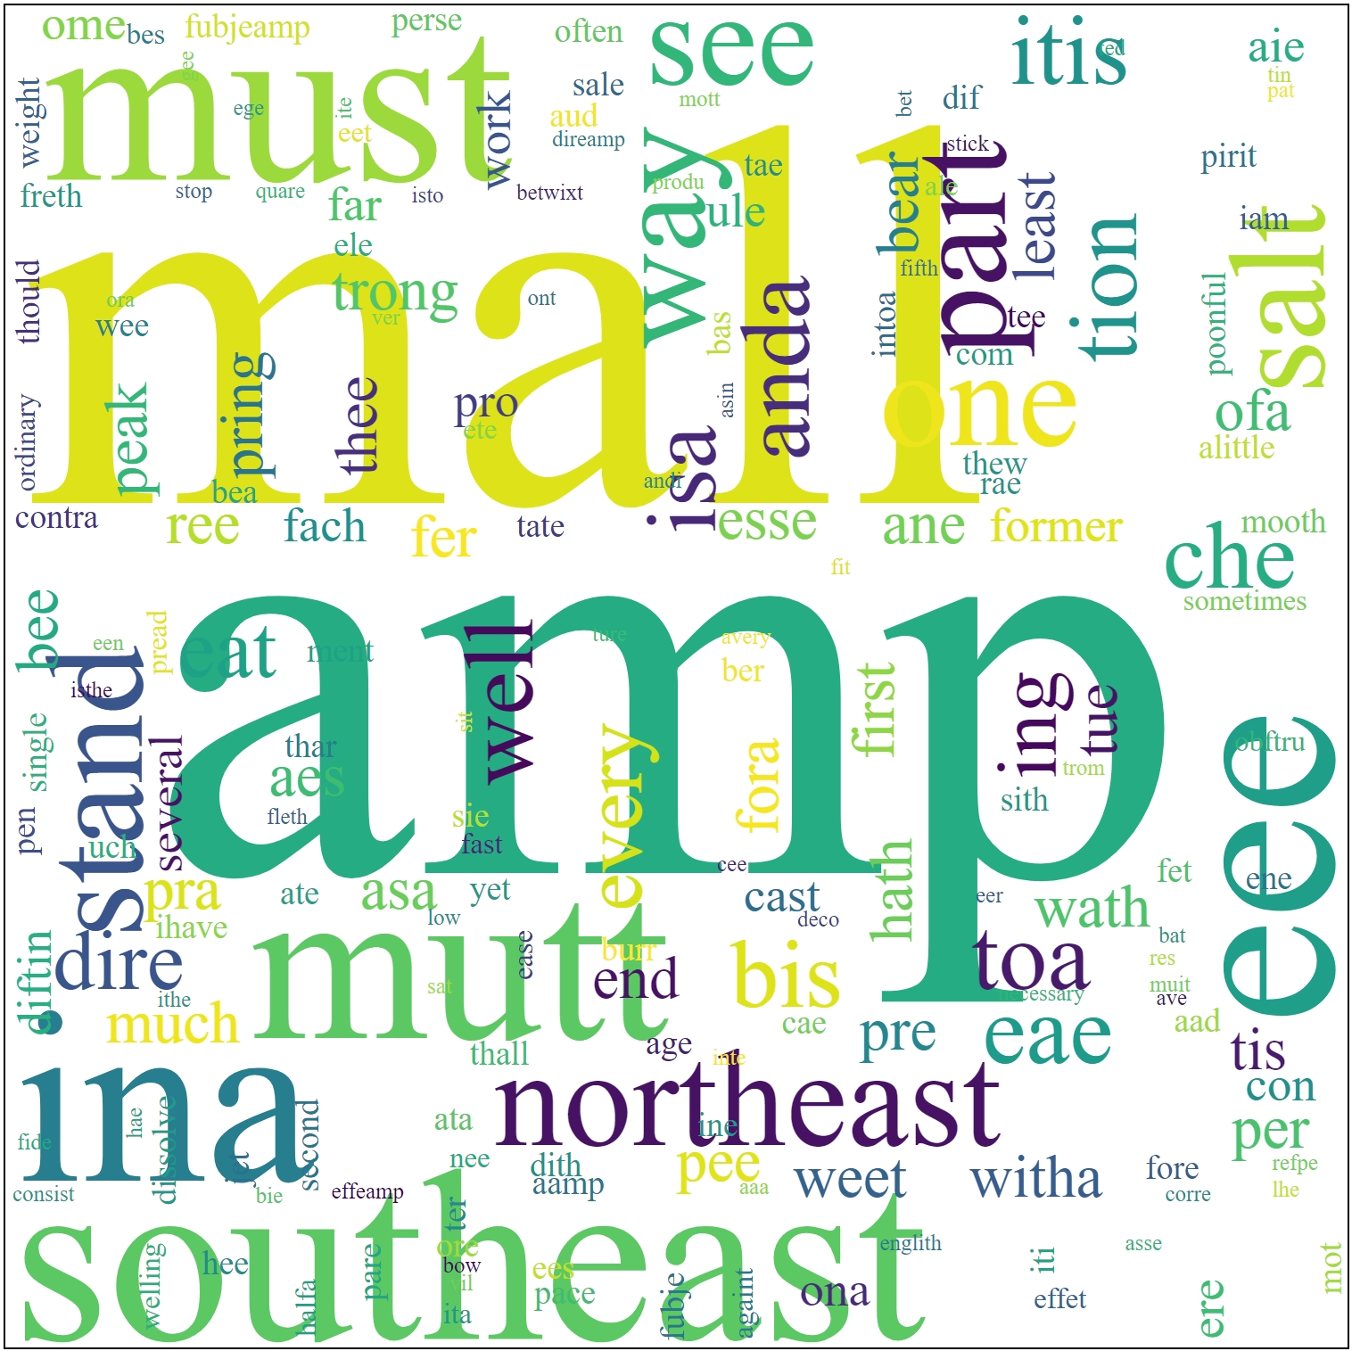
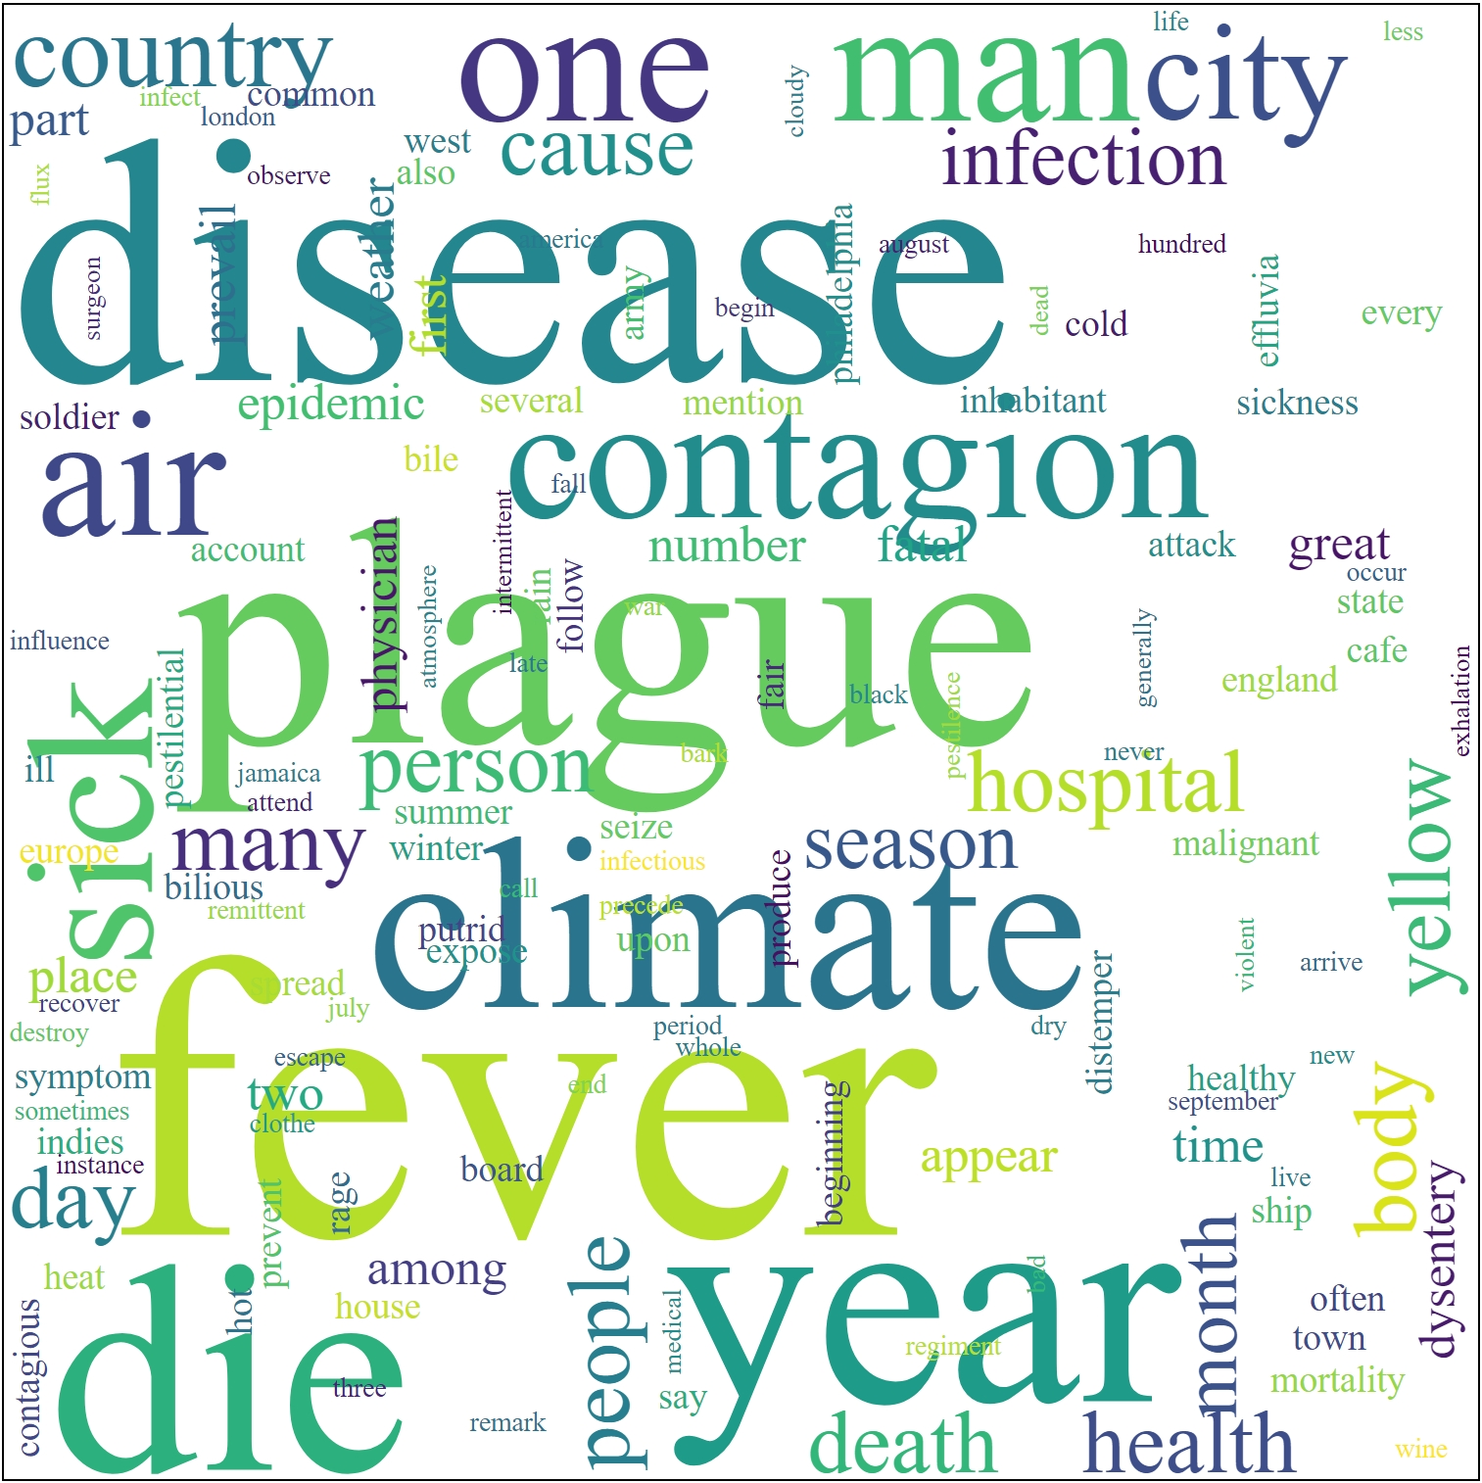
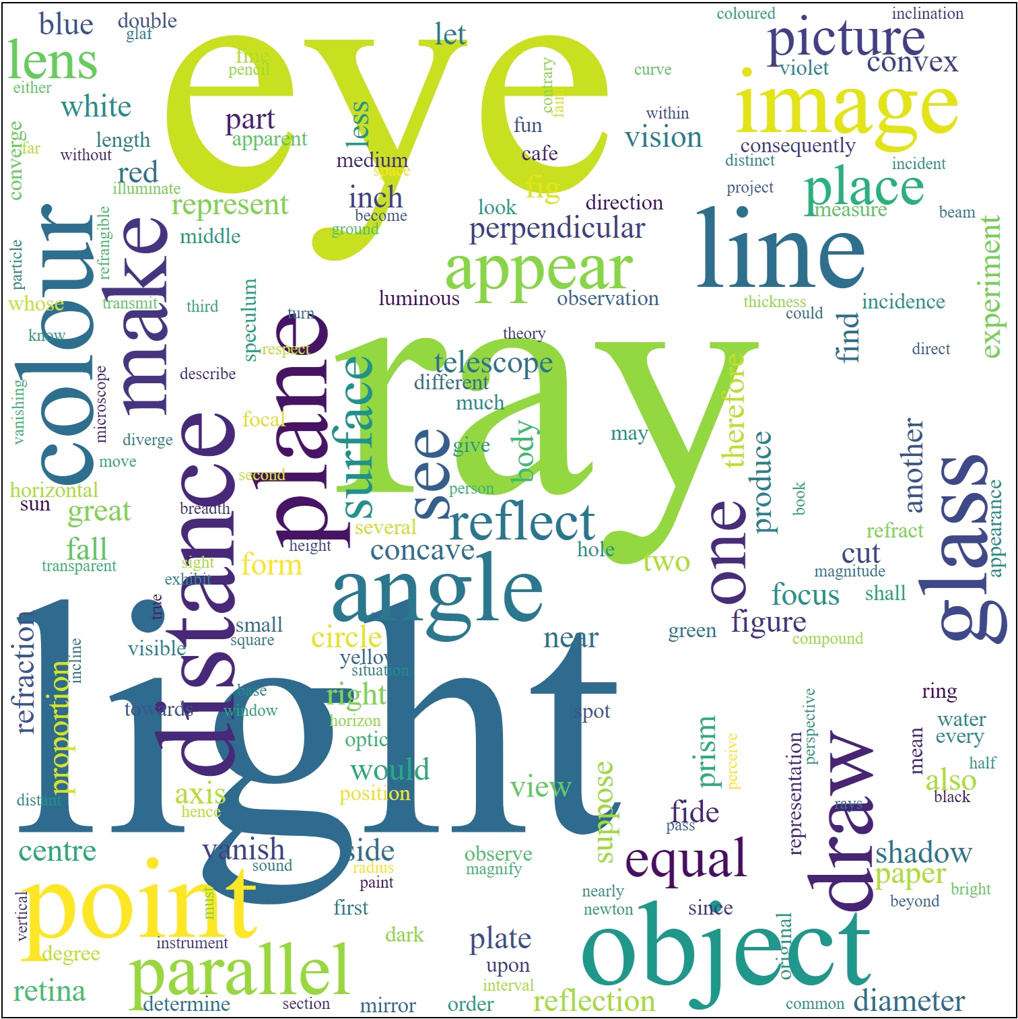
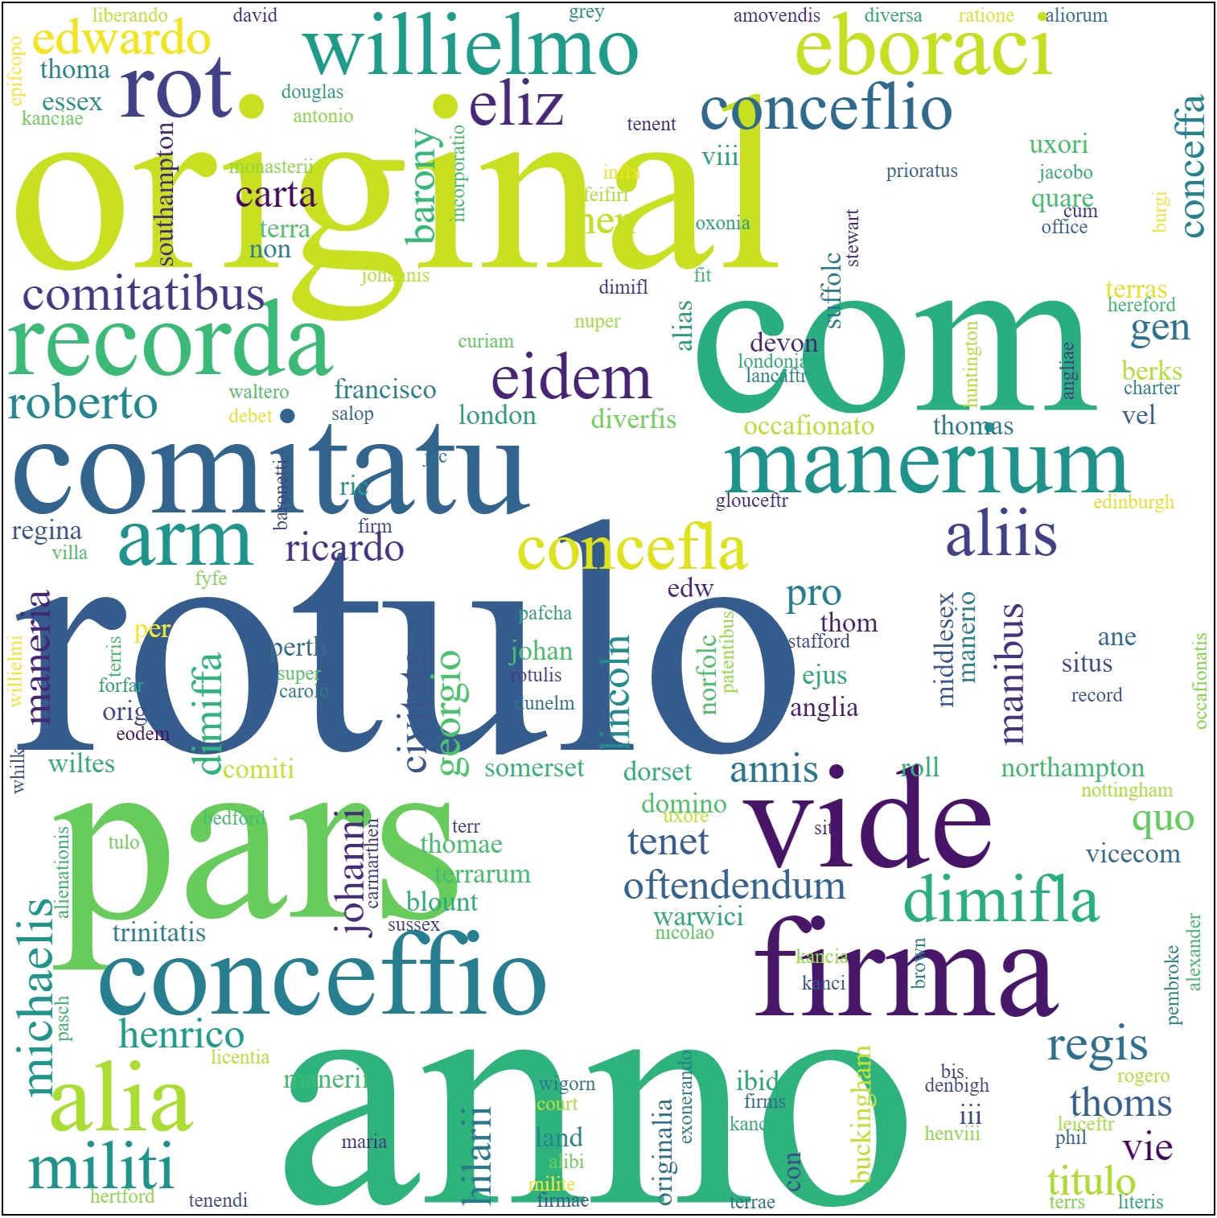
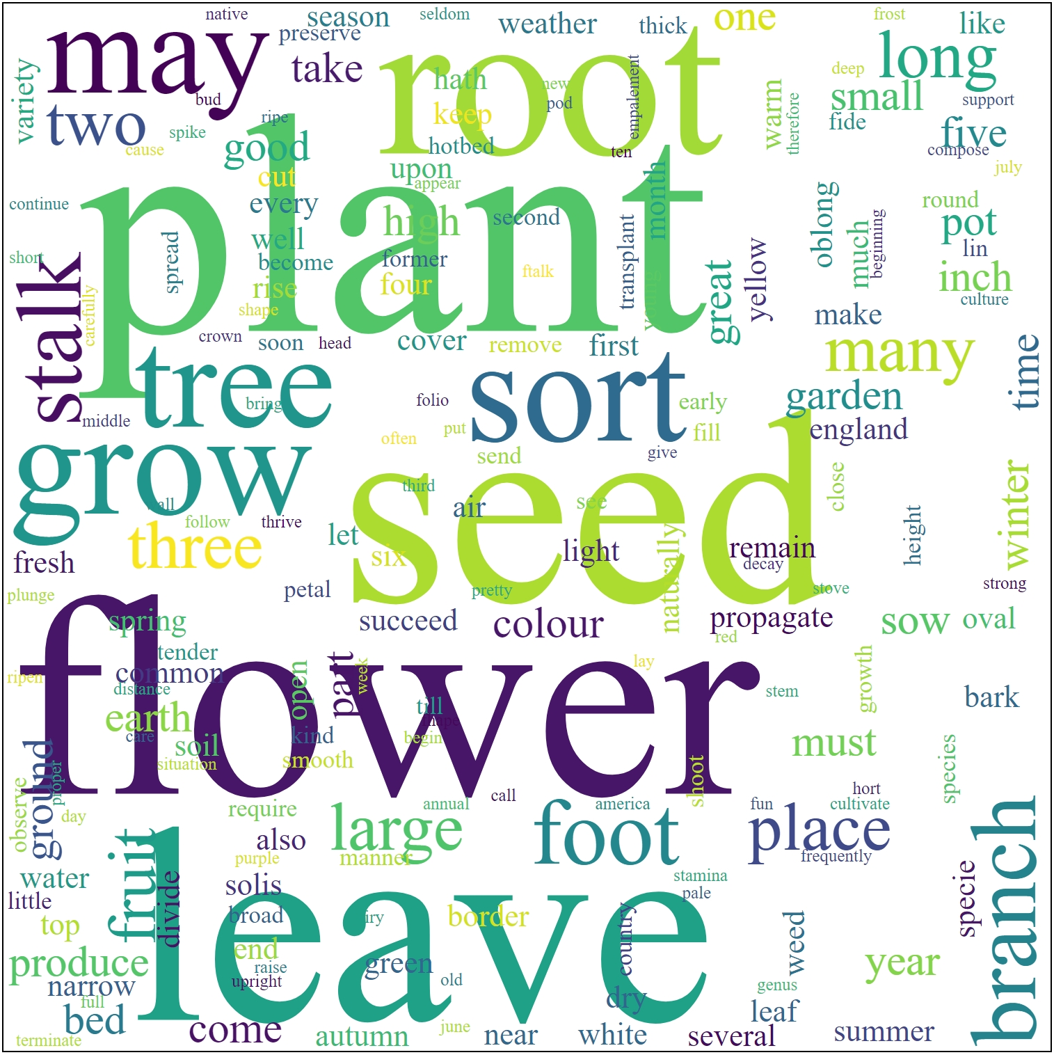

Topic Modelling Historical Medical Texts Learning and exploring digital possibilities through prototyping
How can we best apply digital methods to explore, understand, or present our collections? This poster presents some questions that arose during an experiment in building digital prototypes to facilitate interdisciplinary collaboration and co-learning between digital and collections specialists.
This work is part of a TNA/RLUK Professional Fellowship hosted at Wellcome Collection.
Professional Fellowships pair an employee of The National Archives with a host organisation from Research Libraries UK (or vice versa) to explore a professional practice question.
Topic modelling statistically analyses documents to find words that are important in a topic. It can tell us what the words are, how important to the topic they are, and which documents the topic appears in.
But it cannot tell us what the actual topic is. We have to interpret the model to make sense of it.
On the right are models of topics found in Wellcome Collection’s 18th century books. The models are represented as word clouds. Ideally, each cloud will represent some meaningful topic in the books.
Some clouds may describe just one book, others a theme that cuts across some part of the collection. Some may spark ideas — and some may mean nothing at all.
What could these topic models be about?
Questions
Wellcome Collection collects material about health and human experience. What do the topics suggest about what can be found in the collection?
Can we trust our interpretations of the topics? Can other data help us to interpret the topics?
Which topics are useful? Which are meaningless?
How can we use topics to search or explore the collection? To understand it from a new perspective, or to inspire questions about it?
Bernard Ogden, bernard.ogden@nationalarchives.gov.uk, The National Archives (UK)

