Slide 1
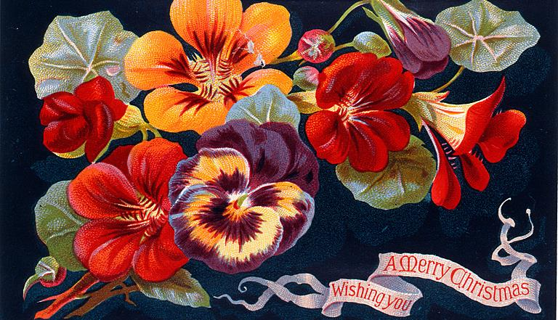
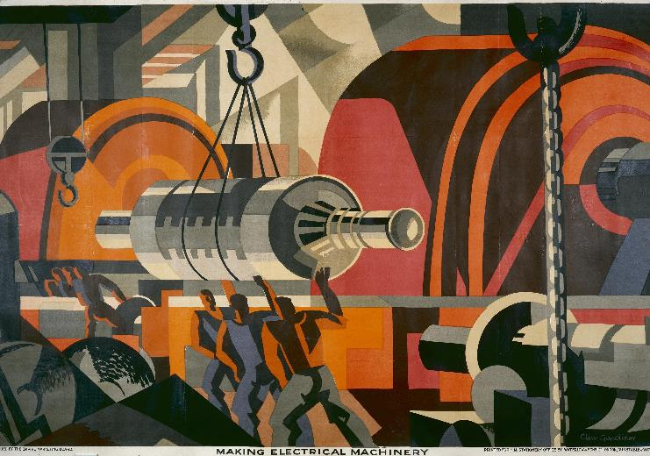

Adventures in Topic Modelling
5 June 2024
Notes:
Plan for today is to be a bit more interactive
I’ll talk through what I’ve done so far, and show you a tool that you can use to explore a part of the collection through the lens of topic models
I’d like to have a bit of a discussion about the pros and cons of such views of the collection – for research, but also more generally as a way of presenting it to the outside world
And I’d like to take a bit of time for you all to try it out – in small groups
With a bit of time at the end to reflect some more on this approach, in light of this experience
And to think about what would be productive to do next

Slide 2
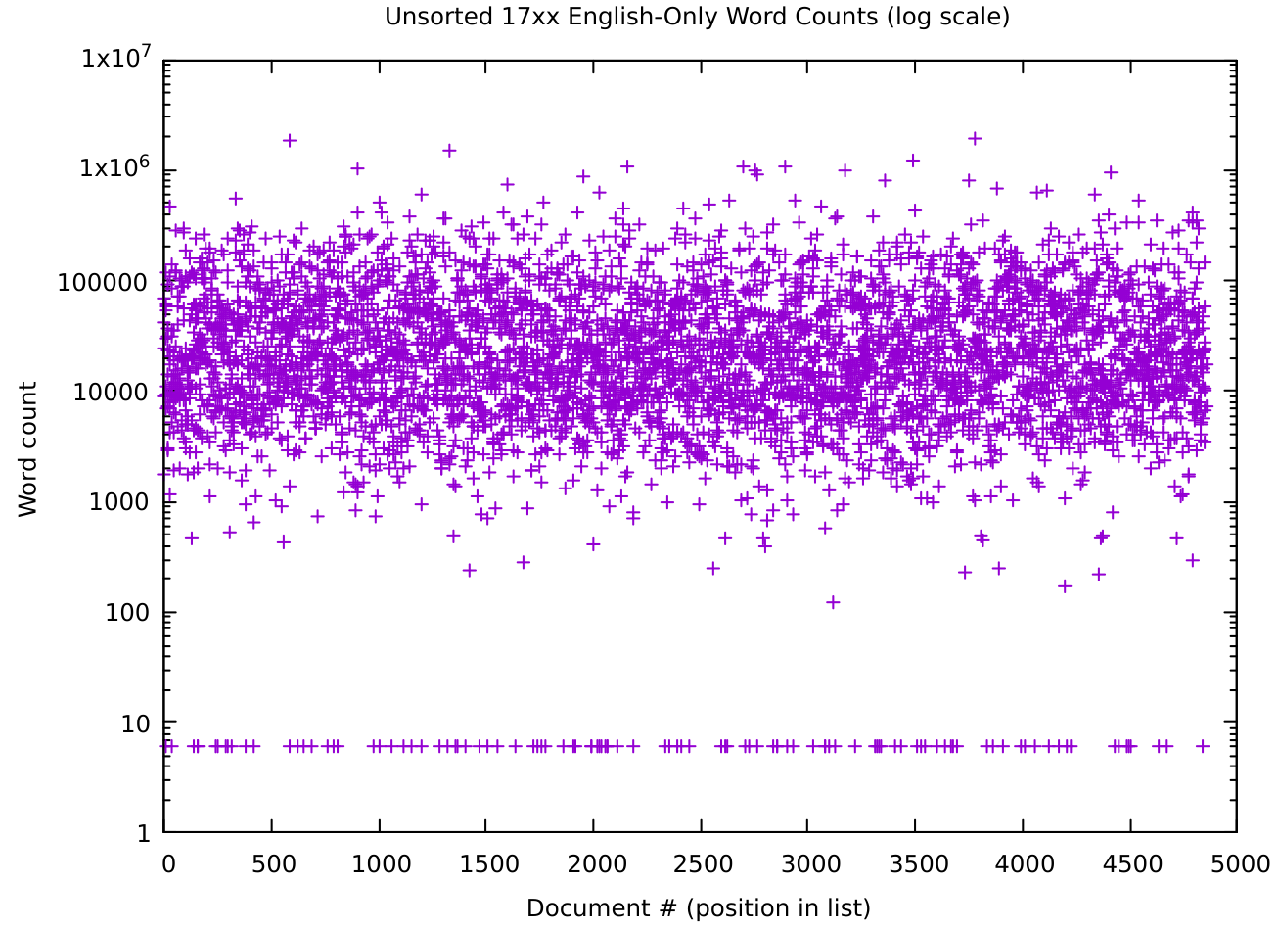
What have I done? (pipeline/corpus)
Notes:
Got a bit better at working with the text
“Pipeline” sounds more engineered than what I have but
I can dig out texts by categories like date and subject
And gather it up for transformation and analysis
There are some bugs
For example, some texts are getting pulled in more than once
But it works in a rough and ready sort of way
The corpus I’ve brought today is just one I made to have something to get started with
All text where the catalogue gives English and only English as the text language
Dated from 1700 to 1799
Some slight difficulties here as dates are sometimes not a straightforward year
I’ve just taken the first 4 digits from the entry, which seems like it should work most of the time
This graph is on a log scale
A little tricky to read, but good for seeing detail at different scale
The y axis is word count, from 1 to 10 million
Each “chunk” is an order of magnitude – so 1 to 10 gets the same amount of graph space as 100,000 to 1 million
And within each chunk, the lower numbers get more vertical space
The thick line below 10 is actually 6, but kind of feels like it should be a higher number
What it shows is that most texts fall within maybe a 2 or 3 thousand to 100,000 range
But there are also a lot of 6 word texts
Which all turn out to say “No text resource found for <identifier>”
A few are even shorter and just contain a few characters of garbage
Honestly, I’m suspicious of everything at the lower end of this chart but only looked at 6 and below
Wouldn’t have spotted these without the log scale everything is just mushed at the bottom and you can’t see details like this
Even just this subset was pushing my computer very hard
4+ hours to produce topic models
An hour or so to generate visualizations from them (plus crazy RAM demands and occasional crashes)
Plus other difficulties with vast numbers of files (e.g. listing the contents of a directory taking the best part of a minute)
I think I have all of the OCR’d text on my laptop, that’s:
50 GB of data
Honestly, I’m surprised it was so little, given that the version of the catalogue that I have is 11GB
But then text is pretty small
220,582 documents [6 of them are empty, a few thousand are so small that something probably went wrong]
9,096,426,489 words (9 billion)
So average of 41,238 words per document, but they vary quite a lot

Slide 3
What have I done? (to your text)
Normalization (Ted Underwood’s OCRnormalizer)
Fixing some common errors (e.g. long s vs f)
More consistent spellings (UK-ification)
Lemmatization (NLTK (Natural Language Toolkit))
Caring, Cared, Cares -> Care
Better -> Good
Stop word removal (NLTK again)
Notes:
Apart from filtering down to English-only, 1700-1799
The text itself has been through some transformations to try to do better at finding topic models
Applied Ted Underwood’s OCRNormalizer
His own notes say that this needs to be tuned for different corpora
But I didn’t have time to do that, so I’ve just run it as it comes and hoped for the best
I believe he works in this period or thereabouts, so that is some cause for hope
It certainly hasn’t always worked, but it should at least have made things a bit better
Doesn’t always fix long s, for example its hard to do that where both spellings work
I’ve noticed “case” and “cafe” showing up in the same topic models
Lemmatization (examples from Stemming vs Lemmatization in NLP: Must-Know Differences (analyticsvidhya.com))
Converting words into their lemma, so that we get at the sense of the word in the topic model, instead of treating different forms as different
This is a bit more sophisticated than another technique, stemming, which just chops off suffixes
So in these exampes, stemming would give me “car” and “bet” (or “bett”?)
Actually I noticed while putting this together that the lemmatizer seems not to be working
Maybe not working at all, certainly not working well
So I should revisit that.
Stop word removal
Removing words with low information content in themselves, such as conjunctions
Stopword removal and lemmatization are both using NLTK, the Natural Language ToolKit
Which is one of the commonly used toolkits for this kind of work
I’ve just used the stuff that comes out of the box
So it will be based on modern English, which is obviously a problem with older text
But on the principle of working quickly, I’ve just gone with them
Could do some more here – sometimes people:
throw away all words that aren’t in a dictionary
strip out all non-alphabetic characters
remove proper nouns

Slide 4
Extract from Distinct notions of the plague, with the rise and fall of pestilential contagion, 1722
But as I have already fliewn, in my Explanation, that there is not an Experiment for the Infection of the Plague being conveyed by Goods ( which has been given up to me by my Remarker), and that I intend in a full Difcourfe to fiiew the Folly and Novelty of this Opinion, that Goods are as Pomes for pickling up the Plague, in order to carry it into far diftant Countries, I beg my Reader Patience for a little Time, and I hope he will find his Lois of Time fuffid- ently recompensed. In the mean time we muff obferve, that, as Contagion and Peflilence have never yet met together in our Doctor artful Difcourfe ; fo peftilential Contagion is wholly neglected ; and with this Neglect the principal Ground, upon which all Cautions to keep out the Plague, are founded; which are the Words, and muff be the Confeflion of my judicious Remarker, Dr. Mead\'s chofen Champion. Our Dodior, on the other hand, would make us believe, That it appears very plain- [ 7 ] that the Plague is a real Poifon
already shown , Explanation , Experiment Infection Plague conveyed Goods ( ha given Remarker ) , intend full Discourse fiiew Folly Novelty Opinion , Goods Pomes pickling Plague , order carry far distant Countries , beg Reader Patience little Time , hope find Lois Time fuffid ently recompensed . mean time mus observe , , Contagion Pestilence never yet met together Doctor artful Discourse ; ; pestilential Contagion wholly neglected ; Neglect principal Ground , upon Cautions keep Plague , founded ; Words , muff Confession judicious Remarker , Dr. mead 's chosen Champion . Dodior , hand , would make u believe , appears plain [ [ ] Plague real Poison .
Notes:
Example of some transformed text, formatted to highlight a few points

Slide 5
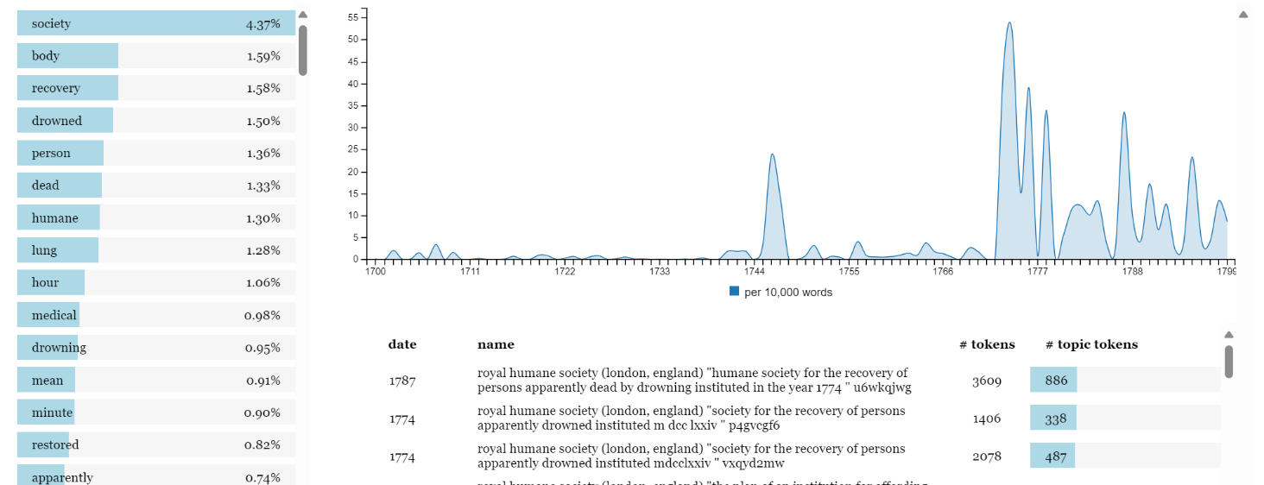
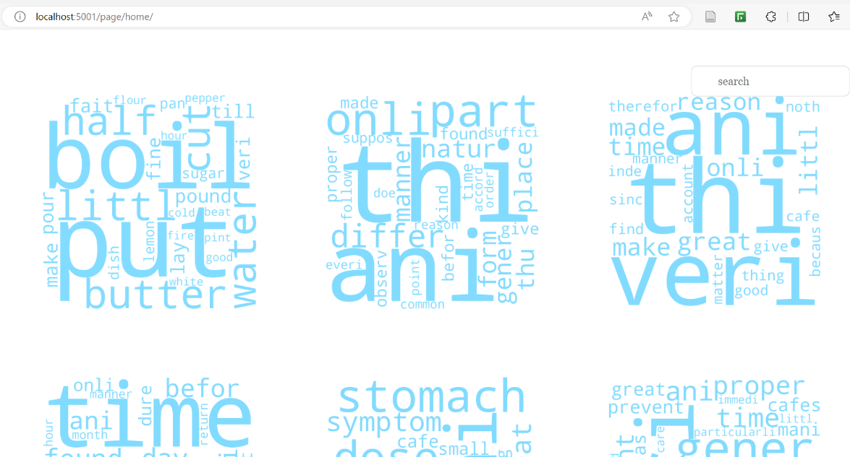
What have I done? (HaToRI)
Notes:
Took “HaToRI” (Hansard Topic Relevance Identifier) and some related software, which was used to do some analysis of Hansard
And kind of bashed it all until it accepted Wellcome text (one bit isn’t working)
So this is just something I’ve worked around the edges of, I didn’t make all this myself, and I don’t know the internals of it
At least not yet
HaToRI was written to study Hansard (hence the “Ha” bit – so I guess this is WeToRI, maybe)
The creators of HaToRI wrote a paper about their pipeline-based approach
The idea is that you put your text through a pipeline
With each step in the pipeline transforming text in different ways
Or doing different kinds of analysis
At each stage in the pipeline, you can change the step to transform the text differently
Or do a different kind of analysis
So their software is easy to adapt to do different kinds of study, on different corpora
This sounds great but – disappointingly, but not very surprisingly – turned out to be only sort of true...
Compared to my impression of typical DH projects, they have made quite a bit of effort to make their creation adaptable and reusable
Compared to typical software engineering projects, it is not so great – the documentation is both sparse and wrong, it doesn’t work out of the box
Slightly worried that I might be throwing stones from a glass house there
What they’ve done is helpful, it’s just a bit frustrating because it could be better
So I hope that taking this approach has saved some time, but increasingly feel that I may have been better off building my own visualisations
I’ll show you how it works in a few minutes
And before I go on to talk about topics, just to set future expectations:
The project schedule front-loaded the work, because I knew it would take some time just to build up some tools and experience to work with the data at all
So I will have done less stuff next time!

Slide 6
Reflections
{"succeededBy":[],"production":[{"label":"Stuttgart : Hippokrates, 1984.","agents":[{"label":"Hippokrates","type":"Agent"}],"dates":[{"label":"1984","type":"Period"}],"type":"ProductionEvent","places":[{"label":"Stuttgart","type":"Place"}]}],"physicalDescription":"pages 84-140 : illustrations ; 28 cm.","subjects":[{"label":"Hydrocephalus","concepts":[{"id":"zr3423uz","identifiers":[{"identifierType":{"id":"nlm-mesh","label":"Medical Subject Headings (MeSH) identifier","type":"IdentifierType"},"value":"D006849","type":"Identifier"}],"label":"Hydrocephalus","type":"Concept"}],"identifiers":[{"identifierType":{"id":"nlm-mesh","label":"Medical Subject Headings (MeSH) identifier","type":"IdentifierType"},"value":"D006849","type":"Identifier"}],"id":"zr3423uz","type":"Subject"},{"label":"Spinal Dysraphism","concepts":[{"id":"kpkh9zkh","identifiers":[{"identifierType":{"id":"nlm-mesh","label":"Medical Subject Headings (MeSH) identifier","type":"IdentifierType"},"value":"D016135","type":"Identifier"}],"label":"Spinal Dysraphism","type":"Concept"}],"identifiers":[{"identifierType":{"id":"nlm-mesh","label":"Medical Subject Headings (MeSH) identifier","type":"IdentifierType"},"value":"D016135","type":"Identifier"}],"id":"kpkh9zkh","type":"Subject"}],"items":[{"id":"mw46fg7b","identifiers":[{"identifierType":{"id":"sierra-system-number","label":"Sierra system number","type":"IdentifierType"},"value":"i16848032","type":"Identifier"},{"identifierType":{"id":"sierra-identifier","label":"Sierra identifier","type":"IdentifierType"},"value":"1684803","type":"Identifier"}],"locations":[{"label":"Closed stores","accessConditions":[{"method":{"id":"online-request","label":"Online request","type":"AccessMethod"},"status":{"id":"open","label":"Open","type":"AccessStatus"},"type":"AccessCondition"}],"shelfmark":"M9744","locationType":{"id":"closed-stores","label":"Closed stores","type":"LocationType"},"type":"PhysicalLocation"}],"type":"Item"}],"designation":[],"workType":{"id":"a","label":"Books","type":"Format"},"identifiers":[{"identifierType":{"id":"sierra-system-number","label":"Sierra system number","type":"IdentifierType"},"value":"b17478388","type":"Identifier"},{"identifierType":{"id":"sierra-identifier","label":"Sierra identifier","type":"IdentifierType"},"value":"1747838","type":"Identifier"}],"formerFrequency":[],"alternativeTitles":[],"id":"zk5v8v3q","languages":[{"id":"eng","label":"English","type":"Language"}],"precededBy":[],"partOf":[{"title":"Zeitschrift für Kinderchirurgie","totalParts":0,"totalDescendentParts":0,"type":"Series"}],"genres":[],"notes":[{"contents":["Includes bibliographical references."],"noteType":{"id":"bibliographic-info","label":"Bibliographic information","type":"NoteType"},"type":"Note"}],"holdings":[],"title":"Proceedings of the Noordwijkerhout (The Netherlands) meeting of the Society for Research into Hydrocephalus and Spina Bifida, 1984 / edited by S. Variend.","type":"Work","contributors":[{"agent":{"id":"u8dp59vn","identifiers":[{"identifierType":{"id":"lc-names","label":"Library of Congress Name authority records","type":"IdentifierType"},"value":"no96010071","type":"Identifier"}],"label":"Society for Research into Hydrocephalus and Spina Bifida.","type":"Organisation"},"roles":[],"primary":true,"type":"Contributor"},{"agent":{"id":"ht2f88tb","identifiers":[{"identifierType":{"id":"lc-names","label":"Library of Congress Name authority records","type":"IdentifierType"},"value":"n93800700","type":"Identifier"}],"label":"Variend, S.","type":"Person"},"roles":[],"primary":false,"type":"Contributor"}],"images":[],"availabilities":[{"id":"closed-stores","label":"Closed stores","type":"Availability"}],"parts":[]}
--April, 1799
[1979], ©1979
M.DCC.LI. [1751]
Printed in this present year
M,DCC,LXIV. [1764]
23.2.78 [23 February 1978]
27[...] [ca. 1967]
Nd
1819?
Printed in the year, 1716
1773?
1700-1799
18th century
s.d.
c. 1777-1810
1732-[?]
Anno Dom. 1698
between 1800 and 1899
20 June 1820
Notes:
So that’s what I’ve done.
Inasmuch as part of the interest of this project is “what can people do with the stuff that’s available”
Here are a few reflections on working with collection in this way.
“This way” being:
Reading the catalogue as a big JSON file
Working with the digitised text of the books
This on the left is just one entry in the catalogue... I have two immediate reactions when I see something like this:
This is great, look at all this data that I have to work with
Argh, what does this all mean and how do I find the parts I’m interested in?
Perhaps some explanation of how the catalogue is laid out would increase the value of having it available
I can look at some examples and make some guesses about how data works
But I generally don’t know things like “is a record guaranteed to include a date”, “will it always have at least one author”, “does “primary contributor” mean “author”
It would also be neat to have some functions that reliably give certain kinds of important information, such as date and author
Data is not always presented consistently, as with these examples of dates
Because it is, rightly, designed to be interpreted by humans (and perhaps because methods have changed over the years?)
Or it can be tricky to make sense of, for example it was odd to me to encounter “Centre for policy on ageing (London, England)” as a subject alongside categories such as “Gerontology”
That said, it hasn’t been hard to figure out to the point that I’ve been able to do stuff.
For an audience of software engineers and the more technical digital humanists it does work, provided they have a little time.
On the text side, the OCR’d text, at least with the way I am accessing it, comes out as a single line of text.
There is no structural information at all, not even line breaks to separate out paragraphs.
In principle we could reconstruct this with the full ALTO information, which describes where text is on a page.
But that’s a lot of work and I wonder whether a format in-between the full positional information of ALTO and the completely un-positional information of a very long line of text would be helpful.
For example, if I wanted to topic model at the level of paragraphs, pages, chapters, this would be difficult.
Also makes me wonder what’s happening with marginal text.
Lastly, working with data at this volume is just challenging computationally.
Waiting for the best part of a minute to list the contents of a directory, running out of disk, multi-day operations...
Although I’m honestly starting to wonder if my computer is broken, filesystem operations do seem to be quite slow
I hope that’s not too much of a moan, I just thought it could be useful to highlighting some of the difficulties that arise when approaching this kind of data.
Many of them are quite standard digital humanities sort of problems
And honestly, if I had to choose between this kind of “raw but complete” access, and a more polished interface that is hiding details from me, I’d choose this, because I can build whatever I need from it.
Again, that might be quite a “software engineer” way of thinking, though

Slide 7
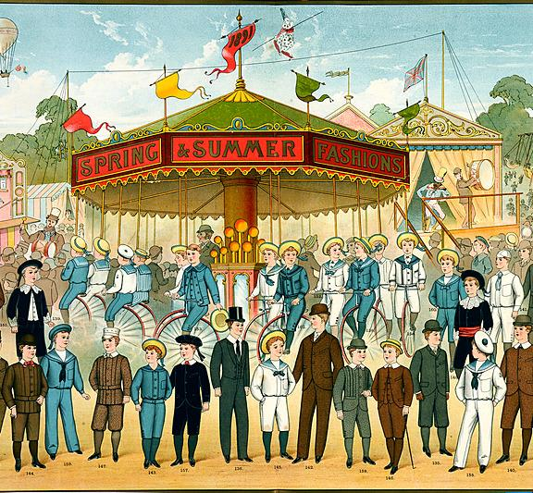
Topic Models
Notes:
So that’s what I’ve been doing
Now I’d like to show you some topic models, so we can think a bit more about them
I’ll show you examples, would be interested to hear your thoughts
We should keep in mind that the lemmatization hasn’t worked and that some texts are pulled in multiple times
* So there is some distortion here, but its enough to get some feel for working with topic models, at least

Slide 8
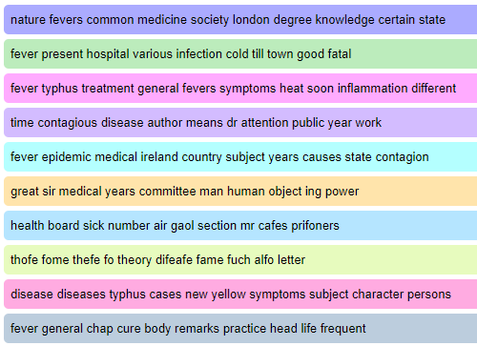
Topic models from Voyant
Notes:
This is a reminder – I briefly showed you Voyant’s topic modelling last time
It would have looked something like this
It wasn’t very clear, at least at first, what “topic” the collection of words might have been relevant to
This was with a small corpus of “typhus”-related texts
I now have a much bigger corpus that is not subject specific, which would make the problem worse...
But I also generate a lot more topics – 500 rather than 10 – which should help a bit
Honestly, it was more effective than I hoped, a lot that seemed to me to have some sort of meaning
But a lot of the topics seemed to be referring to something identifiable.

Slide 9
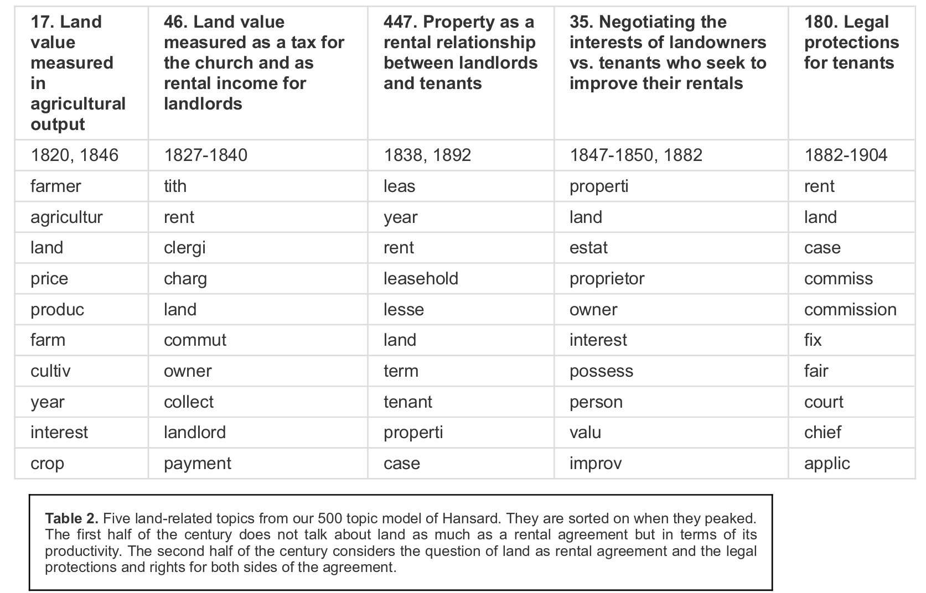
Table of topics from Lee et al
Lee et al., ‘The Role of Critical Thinking in Humanities Infrastructure’.
Notes:
So I’ve brought a couple of examples of “people making sense of topic models”
This one is from the same project that produced HaToRI, so looking at parliamentary debates about land in Hansard
In this case the models have been reviewed by experts in the period, who have suggested what they appear to be about.
They may also have checked the sources that the topics pointed to
I’d need to re-read the paper to be sure
But that would be consistent with the methodology advocated elsewhere by one of the authors
---
Lee, Ashley S., Poom Chiarawongse, Jo Guldi, and Andras Zsom. ‘The Role of Critical Thinking in Humanities Infrastructure: The Pipeline Concept with a Study of HaToRI (Hansard Topic Relevance Identifier)’. Digital Humanities Quarterly 014, no. 3 (25 September 2020).

Slide 10
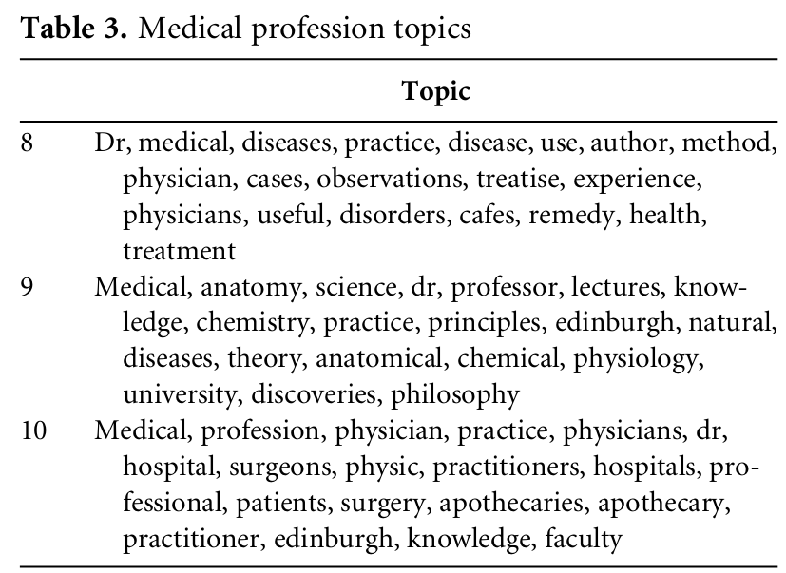
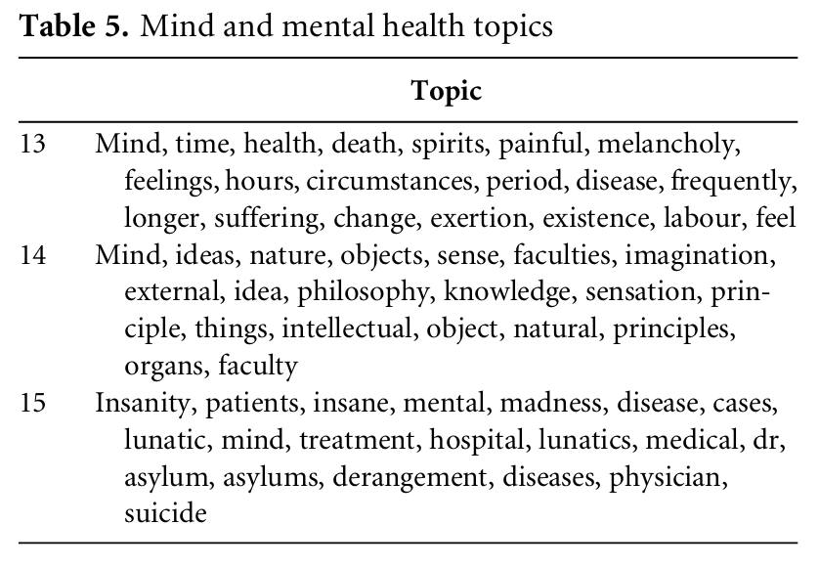
Arnold and Arnold, ‘Medicine in the Monthly Review’.
Notes:
A different approach – grouping topics by an apparent common (less detailed) theme
This is from a paper that was attempting to track medical discouse in a particular magazine
Here we have two groups of three topic models
the first classified as being about the medical profession
the second as being about “mind and mental health”
Arnold, Whitney, and Corey Arnold. ‘Medicine in the Monthly Review: Revealing Public Medical Discourse with Topic Modelling’. Digital Scholarship in the Humanities 37, no. 3 (1 September 2022): 611–29. https://doi.org/10.1093/llc/fqab034. Arnold and Arnold, ‘Medicine in the Monthly Review’.

Slide 11
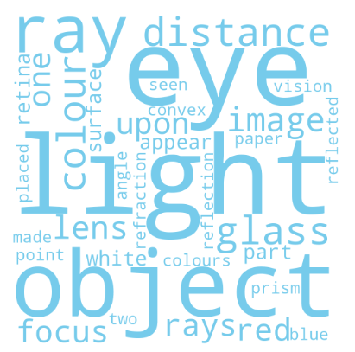
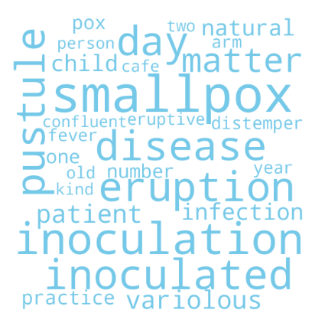
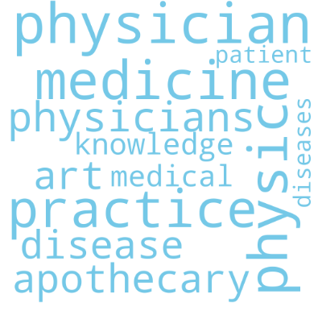
Interpretable topics?
Notes:
So those are a couple of ways to do it
These are some topic models from the work I’ve been doing
HaToRI shows them as word clouds, so the size of the word gives some sense of the relevance of that word in the topic
So on the left here, seems to be something to do with light and/or optics (topic 36)
In the middle, maybe about medicine as profession? (topic 45)
On the right, smallpox inoculation (451)
A quick look at the titles of the texts related to these topics seems to support these as rough interpretations
---
Wording from paper (para 61): “The size of the word indicates its probability within the topic; bigger words are more likely to be sampled from the topic than smaller words.”
Wording from paper (figure 8): [This is the detail view figure] “shows relevance to the topic”

Slide 12
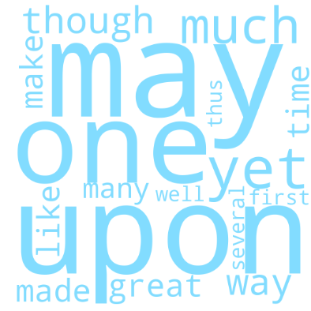
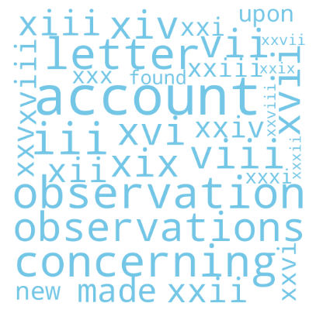
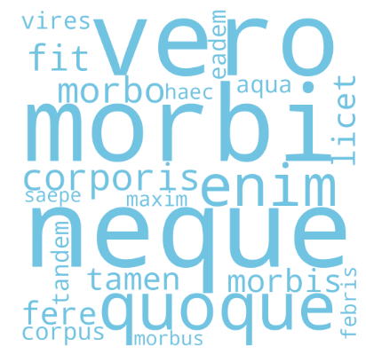
On the other hand
Notes:
These topics seem less useful, in different ways
Left (topic 428) doesn’t seem to be saying anything meaningful, and makes me think I might need to add more stopwords to be removed
Middle (topic 260) i thought maybe this was picking up on title pages, contents, indexes – but it seems like this model came pretty much just from one book, which is “A General Index to the Philosophical Transactions” – which makes sense
Right (topic 474) seems to just be stuff in Latin?

Slide 13
Prompts (1)
Do these seem to make any sense at all? Could you imagine using them? How?
Is it too easy/too hard to attach “meaning” to a topic model?
Helpful for inspiration? Too inspiring?
Notes:
I’d like to pause to explore topic models a bit now
I have some pages of topics from the 18th century, English-only corpus
I’ll give you one each, take a look and see whether you can identify topics for any of them
Are some of them suggestive of more than one thing?
Are some suggestive of nothing at all?
How confident are you in your sense of what the topics is about?
Feel free to collaborate
Lets give it about 5 minutes and then compare notes
You can use these prompts to help if you like, but that’s not compulsory
Is it too easy/too hard to attach “meaning” to a topic model?
One way to approach this is to look at the words they contain – are you ignoring some? Which words help?

Slide 14
HaToRI Exercise
Notes:
So now I’ll show you how HaToRI works
Remember, this is someone else’s tool that has been coerced into working with Wellcome text
Not my own work, so I don’t have all the answers about how it works
I’m guided here by a limited amount of experimentation, and a paper that its creators wrote.
[Demo]
With the remaining time, I’d like to split into groups so that you can each explore it yourselves
And then reconvene, talk about what you’ve found

Slide 15
Activities
Browse the topics
Look for topics relevant to a theme e.g.
Aging
Melancholy/mental health
Disability
Insensitive language
Exploring a particular view (front, home, embedding)
e.g. do topics get more specific lower down in the “home” view?
e.g. do the graphs in the “embeddings” view make any sense at all?
Notes:
These are just suggestions – please do feel free to explore other ideas

Slide 16
Prompts (2)
What is the “right” number of topics?
Would you be comfortable showing topic models to the public?
What works in this interface? What doesn’t? What would help?
Notes:
What is the “right” number of topics?
Comparison – what is the “right” number of subjects in a catalogue?
Bit of a “piece of string” question – in this case, to describe Wellcome’s 18th century collection
Would you be comfortable showing topic models to the public?
They require some interpretation
I think it is probably easy to be misled by them – but that’s just an opinion, not based on serious study
There is certainly a risk of insensitive language leaking through – imagine an offensive term in massive text in the centre of a word cloud...
What works in this interface? What doesn’t?
What doesn’t is probably more useful... and there’s probably a lot of it, this tool was created for a different project with a different purpose
Prompts:
What is the “right” number of topics?
I wonder if cataloguers might have a sense of this from their ontologies
What makes a useful topic?
Are topics hazardous?
Do topics have value for search?
What impression does this view give of the collection? (Perhaps if we sort the topics into broader “themes”)
Do these look like the topics you might “expect”? What is (may be) missing?
How might you use a topic? How might someone else?
(“May be” missing – because it’s impossible to check hundreds of topics during a workshop session!)

Slide 17
What next?
Notes:
More topic models?
e.g. smaller units than whole-text
e.g. sub-topics (build a sub-corpus from a set of topics, then topic-model the sub-corpus)
e.g. topics from a focused corpus (if some relevant texts can be identified)
An alternative technique?
e.g. word embeddings
A nicer/better interface?
Likely makes more sense to try to think of this in terms of “requirements” than technologies – so what else would we like to be able to do?
My feeling is to experiment with using the examples of “aging language” that I’ve been given as a seed corpus, so constructing topics from those and then trying to find similar topics in other texts

Slide 18
Thank you
Bernard Ogden
The National Archives
Kew, Richmond
TW9 4DU

