Slide 1
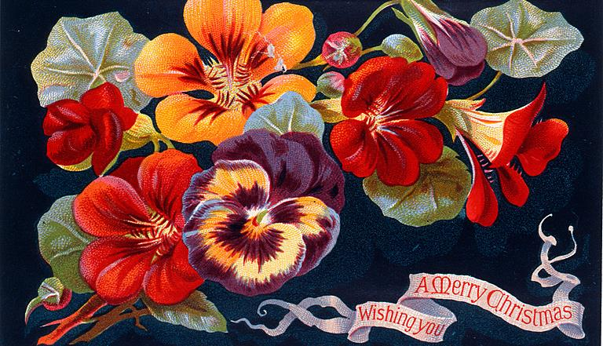
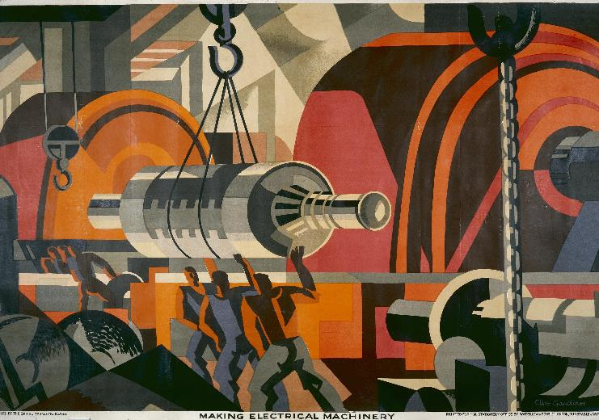
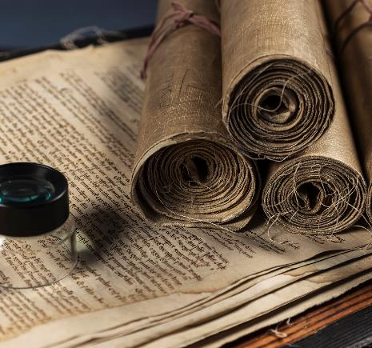
Collaborative Experimentation The Story So Far
Research Software Prototyping for Co-Learning and Exploration in Cultural Heritage
Notes:
Thank you for coming
Some of you will have seen a lot of this before
It might be new to some of you
But I wanted to start this fortnight with a sort of a review and a reboot of the project
In particular, I want to focus more on if and how Wellcome might be able to use text mining for itself and its audiences
I’ve also got some slides in here for newcomers – will go through these very quickly if no-one is new

Slide 2
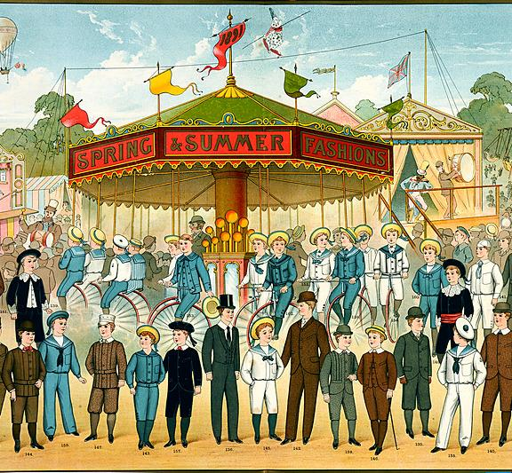
Recap

Slide 3
What is an RLUK/TNA Professional Fellowship?
Per https://www.rluk.ac.uk/professional-fellowships/:
“Focus on a professional-practice question”
“Contribute to a wider piece of work”
“Facilitate shared learning between RLUK & TNA members”
Two weeks of residency with partner institution
Total of 10% of time for one year, including 2 weeks of residency
Notes:
To begin at the beginning, this project is an RLUK/TNA Professional Fellowship
These fellowships are for:
Exploring a professional practice question
Contributing to a wider piece of work
Facilitating shared learning between RLUK and TNA.
Comprise:
A project with a short-term residency with a partner institution
So a staff member at an RLUK library will do a residency at The National Archives and vice versa
Someone at the host institution acts as a mentor – for me that’s been Alexandra and Jonathan
It’s quite a small project -- 10% of time for a year, so works out at a couple of days a month.
I’ve done more than that, with line management blessing
But I have tried to keep it as small as I can
I’ve done about half of my residency as one-day visits
Now I’m here for two weeks at 3 days each, for the other half

Slide 4
What is the project? (1) Interdisciplinary collaboration
Exploring and learning together
Led by digital exploration, but guided by input from as wide a range of specialisms as we can assemble
In the form of workshops organised around discussion of digital artefacts
Notes:
The main point of the project is to explore interdisciplinary collaboration
How do we bring digital and what I variously call collections or humanities specialisms together
In order to identify areas where digital methods can bring some value
And then to explore one or more of those areas
Inspired by the sprint demo from the Agile software development methodology
I’ve been building prototypes and bringing them back here for demonstration and discussion

Slide 5
What is the project? (2) Text mining to discover sources
The interdisciplinary collaboration needs something to explore
Wellcome Library has a large amount of OCR’d material
Offers traditional catalogue search based on metadata
And an API, including some example notebooks
So: use these tools, and “text mining” techniques, to build a corpus of primary sources relevant to a specific theme
Notes:
So what am I prototyping?
I’m mining your texts
The original idea was inspired by Jo Guldi’s critical search
Which is essentially about experimenting with text mining methods
Informed by historical knowledge and with a humanistic critical eye
In this case, using text mining to search your collection
The intention was to look for early modern material on aging
But for one reason and another, haven’t got much past high level explorations of the collection

Slide 6
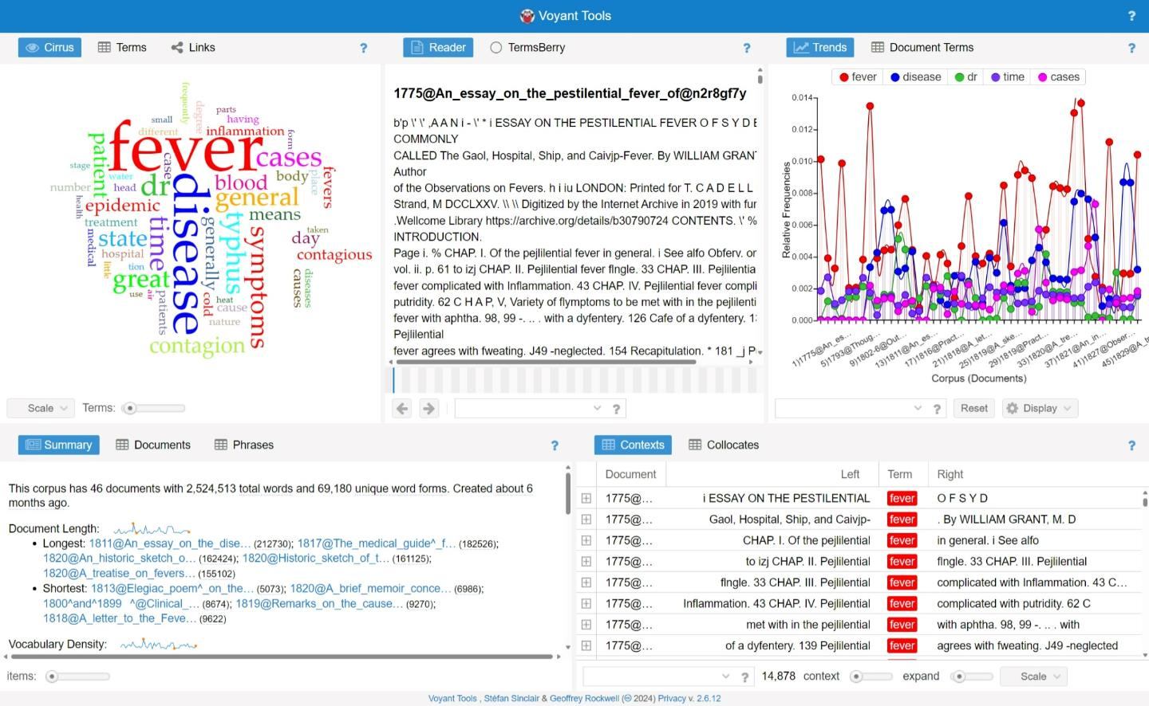
Introduction (May 1st)
Notes:
So, to run over work so far:
The first workshop was back in May and was mainly an introduction to the project as I’d originally intended it
And a demonstration of some text mining methods using a tool called Voyant and a small amount of Wellcome text
I’ll come back to Voyant later

Slide 7
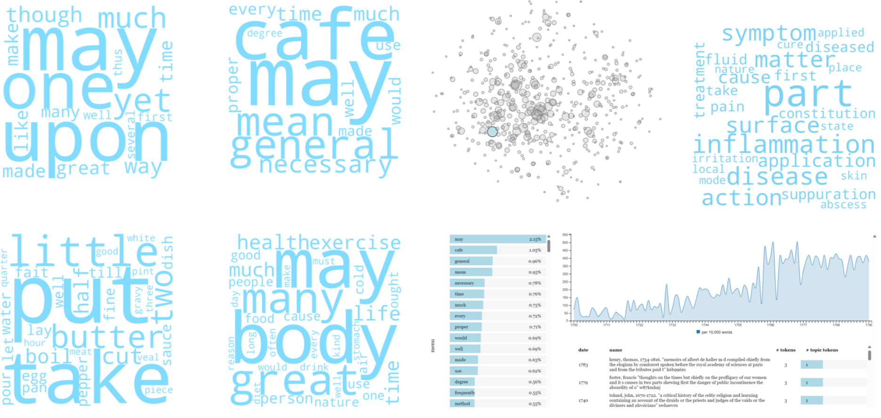
Workshop 1 (June 5th)
Notes:
For workshop 2 I started with a tool called HaToRI
This was created by some digital historians to study Hansard through the medium of topic models
They intended it to be reusable for other data sets
I found it to be not quite as reusable as I’d hoped (but not bad for a DH project)
But did get it to consume a corpus of Wellcome Collection text
Roughly, the English-language, 18th century stuff
HaToRI is a topic modelling tool
Topic modelling uses statistical methods to look for collections of related words
These are assumed to represent topics that the text talks about
Topic modelling can’t put a name to the topics, but it can show you the most important words in each topic
HaToRI renders topic models as word clouds, which are helpful for getting an intuitive sense
So you might be able to see this bottom left topic seems to relate to cooking or recipes
On the other hand, the top left one doesn’t seem to mean anything much
HaToRI offered other views that let you see topics clustered by some measure of their closeness to each other
And to deep dive into the makeup of a particular topic and its occurrence over time

Slide 8
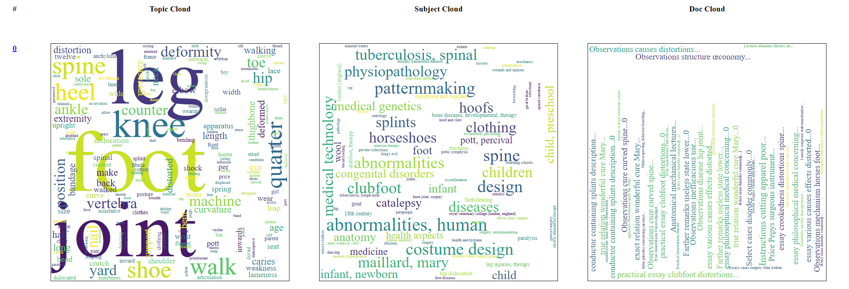
Workshop 2 (July 24th)
Notes:
So that was all good, but a bit tricky to customize
Sticking with topic models, I created my own simple interface, built on a pipeline similar to HaToRI’s
This tried to make use of subject information from the catalogue
I think I also kind of pushed the limits of word clouds
On the left here we have a topic model again
In the middle are subjects that seem to relate to that topic
Based on the catalogue description of the books that are important in the topic
Sizes based on the importance of the books to the topic
On the right are the key titles
At this point I was getting concerned about interpretability
Word clouds are quite intuitive and that seems to make them good for inspiration and suggestion
Sometimes they seem to juxtapose a couple of broad themes, perhaps suggesting a connection of interest
I feel like this happens more with the subject cloud based on catalogue subjects, rather than the original topic itself
What bothers me is that it is very easy to read a story into a word cloud
Its also a bit technically tricky to scale the words right, and we see that particularly in the document cloud, where nothing especially stands out
So I wouldn’t like to use this for direct analysis
But for search and exploration it seems OK
Feedback from the workshop itself was that seeing these three representations side by side was helpful for interpretation
But also general agreement that a word cloud is not the best way to show the titles
At the this point I was also generating different numbers of topics
When we topic model, we tell the algorithm how many topics to divide the corpus into
If we look for a small number of topics we should get a high level view of main themes in the collection
If we look for a large number of topics we hopefully get a more fine-grained view
Though we might also get quite a lot of repetition

Slide 9
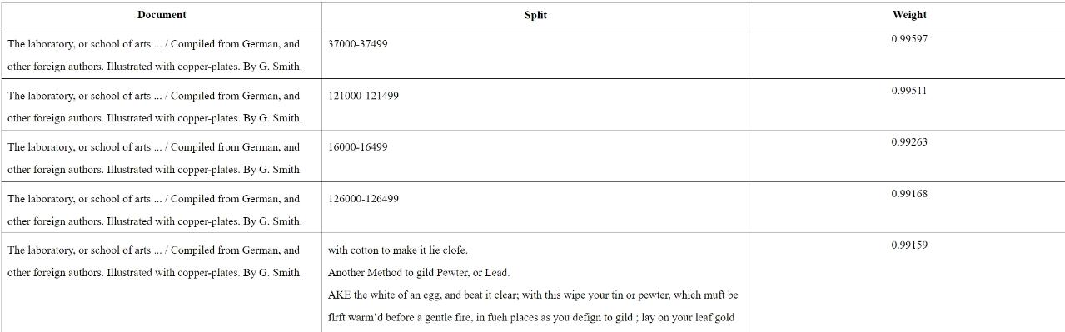
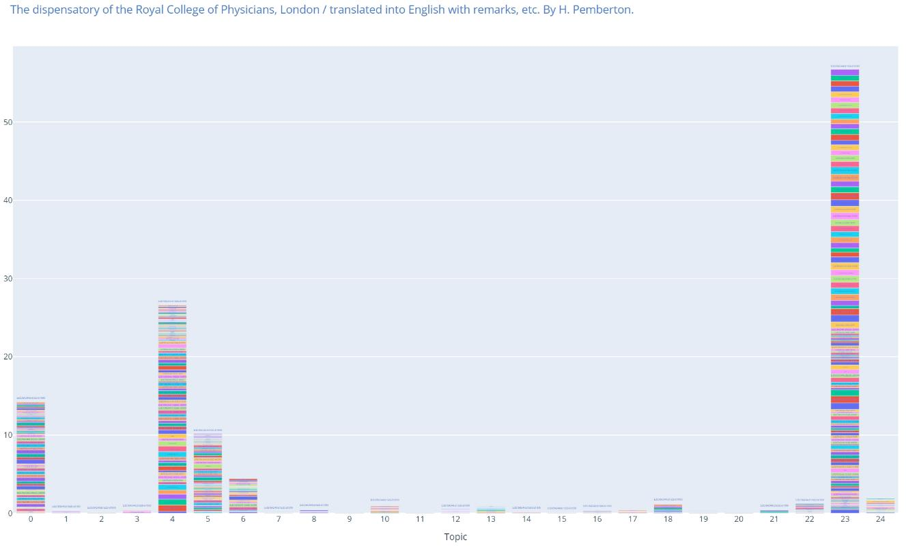
Workshop 3 (25th September)
Notes:
Bit of a break for summer, came back in September
Now I’d changed the way that I was building topics
Instead of feeding texts one at a time into the modeller, I fed snippets of 500 words at a time
The thinking being that this would make it easier to pinpoint passages of relevant text
The main interface for this prototype was the word clouds, as on the previous slide
This slide is showing a couple of other views
One allows viewing the snippets of text making up the topic, ordered by their importance to the topic
The other shows the topics in a single book
Each column is a topic
Each block inside a column is a 500 word chunk
The size of the block indicates importance of that chunk to the topic
Ideally, similar books will have similar-looking graphs

Slide 10
Topic Model Reflections
High computational cost
Potential for summarization & exploration
Search is hard!
Notes:
Require a lot of time and compute to preprocess data
There is a lot of text to handle, and to transform into shapes that work well for topic modelling
Enough to push the limits of what computers can easily or quickly do
So I’ve spent much more time than I expected dealing with just plain software engineering problems around marshalling large volumes of data
And doing intensive compute with them
That said:
I have strong suspicions that the computer I’m using isn’t working quite right, possibly something is up with disk IO
So the compute is a lot, but its probably not quite as much as it feels like, given the computer I’m working with
And once the pipeline is built it is possible to just let it run and produce more and more data/models
Still, building and running the pipeline has been a lot of the work
Which has left little time for analysis of what comes out of the pipe!
From what little analysis I have been able to do, I would say that topic modelling seems to have potential for summarization and exploration
I have certainly learned things about the collection, e.g. horses
Sometimes models seem to juxtapose a couple of themes e.g. religion and medicine
Combining views of models with other views seem especially effective
I’ve found the catalogue subject clouds especially helpful
However, there are risks of misinterpretation
There’s likely more potential to develop here e.g.
linking texts together based on topics rather than catalogue subjects
getting a “topics” sense of what is in a book
Search is harder
This is with the caveat that I haven’t found much time to dig into search, which is a pity
I wonder if there is something about early modern aging as a theme (or the way that it manifests within the collection) that might make topic modelling an inappropriate way to look for it
There are other ways to do topic modelling that might be more effective
e.g. taking an approach based on sentence embeddings rather than treating each word in isolation
e.g. sub-topic modelling, where we start with a topic and break it into sub-topics to explore
But this is all very speculative
And specific to topic modelling, other text mining approaches might prove more effective

Slide 11
Taking Stock
Notes:
So that was the the one-day visits and a bit of reflection on what came out of them
Since September I’ve had a bit of time to take stock and talk to mentors a bit
Also been writing a paper about the fellowship so far, which was really helpful for taking a breath and thinking rather than doing
I didn’t originally mean to make this project about topic models
That happened more for efficiency
Once I’d started going down that path, it was easier to prototype new things around it that to jump to something else
But that means I’ve gone probably too deep and narrow
The point of this is to explore, learn, collaborate
Too much technical depth too early is perhaps not conducive to that
I’ve got a lot out of the sessions I’ve run here so far and had useful feedback that has helped me in shaping the prototypes
But for this 2 weeks I’d like to take a step back and refocus more on possibilities for using text mining in general
So not so much a focus on using topic models for search, which is a bit esoteric
But more on exploring possibilities of text mining in terms of uses which might have value for Wellcome
And might be of interest to Wellcome’s audiences
Alexandra has mentioned developing the digital audience
That can include topic models, but doesn’t have to be limited to them
(And I might squeeze in a bit of “topics for search” but suspect that I won’t have time)
I’ve brought some text with me that’s been through a lot of processing to prepare it for analysis
It’s all eighteenth century and English, but within that I can slice it up in various ways

Slide 12
Plan (for this morning)
Demo
Optional “have a go” time
Notes:
So my plan for the remainder of the morning is to demonstrate some text mining techniques, mainly using Voyant
And then, as Voyant is just online, it would be nice to give you all some time to explore it a bit
I can give some guidance/support with getting it to work or trying to make sense of what is coming out of it
But only if you want to, please do feel free to skip that part if it will not be useful for you

Slide 13
Plan (for this fortnight)
Thursday 14th: Paper prototyping/dream tools
Wednesday 20th: Cat Chat
Thursday 21st: Wrap up & reflections
Notes:
So these are sort of fixed points in the week, otherwise I’ll be working on those possibilities I mentioned earlier, or preparing the things on this slide
But I am very much available for anyone who would like to explore an idea
That top item maybe needs a bit more explanation
I’m hoping that the remainder of today will plant some ideas and that on Thursday we can sketch out some ideal interfaces or visualisations building on text mining concepts, that would be of some relevance to what you do here at Wellcome.
Another way to think of this is “dream tools”, which is an exercise a couple of placement students did with me earlier this year
In which they started from the assumption that technical limits were no barrier, and described tools that they would like to exist
Which was quite illuminating about ways that humanists might seek to make use of digital tech
Please don’t feel obligated to come if that sounds horrifying, but I hope it’ll be fun
My hope is that it will be helpful in identifying possibilities, ways that the digital can be used to enhance your collection or practice in some way
The Cat Chat is just to talk a bit more broadly to Wellcome about the project
These slides have been a wrap-up of sorts, the wrap up session will be more about this visit
But for the willing, I’d like to do a whole-project reflections activity
That could be really helpful for writing up on what has and hasn’t worked in this approach to collaboration

Slide 14
Possibilities
Automatic classification
Summarization
Representation
Detecting offensive language
...
Notes:
So I’m really interested in exploring other possibilities or hearing more about what might be useful for you, for new or existing audiences
These are just possibilities that have come up during the course of this project [or possibly I might have made some of them up]
I would love to expand on this, and that’s one thing that I’d like to revisit on Thursday with anyone who is willing
I’m also very happy to work one on one with anyone who has a particular thought or idea to explore while I am here
Automatic classification
Can we use text mining techniques to suggest subjects for books that currently have none in the catalogue?
Summarisation
Using topic models, graphs of topics etc to summarize the content of a text or a collection of texts
Representation
I could imagine doing this as a small part of a physical exhibition, as a part of an online exhibition, in tools that allow digital audiences to engage with the collection
Detecting offensive language
Scanning texts for offensive language, or even phrases that contain no out and out offensive words, but are offensive in their content
...
I’m sure those are more, those are just the ones in my head, I think they follow largely from things that have been mentioned on prior visits

Slide 15
Demo
Notes:
So to try to plant some ideas, I’d just like to run back through Voyant
As I’m working through this, please just have in mind potential uses, potential audiences, really any ideas at all
Please feel very free to interrupt, we can pause to discuss things, try things out etc

Slide 16
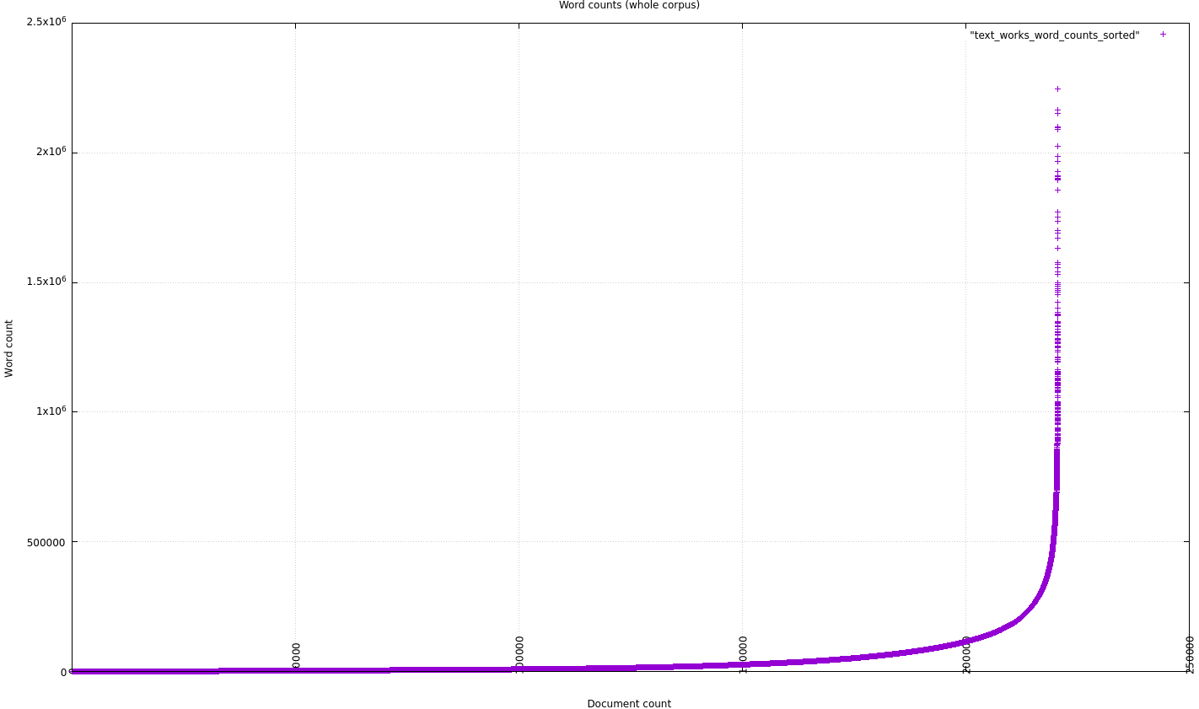
Sorted word counts
Notes:
But first, if we’re thinking about what can be done with “data methods” to reach new audiences, we can think a bit more generally
Though I’m mainly focused on text analysis, more traditional data can also be interesting or telling
This is the word counts of my 18th century corpus, which tells us something about the lengths of books over this time (as represented in your collection)
Word counts, normal scale, size-sorted

Slide 17
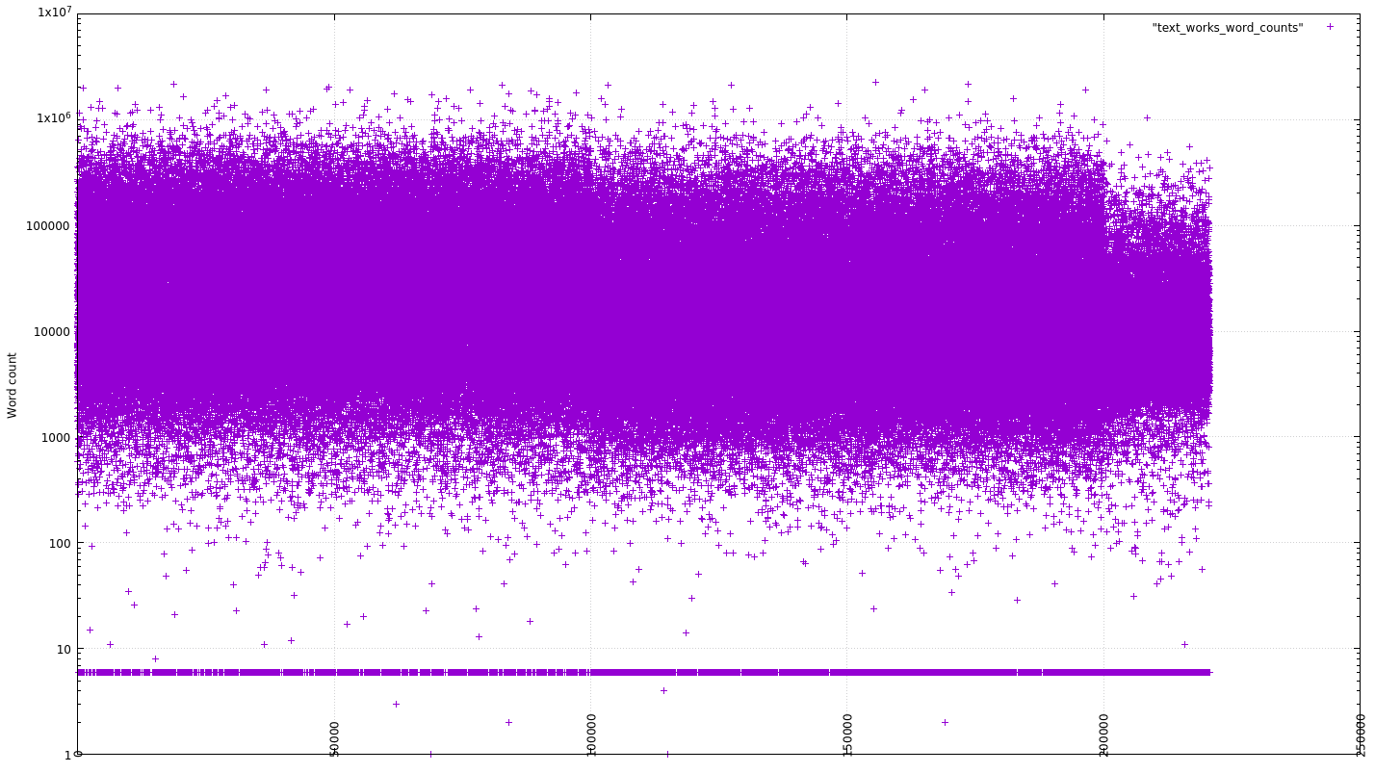
Unsorted word counts
Notes:
This is the same thing, visualised in a different way, that perhaps makes the point about the typical size range more clearly
There must be a very large range of visualisations of this sort that can be generated just from data in the catalogue
Something like number of books over time, number of words over time, might be interesting... or at least I would find it interesting!
Or from data in the catalogue plus simple operations like word counts
Word counts, log scale, unsorted
The large number of 6-word documents are mostly “No text resource found for X”

Slide 18
Thank you
Bernard Ogden
The National Archives
Kew, Richmond
TW9 4DU

