Slide 1
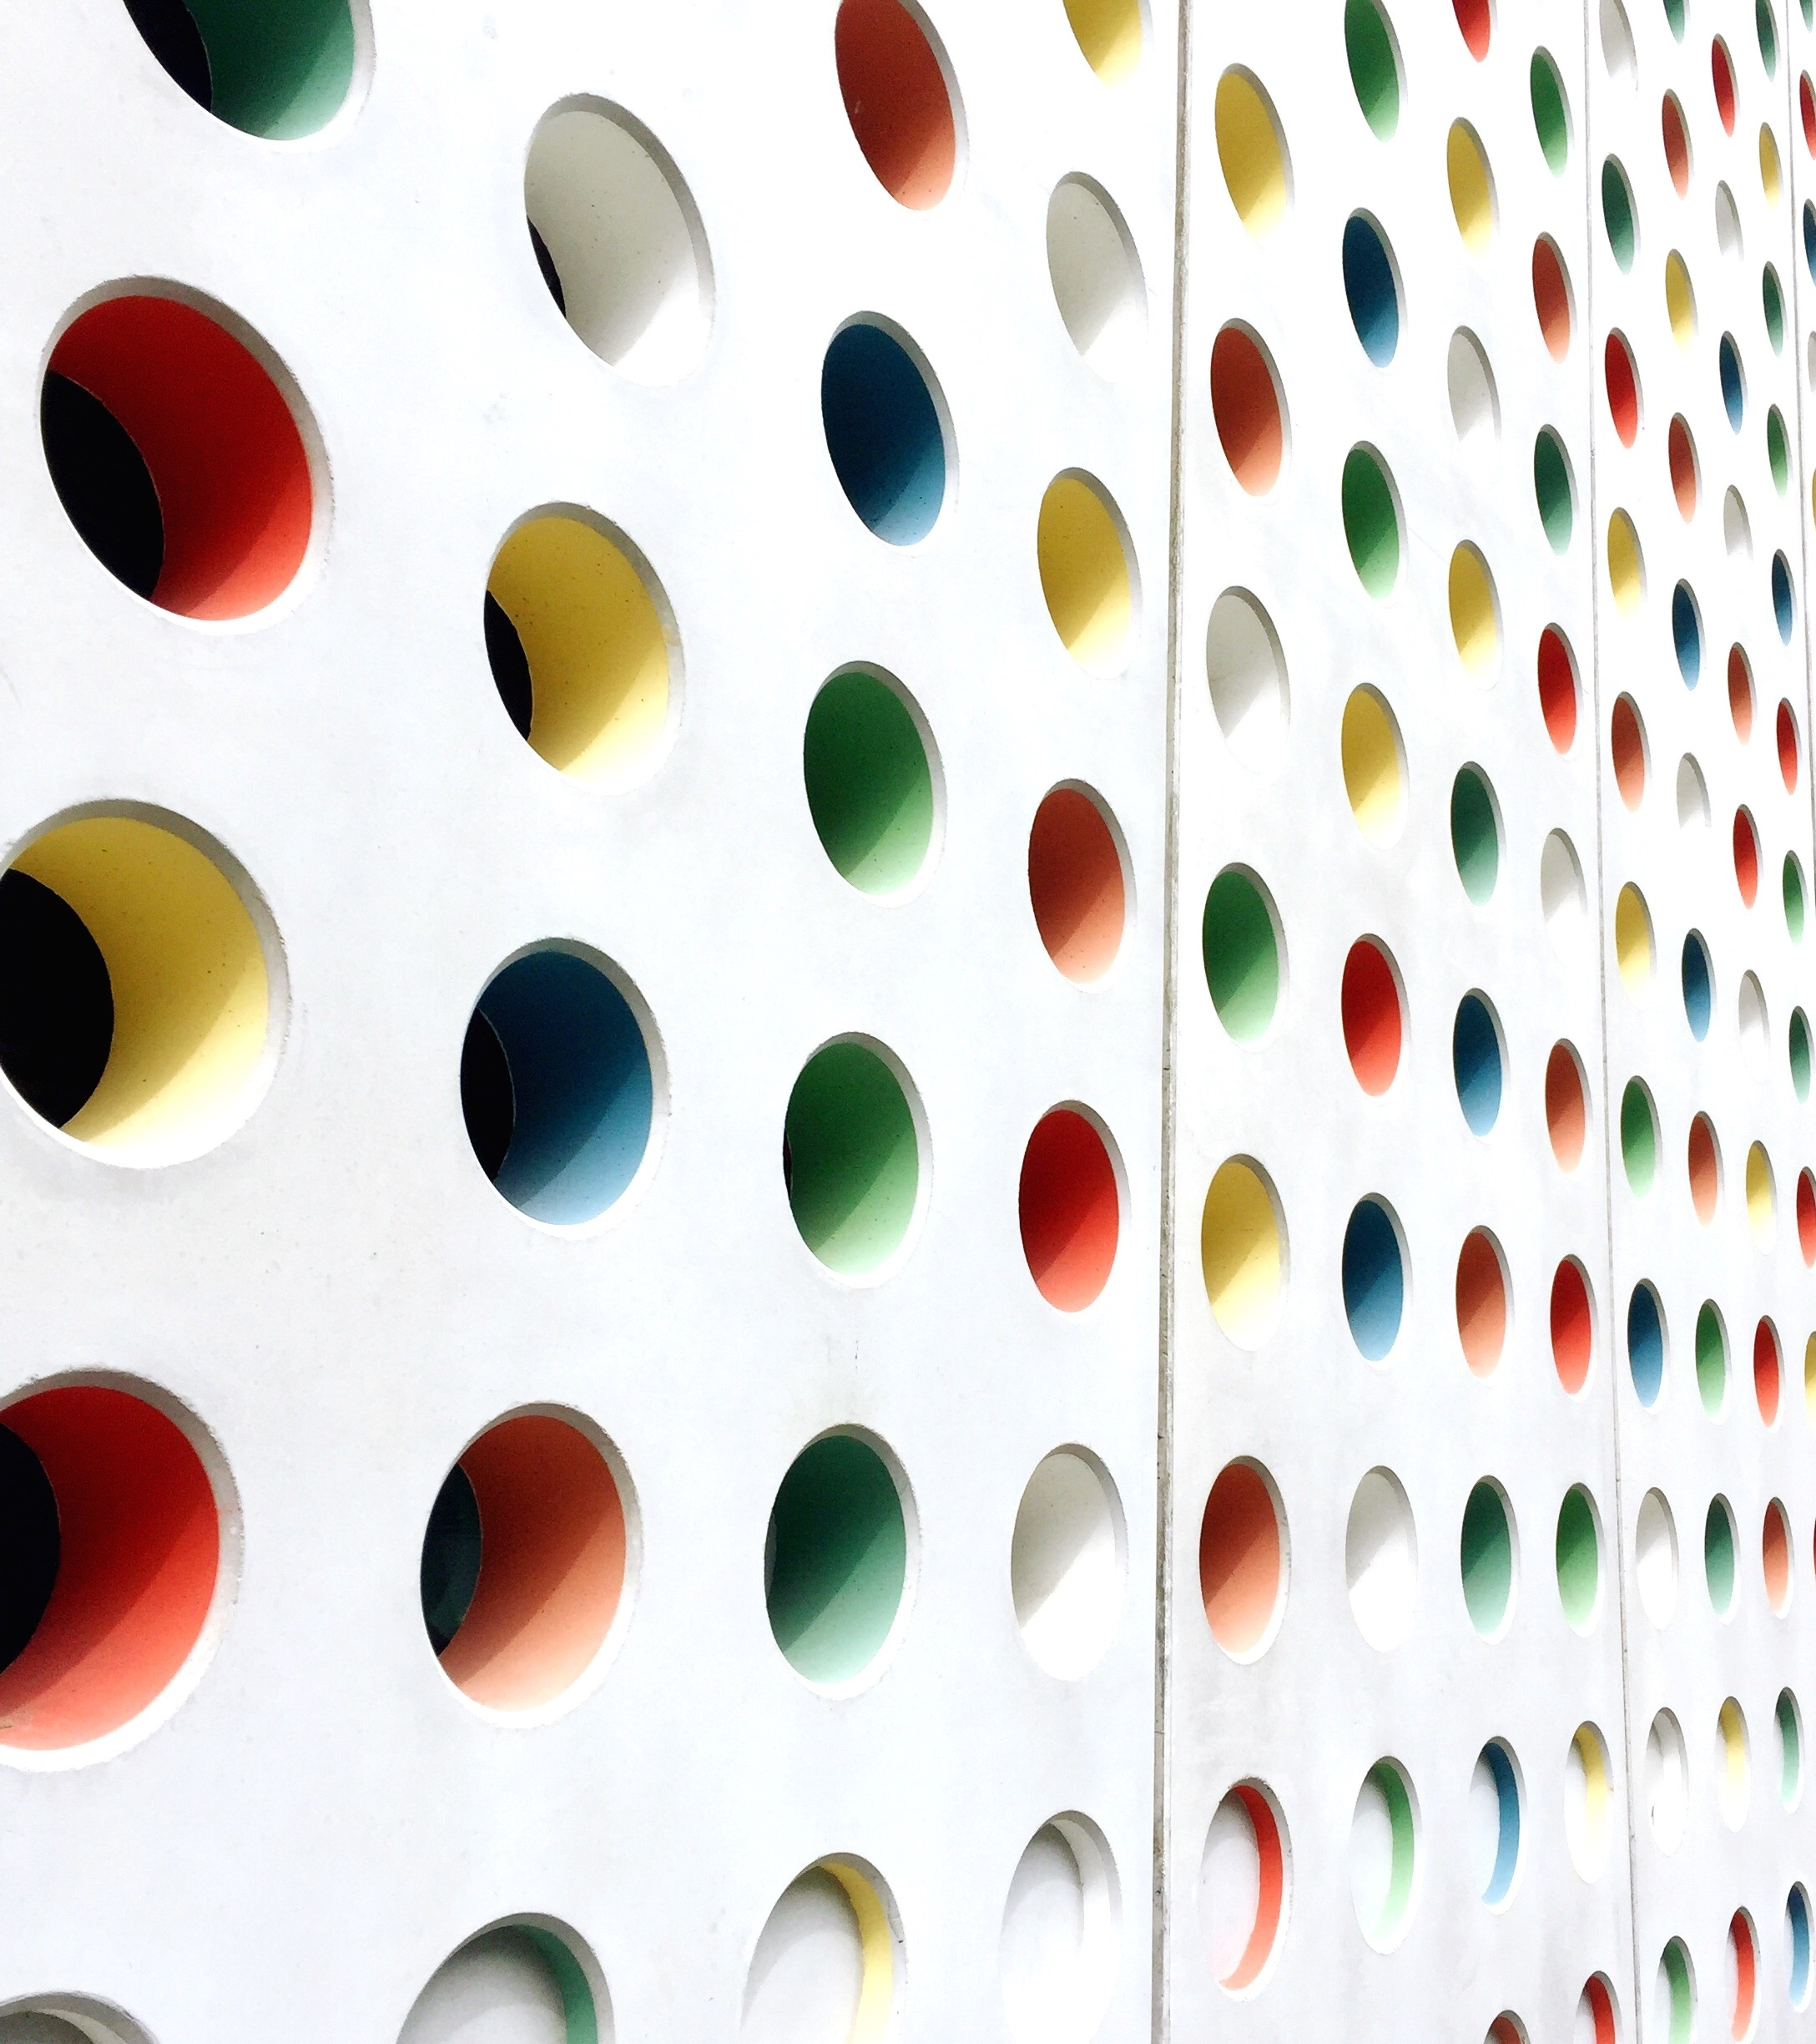
Blind Assistance
Presentation for pdi

Slide 2
Objectives :
➔ To provide mobility assistance to visually impaired individuals.
➔ To enhance the independence and safety of blind individuals through the use of robotic . technology.
➔To integrate Hector-SLAM and Machine learning to improve the robots ability to navigate . . and interact with its environment.
➔To provide an affordable and accessible solution for blind individuals.
➔To improve the quality of life of blind individuals by reducing their dependence on human . Assistance.

Slide 3
Origin of the idea and State of art :
➔In the 21st century, technology has made significant advancements and has greatly impacted every aspect of our lives. One of the areas where technology can make a positive impact is in the lives of people who are blind or visually impaired. This inspired the creation of a smart and environment-aware blind stick, which provide greater independence and convenience for these individuals.
➔Compared to traditional manual sticks, this new device offers numerous advantages. It uses sensors and other advanced technologies to detect and alert the user about obstacles, provide audio instructions. This device aims to make navigation easier, safer, and more enjoyable for those who are blind or visually impaired. By incorporating technology into the design, the smart and environment-aware blind stick helps to improve the quality of life for those who use it, and provides a more comprehensive and user-friendly experience.

Slide 4
Methodology :
Mapping and Navigation Mechanism :
We will build a map of our environment using the ROS Hector-SLAM package. Hector-SLAM is an algorithm that uses laser scan data to create a map in RVIZ.
SLAM is a popular technique in which a robot generates a map of an unknown environment (i.e., mapping) while simultaneously keeping track of its position within that map (i.e., localization).
After creating the map using the AMCL algorithm we are going to perform the localization. And we are going to perform the navigation tasks using ROS packages.

Slide 5
Voice Assistance :
We will be incorporating a voice assistance similar to alexa which can respond to user commands like navigate to the [place], where am I?, etc. The voice assistance can also inform the user about his location, the people present around the user, any obstacles present.
Voice assistant is the convenient way for a visual impaired person to communicate the instructions and know about his environment.
Voice assistant will be built in form of a chatbot which can perform specific functions respective to the given commands and can report the necessary data. We will use a pre-trained ML model for speech recognition to work in offline and software libraries like Picroft to implement it on Raspberry pi.
Image Processing:
Using a camera module connected to Raspberry pi the stick can detect the people and any obstacles that are present. User will be able to register the faces of people and user will be notified when they are present in scene. This allows user to be aware of the important people around him.
We will detect people using computer vision libraries like Face Recognition and obstacle detection will be done through image processing in OpenCV.

Slide 6
Deliverables :
➔Improved mobility and independence for visually impaired individuals.
➔Enhanced safety for blind people while navigating.
➔Development of new and innovative navigation solution.
➔Increased awareness about the challenges faced by visually impaired individuals.

Slide 7
THANK YOU

