Slide 1

Introduction to
Luca Bognolo

Slide 2
Agenda
Testing is not a dirty word
The red corner
  The old battler
  A quick look at the code
The black corner
  The alien defender
  Another look at the code
Q&A

Slide 3
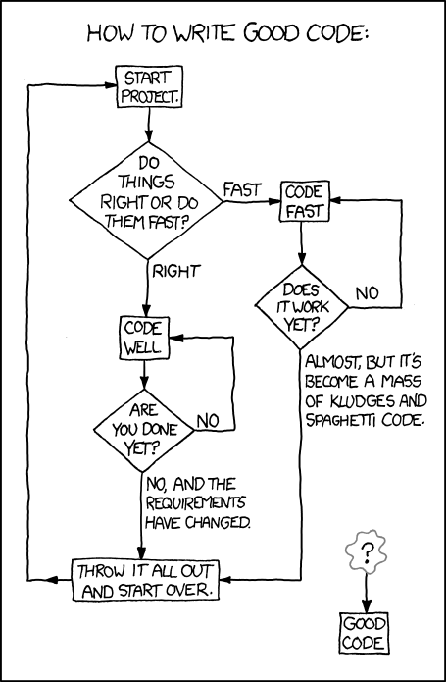
Testing is not a dirty word
Hey, we are only trying to create “good code”, right?
xkcd.com
Notes:
Is there any hope​ for us?

Slide 4
Testing is not a dirty word
“
The purpose of automated testing is to enable change. Verifying correctness is just a nice side effect.
Jeremy Norris
“
Notes:
A nice sentence to frame the scope

Slide 5
Testing is not a dirty word
Tests need to
be fast to be run often
portable if the environment changes
run in the IDE and the CI tool
ensure the implementation matches the design in the face of refactoring
Notes:
Set the match rules

Slide 6

The red corner
In the red corner:
JUnit, the old battler
also representing
TestNG
Spock
JBehave
???

Slide 7

The red corner
JUnit's (not-so) secret disease:
MOCK CLASSES!

Slide 8

The black corner
In the black corner:
Arquillian, so you can rule your code. Not the bugs!

Slide 9
The black corner
Arquillian extends your preferred test framework:
JUnit
TestNG
Spock
JBehave

Slide 10
The black corner
@RunWith(Arquillian.class)
public class SomeTest {
@Deployment
public static Archive<?> deploy() {
… create someArchive …
return someArchive;
}
@Test
public void someTest() {
… perform some test …
}
}

Slide 11
The black corner
@RunWith(Arquillian.class)
public class SomeTest {
@Deployment
public static Archive<?> deploy() {
… create someArchive …
return someArchive;
}
@Test
public void someTest() {
… perform some test …
}
}

Slide 12
The black corner
Websphere
WebLogic
Spring
Weld
Arquillian deploys to your preferred runtime:
JBoss AS
Glassfish
Jetty
Tomcat

Slide 13

The black corner
Use ShrinkWrap for all your wrapping needs
ShrinkWrap.create(JavaArchive.class)
.addClasses(x)
.addPackages(y.z)
ShrinkWrap.create(WebArchive.class)
.addAsLibraries(x)
.addAsWebInfResource(y)
.setWebXML(z)
ShrinkWrap.create(EnterpriseArchive.class)
.addAsModules(war, jar)
.setApplicationXML(x)

Slide 14
The black corner
So... how does it work?

Slide 15
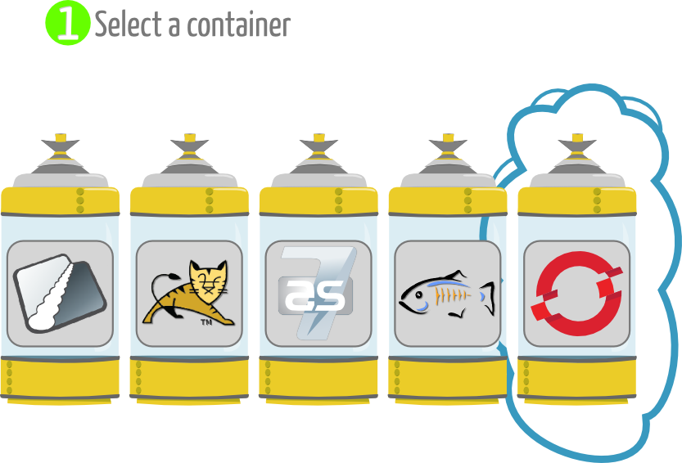
The black corner

Slide 16
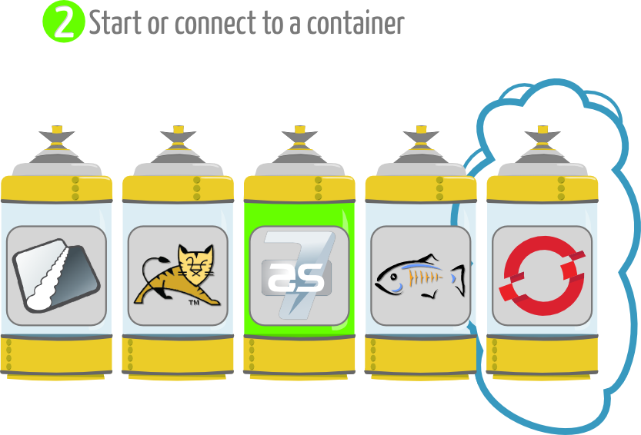
The black corner

Slide 17
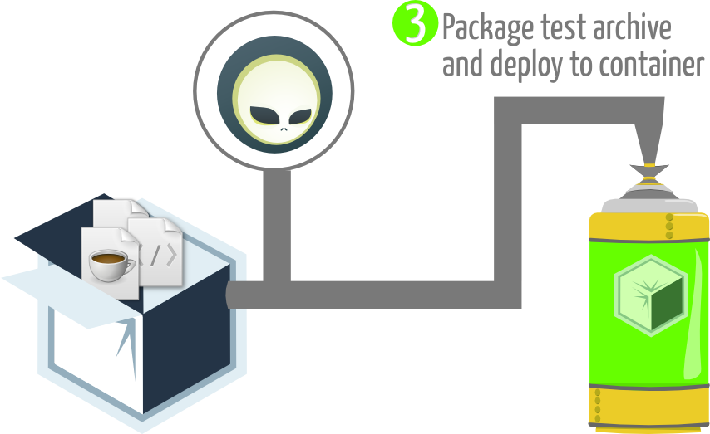
The black corner

Slide 18
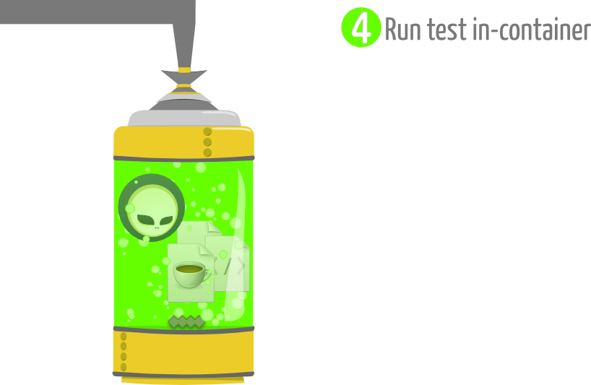
The black corner

Slide 19
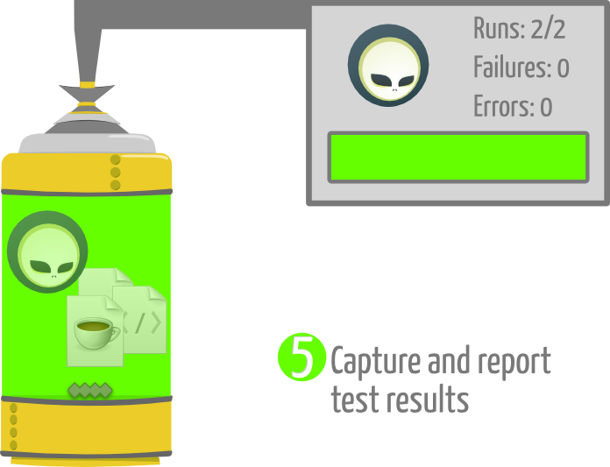
The black corner

Slide 20
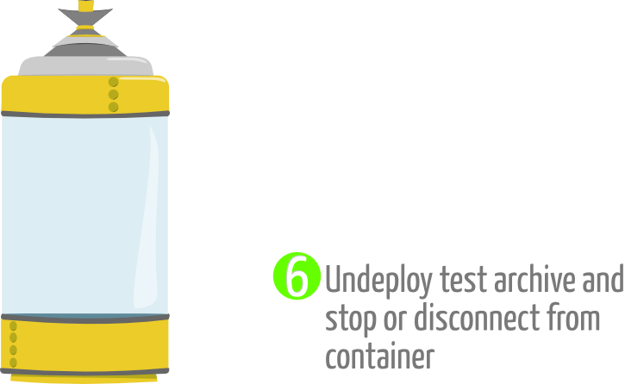
The black corner

Slide 21
Summarising...
Writing unit tests is not all bad news
Your “standard” unit testing framework works best when the scope is limited
Arquillian provides access to container features by extending your “standard” testing framework

Slide 22






