Slide 1
Search Engine
John Call & Lia Bogoev

Slide 2
Main contributions
Search algorithm in Python
Eliminates stop words
Implemented a document ranking function
Sorted results by rank
Can accommodate extended Boolean search operators
this AND that OR thing
Fancy interface
Implemented using JavaScript, HTML, CSS, and negligibly PHP

Slide 3

Data structures
Variable-length Arrays
Simple list of DOC
Python’s list ≡ array
Dictionary
Best suited for our needs
Great time complexity
$O(1)$ to retrieve
class DOC:
# document frequency statically referenced
# each key maps to an array of DOC references that have that key
docsHave = dict()
def __init__(self, file):
# prep the xml parser
doc = xml.parse("documents/" + file).getroot()
# index words in document
self.docHas = dict()
self.__index(self.title)
self.__index(self.author)
self.__index(self.biblio)
self.__index(self.text)
def __index(self, str):
# replace punctuation delimiters with whitespace delimiters and split
for word in re.sub('[^\w]+', ' ', str.upper()).split():
# don't index unnecessarily short words or numbers
if word not in stopWords and re.search('[a-zA-Z]', word):
if not word in DOC.docsHave:
DOC.docsHave[word] = []
if not word in self.docHas:
DOC.docsHave[word].append(self)
self.docHas[word] = 1
else:
self.docHas[word] += 1

Slide 4
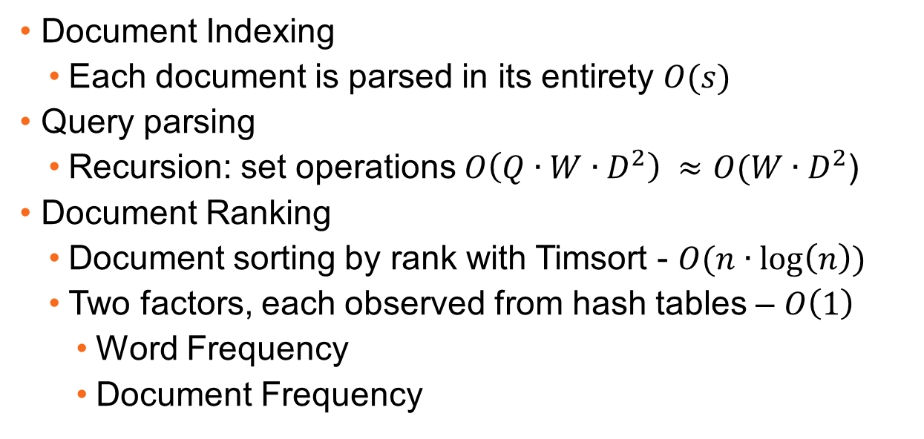
Algorithms
Document Indexing
Each document is parsed in its entirety $O(s)$
Query parsing
Recursion: set operations $O\left(Q∙W∙D^{2}\right) ≈O(W∙D^{2}$)
Document Ranking
Document sorting by rank with Timsort - $O(n∙\log\left(n\right))$
Two factors, each observed from hash tables – $O\left(1\right)$
Word Frequency
Document Frequency

