Slide 1
Search Engine
John Call & Lia Bogoev

Slide 2
Main contributions
Search algorithm in Python
Eliminates stop words
Implemented a document ranking function
Sorted results by rank
Can accommodate extended Boolean search operators
this AND that OR thing
Fancy interface
Implemented using JavaScript, HTML, CSS, and negligibly PHP

Slide 3
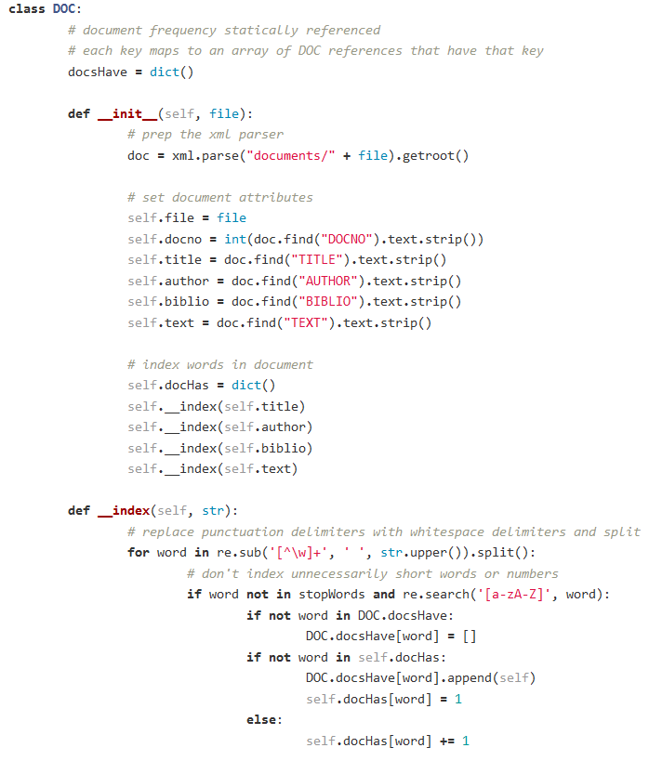

Data structures
Variable-length Arrays
Simple list of DOC
Python’s list ≡ array
Dictionary
Best suited for our needs
Great time complexity
$O(1)$ to retrieve

Slide 4
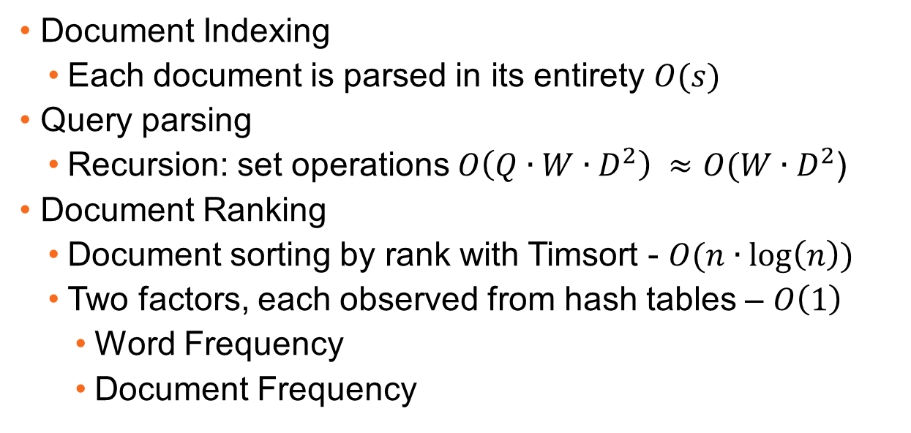
Algorithms
Document Indexing
Each document is parsed in its entirety $O(s)$
Query parsing
Recursion: set operations $O\left(Q∙W∙D^{2}\right) ≈O(W∙D^{2}$)
Document Ranking
Document sorting by rank with Timsort - $O(n∙\log\left(n\right))$
Two factors, each observed from hash tables – $O\left(1\right)$
Word Frequency
Document Frequency

Slide 5
