Slide 1
COVID-19 new cases classifier
Bogumił Wierzchowski

Slide 2
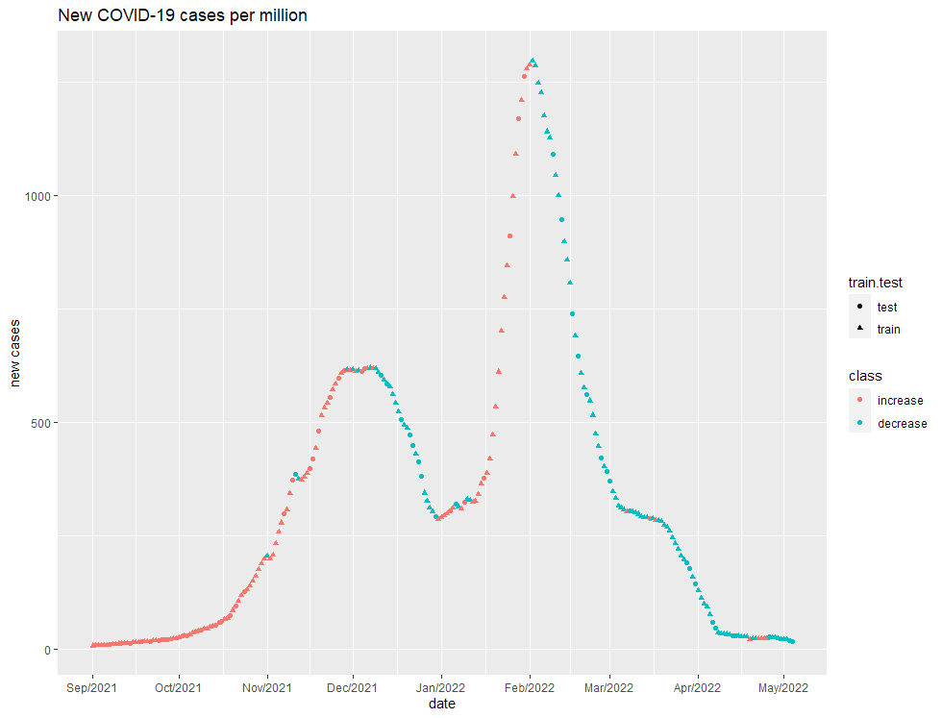
Data
Data gathered by the Center for Systems Science and Engineering (CSSE) at Johns Hopkins University
From September 2021 to May 2022
75%/25% train/test split
All data relative to population
Smoothed by a moving average with a length of 7

Slide 3
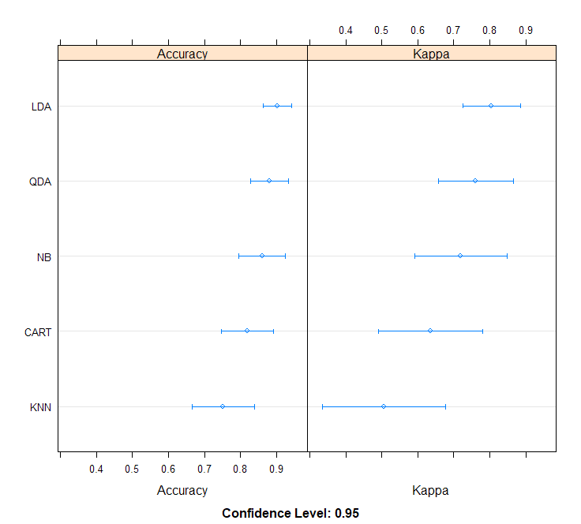
Classifiers validation
10-fold cross validation on train set
KNN validated on grid from 2 to 20 NN
Factors used for classification: new deaths, new vaccinations, new tests, tests per case + daily increases for all of them

Slide 4
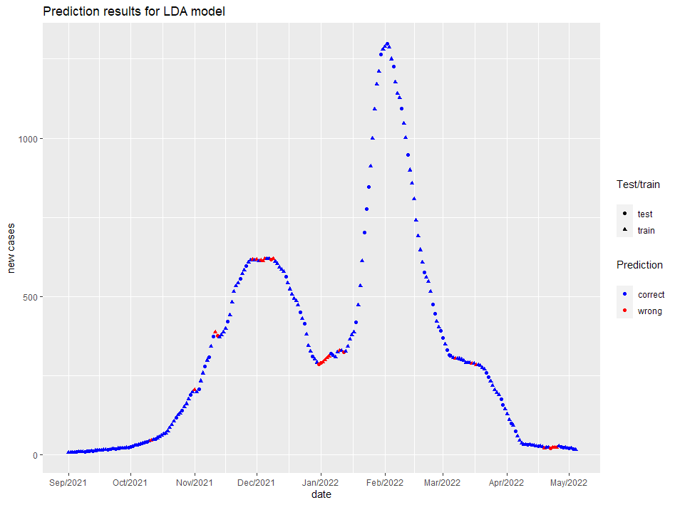
LDA model results
Train accuracy: 0,886
Test accuracy: 0,902
Total accuracy: 0,890

Slide 5
Sources
Data on COVID-19 (coronavirus) by Our World in Data (https://github.com/owid/covid-19-data/tree/master/public/data)
Used R libraries: Hmisc, ggplot2, caret

