Slide 1
K-means Clustering
Aliaksandr Zaman 109163, Bogdan Yanovich 109072

Slide 2
Agenda
What is K-means clustering How does it work Algorithm | Dataset information Data exploration Analysis and results | Multi-class confusion matrix Classification metrics

Slide 3
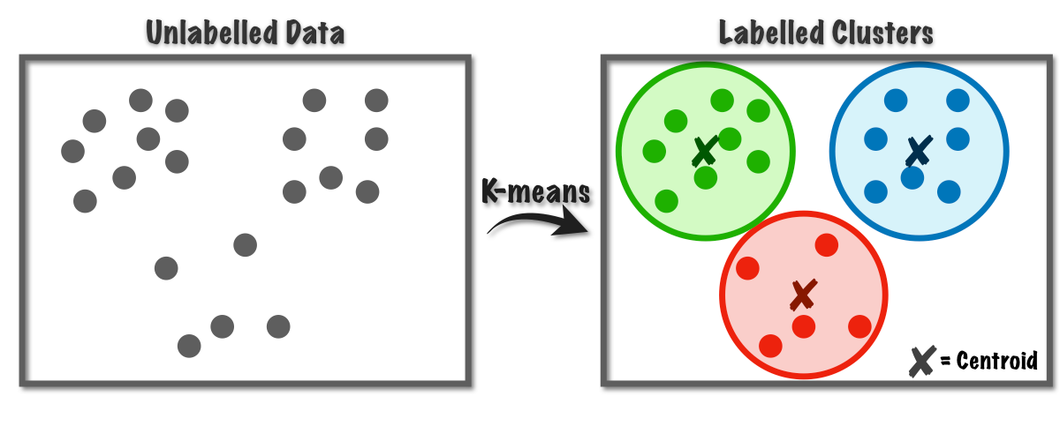
What is K-means clustering
It is an unsupervised machine learning algorithm used for clustering. Clustering, in essence, is a methodology that groups data points into clusters or cohorts based on their inherent similarities. K-Means employs a "centroid-based" strategy where each data point aligns itself with the closest centroid, ensuring that data points within each cluster exhibit strong similarity.

Slide 4
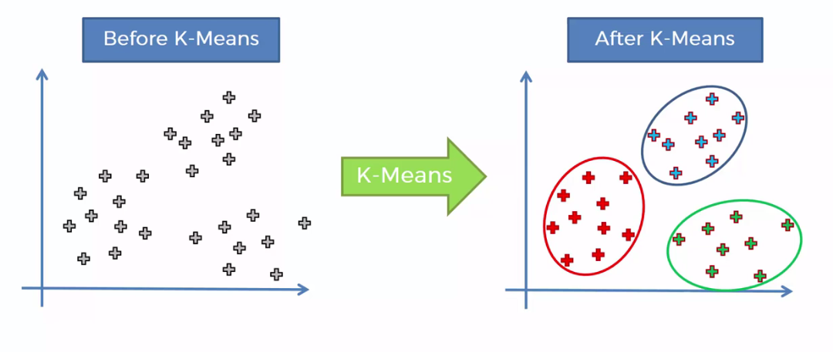
How does it work
To classify (assign class) some data point using K-means we need to perform the following steps:
Select the number of clusters, k
Set k cluster centroids
Make k clusters
Compute new centroid for each cluster
Assess the quality of each cluster
Repeat steps 3-5

Slide 5
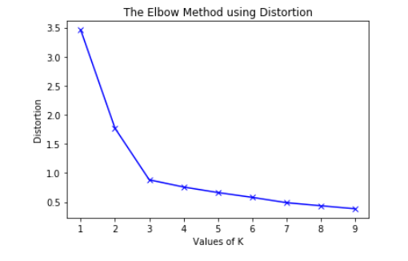
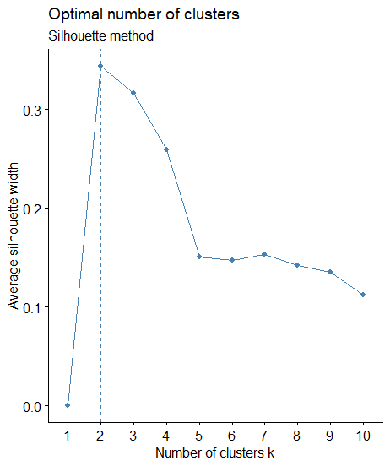
How many clusters should I create?
There are 2 popular methods:
Elbow method - choose the number of clusters at the point where the rate of decrease in WCSS sharply changes, forming an elbow shape.
Silhouette width method - provides a silhouette score for each number of clusters, and you want to choose the number of clusters that maximizes this score.

Slide 6
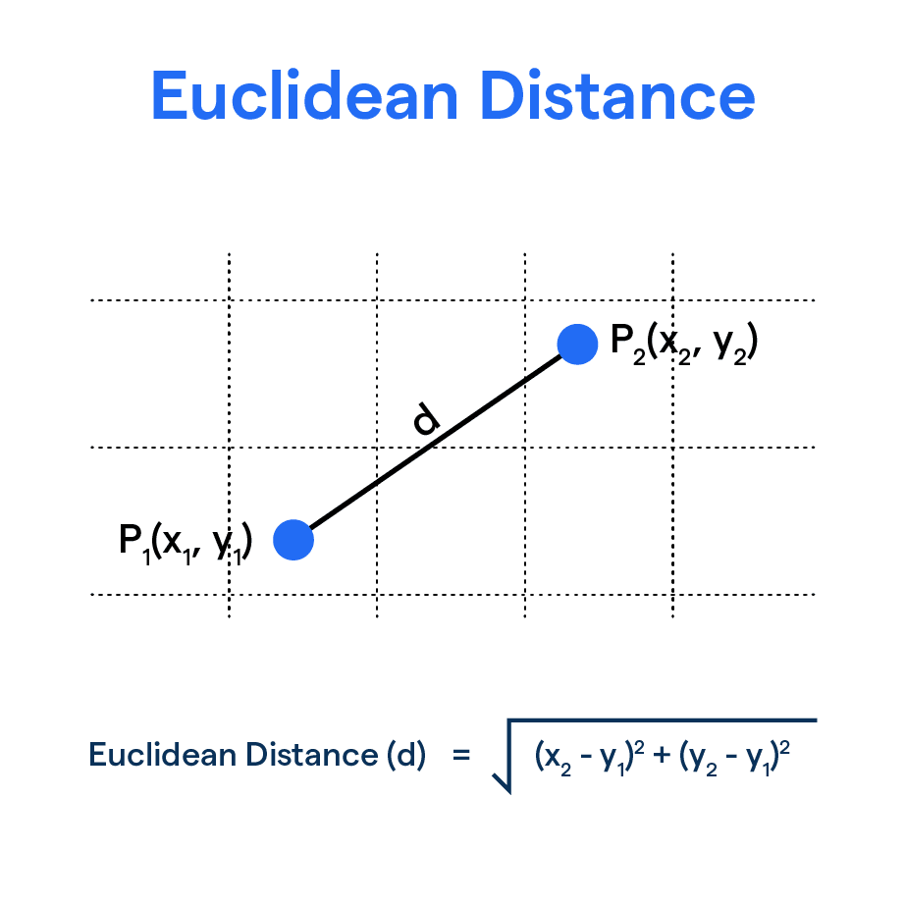
Centroids and clusters
Initial centroids are randomly chosen data points. They would be the centers of the original clusters.
Clusters are created by calculating the distance from every data point to each of the centroids. After calculating all the distances the point is assigned to the cluster with the closest centroid.

Slide 7
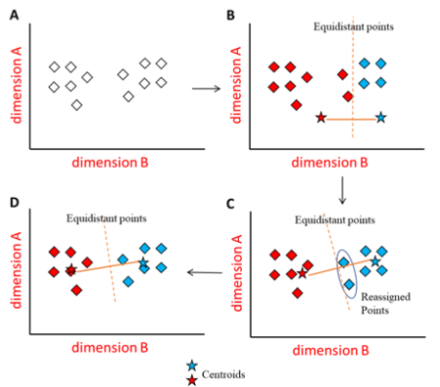
New centroids
Calculating the coordinates of new centroids for next iterations is straightforward:
Get coordinates of each point assigned to the cluster
Calculate mean value for dimension A
Calculate mean value for dimension B
New centroid would be at the point (mean(A), mean(B))
With new centroids we continue calculating distances to every data point in order to create more precise clusters.

Slide 8
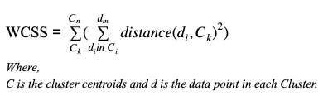
Assessing the quality of each cluster
After finding out the coordinates of new centroids we can check the quality of the model. The idea behind K-means clustering is to minimize the within-cluster variation. After some number of iterations, coordinates of the centroids will be stationary. That means that the algorithm has found optimal clusters.

Slide 9
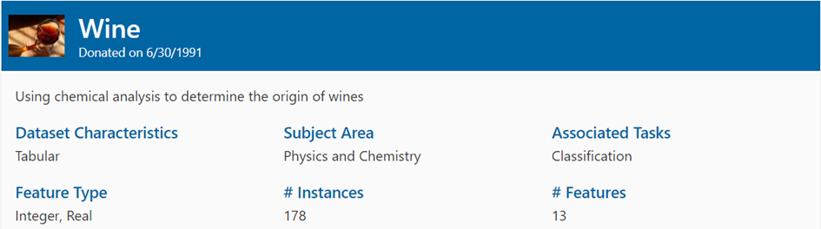
Dataset information

Slide 10
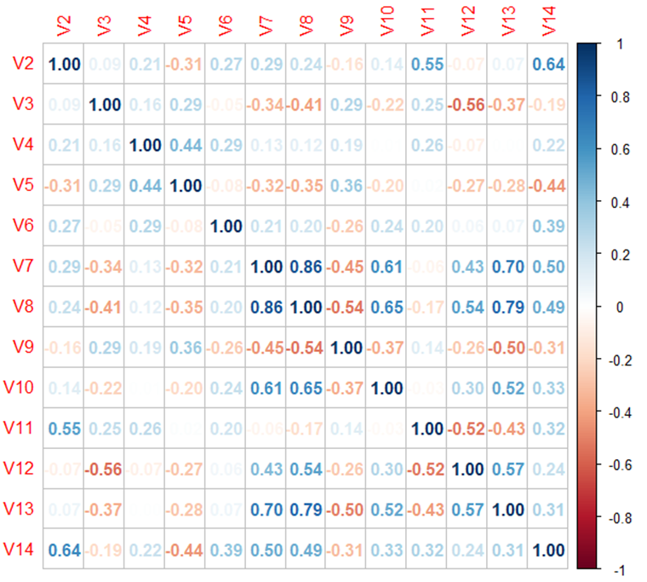
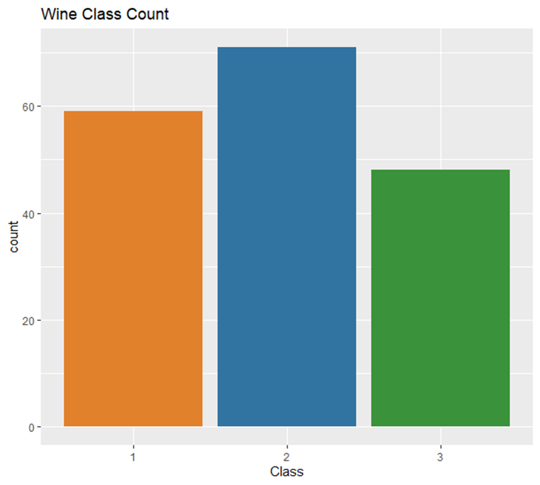
Data exploration

Slide 11
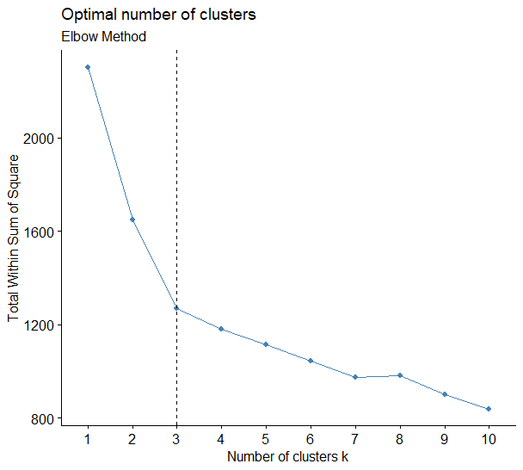
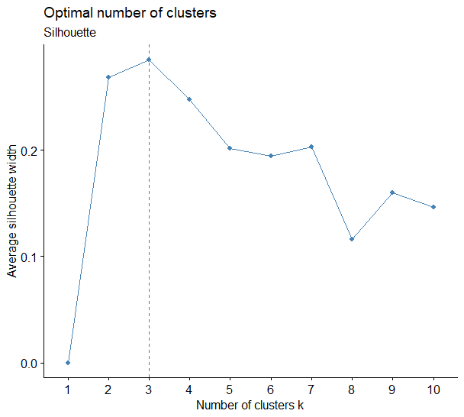
Analysis and results - part 1

Slide 12
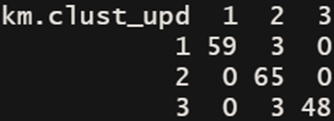
Analysis and results - part 2
After running K-means clustering algorithm with 3 clusters we’ve got the following confusion matrix:
Cluster 1 consists of 62 data points, out of which 59 belong to "Region A", 3 belong to "Region B", and 0 to "Region C".
Cluster 2 comprises 65 data points, with 0 wines from "Region A", 65 from "Region B", and 0 from "Region C".
Cluster 3 encompasses 51 data points, with 0 wines from "Region A", 3 from "Region B", and 48 from "Region C".

Slide 13
Confusion Matrix for Multi-Class Classification
Since we have more than 2 classes, the analysis of the confusion matrix isn’t straightforward. To calculate TP, FN, FP and TN values we should follow these rules:
TP = intersection of row and column of the class
FN = sum of values of the class row except TP value
FP = sum of values of the class column except TP value
TN = sum of values of the values of all columns and rows except the values of that class that we are calculating the values for
 | Class 1 | Class 2 | Class 3
Class 1 | TN1 | FP1 | TN2
Class 2 | FN1 | TP | FN2
Class 3 | TN3 | FP2 | TN4

Slide 14
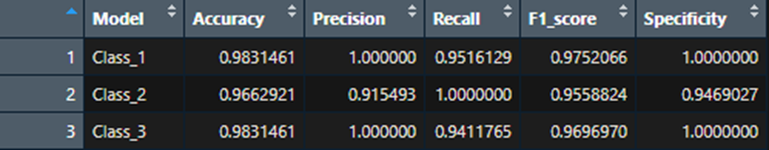
Classification metrics
With the knowledge how to calculate TP, FP, TN and FN we’ve created a table with classification metrics. All of the interpretation of the statistics are just for one class (except accuracy).
Example:
Accuracy - measures the proportion of correctly classified cases from the total number of objects in the dataset
Precision - fraction of instances correctly classified as belonging to a specific class out of all instances the model predicted to belong to that class
Etc.

Slide 15
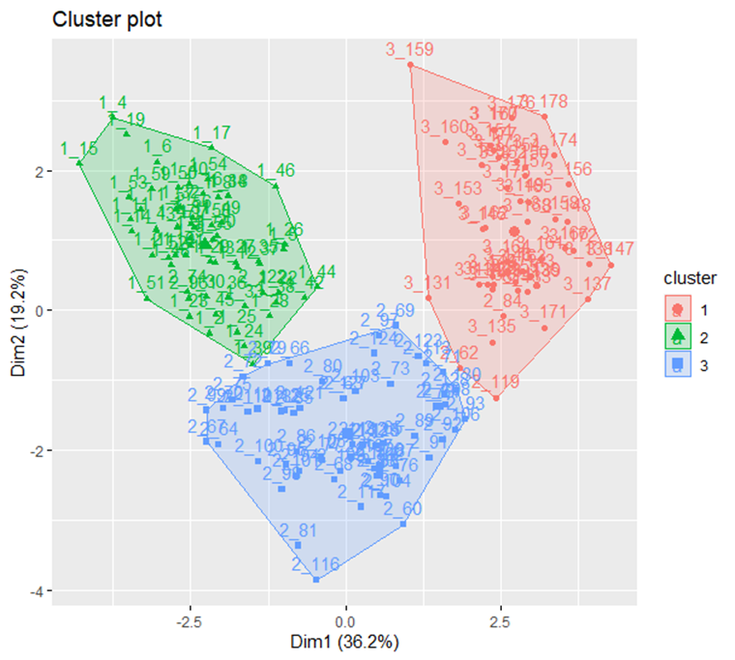
Visualization of clusters
The number before underscore represents the original class of the particular observation.
Some of the misclassified observations could be found on the plot:
Class 2 observations on the border of the cluster 1 (red)
Class 2 observations in the cluster 2 (green). Coordinates: (0.5, -2.5)

Slide 16
Thank you for your attention!!!
❤️

