Slide 1



MavenMarket_Report
View in Power BI
Last data refresh:
30/03/2023 13:58:28 UTC
Downloaded at:
30/03/2023 14:18:16 UTC

Slide 2
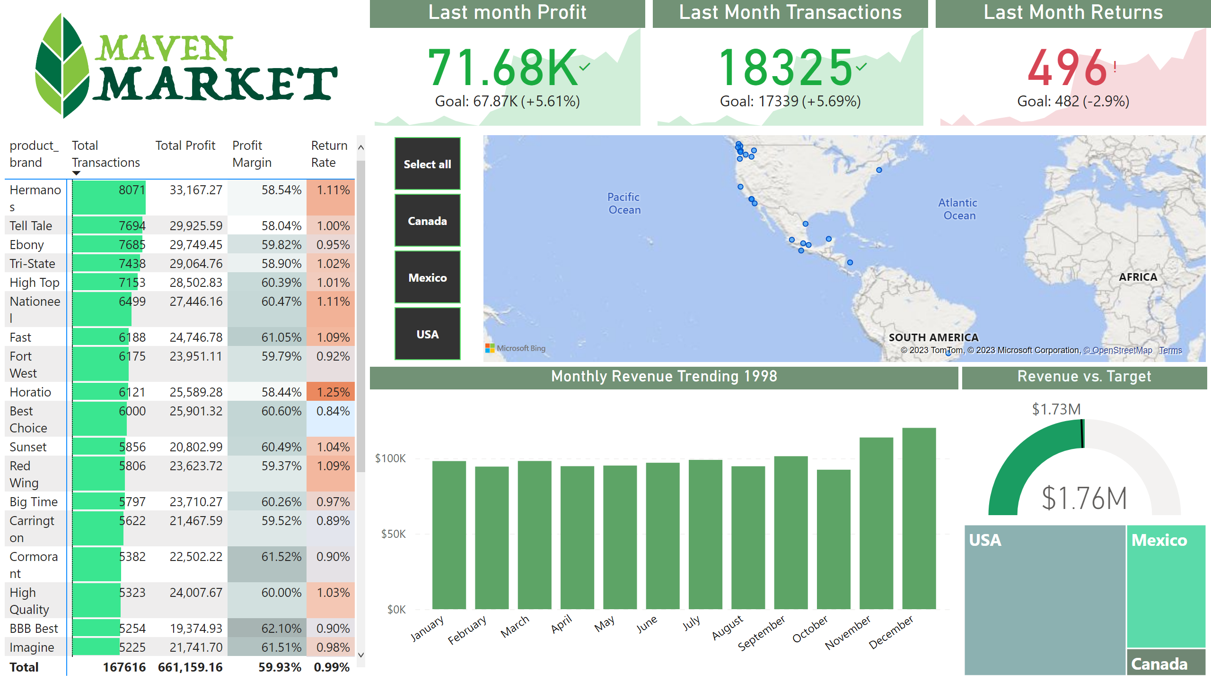
Topline Performance
Notes:
image
No alt text provided
pivotTable
No alt text provided
Last Month Transactions
No alt text provided
Last month Profit
No alt text provided
Last Month Returns
No alt text provided
map
No alt text provided
slicer
No alt text provided
treemap
No alt text provided
Monthly Revenue Trending 1998
No alt text provided
Revenue vs. Target
No alt text provided

