Slide 1

KD’s Landsat Data
KD Fan Club

Slide 2
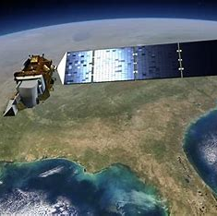
About our project
We have constructed a web-based application which integrates Landsat 8 data and allows the user to select a specific location on a map and returns when the satellite is going to pass over the location.

Slide 3
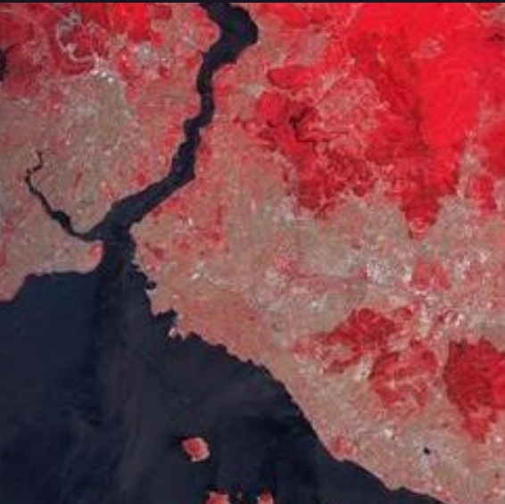
Roles
Bogdan developed the functionality of the website’s front-end and worked on the UI.
Makar worked on the satellite math and developed the website’s backend.
Sergei created our project demo and was the team organizer.

Slide 4

Deeper understanding
Our application works by taking in the latitude and longitude of the pinpointed location by the user. It then scans 48 thousand cities in our database to match to the closest city in a 100km radius, as this is equivalent to one NASA pixel. We determine in which of the 16 cycles the satellite gets these coordinates, and with the knowledge of the first cycle’s data, we calculate the next date of when there will be the same cycle that catches the coordinates entered by the user.

Slide 5

Purpose of the project
Our program is to be used as an easy access and simple tool mostly for researchers and scientists, as they will be able to use the data to help with their research.
Our goal is to inform as many people as possible about what satellites see and how they work.

Slide 6
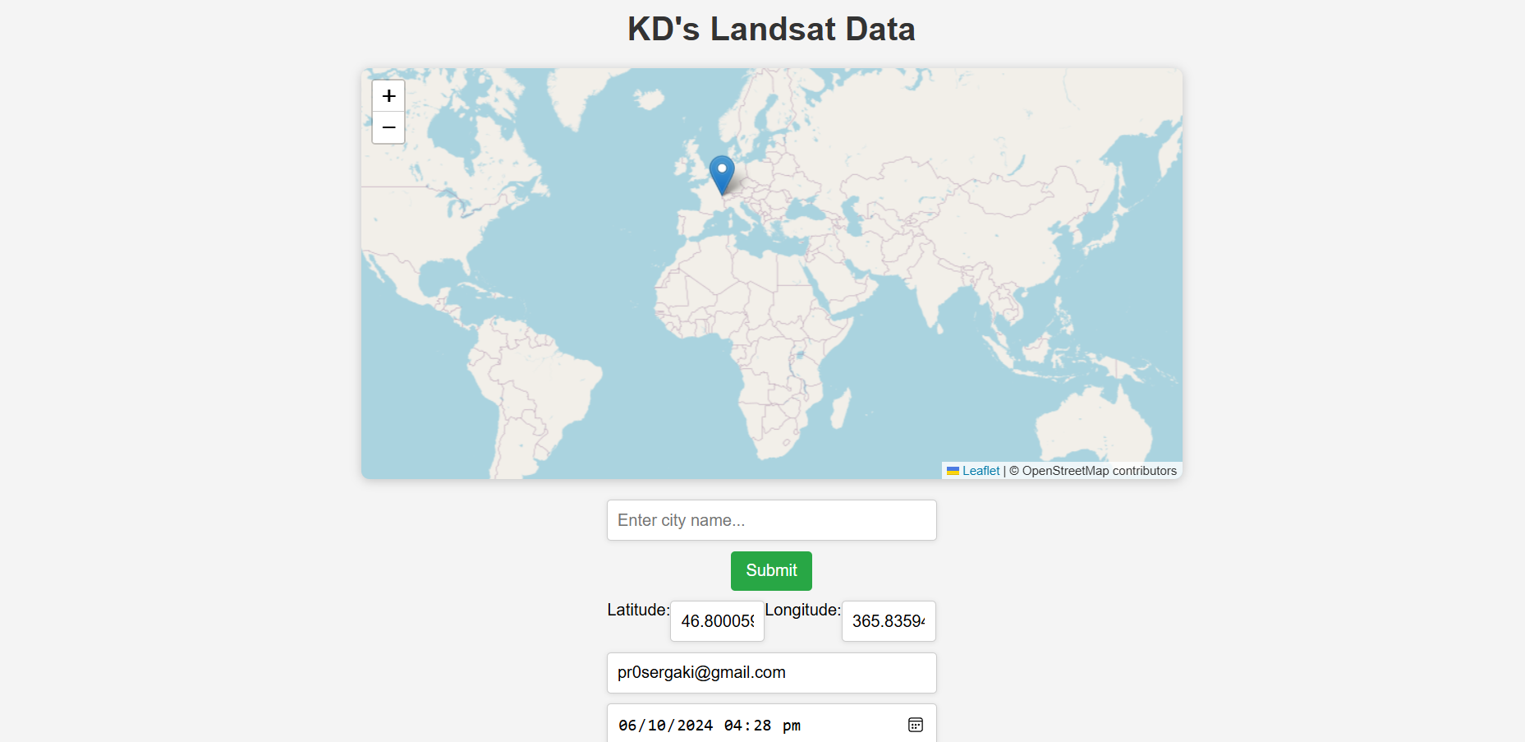
UI of the Website

Slide 7
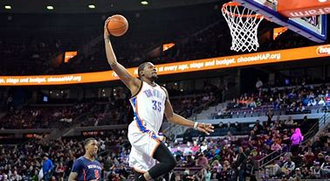
Thank you for reading!
Brought to you by:
Makar, Bogdan and Sergei

