Slide 1




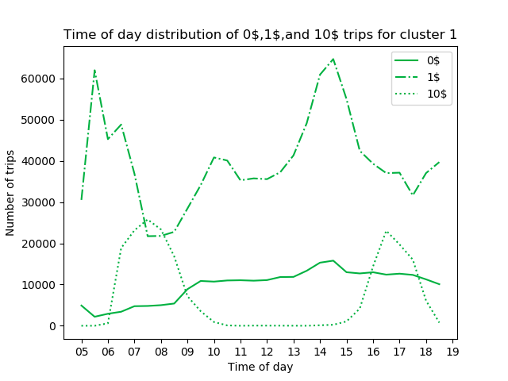
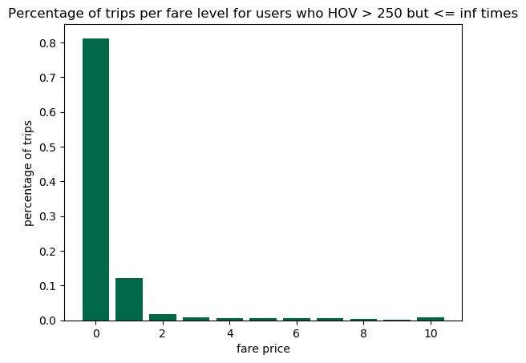
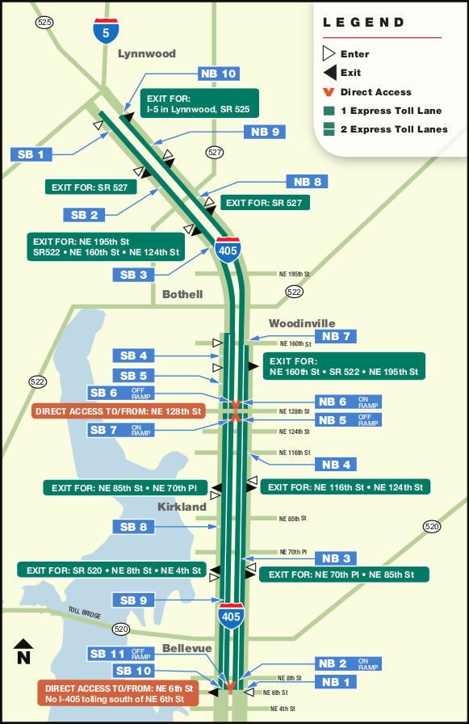
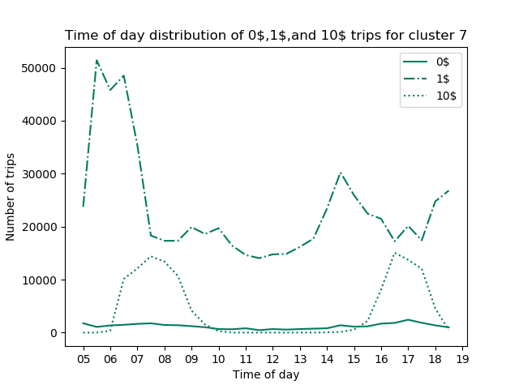
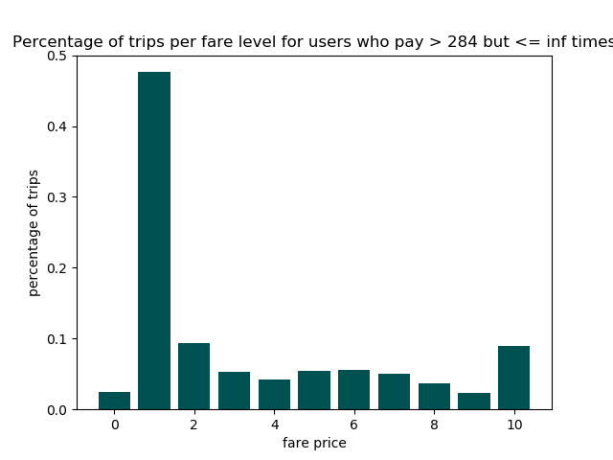
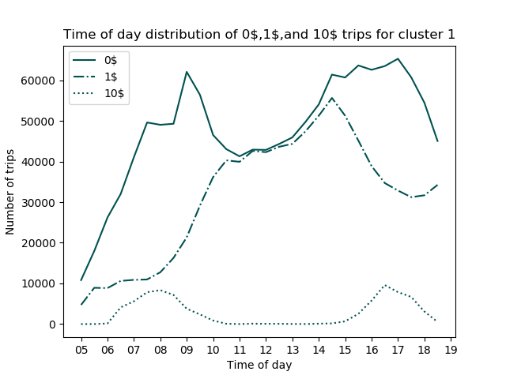
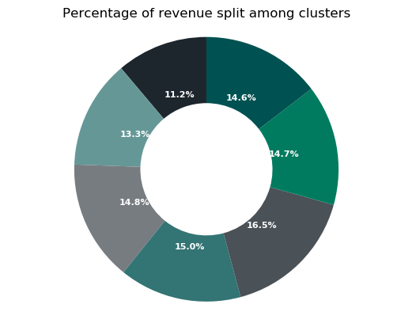
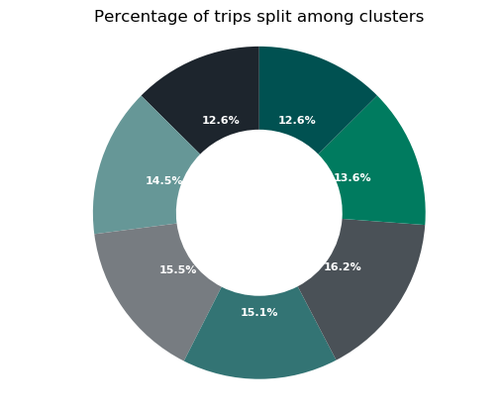
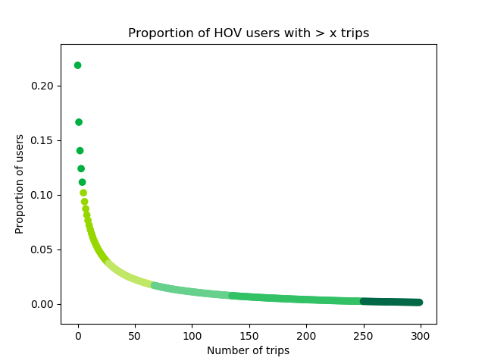
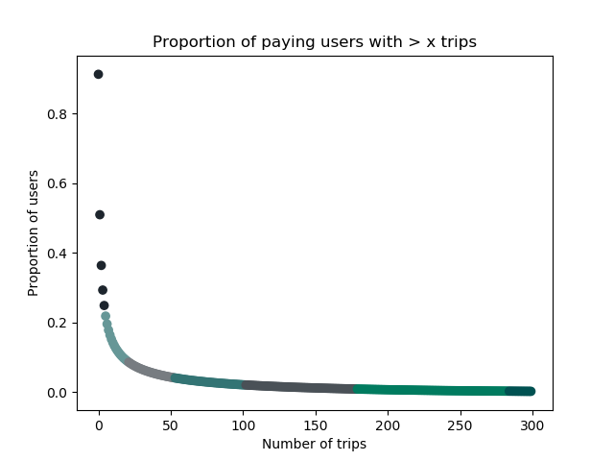
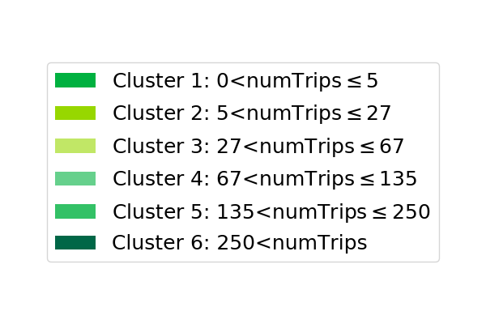
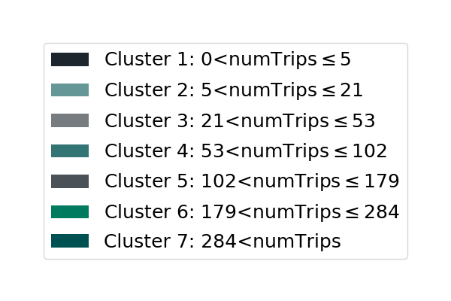
I-405 Express Toll Lanes Usage Pattern Discovery
Alexander Van Roijen
INTRODUCTION
Express Toll Lanes (ETLs) established on the I-405 has offered priority lanes for both willing paying users and HOV drivers. Utilizing unsupervised methods, we establish usage groups and seek to gain insight on how they behave differently.
ENTRY TIME DISTRIBUTION
CLUSTER RELATIONSHIPS
Low frequency HOV users contribute dominantly to 1$ transactions
Increasing HOV usage decreases likelihood of paying and vice versa
DATA
> 15,668,745 Transactions
> 1,086,073 Unique Users
> 5am to 7pm M-F
> Entry Time/Exit Time
> Entry/Exit Plaza
> Tag/Plate ID
> Fare rounded to highest dollar
Figure 4(below): Volume of trips accrued throughout the day for paying cluster 7 (>284 transactions) at the 0$,1$, and 10$ fatre levels
Figure 8 (above): Distribution of payments for users who HOV very often(cluster 6)
Figure 3: Distribution of payments for users who rarely pay(cluster 1)
Figure 3(above): Volume of trips accrued throughout the day for HOV cluster 1(<5 transactions) at the 0$,1$, and 10$ fatre levels
DIGGING DEEPER
> ~80% of users in high frequency paying clusters (5,6,7) lie within the first 2 HOV clusters (<27 times)
Image 1: 405 plaza points and geography.
METHODOLOGY
Group transactions by unique ID
Remove outlier & nulls
Create two datasets; per user
  Sum all HOV transactions
  Sum all Paid Transactions
Use K-Means clustering until next cluster provide no additional information
High and Low frequency payers distribute 1$ payments evenly throughout the day
Figure 9(above): Distribution of payments for users who pay very often(cluster 7)
Figure 5(above): Volume of trips accrued throughout the day for paying cluster 1(<5 transactions) at the 0$,1$, and 10$ fatre levels
CONCLUSION
REVENUE & TRIP DISTRIBUTION
We have found that within driving frequencies, there are 7 distinct paying groups, and 6 HOV groups. Within these groups, we see minimal cross over (frequent payers are not frequent HOVs). Furthermore, we find many interesting patterns within the time of day distributions. Next steps look to analyze patterns within the northern third and southern two thirds of the I-405, and potentially identifying fraudulent vehicles.
K-MEANS CLUSTERING RESULTS
ACKNOWLEDGEMENTS
Special thanks to Eric Knigge,Tyler Patterson, and Marie Rogers of WSDOT for their funding and data. Further thanks to Mark Hallenbeck and Dmitri Zyuzin of the Washington State Transportation Center (TRAC) for their leadership.
Figure 6,7(above): Given all paid trips, all clusters representing low, intermediate, and very high paying usage of the ETL contribute approximately equal amounts of traffic and revenue
Figure 1: Clustering results on proportion of HOV usage per user above each x
Figure 2: Clustering results on proportion of paying usage per user above each x
TAKEAWAYS
> Low, intermediate, and high frequency clusters contribute near equal amounts to both revenue and trip volume
REFERENCES
Scikit-learn: Machine Learning in Python, Pedregosa et al., JMLR 12, pp. 2825-2830, 2011.
Jones E, Oliphant E, Peterson P, et al. SciPy: Open Source Scientific Tools for Python, 2001-, http://www.scipy.org/ [Online; accessed 2019-06-05].

