Slide 1
F# Software Craftsmanship Introduction

Slide 2
Statically typed
Type inference
Closures
Pattern matching
Once upon a time…
Lisp
ML
OCaml
F#
Haskell
Higher order types
C
Scala
Java
SmallTalk
Swift
Clojure

Slide 3

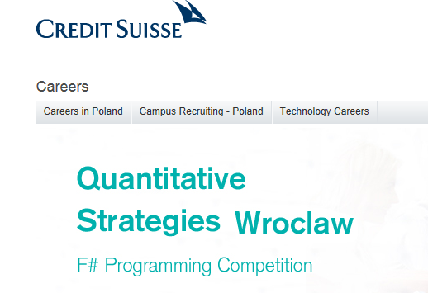



https://www.credit-suisse.com/pl/en/careers/qs-programming-competition/home.html
http://www.tachyus.com/
http://time.com/money/4068884/jet-com-vs-amazon-price-comparison/

Slide 4


http://tech.jet.com/blog/2016/02-05-the-jet-engine-we-built-in-2015/index.html

Slide 5


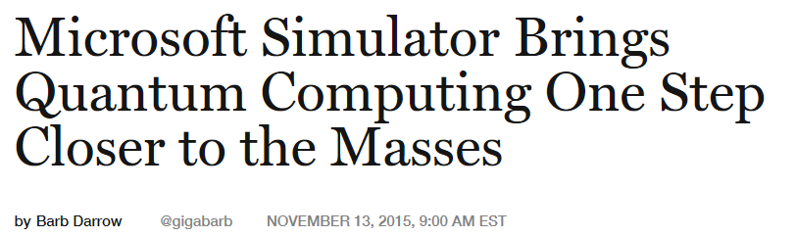
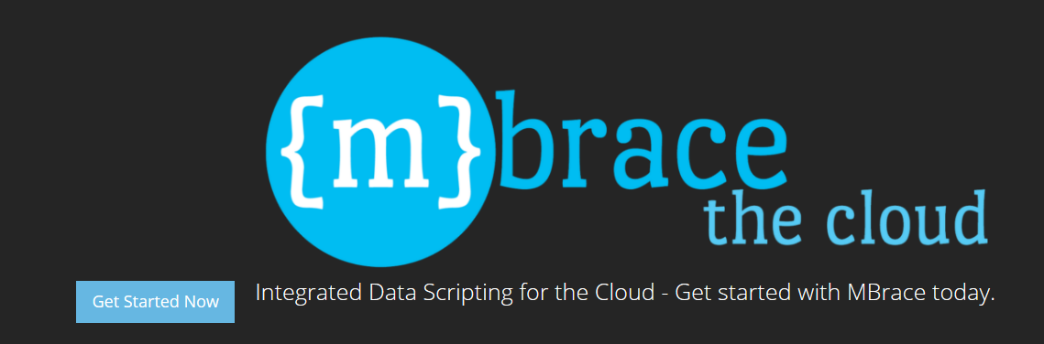

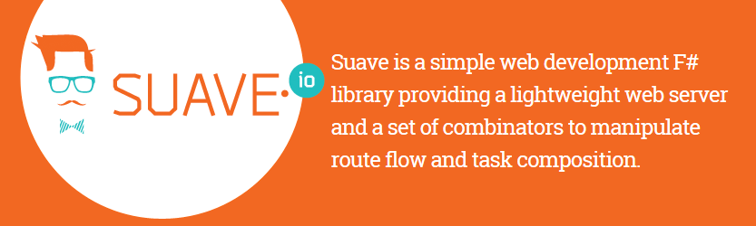
http://fortune.com/2015/11/13/microsoft-quantum-computing-simulator/
http://mbrace.io/
https://suave.io/

Slide 6
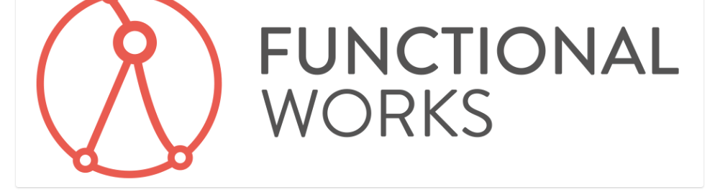


http://jobs.functionalworks.com/
NZD $330k!

Slide 7
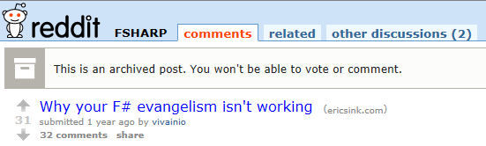
https://www.reddit.com/r/fsharp/comments/2rfqkd/why_your_f_evangelism_isnt_working/
Arguments seem to fall into a few areas:
Java was less functional than C# - more compelling to use Scala than it is to use F# in .NET
Scala has higher kinded types – but lots of argument over whether it’s really important – probably not (and anyhow, F* does)
C# is actually pretty good and a pragmatic choice for most people and most work.
Swift has the Apple affect – Objective-C sucked and with Apple being so cool now, and Swift opensourced, that’s where the functional future is.
Same arguments happening with Swift
http://stackoverflow.com/questions/21170493/when-are-higher-kinded-types-useful
http://www.sparxeng.com/blog/software/an-example-of-what-higher-kinded-types-could-make-possible-in-c - comments worth reading

Slide 8
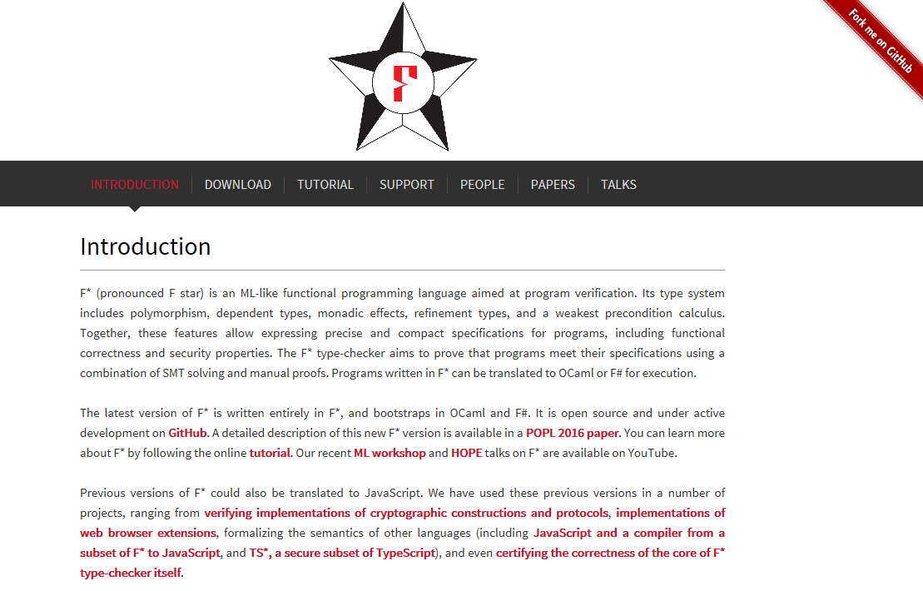
https://fstar-lang.org/
A more functional F#?

Slide 9
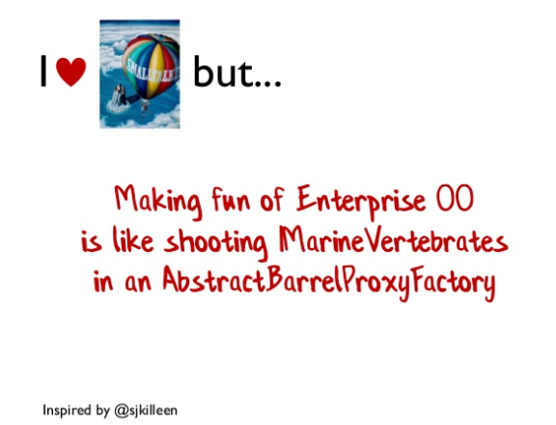
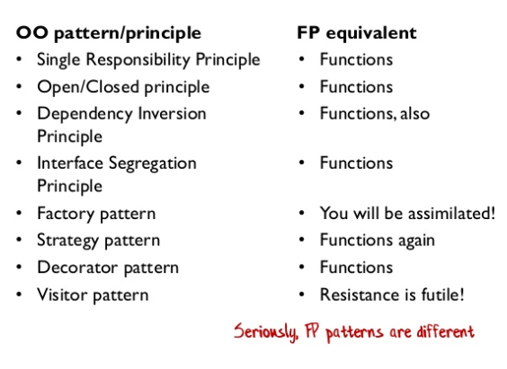
Strongly recommend…
http://www.slideshare.net/ScottWlaschin/fp-patterns-ndc-london2014
My favourite takeouts… ☺

Slide 10
Important stuff
Type composition
Product types
Sum types
Domain Driven Design is all
about designing with types
Types are not classes
F# is all about static types
Function types are interfaces

Slide 11
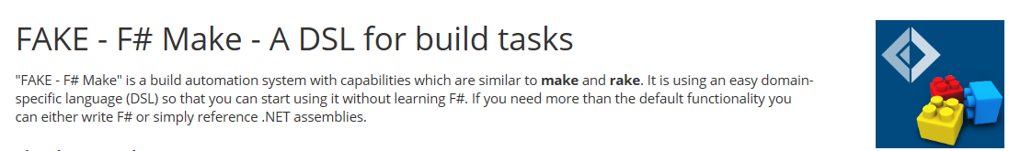
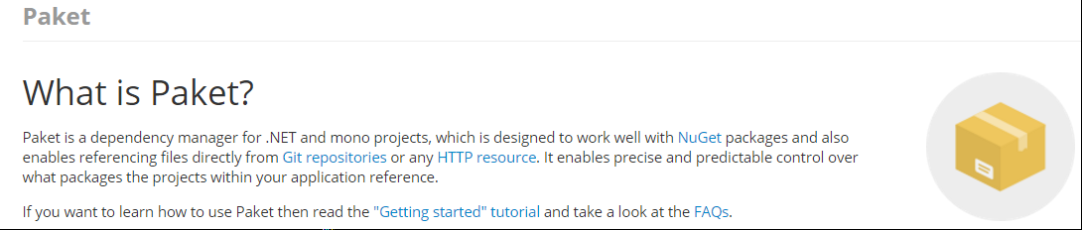
ProjectScaffold
https://github.com/fsprojects/ProjectScaffold

Slide 12
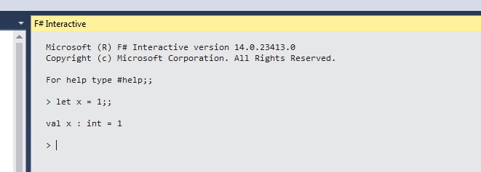
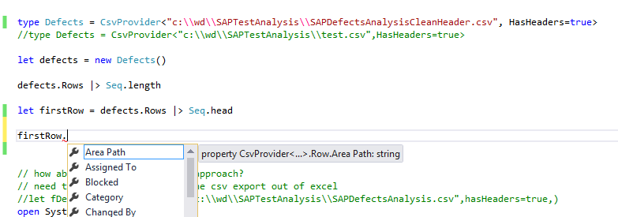
Editor experience
REPL
Type provider
Inferred static types

Slide 13
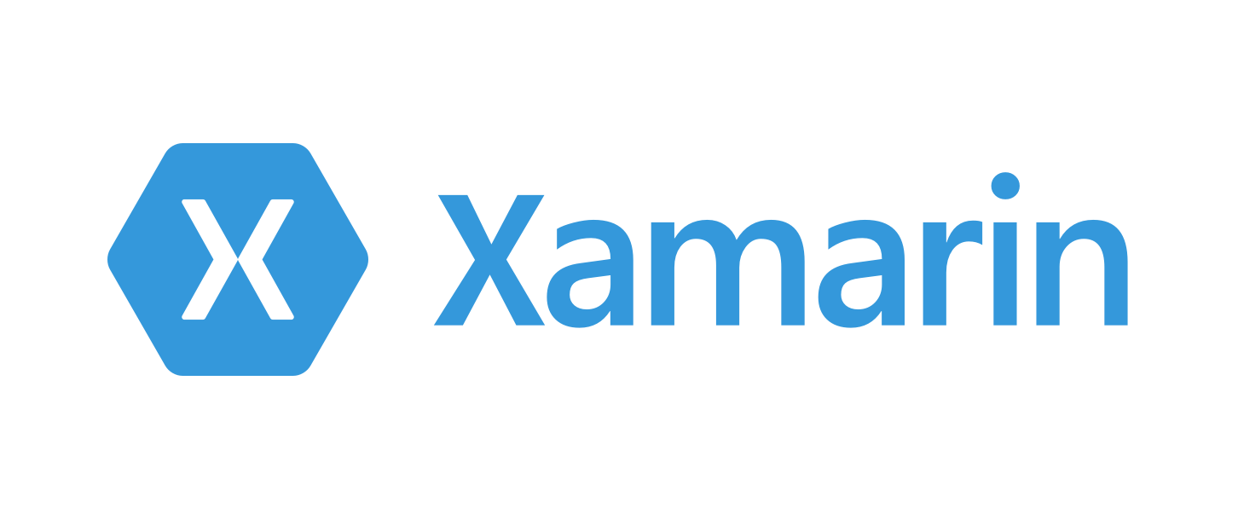
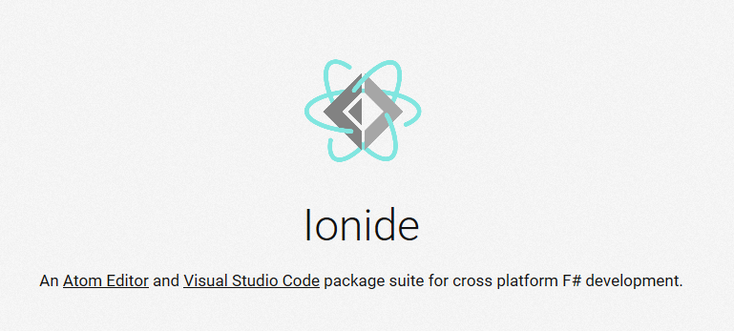
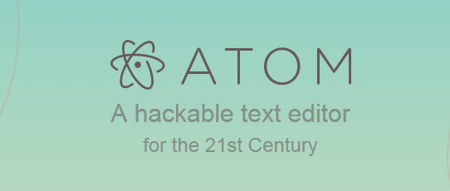


Slide 14
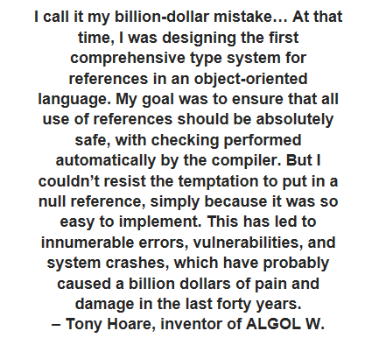
Null – the $billion mistake
https://dzone.com/articles/the-worst-mistake-of-computer-science-1
F# and Scala prefers Some/None option types
Haskell has the Maybe monad
Swift has an Optional

Slide 15
It’s a niche…
Which is a little sad ☹

Slide 16

https://www.packtpub.com/application-development/testing-f

Slide 17
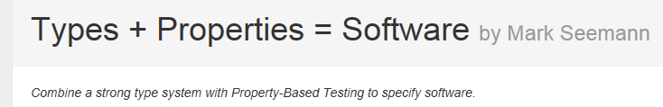
http://blog.ploeh.dk/2016/02/10/types-properties-software/
Property based tests are like running experiments on your system under test.

Slide 18
Topic recap
Pattern matching
Option Types
Composition
Type inference
Syntax – concise, convenient and correct
Development environment experience - file ordering – VS, Ionide – Fake, Paket
Async
Type providers
Deedle data frames
Property based testing - FsCheck
Analytics

