Slide 1
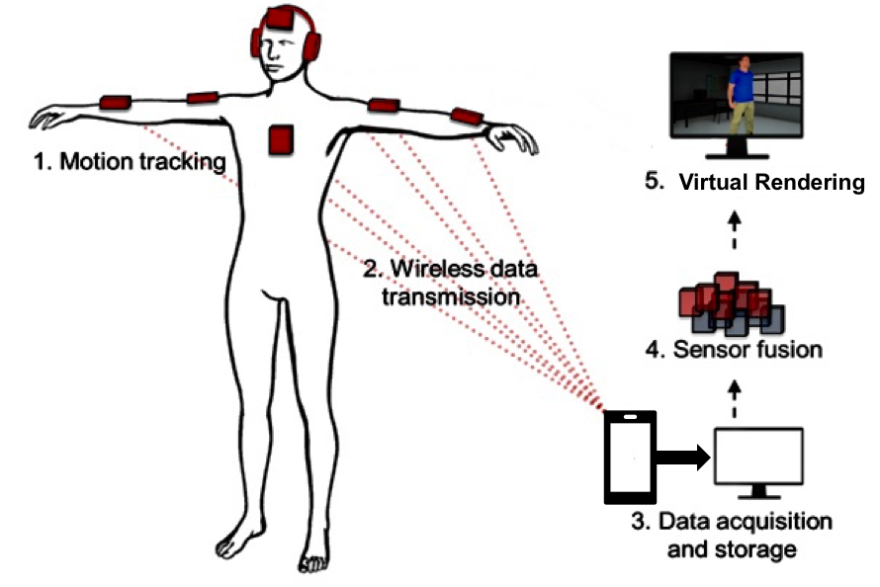

2.10: 3D Markerless Motion Capture System For Active Shooter Response Training
Team Members:
Bo Heyse (PM)
Matt Healea
Karina Paz
Sponsor: Texas State ALERRT Center
Faculty Advisor: Dr. Stan McClellan

