Slide 1




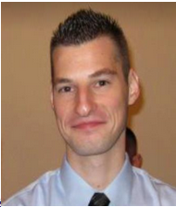
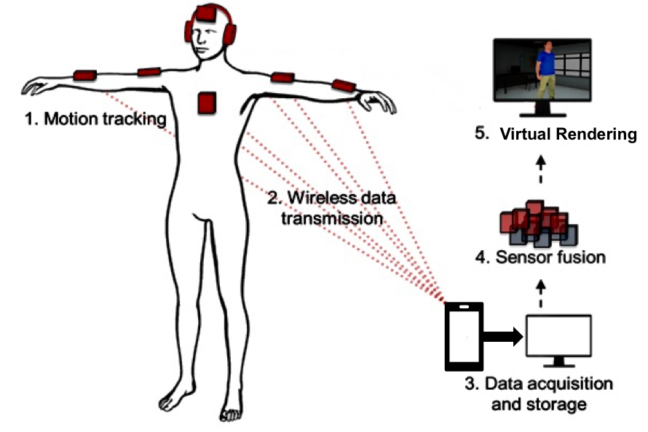
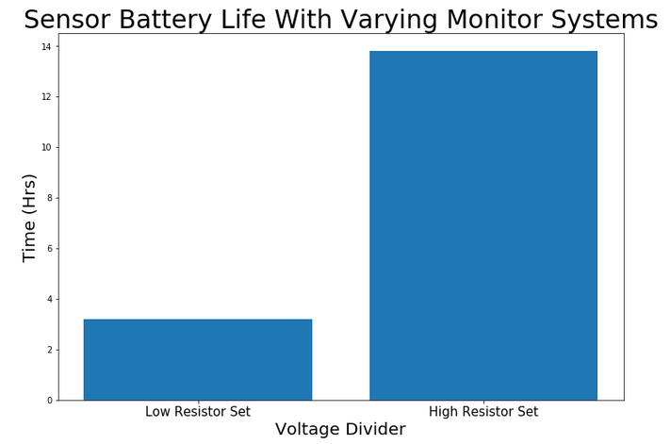

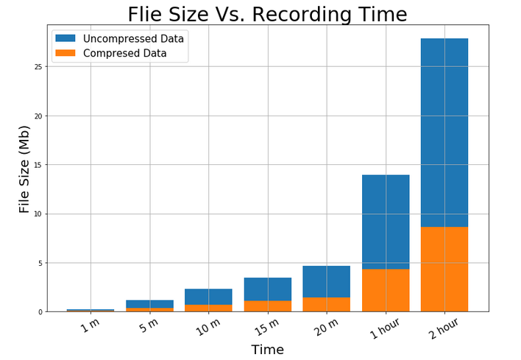
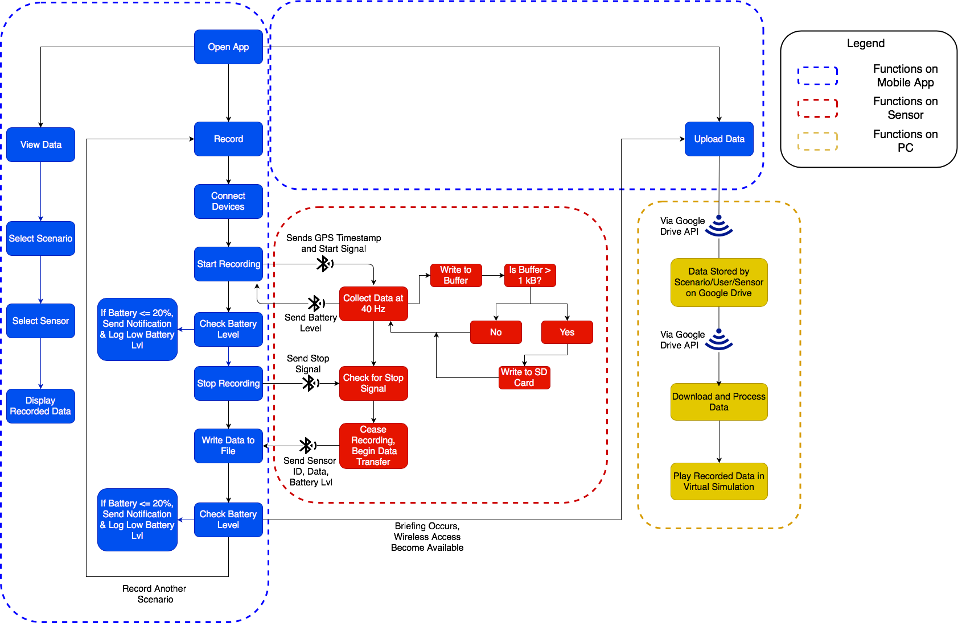
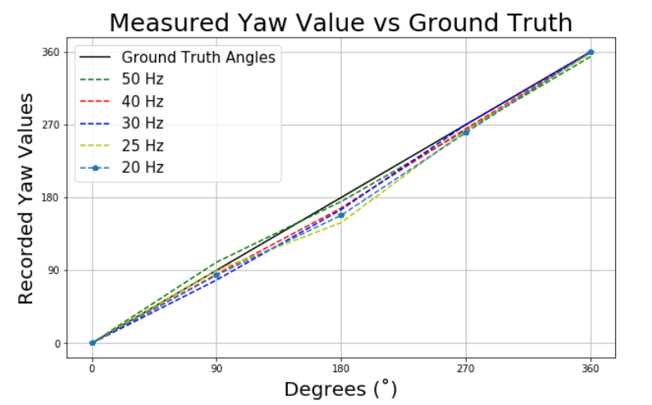
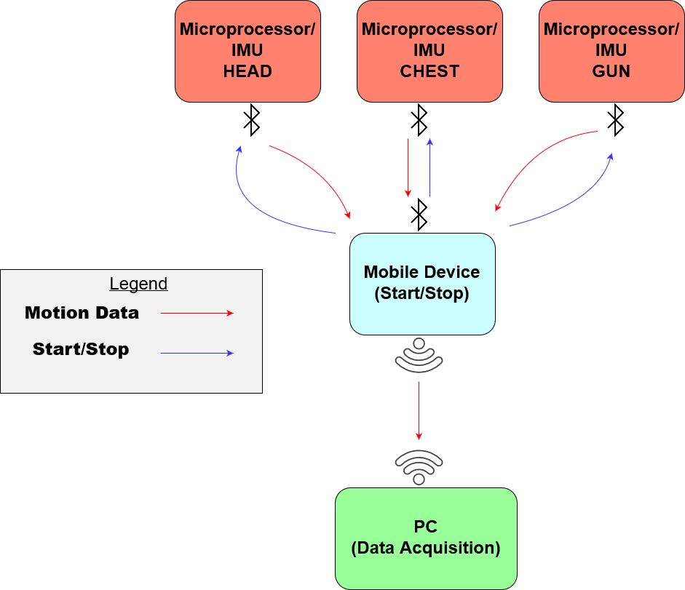



Bo Heyse Karina Paz Matt Healea
E2.10 – 3D Markerless Motion Capture System For Active Shooter Response Training
Untitled Diagram.png
Results
Purpose
The System
What?
Virtualize Texas State ALERRT Center’s active shooter training scenarios
Why?
Allow smaller municipalities to have access to the training
How?
Build a wireless sensor-based system focused on collecting motion data at key points on a first responder
Battery Life – 13.82 Hours
Background
Storage Capacity – 8.64 MB
The current industry standard for motion capture is a marker system that requires a 360-degree field of view, the wearer to be covered in restrictive equipment, and several high-resolution cameras.
Our system:
Is minimally invasive and does not require excessive equipment
Operates in dynamic environments
Low cost which will greatly enhance the availability of training for municipalities
Detailed Functionality
Approach
Ideal Sample Rate – 40 Hz
Hardware
Inertial Measurement Unit (IMU) – Collect analog data
Microprocessor – Convert to digital and process data
Micro SD – Locally store data
Bluetooth Module – Create local area network among devices and transfer data upon completion of recording
Software
Process digital data
Visualization model
Advanced Heading and Reference System (AHRS),
Kalman Filter – To smooth the digital data
Project Goals
A 40 Hz Sampling Rate Minimizes Angular Deviation
Record motion and orientation of the body, gun, and head of the responder
Non-intrusive design/integration with ALERRT Center equipment
2-hour battery life – minimum
Scalable design
Simple and intuitive user interface
Virtualize the motion of the body, head, and gun
Acknowledgements
Sensor System
User System
ALERRT Center:
Dr. Hunter Martaindale (Director of Research)
Mr. Coby Briehn (Program Manager)
Texas State University:
Dr. Stan McClellan (Faculty advisor)
Admin System
Sponsored by the Texas State University ALERRT Center

