Slide 1
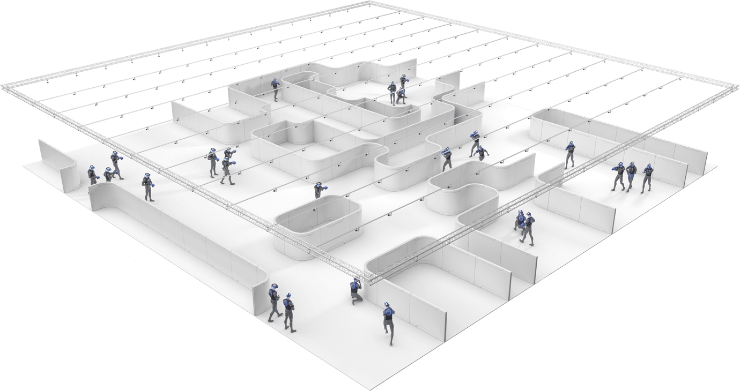

3D Markerless Motion Capture System For Active Shooter Response Training
Bo Heyse (PM) | Matt Healea | Karina Paz

Slide 2

Advanced Law Enforcement Rapid Response Training (ALERRT)
Training for Active Shooter Scenarios
Provide Equipment for Training
Active Shooter Simulations
Federally Funded (56 million since 2002)
Problem:
Training accessibility for small municipalities
How to provide access using with modern technology?
Create Gold Standard AR/VR simulations

Slide 3
A wireless sensor system that extracts 3-Dimensional Position and Orientation at the Head, Gun, and Chest of a first responder
Designed with scalability in mind, must work the same for 1 person as it does for 30
Use the data to drive a virtual simulation and in the future augmented or virtual reality
Project Overview

Slide 4

Project Goals
 | Functional Deliverable | DRI | Status
1 | Wireless start/stop/viewing from mobile app | Bo
2 | Extend open source firmware to meet wireless system capabilities (start/stop/store/transmit) | Bo
3 | Upload data files to central location | Bo | In-Progress
4 | IMU to Bluetooth module integration | Matt
5 | Transmit data over Bluetooth to mobile device | Matt | In-Progress
6 | Power management system | Karina
7 | Non-Intrusive design enclosure | Karina | In-progress
Stretch Goals:
8 | Data Visualization in Unity/MATLAB | Bo | Not Started

Slide 5
Project Goals
Deliverables:
Stretch Goals:
1) Create a mobile application that the user can interface with to connect/start/stop the sensors.
2) Automatic wireless data transfer from the sensors to the mobile device
3) Error reporting and handling propagated via the mobile app
3) The ability to upload the data to a centralized admin-controlled cloud location
4) A program that automatically recognizes new data uploaded to the cloud location, downloads it, and prepares it for simulation
A software simulation that recreates the trajectory and position of the sensor

Slide 6
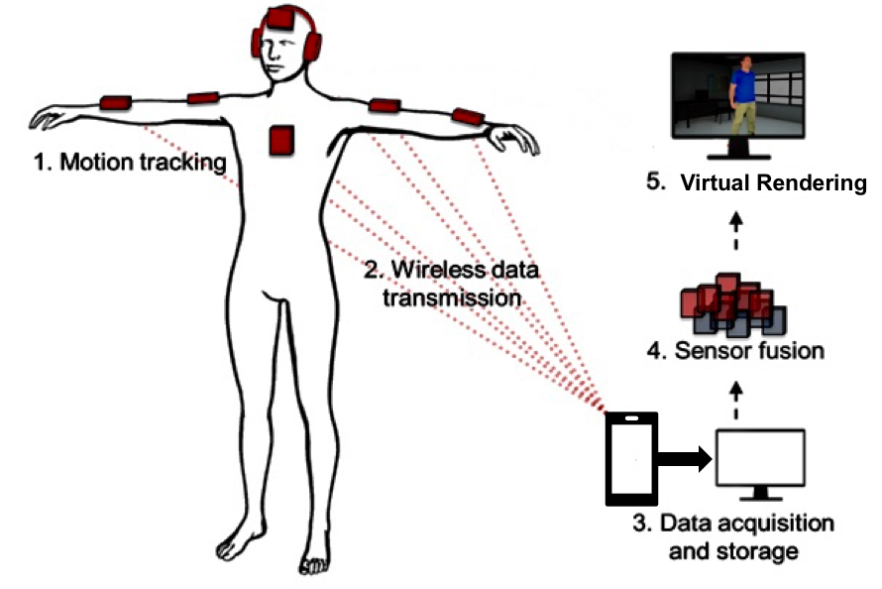
Top View Diagram
Virtual Rendering

Slide 7
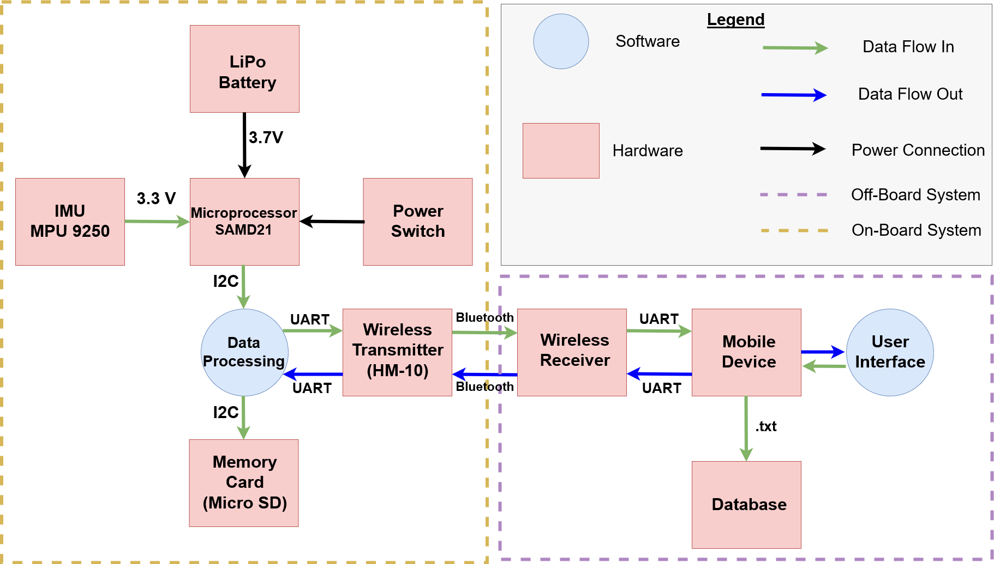
Product
Design (Hardware):

Slide 8
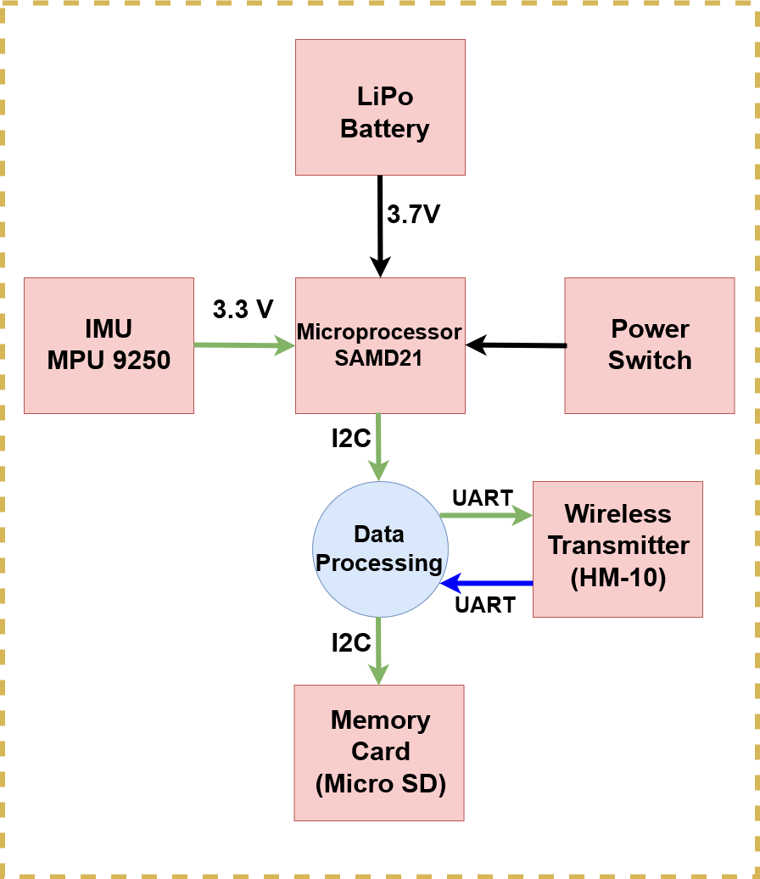
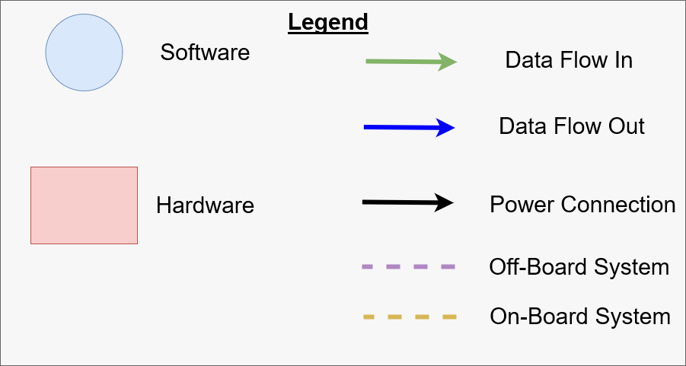
On-Board System
Product
Design (Hardware):

Slide 9
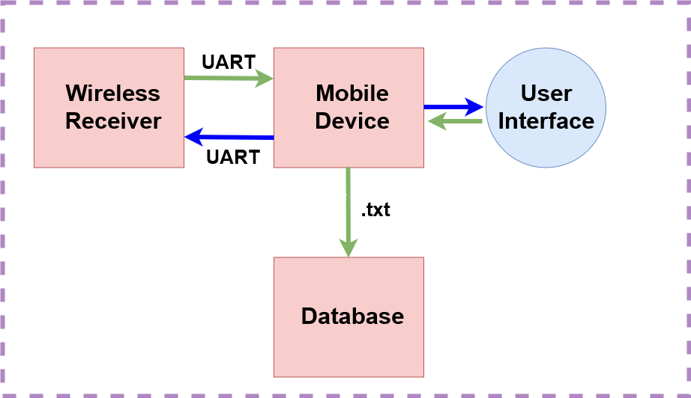
Off-Board System
Product
Design (Hardware):

Slide 10
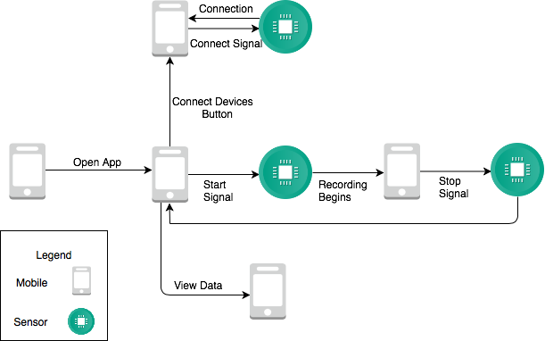
Product
Design (Software):

Slide 11
Errors are unknown until post-simulation
Data is not compressed, transfer from sensors is slow
Drift in the IMU
Limits of the System

Slide 12
Lessons Learned
Pick one thing to work on at a time and work on it. It’s easy to get consumed by the whole system and never actually get anywhere
Don’t put things off to tomorrow that can be done today
How to manage stress and looming deadlines
How to be resourceful. The internet and open source are beautiful things.

