Slide 1
Outlook / Thunderbird,
Shibboleth IDP,
Printer Login
…
LDAP
Request
Library Management System
LDAP Request
Query
LDAP
Query
(Somehow)
Library Management System
OpenLDAP
E-Mail program
Fetch mail address
OpenLDAP
LDAP
Request
Backend Shell
Program/Skript
Shibboleth IDP
Fetch user data like expire date
Library Management System

Slide 2
SEARCH
msgid: 2
suffix: dc=lms,dc=library
base: dc=lms,dc=library
scope: 2
deref: 0
sizelimit: 500
timelimit: 3600
filter: (sn=Mysteri*)
attrsonly: 0
attrs: all
Data flow
Query by
e.g. SQL, RESTful, CVS
<STDIN>
Library Management System
Backend
Shell
Program/Skript
<STDOUT>
Return Data
# 501224, lms.library
dn: uid=501224,dc=lms,dc=library
objectClass: top
objectClass: person
objectClass: organizationalPerson
objectClass: inetOrgPerson
objectClass: officePerson
objectClass: mozillaAddressBookEntry
displayName: Mysteri Eve 501224
uid: 501224
ou: library
departmentNumber: lms
cn: Mysteri Eve 501224
sn: Mysteri
givenName: Eve
mail: eve@myst.test
RESULT
code: 0
Lastname: Mysteri
Firstname: Eve
LibID: 501224
Emailadress: eve@myst.test
Program/Skript
do the mapping and output
openLALDAP attributes <- -> your attributes
cn <- -> Benutzernummer
sn <- -> Nachname
givenName <- -> Vorname
mail <- -> Emailaddresse1
…

Slide 3
Class person
Must: cn, sn
May:
userPassword
telephoneNumber
seeAlso
description
Class inetOrgPerson
(is a subclass of
organizationalPerson)
MAY:
audio
businessCategory
carLicense
departmentNumber
displayName
employeeNumber
employeeType
givenName
homePhone
homePostalAddress
initials
jpegPhoto
labeledURI
mail
manager
mobile
o
mager
mhoto
roomNumber
Secretary
uid
userCertificate
x500uniqueIdentifier
preferredLanguage
userSMIMECertificate
userPKCS12
Primary Attributes
openLDAP
(for mail address)
Class organizationalPerson
(is a subclass of person)
May:
title
x121Address
registeredAddress
destinationIndicator
preferredDeliveryMethod
telexNumber
teletexTerminalIdentifier
telephoneNumber
internationaliSDNNumber
facsimileTelephoneNumber
street
postOfficeBox
postalCode
postalAddress
physicalDeliveryOfficeName
ou
st
Class officePerson (Outlook)
(is a subclass of inetOrgPerson)
MAY:
rdn
otherFacsimiletelephoneNumber
IPPhone
comment
reports
conferenceInformation
Class mozillaAddressBookEntry
(is a subclass of inetOrgPerson)
MAY:
Custom1
Custom2
Custom3
Custom4
xmozillanickname
xmozillasecondemail
xmozillausehtmlmail
nsAIMid

Slide 4

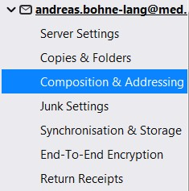

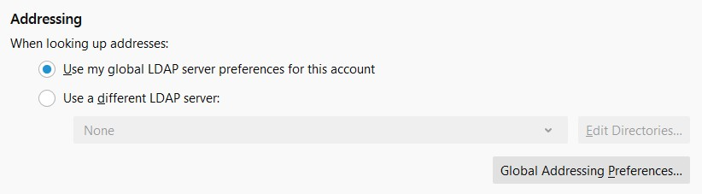
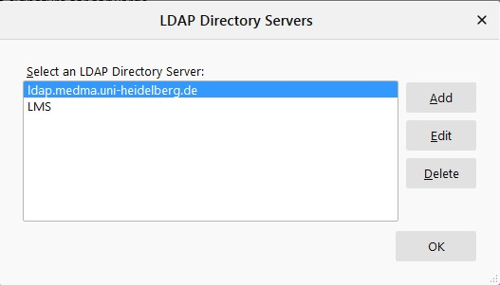
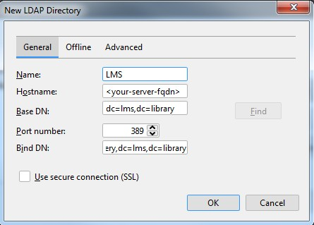
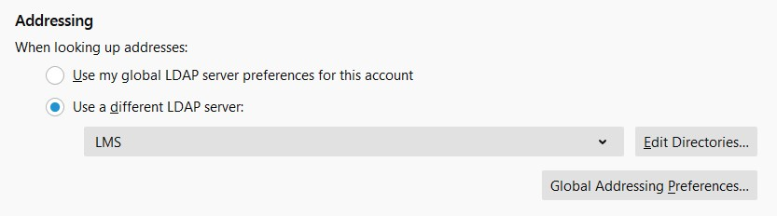
Thunderbird – Add account LDAP
dc=lms,dc=library
And
select the
new „LMS“ LDAP
cn=query,dc=lms,dc=library

Slide 5

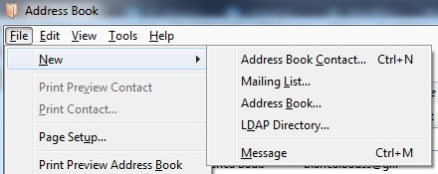
Thunderbird – Add Adressbook LDAP
dc=lms,dc=library
cn=query,dc=lms,dc=library

Slide 6
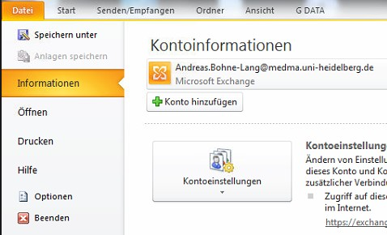

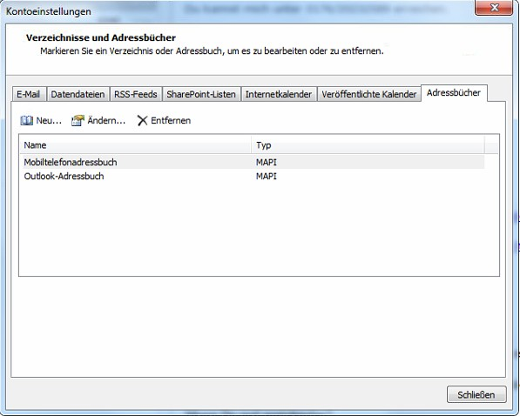
Outlook 2010
(German)
Account settings
new
Addressbook

Slide 7
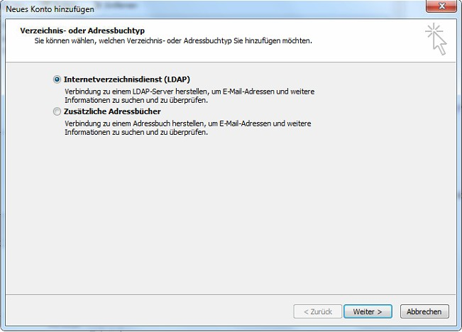
Directory service

Slide 8
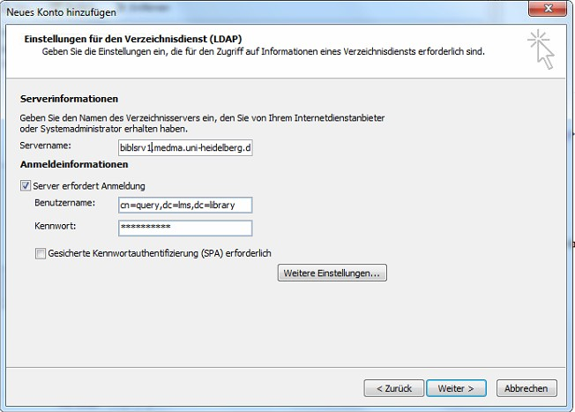
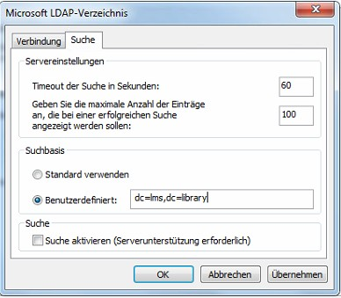
YOUR server name
cn=query,dc=lms,dc=library
YOUR Credentials
Search/query
dc=lms,dc=library

Slide 9
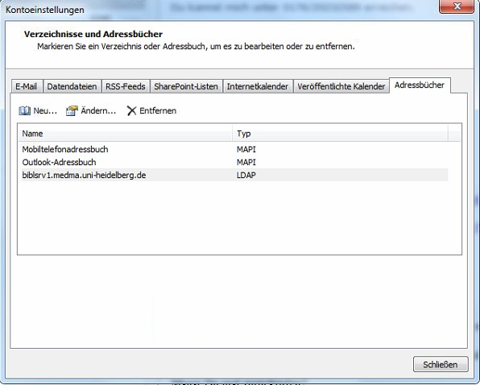
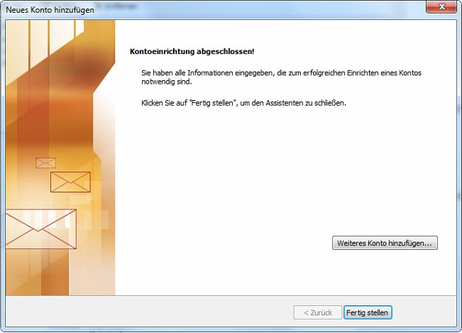
Finish and
restart Outlook

Slide 10
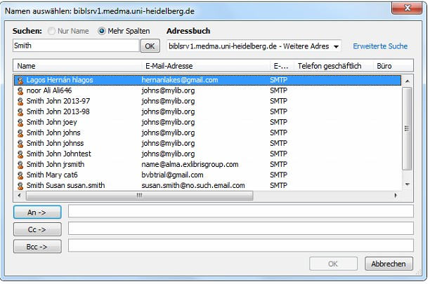
Search example with ALMA backend and sandbox
1
3
2
4

