Slide 1
AI Trend Detection in Healthcare by applying Topic Clustering and Sentiment Analysis using Podcast Data
Tim Löhr, B. A.
Advisors: Philipp Dumbach, M. Sc., Leo Schwinn, M. Sc., Prof. Dr. Björn Eskofier
Machine Learning and Data Analytics (MaD) Lab
Friedrich-Alexander-Universität Erlangen-Nürnberg (FAU)
2022-01-19

Slide 2






AI Impacts Many Industries
AI
Stocks
Education
Healthcare
Retail
Fashion
Notes:
In my master thesis, I want to find out how much I can get out of podcast data to detect trends of AI in the healthcare sector. For this trend detection, I will leverage different modern techniques, to get the most out of the data.

Slide 3





Podcast – The Most Popular Plattforms

Slide 4
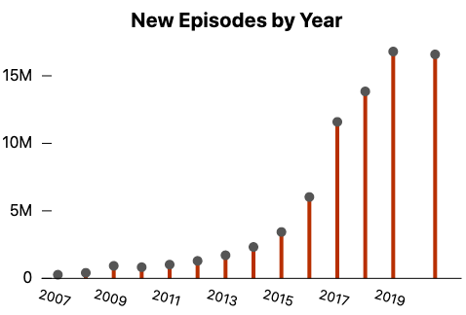
Rising Popularity and Production
550.000 Podcasts
18.5 million Episodes
463.5 Terabyte
June 2018
[1]
2.000.000 Podcasts
48.000.000 Episodes
1.2 Petabyte
April 2021
[1]
[2]

Slide 5



How to Predict the Trend?
Notes:
So how do we get now from the podcast to the transcriped text and then finally to the trend detection?

Slide 6
Related Work – Part l
Podcasts
30 Healthcare Podcasts
Episodes
~ 2000 Episodes
Date
2010 to 31.12.2021
Keyword Count
> 50,000 Keywords
Artificial Intelligence Trend Analysis
using Speech-to-Text
Data from Healthcare Podcasts
Phi Long Do
[2]
Conclusion: Predict Future AI Trends with
Better transcriptions
More data, buzzword list and longer time frame
Notes:
Keine Ahnung wie der Long auf 4400 episoden kommt, aber ich zähle mit neu gecrawlten episoden nur 1981

Slide 7
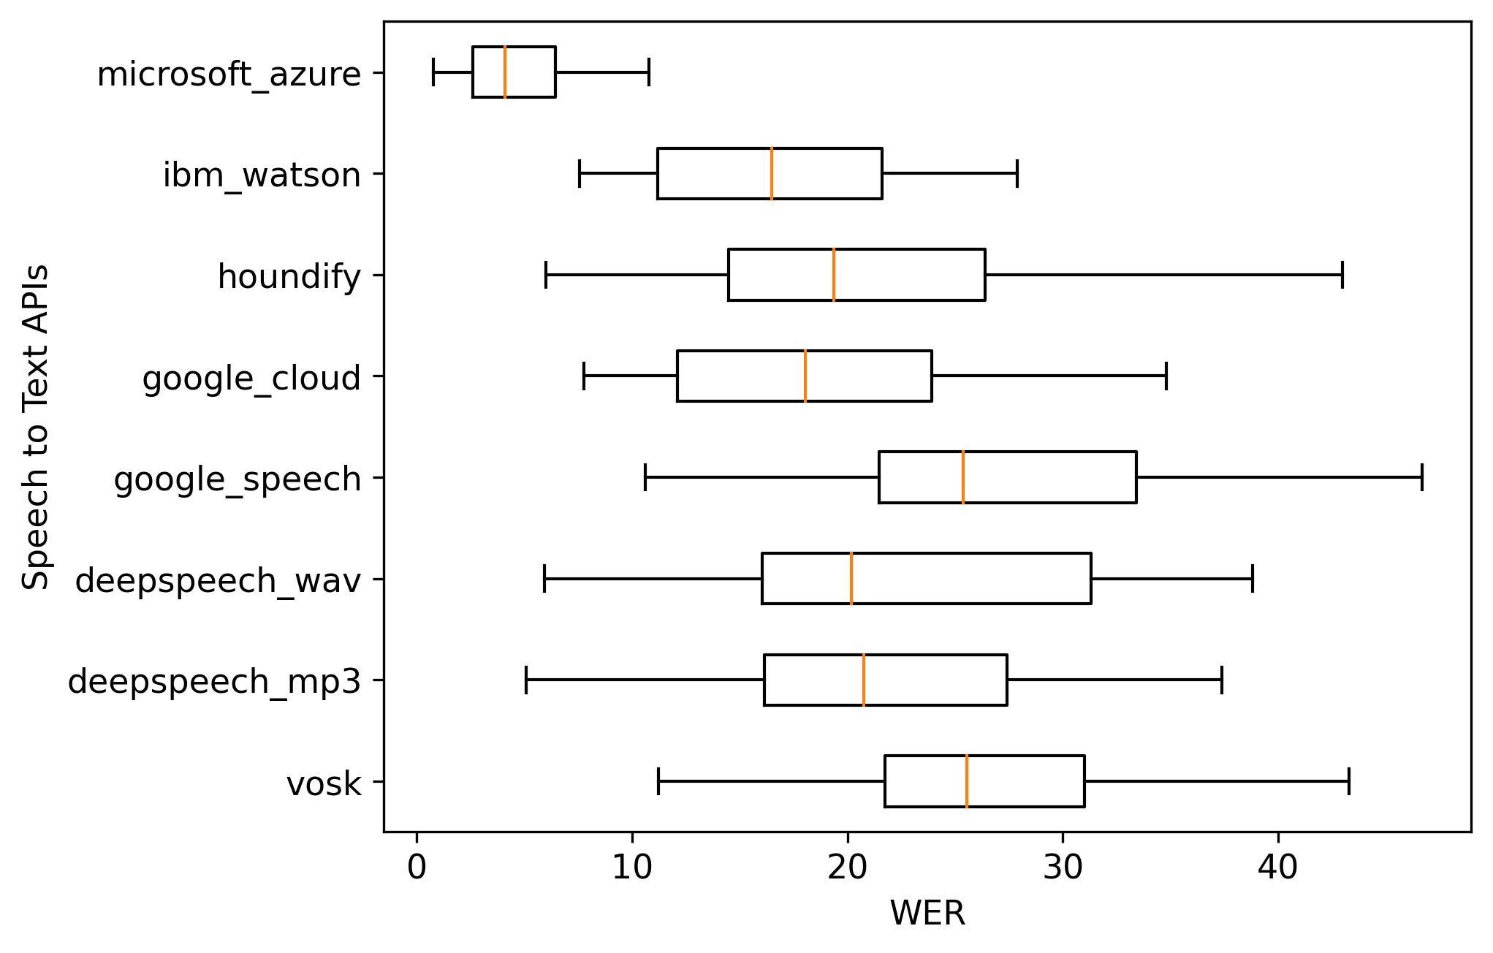
Related Work - Part l
Artificial Intelligence Trend Analysis
using Speech-to-Text
Data from Healthcare Podcasts
Phi Long Do
[2]
[2]
Notes:
In my master thesis, I want to find out how much I can get out of podcast data to detect trends of AI in the healthcare sector. For this trend detect, I will leverage different modern techniques, to get the most out of the data.

Slide 8
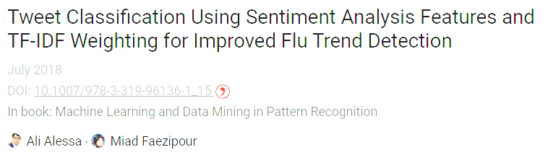
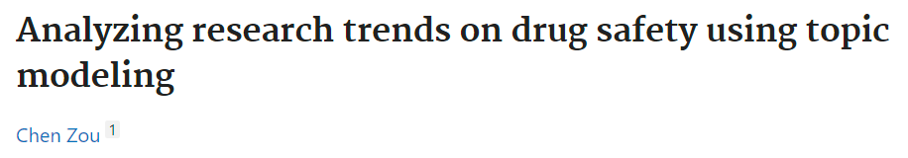
Related Work - Part ll
Sentiment Analysis
Topic Clustering
[3]
[4]
Notes:
In my master thesis, I want to find out how much I can get out of podcast data to detect trends of AI in the healthcare sector. For this trend detect, I will leverage different modern techniques, to get the most out of the data.

Slide 9


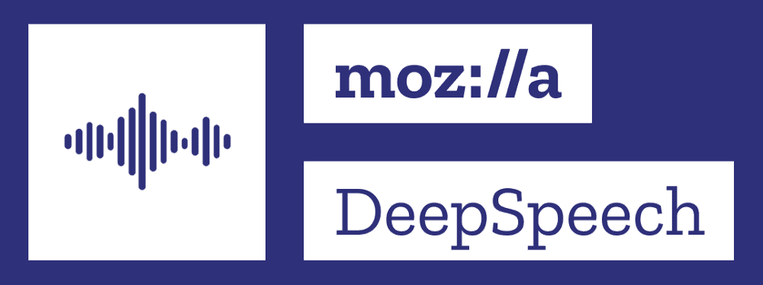
WER
Measuring the Word Error Rate (WER)
Notes:
In my master thesis, I want to find out how much I can get out of podcast data to detect trends of AI in the healthcare sector. For this trend detect, I will leverage different modern techniques, to get the most out of the data.

Slide 10
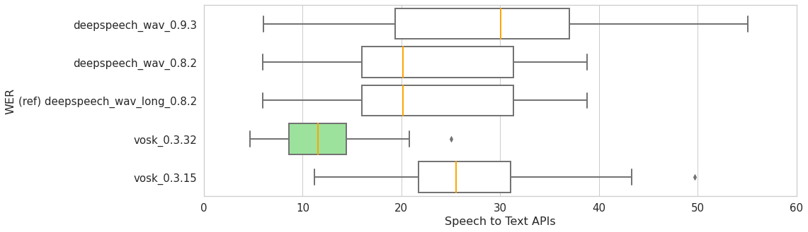
WER Model Version Comparison
Notes:
In my master thesis, I want to find out how much I can get out of podcast data to detect trends of AI in the healthcare sector. For this trend detect, I will leverage different modern techniques, to get the most out of the data.

Slide 11
Detecting the Trend with Extended Keyword List
Keyword List

Slide 12
My Research Questions
Is there a qualitative difference between the open-source speech-to-text APIs Deepspeech
and Vosk by evaluating their language models and their Word Error Rate (WER) metrics?
Is topic clustering a suitable approach for identifying keyword clusters and investigating the
relationship of the keywords for enhanced AI trend analysis?
Is it possible to predict the speakers' sentiments towards specific AI-related keywords by
applying sentiment analysis?

Slide 13


Roadmap Month
Literature Research
1
Comparison of WER for Vosk and Deepspeech Versions
1
Update and Transcription of Podcasts
1 - 2
Creation of Keyword List
2 - 3
Evaluation
3 - 4
Writing the Thesis
4 - 6

Slide 14
References
[1] https://www.podcastinsights.com/podcast-statistics/
[2] Artificial Intelligence Trend Analysis using Speech-to-Text Data from Healthcare Podcasts
[3] Ali Alessa and Miad Faezipour. Tweet Classication Using Sentiment Analysis Features and
TF-IDF Weighting for Improved Flu Trend Detection
[4] Chen Zou. Analyzing Research Trends on Drug Safety using Topic Modeling. Expert opinion
on drug safety

Slide 15
Thanks for listening!

