Slide 1

PATCH
Your AI coding and
security teammate
Release Detective
Naija AI / DevX Arena 2026
1
Notes:
Patch is the native VS Code companion for Release Detective. Naija AI, DevX Arena 2026, Build track. Original project artwork from companion/assets/patch.png. This deck describes demonstrated capabilities, not deployment approval.

Slide 2
The manual investigation takes several steps
90 min
01
Understand the route and access policy
02
Reproduce access and data exposure
Published median for manual
CodeQL alert remediation [1]
03
Prepare the change and check regressions
Different tasks and timing boundaries.
This is industry context, not Patch
performance or its human baseline.
04
Rerun checks and assemble evidence
OWASP supports the testing workflow [2, 3]; it does not assign minutes to these steps.
2
Notes:
GitHub reports 90 minutes median manual remediation versus 28 minutes with its AI assistance for new CodeQL PR alerts during May-July 2024 beta telemetry. Vendor observations, not a Patch benchmark or controlled matched trial. Source [1]: https://github.blog/news-insights/product-news/secure-code-more-than-three-times-faster-with-copilot-autofix/
OWASP describes role-based checks and authorization matrices, not a timing baseline. [2]: https://wstg.owasp.org/v4.2/4-Web_Application_Security_Testing/05-Authorization_Testing/02-Testing_for_Bypassing_Authorization_Schema/ [3]: https://cheatsheetseries.owasp.org/cheatsheets/Authorization_Testing_Automation_Cheat_Sheet.html

Slide 3
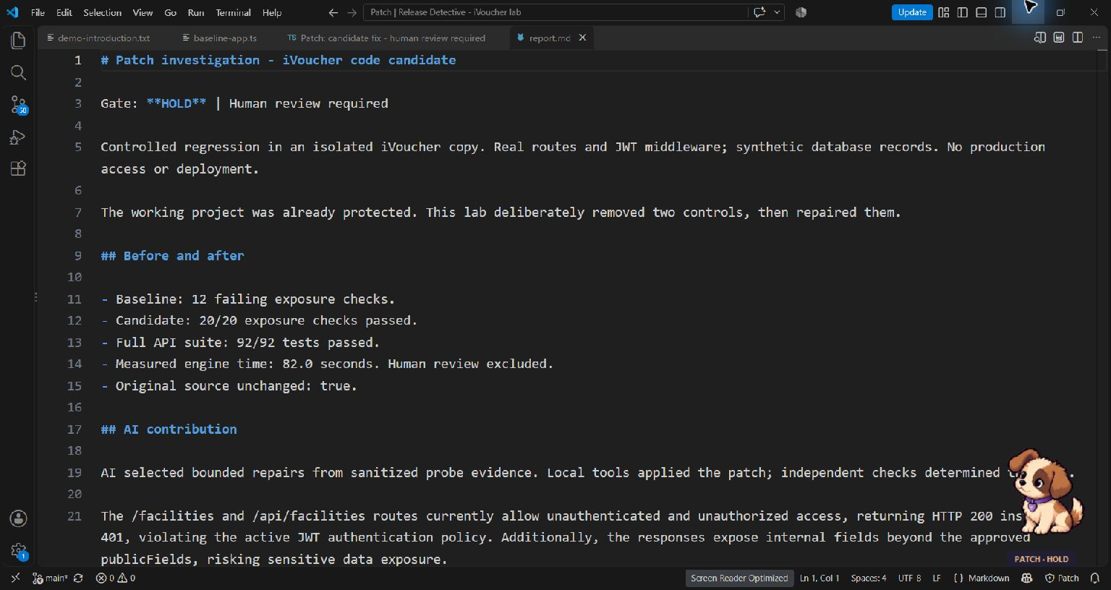
Patch keeps evidence and review in the editor
An engineer starts
one investigation
AI selects
approved repairs
Tools verify
the candidate
The engineer reviews
the diff and report
Controlled regression in an isolated copy. Real routes, synthetic records. No deployment.
3
Notes:
Actual VS Code capture from the recorded iVoucher copy investigation, 7 October 2026. Controlled regression, synthetic database responses. Source frame: data/submission-video/frames/13-results-000.png. The report keeps HOLD visible because dependency advisories remain. The image records real UI; the adjacent text explains the workflow.

Slide 4
Patch architecture
Investigate
Findings
VS Code extension
Local heuristics + commands
Shared engine
Local context + HTTP evidence
AI planner
Sanitized findings only
Authenticated loopback
Commands and status
Validated
action list
Native Patch
Tips, status and review actions
Separate candidate
Source copy or synthetic API
Bounded local tools
Approved actions only
Probes, build, tests,
audits and source scan
Diff and evidence
Engineer review
Independent checks
PASS or HOLD
Optional dashboard / CLI use the same engine. Offline playbook remains labelled.
API key stays in the extension/backend. No source code, credentials or real records enter model context.
4
Notes:
Current implementation, not a planned deployment architecture. Extension and local heuristics: companion/extension.cjs and companion/lib/rules.cjs. Authenticated native bridge: companion/lib/bridge.cjs. Controller: companion/lib/investigation.cjs. Engine: src/agent.mjs and src/project-lab.mjs. Structured planner validation: src/providers.mjs. Keys stay local to extension/backend, and raw code, secrets and real records stay out of model context. The optional dashboard/CLI invoke the same engine.

Slide 5
Measured results from two different rehearsals
Workflow | Observed time | Verified outcome
iVoucher source copy | 82.0 seconds | 92/92 API tests 20 exposure checks included
Smaller policy sandbox | 5.188 seconds | 36/36 exposure checks Five approved policy repairs
The code candidate builds and passes its tests
The release remains on HOLD: eight production dependency advisories still need attention.
One run per scenario. Human review and dependency remediation are outside these timings.
5
Notes:
Source: submission/MEASUREMENTS.json, copied only from local evidence. Project run 5f442a32-359d-4a57-9644-ba1aae74b250: 81,999ms engine runtime, 92/92 API tests including 20 exposure tests, shared/API/web build PASS, original unchanged. Eight production advisories keep overall HOLD. Sandbox run b6a03b53-cb39-4ba3-ab06-d3c7c32de0d9: 5,188ms command-to-completion, 36/36 checks. One observed run each; review excluded.

Slide 6
Potential developer time saved
10–28 min
Component | Time
Manual workflow | 15–30 min assumed
Patch automation | 5.188 sec measured
Human review | 2–5 min assumed
Assisted total | 2.09–5.09 min estimated
Estimated saving per smaller
sandbox investigation
Includes human review.
A timed manual comparison is still needed.
This estimate is separate from the larger 82-second iVoucher code investigation.
6
Notes:
Planning scenario only, for the smaller sandbox. Manual assumption 15-30 minutes; review assumption 2-5 minutes; automated command time measured at 5.188 seconds = 0.0864667 minutes. Assisted total 2.0864667-5.0864667 minutes. Savings interval 15-5-0.0864667 to 30-2-0.0864667 = 9.9135333-27.9135333 minutes. No manual baseline, weekly frequency or observed productivity gain has been measured. External sources do not validate this baseline. See TIMING.md.

Slide 7
What the prototype taught us
Worked
Next evidence
A real candidate and evidence
arrive inside the editor.
The gate keeps dependency
blockers visible after a repair.
Time matched manual and assisted tasks,
including review and rework.
Validate the recipe in authorized staging
with a real database.
A Windows path mismatch and overly broad model actions both surfaced in rehearsal.
We fixed those failures and added regression checks.
Current scope: one facilities recipe, synthetic records, human release authority.
7
Notes:
Observed implementation lessons: Windows drive-letter case mismatch prevented matching mocked modules until canonicalization; the model action schema was narrowed to observed findings; credential lookup now recognizes package identity independently of folder name. Current gate: 57 automated tests plus source scan, dependency audits and native pet checks. No measured manual trial or production deployment. NIST SSDF provides general secure-development context, not a compliance certification: https://csrc.nist.gov/pubs/sp/800/218/final

Slide 8
Sources and project evidence
[1] GitHub, 2024
CodeQL alert remediation timing; vendor beta telemetry
[2] OWASP WSTG v4.2
Testing for Bypassing Authorization Schema
[3] OWASP Cheat Sheet Series
Authorization Testing Automation
[4] NIST SP 800-218 v1.1, 2022
Secure Software Development Framework
Full citations, claim boundaries and local measurements are in submission/SOURCES.md
and submission/MEASUREMENTS.json in the project repository.
8
Notes:
Primary sources accessed 7 October 2026.
[1] https://github.blog/news-insights/product-news/secure-code-more-than-three-times-faster-with-copilot-autofix/
[2] https://wstg.owasp.org/v4.2/4-Web_Application_Security_Testing/05-Authorization_Testing/02-Testing_for_Bypassing_Authorization_Schema/
[3] https://cheatsheetseries.owasp.org/cheatsheets/Authorization_Testing_Automation_Cheat_Sheet.html
[4] https://csrc.nist.gov/pubs/sp/800/218/final
Local evidence: submission/MEASUREMENTS.json and VERIFICATION.md. Rehearsal artifacts stay local. Repository: https://github.com/roche-sandbox/devxarena2026-naija-ai-build

