Slide 1



UTIVA DATA HACKATHON
TEAM 2 CONSULTING FIRM

Slide 2



INTRODUCTION PROBLEM STATEMENT
WHO ARE WE ?
CredPal is a fintech company that develops point-of-sale credit infrastructure to ease consumer credit purchases and enables retail businesses to provide on-demand credit for the consumer population. Working from Lagos Nigeria.

Slide 3

PROBLEM STATEMENT
We are currently working with a large e-commerce company in the United States, Stripe, a software technology company based in San Francisco who decided to invest 2.9 million USD in our company, enveloped an internal project with the aim of analyzing consumers’ spending habits at different levels and regions of transactions but there is a need to prioritize its investments across different regions.
the business Analytics and Intelligence has been provide in the following slides considering
Descriptive analysis (what)
Diagnostic analysis (why)
Predictive analysis (what could be)
Prescriptive analysis (what should be)

Slide 4

THE DATA

Slide 5
THE DATA Descriptive analysis
The following can be easily observed from the data we were provided with:
Region
Country
Consumer Preference
Sample Priority
Study Time: Start and End time
Number of Samples
Average monthly income
Month Expenditure
Total Income of Sample size
Total Expenditure of Sample Size
Disposable Income of Sample Size which is the income remaining after deduction of taxes and social security charges, available to be spent or saved as one wishes. (total income –Total expenditure)

Slide 6
DIANOGISTIC ANALYSIS
As a group we have decide to focus on the following:
Items consumers prefer to buy
Items that bring in more income for the company, stripe
Saving rate of each region

Slide 7

Our insight

Slide 8
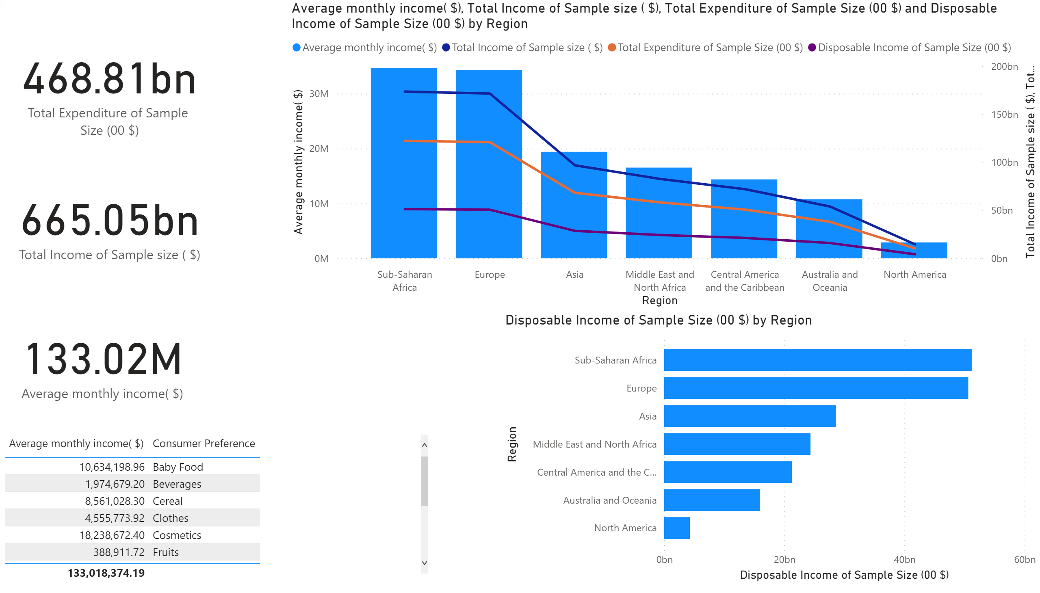
From the charts, it is clear that sub Saharan African and Europe consumers earn more income and north America earn less
Baby food happens to be goods to spend majority of their income on

Slide 9
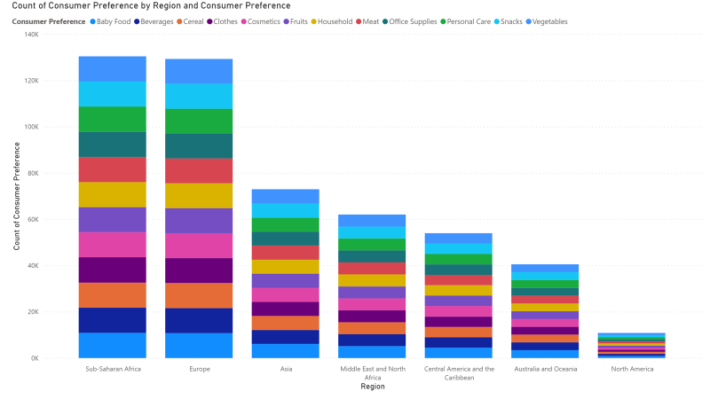
Baby food happens to be consumers preferred goods to buy and they do not buy much vegetable across all regions

Slide 10
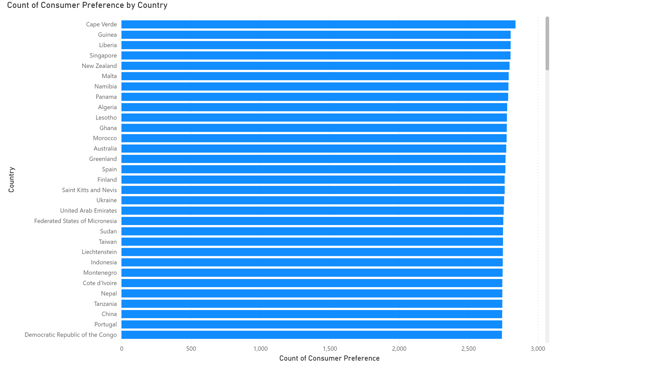
Cape Verde had the highest number of consumer's preference in sub Saharan Africa

Slide 11
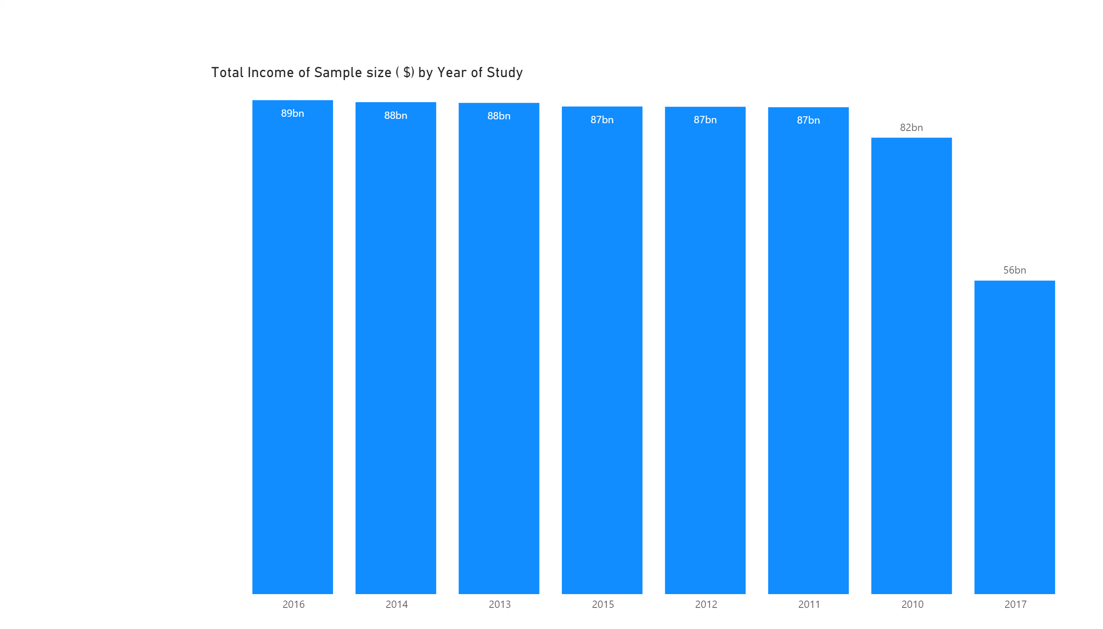
The year of study took place from 2010 to 2017 and 2016 had the highest number of income

Slide 12
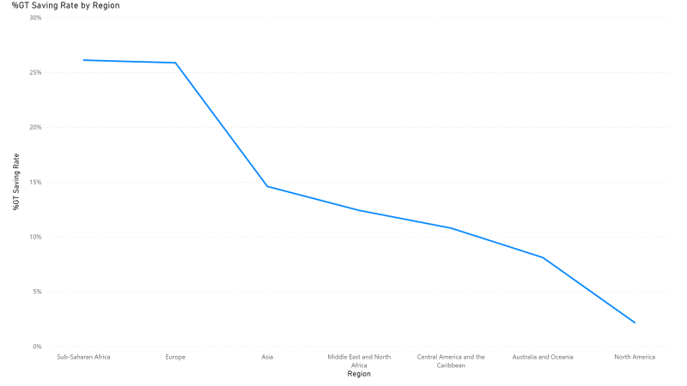
Consumers in sub Saharan African and Europe were able to save more

Slide 13
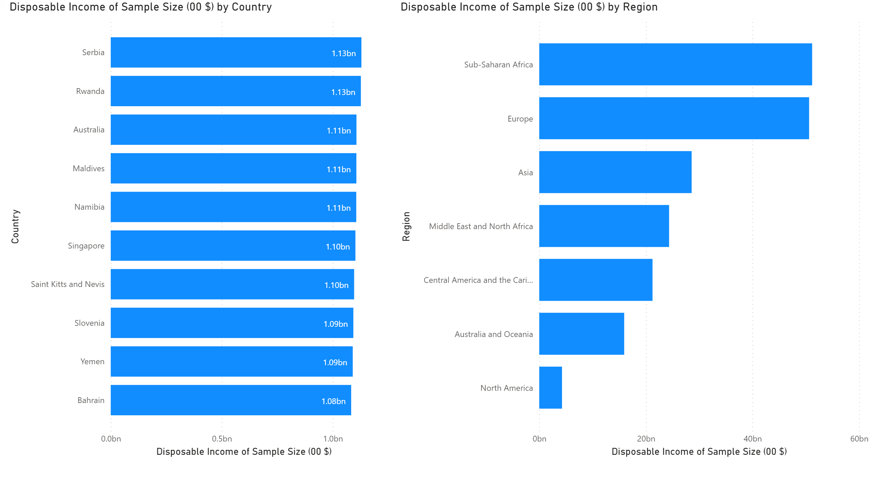
Serbia and sub Saharan Africa had the highest number of disposable income of the sample size considered in terms of country and continent/ region respectively.

Slide 14


Slide 15
Recommendation Prescriptive analysis
As a team we recommend that;
The company should invest more in Sub Saharan Africa and Europe for profits.
The company should focus on exporting baby foods to sub Saharan Africa and Europe
Vegetable should be more preserved better as they are perishable and could be what must have constituted to their low costumer preference
The company should look into 2016 report in other to be able to grow in the coming years.

Slide 16
UTIVA DATA HACKATHON
THANK YOU
TEAM 2 CONSULTING FIRM

