Slide 1
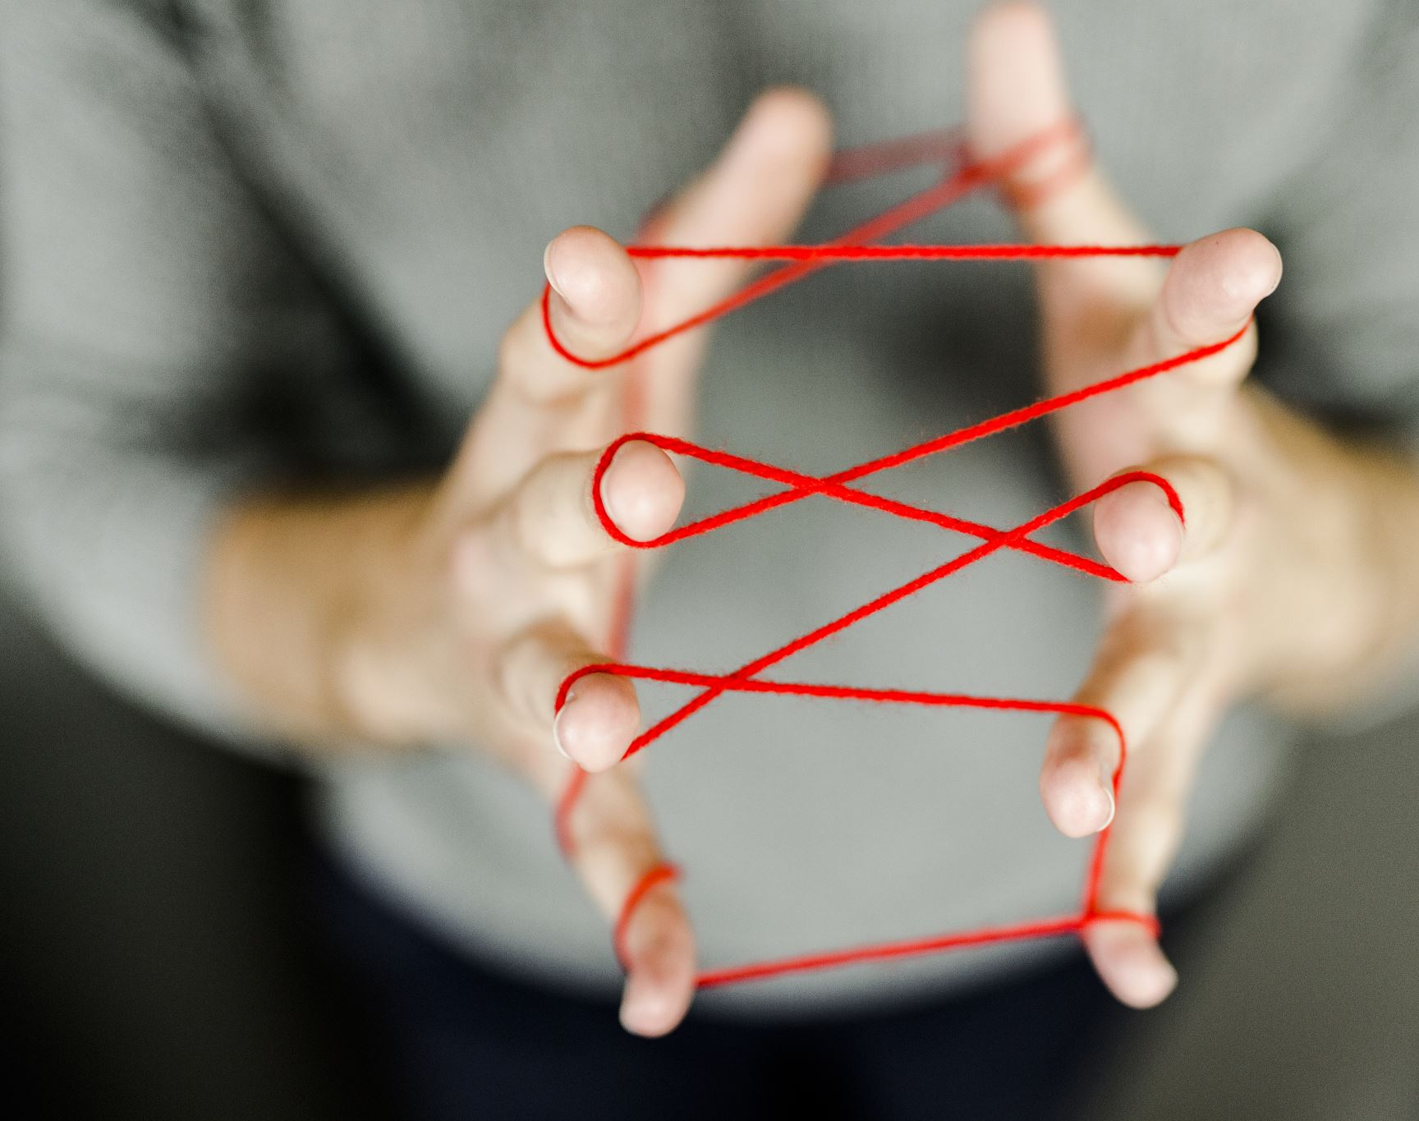
Friend recommendation with graph neural networks
Topic Rep: Unyi Dániel
Team: Solo que
Student: Mihályi Balázs Márk

Slide 2
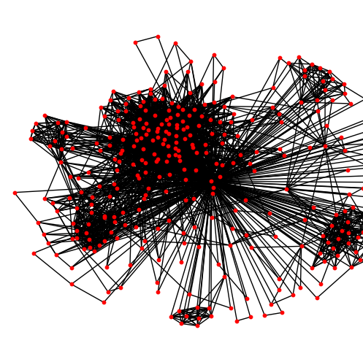
Introduction of the problem
Social networks as graphs
Learn graph representations
Suggest meaningful connections (that are not present yet)

Slide 3

Data
Social circles Facebook dataset
Nodes: Facebook profiles
Edges: Two profiles are Facebook friends
Used the ego network of user 0
70-15-15 train-validation-test split
1:1 real to false edge ratio
3996, 854, 854 edges in total

Slide 4
Modeling approaches - baselines
Node2Vec
10 random walks + logistic regression model
Spectral Clustering
16D embeddings, dot product + sigmoid

Slide 5
Modeling approaches - proposed methods
GAE
Encoder: Graph convolutional layers (16, and 1 channels)
Decoder: Dot product
Adam + 0.01 lr, BCE loss
100 epochs
VGAE
Encoder: VGraphEncoder class
Decoder: InnerProductDecoder
AdamW + 0.01 lr + 0.0005 wd, Reconstruction loss + KL-Divergence
Small hyperparameter optimization

Slide 6
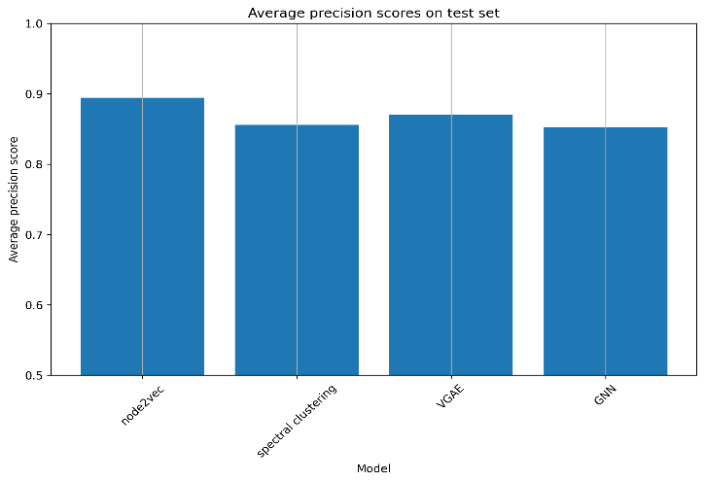
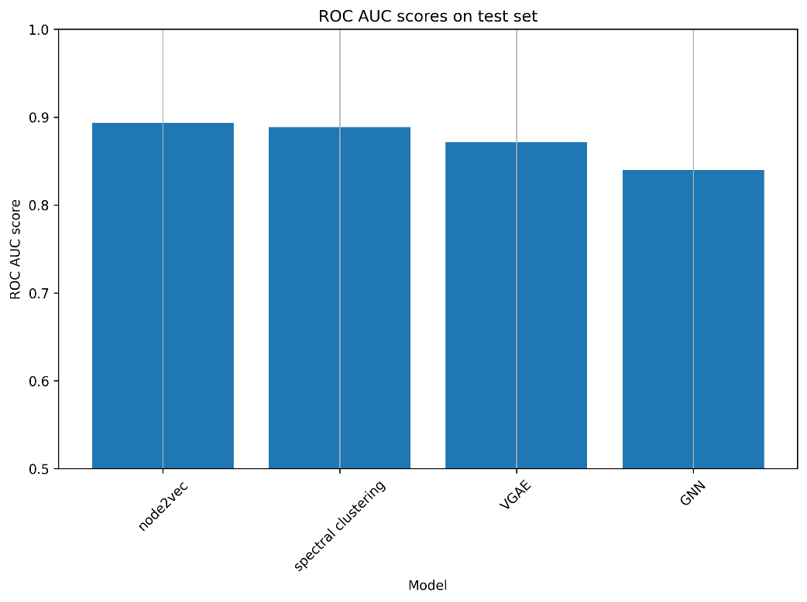
Results I. – AP, ROC AUC scores

Slide 7
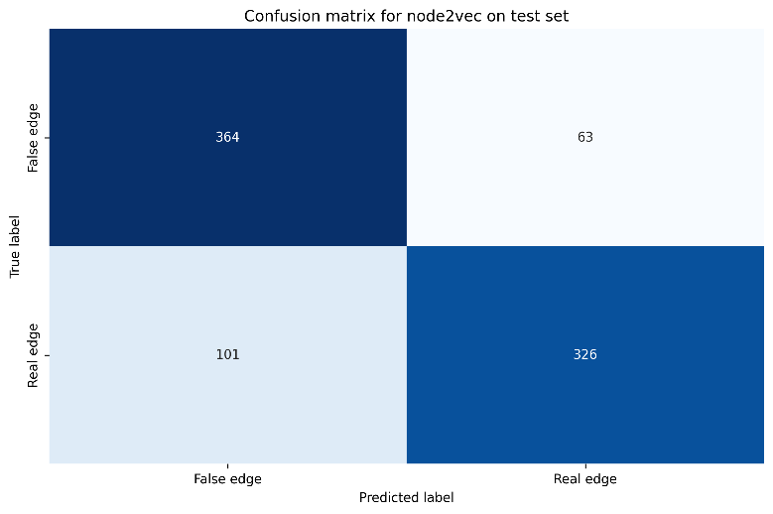
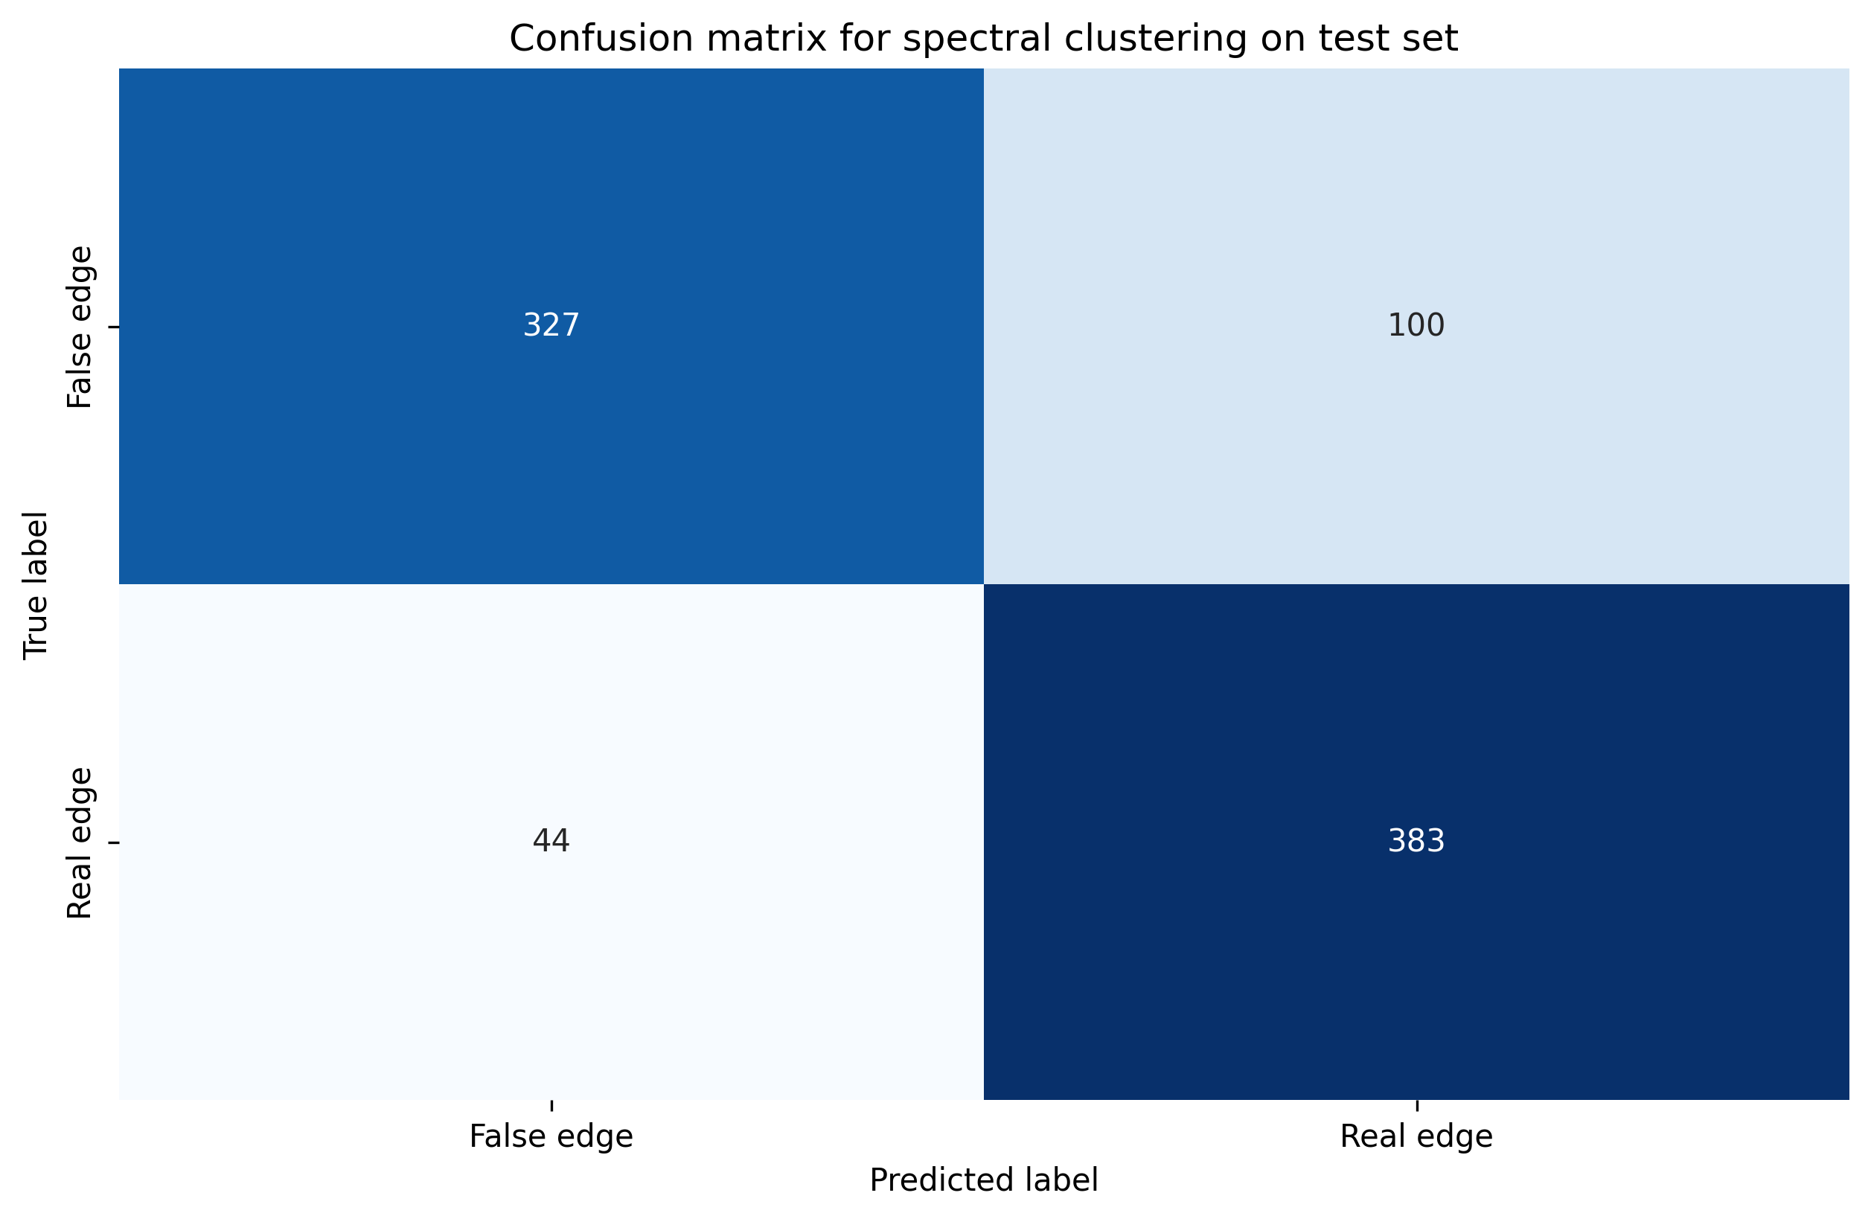
Confusion matrices I. - Baselines

Slide 8
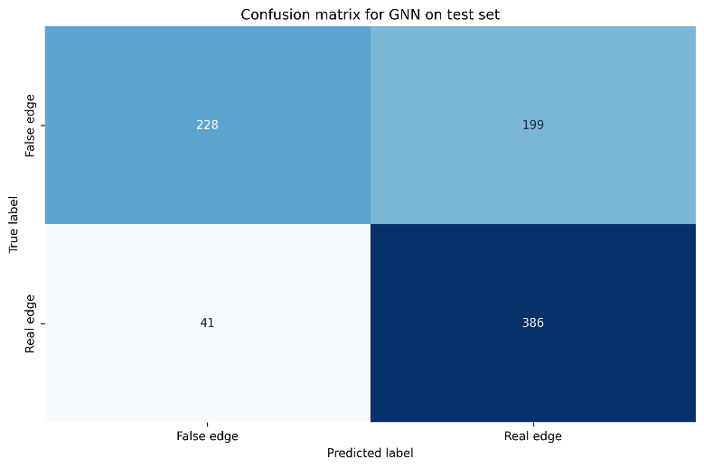

Confusion matrices II. – GAE, VGAE

Slide 9
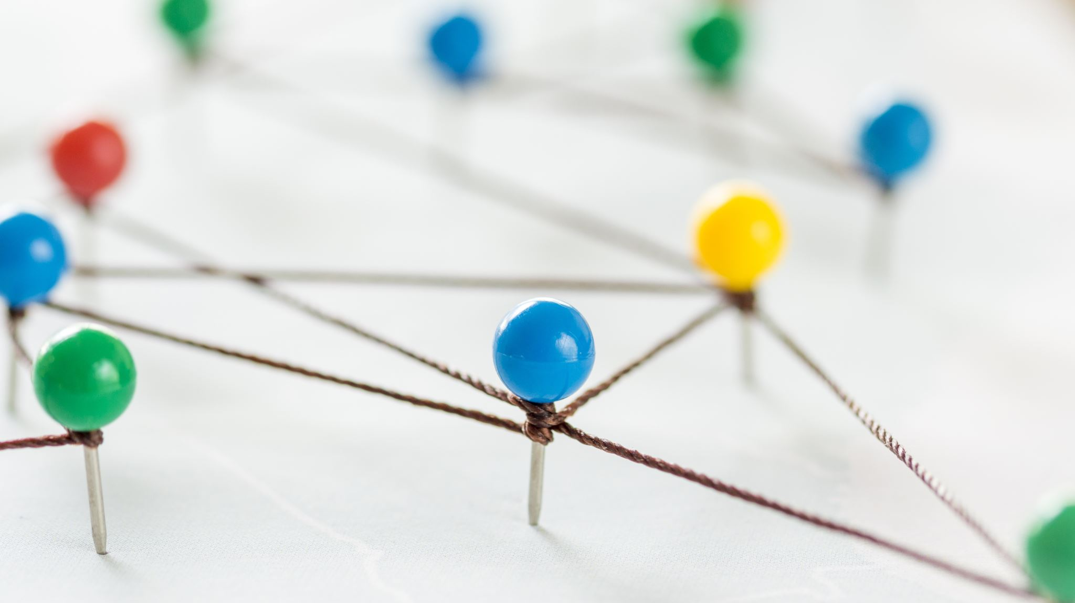
Conclusion
Performed link prediction task on the Facebook social circles dataset
Two baselines: Node2Vec, Spectral Clustering
Two proposed methods: GAE, VGAE
The proposed methods did not beat the baselines
Initial thought: low GNN performance due to scarce node features
Real reason: Bad hyperparameters/structures, Connection with ego node

