Slide 1
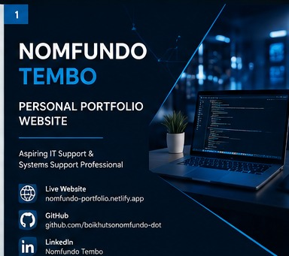
PERSONAL PORTFOLIO WEBSITE
Nomfundo Tembo
Aspiring IT Support & Systems Support Professional
Professional Portfolio Project • 2026
Nomfundo Tembo • Personal Portfolio Project
1

Slide 2
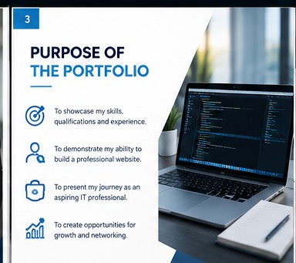
About Me
• Nomfundo Tembo — an aspiring IT Support & Systems Support Professional.
• Currently studying towards System Support NQF Level 5.
• Developing practical technical, communication and problem-solving skills.
• Focused on building a professional career in IT.
Nomfundo Tembo • Personal Portfolio Project
2

Slide 3

Purpose of the Portfolio
• Create a professional online presence for internships and employment opportunities.
• Showcase education, skills, experience, certifications and career goals.
• Demonstrate practical web-development skills through a real deployed website.
• Give employers an easy way to learn about me and connect with me.
Nomfundo Tembo • Personal Portfolio Project
3

Slide 4
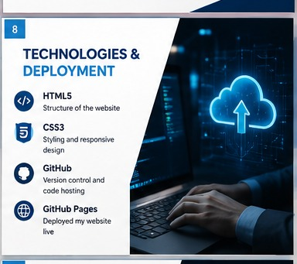
Education & Certifications
• Matric — Ferndale High School.
• System Support NQF Level 5 — Currently studying.
• YES4Youth Certificate.
• Continuing to build technical knowledge through professional development.
Nomfundo Tembo • Personal Portfolio Project
4

Slide 5
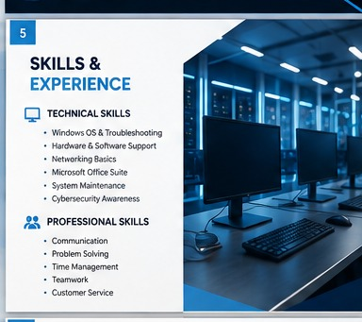
Skills & Experience
• Technical interests: system support, troubleshooting and computer systems.
• Professional strengths: communication, customer service, teamwork and problem-solving.
• Work experience includes cashier, sales assistant and deli assistant roles.
• These experiences strengthened my ability to work with people and solve problems.
Nomfundo Tembo • Personal Portfolio Project
5

Slide 6
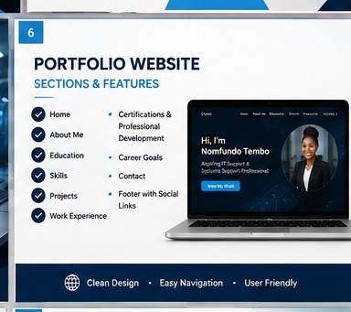
Portfolio Website
• Home, About Me, Education, Skills, Projects and Work Experience.
• Certifications & Professional Development and Career Goals.
• Contact section with email, LinkedIn and GitHub.
• Clear navigation makes the website easy to explore.
Nomfundo Tembo • Personal Portfolio Project
6

Slide 7
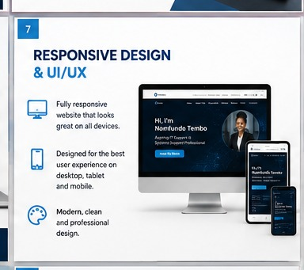
Responsive Design & UI/UX
• Responsive layout for desktop, tablet and mobile devices.
• Clear headings, readable text and consistent spacing.
• Easy navigation and a clean, professional visual style.
• Responsive CSS improves usability on smaller screens.
Nomfundo Tembo • Personal Portfolio Project
7

Slide 8

Technologies & Deployment
• HTML5 — website structure and content.
• CSS3 — styling, layout and responsive design.
• GitHub — source-code repository.
• GitHub Pages — live deployment of the portfolio website.
• Netlify was also used as a hosted version during development.
Nomfundo Tembo • Personal Portfolio Project
8

Slide 9
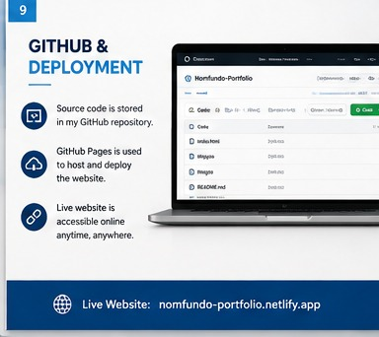
GitHub & Live Deployment
• Source code is stored in the Nomfundo-Portfolio repository.
• GitHub Pages publishes the website directly from the main branch.
• The live site can be shared with employers and assessors.
• Keeping the code in GitHub makes future improvements easier.
Nomfundo Tembo • Personal Portfolio Project
9

Slide 10

Career Goals
• Build a successful career in IT and Systems Support.
• Gain practical experience through internships, entry-level roles and projects.
• Continue developing technical skills and pursue relevant certifications.
• Grow into a confident IT professional who can provide reliable technical support.
Nomfundo Tembo • Personal Portfolio Project
10

Slide 11

Conclusion & Contact
• This portfolio demonstrates my commitment to developing a professional career in IT.
• GitHub: github.com/boikhutsonomfundo-dot
• LinkedIn: linkedin.com/in/nomfundo-tembo-03384041a
• Live portfolio: boikhutsonomfundo-dot.github.io/Nomfundo-Portfolio/
Nomfundo Tembo • Personal Portfolio Project
11

