Slide 1
CSCI251
Advanced Programming (S2a)
C++ Foundations I:
Introduction to Programming
Java vs C++

Slide 2
Outline
What is programming?
Programming paradigms.
Java vs C++.
Machine language and the JVM.
Compilers and linkers.

Slide 3
What is programming?
Writing instructions for a computer with the purpose of getting the computer to perform required tasks.
  I prefer to think of programming as encompassing a lot of the design too rather than just being the writing the code part.
The instructions are written in a programming language which has a specified syntax.
In particular there is syntax associated with:
    Input and output
    Variables and data types
    Control structures
    etc.

Slide 4
Programming paradigms
Emphasis on how the program operates
Emphasis on what the program should achieve
Declarative programming
Imperative programming
Data types, Instructions
Result focused.
Structured programming
Structured program theorem
}
Procedural programming
Modularity, scope
Object Based & Object Oriented programming
CSCI251
Objects, classes + …
Generic programming
Templates, parameterised types
Imperative:
Statements change the program state and describe how things happen.

Slide 5
Don’t get too carried away with the separation though.
You can write procedural programs that call black-box functions or modules.
  So you know want you want to be done but don’t want to know the details → which is heading towards being declarative, but only at a certain level.

Slide 6
C++ vs Java: Paradigms
Java is object oriented.
  It’s difficult to avoid objects in Java, everything has to be in a class … but some of the primitive data types are not objects so it’s not a pure object oriented language.
  Does have some generic programming.
C++ is object oriented too but …
  You don’t have to have classes → procedural programming.
  Even when objects are around you don’t need to use all the object oriented programming features, so programming can be object-based.
  Can also be generic, providing extra abstraction.

Slide 7
Java is used for implementing client-server web based applications, among other things.
It’s often described as being platform independent, …
… but it’s perhaps better to think of it as being a dedicated platform that you are writing for, the Java Virtual Machine (JVM).
The Java Virtual Machine is a platform dependent application that runs on hardware/OS.
  In many cases, but not all, the JVM is written in C or C++.

Slide 8
C++ is mostly used for desktop applications and systems programming.
    Systems programming produces software that serves the system, vs application programming which serves the user.
  Bjarne Stroustrup writes (“Foundations of C++”: ETAPS 2012) … http://www.stroustrup.com/
  “The aim of C++ is to help classical systems programming tasks.”
  It’s also used for embedded systems, resource constrained systems, and large systems.
The evolution of C++ standards has driven it towards platform independence, but it has operating system dependent functionality.

Slide 9
Machine language and the JVM
Computers work can understand only a machine language, which is a sequence of binary instructions (0’s and 1’s).
Generally, programs are not written in machine language, although it is possible.
There are “simpler” languages to program in:
  Assembly language.
  High-level languages, such as C or C++.
While C++ program runs as executable native machine code; so directly on the hardware/OS, a Java program runs in a Java Virtual Machine (JVM).

Slide 10
Java is good for safety, and web programming, but is often slow and less powerful for top end game coding and building large complex applications.
The JVM manages hardware/OS resources.
C++ allows more direct control of the hardware resources, including using memory pointers.
  This means you have to be more careful to avoid resource mishandling.
  We will look at programming defensively later

Slide 11
C++ vs Java: OO differences
There are naming differences:
  Java has fields and methods, C++ has data members and member functions.
And different functionality:
  C++ supports multiple inheritance.
  C++ supports operator overloading, in addition to function overloading.
  C++ supports C-functionality, including structs and unions.
We are going to move away from object oriented programming initially.

Slide 12
Hello World …
alert('Hello, world!');
Javascript
public class HelloWorld {
public static void main(String[] args) {
System.out.println("Hello, world!");
}
}
Java
#include <iostream>
using namespace std;
int main()
{
cout << "Hello World!" << endl;
return 0;
}
Both
have
a lot of
syntax
☹
C++

Slide 13
Compilers and linkers
Before the computer can run any program it needs to be converted from the programming language into machine instructions.
This is the job of
  A compiler, and/or
  An interpreter …
… in combination with a linker.

Slide 14
Java
Java Program
HelloWorldApp.java
Roughly …
The compiler take a .java file and produces a .class file, so bytecode.
The JVM interprets that bytecode to turn in into native machine code.
There are compilers that produce native machine code for some specified platform.
Compiler
HelloWorldApp.class
binary code
Interpreter
Interpreter
11000110101
01001110101
PC
Unix
From CSIT111

Slide 15
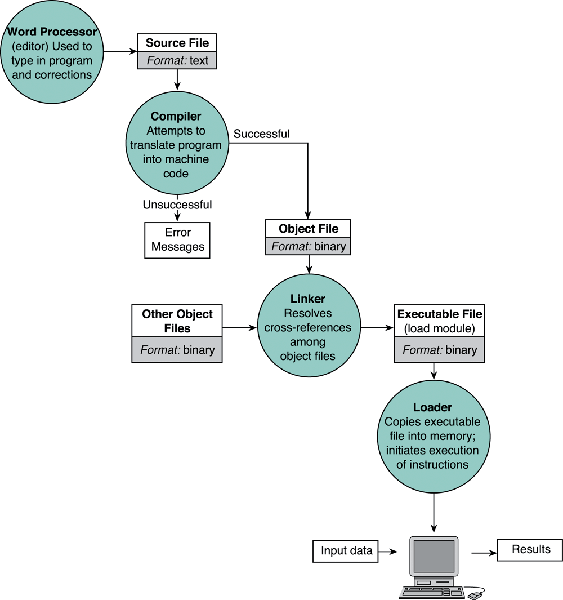
C++
hello.cpp
There is some preprocessing
in there too!
CC –o hello hello.cpp
hello
Hello World !
Getting started !

