Slide 1
CSCI251
Advanced Programming (S2b)
C++ Foundations II:
Getting started and …
… Procedural Programming

Slide 2
Outline
Procedural programming.
Introducing main() …
… explaining Hello World!
Compilation.
Comments.
Primitive types, variables and memory.
Functions.
Multiple files.

Slide 3
Procedural programming
In procedural programming, procedures, also called routines, subroutines or functions, are declared or defined independent of the main program construct.
  Main is something special we will get to soon.
The program is a list of procedure calls, effectively a list of operations that change the state.
Step 1: Call procedure B
Step 2: Call procedure A
Step 3: Call procedure C
Step 4: Call procedure B
Step 5: Call procedure C
Step 6: Call procedure A
Step 7: Call procedure A

Slide 4
It is possible to write programs without any procedures or “function calls”.
Such code might be referred to as unstructured or sequential.
While this may be appropriate for simple tasks there are advantages in using procedures:
  Code can be re-used within a program.
  Code defined to carry out a specific function can be easily transferred to another program.
  Program flow can be more readily tracked.
    This makes is easier to read and helps with bug fixing.

Slide 5
Individual functions contain exact rules regarding the input and the output.
  For example; exactly two integers as input, and one integer as output.
This exactness is one of the major disadvantages with procedural languages.
  There is a need to keep track of all the detail.
Another major disadvantage is that similar but not identical pieces of code must be rewritten.
  For example: The procedure for calculating the area of a rectangle would often be different from the procedure to calculate the area of a triangle; even though both are polygons.

Slide 6
Introducing main() …
In Java, every method or function needs to be in a class.
In a lot of languages, including C++, you can have stand alone function.
In Java applications, the main() function is a static public member of a Runnable class.
  If you don’t know what this means, don’t stress…
In contrast, C++ programs must have a stand alone main() function, that should return an integer, specifically an int, to the operating system.
  With a return value of 0 typically meaning a normal termination, and some other value being associated with an error.

Slide 7
… explaining Hello World!
#include <iostream>
using namespace std;
int main()
{
cout << "Hello World!" << endl;
return 0;
}
We have our stand alone main(), a special case of:
return_type function(arguments){ }

Slide 8
#include <iostream>
using namespace std;
int main()
{
cout << "Hello World!" << endl;
return 0;
}
#include is like import in Java.
It brings in a header, iostream here.
The header iostream is the part of the standard library for C++ associated with Input/Output.
Bring in your own files using something like
#include “My_file.h”
The .h suffix conventionally indicates header.
More on libraries and pre-processing later …

Slide 9
#include <iostream>
using namespace std;
int main()
{
cout << "Hello World!" << endl;
return 0;
}
Having the library iostream allows us to access input and output streams types, istream and ostream, representing input and output streams respectively.
  Input: Use standard in: object cin of type istream.
  Output: Use standard out: object cout of type ostream.

Slide 10
#include <iostream>
using namespace std;
int main()
{
cout << "Hello World!" << endl;
return 0;
}
So, what about the rest of the line?
<< is the output or insertion operator.
  It pushes the value right operand, in this case the literal “Hello World!”, to the buffer for the stream specified by the left operand, cout, …
  … where it may sit until flushed to the stream by ...
endl, a manipulator.
  Manipulators modify a stream.

Slide 11
Output chaining …
cout << "Hello World!" << endl;
Generally, since << is left-associative,
return X <<(ostream X, values)
… the left referenced ostream is returned and the next values in the chain added to it.
Consider cout << b << c << endl;
(cout << b) << c << end;
Stream (buffer) contains b: (cout << c) << endl;
Stream (buffer) contains b, c cout << endl;
The manipulator endl writes the stream out from the memory buffer to the output stream.

Slide 12
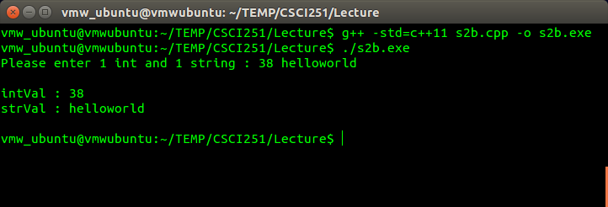
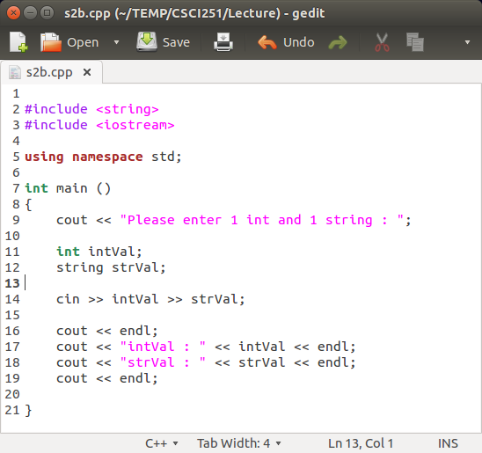
Input chaining …

Slide 13
That just leaves …
This lets us avoid a longer version of …
Specifically …
Namespaces are organisational tools for encapsulation.
  Using X::Y refers to Y in namespace X.
  They can help avoid name clashes.
The standard namespace (std) contains a lot of common C++ functionality.
using namespace std;
cout << "Hello World!" << endl;
std::cout << "Hello World!" << std::endl;

Slide 14
More main() …
The form of main() didn’t have arguments…
… but it can have them...
The first parameter (argc) is the number of command-line arguments, including the name of the executable itself. c is for count.
The second parameter is an array of C-style strings, so a sequence of characters, terminated with a special null character.
int main(){ }
int main( int argc, char *argv[]){ }

Slide 15
Lets have a look and see how this an example of this runs on Banshee.
#include <iostream>
using namespace std;
int main(int argc, char* argv[])
{
int x = 0;
for ( x=0; x <argc; x++ )
{
cout << "arg " << x + 1 << " " << argv[x] << endl;
}
return 0;
}
Try in lab !!! => S2b_1.cpp
This form of main() helps us to get parameters from the command line when we run a program.
The first line is the function header:
int main(int argc, char* argv[])

Slide 16
We almost got to input … cin and >>
So we should look at an example of cin, standard in, and >>, the input or extraction operator.
# include <iostream>
using namespace std;
int main() {
string name;
int age;
cout << "Enter a first name and age: ";
cin >> name >> age;
cout << name << " is " << age << " years old." << endl;
return 0;
}
Try in lab !!! => S2b_2.cpp
Unlike in Java, the name of this program doesn’t need to be tied to a class name.

Slide 17
Compilation and running: on Banshee
We saw some examples of code and how to compile them.
$ CC S2b_2.cpp –o S2b_2
$ g++ S2b_2.cpp –o S2b_2gpp
$ ./S2b_2
Generally, with just one source file for now,
$ CC code.cpp –o output_name
$ g++ code.cpp –o output_name

Slide 18
But wait … how did these work
  cin >> name >> age;
  cout << name << " is " << age << " years old." << endl;
… when we have different arguments for the operators >> and <<?
  Operators are symbols determining particular functionality for an expression.
These work because the insertion and extraction operators are overloaded to work with the primitive types.
An overloaded operator has different functionalities, depending on the arguments given to it.

Slide 19
So the following all work …
int k = 2;
double d = 4/5;
char c = 'x';
cin >> k; // read an int
cin >> d; // read a double
cin >> c; // read a char
cout << k << endl; // write an int
cout << d << endl; // write a double
cout << c << endl; // write a char

Slide 20
Commenting in C++
There are two types of comments:
  line comments: //
  block comments: /* */
// This is a one line comment
float price; //retail price
/* This is a comment that covers
a block over two lines */
/*********************************
* This is another block comment *
*********************************/

Slide 21
Primitive types in C++
The types int, double and char, are all primitive or basic or built-in types in C++.
Type | Meaning | Minimum size
bool | Boolean | NA
char | Character | 8 bits
wchar_t | Wide character | 16 bits
char16_t | Unicode character | 16 bits
char32_t | Unicode character | 32 bits
short | Short integer | 16 bits
int | Integer | 16 bits
long | Long integer | 32 bits
long long | Long integer | 64 bits
float | Single-precision floating-point | 6 significant digits
double | Double-precision floating-point | 10 significant digits
long double | Extended-prevision floating-point | 10 significant digits
New to C++11
Actual sizes are compiler dependent.

Slide 22
Signed or unsigned
Other than bool, char, wchar_t, char16_t, and char32_t, these types can have a qualifier signed or unsigned.
Variables that are declared as unsigned only represent values greater than or equal to zero. ( i.e. only +ive values ! )
unsigned int cats_present = 3;
unsigned int cats_present = -1;
Can compile, but … gibberish numbers when pass to cout !

Slide 23
Stroustrop said …
The Essence of C++, Columbia University 2014:
“ If you understand int and vector, you understand C++.
  The rest is “details” (1,300+ pages of details). ”

Slide 24
Variable declaration and assignment
We have seen this a few times already.
variable_type variable_name = variable_value;
double d = 4/5;
unsigned int cats_present = 3;
We can chain the operator = too, but = is right associative …
int x, y, z;
x=y=z=65;
So z is set to 65, then y to z, then x to y.

Slide 25
Linked to memory
The primitive types map directly on to memory entities like bytes and words, entities that most processors are designed to work with.
This allows C++ to efficiently use the hardware, without there being an abstraction in between.
Memory is effectively seen as a sequence of bytes, each typed object is given a location in memory, and values are placed in such objects.

Slide 26
We refer to and access the locations using pointers.
We will leave pointers for now, and return to them when we look at arrays and dynamic memory.
Pointers play a critical role in C++ (we will cover this later …)

Slide 27
Functions …
Procedural suggests procedures, or functions, should be used …
#include <iostream>
using namespace std;
void print() {
cout << "Hello world!" << endl;
}
int main() {
print();
return 0;
}
Try in lab !!! => S2b_3.cpp
Notice print() isn’t part of a class, so we don’t need to use the dot operator.

Slide 28
The function print() needs to be declared prior to reaching main(), otherwise the compiler won’t recognise it.
The structure of main() often tells a story about what our code does, and sometimes it’s clearer if definitions are out of the way.
  Declarations need to be prior to main(), definitions don’t.
So, it’s not unusual to separate the declaration and the definition of functions.
  When we do this we have a forward declaration, using the function header followed by a semi-colon ;.

Slide 29
# include <iostream>
using namespace std;
void print(); // function prototype
int main()
{
print(); // function call
return 0;
}
// function definition
void print()
{ cout << "Hello world!" << endl; }
Try in lab !!! => S2b_4.cpp

Slide 30
Multiple files …
Code is often, usually and preferably, spread across multiple files.
It is often helpful to put all of the functions into other files.
This is particularly useful if there are a lot of functions, and classes, and some of them are shared between programs.

Slide 31
#include <iostream>
using namespace std;
void print()
{ cout << "Hello world!" << endl; }
int main()
{
print();
return 0;
}
Try in lab !!!
Break up this code, into 3 files below, compile and run!
print.h
Hello.cpp
void print();
#include "print.h"
int main()
{
print();
return 0;
}
print.cpp
#include <iostream>
using namespace std;
void print()
{ cout << "Hello world!" << endl; }
$ g++ Hello.cpp print.cpp -o Run

Slide 32
Typically all data structure declarations, and function prototypes that you want to access in other files should be declared in header (.h) files, such as print.h
The definitions of those declarations go in the implementation file, e.g. “print.cpp”.

Slide 33
C++ libraries …
Sometimes we want to use functions, or classes, that other people have written.
In particular, we often want to use the standard library.
  Each C or C++ standard library has a corresponding header file, like iostream.
These header files contain:
  Function prototypes.
  Definitions of various data types.
  Definitions of constants.
  Declarations of objects.

Slide 34
For example, the math library, cmath, contains a square root function.
# include <iostream>
# include <cmath>
using namespace std;
int main() {
double a;
cout << "Enter a number: ";
cin >> a;
cout << "Square root " << a << " = " << sqrt(a) << endl;
return 0;
}
Try in lab !!! => S2b_5.cpp
More on the library can be found at
http://www.cplusplus.com/reference/cmath/

