Slide 1
CSCI251
Advanced Programming (S2c)
C++ Foundations III:
Pointers, classical arrays, and …

Slide 2
Outline
Pointing to memory.
  Addresses.
  Pointers:
    To variables.
    Null.
Arrays and String things…
Arrays and pointers.
The operator sizeof.
Function pointers.

Slide 3
Pointing to memory
The primitive types map directly on to memory entities like bytes and words, entities that most processors are designed to work with.
This allows C++ to efficiently use the hardware, without there being an abstraction in between.
Memory is effectively seen as a sequence of bytes, each typed object is given a location in memory, and values are placed in such objects.

Slide 4
When we declare a variable we access it using the variable name.
But we can also access the address the variable references, and operate on that address.
  To access the address we use the address-of operator &.
So if we have an integer variable …
int value = 41;
… we can output the address of value as follows:
cout << &value << endl;
The address is probably mostly not useful to output, more on this soon...

Slide 5
But & can be used in another way …
int value = 41;
int &referenceValue = value;
This referenceValue is an alias, not an object, and operations on referenceValue are carried out on the variable/object to which the reference is bound.
So …
referenceValue = 100;
… changes the value of value to 100 and …
Warning: References must be initialised.

Slide 6
…
int otherValue = referenceValue;
… declares a new variable otherValue with an initial value equal to the value in value.
This might seem a little limited in use but we use this all the time in functions where we want the values being passed to change and don’t want to have a complicated return object.
  As in Java, we can pass by reference or pass by value.

Slide 7
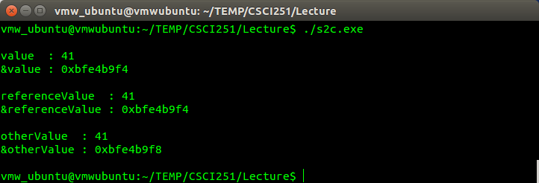
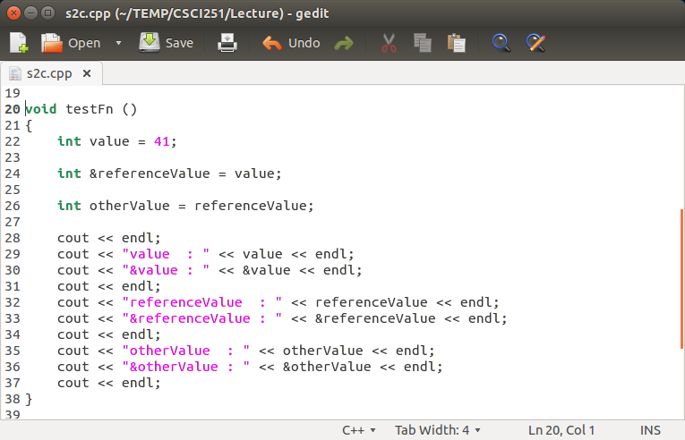
Try in lab !!!

Slide 8
Passing variables to functions
C++ has 2 ways to pass variables to functions:
  Pass by value, to be used when the function doesn’t need to change the value of the arguments given to it.
  return_type function_Name (type var1, type var2, …);
  int get_larger (int A , int B);
  Pass by reference, to be used when the function may change the arguments.
  return_type function_Name (type &var1, type &var2, …);
  int sort (int &A , int &B);
But we can mix these …
  return_type function_Name (type var1, type &var2, …);
  int add_rate(int rate, int &value);

Slide 9
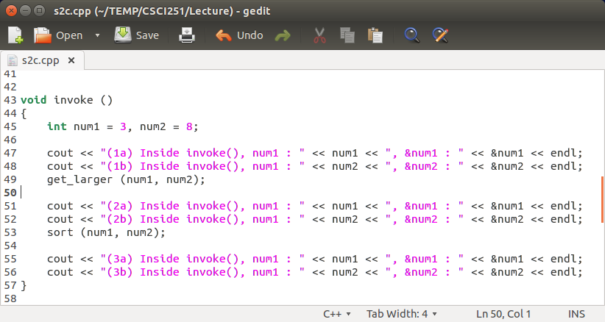
Try in lab !!! =>
Study the following functions (in the next few slides), write the remaining code that will call invoke(), compile and run it!
What do you think are the various output?
What are they trying to show?

Slide 10
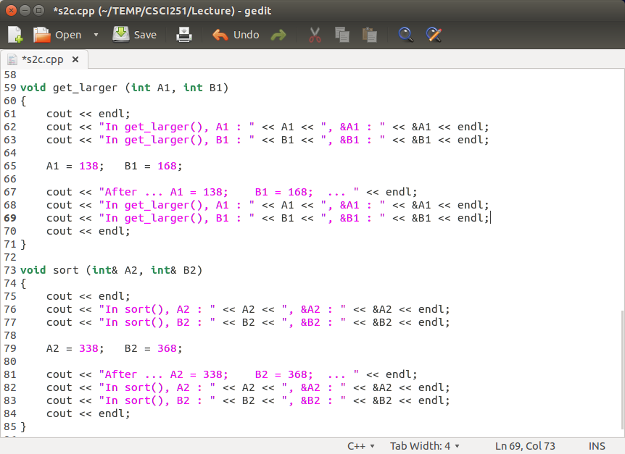

Slide 11
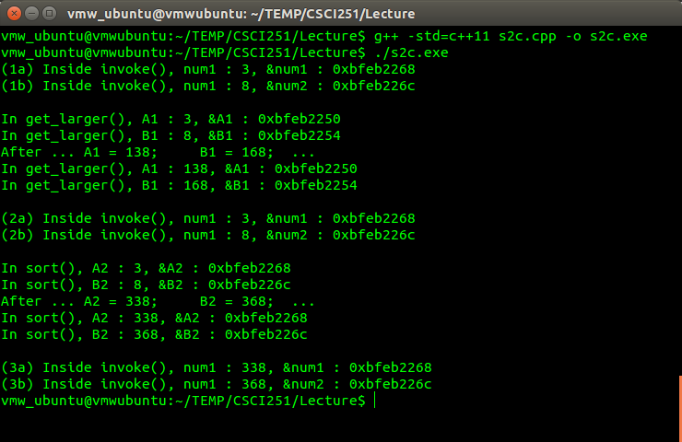

Slide 12
Pointers
Remember we can access the address the variable references, using &, and operate on that address.
  As part of this we have types that store addresses, pointers to type, or pointers.
    Pointers are not aliases, they are actual objects.
  The following three forms mean the same thing…
type* ptr;
type * ptr;
type *ptr;
  … that ptr is a pointer to an int, so it stores the location of an int.

Slide 13
The *, called the dereferencing operator, is tied to the variable name, not to the type name, so you have to be careful if you are declaring multiple pointers.
Use
int *ptr1, *ptr2;
Not
int *ptr1, ptr2;
Best not to mix declarations of pointers and non-pointers.

Slide 14
To set the value of a pointer we use the address-of operator &, as follows:
int value;
int *ptr;
ptr = &value;
And now we can make modifications to value through ptr, for example, …
*ptr = 5;
… sets value to 5.
It’s important to initialise pointers before you use them, otherwise you may get runtime errors based on using whatever happens to be the value in the location the pointer points to.

Slide 15
*ptr is the value stored at the address
stored in ptr. So …
int x=1, y=2, z;
int* p;
p = &x;
z = *p;
p = &y;
z += *p;
cout << z;
1008
1
x
1016
2
y
2000
1008
p
1024
z
Memory Addresses!

Slide 16
int x=1, y=2, z;
int* p;
p = &x;
z = *p;
p = &y;
z += *p;
cout << z;
1008
1
x
1016
2
y
2000
1008
p
1024
z
p is set to point at x.

Slide 17
int x=1, y=2, z;
int* p;
p = &x;
z = *p;
p = &y;
z += *p;
cout << z;
1008
1
x
1016
2
y
2000
1008
p
1024
1
z
z is set to the value (i.e. 1) where p points at.

Slide 18
int x=1, y=2, z;
int* p;
p = &x;
z = *p;
p = &y;
z += *p;
cout << z;
1008
1
x
1016
2
y
2000
1016
p
1024
1
z
p is set to point at y

Slide 19
int x=1, y=2, z;
int* p;
p = &x;
z = *p;
p = &y;
z += *p;
cout << z;
1008
1
x
1016
2
y
2000
1016
p
1024
3
z
increment z by the value pointed at by p.
The += operator means increase left by the right.

Slide 20
int x=1, y=2, z;
int* p;
p = &x;
z = *p;
p = &y;
z += *p;
cout << z;
1008
1
x
1016
2
y
2000
1016
p
1024
3
z
The value 3 is outputted.

Slide 21
Null pointers and nullptr
It is possible to specify that a pointer doesn’t point anywhere, by setting the pointer to the literal 0, or the alias NULL defined as 0 in the cstdlib header.
int *ptr = 0;
  int *ptr = nullptr;
The nullptr is a C++11 literal that can be converted to any other pointer type.

Slide 22
nullptr is always a pointer type, NULL is not.
Where we have overloaded operators, so the same function with different arguments, we don’t have the problem of giving the function a null pointer and having it treated as a integer 0 provided we are using nullptr.

Slide 23
…
int p1=0;
int *p2=0;
int p3=NULL;
int *p4=nullptr;
cout << p1 << " " << &p1 << endl;
cout << p2 << " " << &p2 << endl;
cout << p3 << " " << &p3 << endl;
cout << p4 << " " << &p4 << endl;
…
Try in lab !!! =>
null-pointer.cpp
$ CC null-pointer.cpp
"null-pointer.cpp", line 10: Error: nullptr is not defined.
1 Error(s) detected.
$ CC -std=c++11 null-pointer.cpp
This is CC compilation with the C++11
library included … this now works!

Slide 24
Why use pointers? An example …
There will be more on pointers later in the subject, including topics such as smart pointers, which are used for handling dynamic objects.
For now, consider how it may be useful in sorting.
Consider that have 1000 large records that we are wanting to order.
Rather than swapping the records, we can swap the relatively small pointers instead.

Slide 25
Arrays in C++
Speaking of sorting, that suggests we have multiple elements of the same, or at least comparable, type; which leads to arrays.
Arrays, references, and pointers, are all examples of compound types, types defined in terms of another type.
Arrays are collections of variables of the same type, roughly anyway, and of fixed size, usually, that we access by position.
  This is a pretty qualified statement.

Slide 26
It is possible to have dynamic arrays, but generally …
… if we aren’t sure of the number of elements to be stored …
… we are better off using a vector, more on these later.
Why not use the dynamic vectors all the time?
  Because we may be able to optimise operations for the fixed number of elements that we have.
    But we probably better using array containers rather than classical arrays for a fixed number of elements anyway.

Slide 27
Setting up arrays …
Array declaration uses
type array_Name[dimension];
int class_Marks[10];
The dimension has to be known at compile time, so dimension needs to be a constant.
The [] is referred to as subscripting.
It’s a good time to introduce the qualifier used to make sure something is constant, const.

Slide 28
The const and constexpr qualifers
The keyword const is similar, but not the same as final in Java.
  C++11 has final too, more on this later because it’s tied up with classes.
Operators cannot change an object with the const qualify. So …
int i = 10;
const int ci = 7;
int j = ci;
ci = 2;
… this last one isn’t okay, and neither would leaving ci uninitialized.

Slide 29
The keyword constexpr is used for constant expressions, with values that cannot change but could be evaluated at compile time.
  It’s an instruction to try to evaluate the expression at compile time.
Any const object initialized from a constant expression is a constant expression.
constexpr int ci = 7;
constexpr int sz = size();
These will compile with the –std=c++11 flag on CC…
$ CC -std=c++11 file.cpp
More on these later.

Slide 30
Initialising arrays
When we declare an array like …
const int postCodeLength = 4;
int postCode[postCodeLength];
… the memory location is set up but there is no initialisation.
To initialise all four locations to 0 …
int postCode[4]={0};
The size of an array is constant.
  The array name/identifier represents a memory address
To access an element of an array use its index
postCode[2] = postCode[1] + 1;
Note, the first element is postCode[0].

Slide 31
More initialising
There are a few different ways to initialise.
For an array of three ints with values 0, 1, and 2.
const unsigned sz =3;
int ia1[sz] = {0, 1, 2};
The size can be inferred from the initialiser …
int a2[] = {0, 1, 2};
But we might not have all the initial values so …
int a3[5] ={0, 1, 2};
string a4[3] = {"hi", "bye"};
Careful with the size …
int a5[2] = {0, 1, 2};
… interesting difference between CC and g++...
The unitialized parts are value-initialized, int to 0, string to an empty string.

Slide 32
Character arrays are special
Character arrays can be initialised using a string literal, and they end with a null character \0.
  These are referred to as C-strings.
This can be explicit in element by element declarations.
char a1[] = {'C', '+', '+'};
char a2[] = {'C', '+', '+', '\0');
char a3[] = "C++";
const char a4[6]="123456";
The last one will complain because there is no space for the null to be added ☹

Slide 33
Arrays and pointers
Arrays and pointers are quite closely related.
Mostly when we use an object of array type we are actually using a pointer to the first element of the array.
Note that arrays are, by default, passed by reference.
  Therefore arrays passed to functions can be changed by the function unless the keyword const is used.

Slide 34
Example: Passing Arrays to Functions
void AddArray (
int Size, // size of the arrays
const float A[ ], // array passed as input
const float B[ ], // array passed as input
float C[ ] ) // array passed for output
{
for (int i=0; i<Size; i++)
C[i] = A[i] + B[i];
}
int main(){
const int ArySize = 5;
float Ary1[ArySize]={1,2,3,4,5};
float Ary2[ArySize]={6,7,8,9,10};
float Ary3[ArySize];
AddArray(ArySize, Ary1, Ary2, Ary3);
...
}
Try in lab !!! =>
S2c_1.cpp

Slide 35
Example: Passing Multidimensional Arrays to Functions
Multidimensional arrays must have their dimensions specified within the function's parameters, although the 1st dimension may be omitted, for example:
void print3DMatrix (const float A[][3][3]);
int main() {
float Matrix[3][3][3]={{1,2,3},{4,5,6},{7,8,9}};
print3DMatrix(Matrix);
...
}
void print3DMatrix (const float A[][3][3])
{
for(int i=0;i<3;i++)
for(int j=0;j<3;j++)
for(int k=0;k<3;k++)
cout << i << j << k << " = " << A[i][j][k] << endl;
}

Slide 36
Back to pointers : Consider the following function …
For the array
int A[10] = {1,2,3,4,5,6,7,8,9,10};
we can sum the entire array as
SumArray(A,10);
or
SumArray(&A[0],10);
int SumArray(int arr[], int n)
{
int i, sum=0;
for (i=0;i<n;i++)
sum += arr[i];
return sum;
}
Try in lab !!! =>
S2c_2.cpp
What is the output?

Slide 37
But the same function can also sum the last nine elements using
SumArray(&A[1],9);
So an array name and an address seem to be equivalent.
And indeed, a pointer type can be referenced like an array.
int A[10];
int* B=A;
… meaning the pointer B gets the address of the array A, its name, so B can be used just like A.

Slide 38
If we dereference B, so *B, we get the value of A[0].
But B[0] is the same as referring to A[0].
Similarly B[5] is the same variable as A[5], and B[10] is still off the end of the array.
But it gets worse, in that we can reference the address of other variables and do the same kind of position addition, subscripting, even though it’s not an array.
So with
int A;
int* B=&A;
… we can use variables such as B[7] and B[50].

Slide 39
When a C++ program references array elements, the compiler has to do some pointer arithmetic.
For example, A[1] refers to the memory location one after the address A.
In pointer arithmetic this is *(A+1).
One what?
  One memory location’s worth of array A’s type
What's that?
  Depends on type of A.
  The operator sizeof can help here.

Slide 40
The sizeof operator
If you are doing pointer arithmetic the compiler will figure out how far to jump, but it is still sometimes useful to know how much space is taken by a variable.
C++ provides an operator called sizeof to give the programmer this information.
The operator usually appears looking like a function as in
sizeof(type)
sizeof(int)

Slide 41
sizeof(int)
.. returns the number of bytes that the int type occupies – in this particular implementation of C++.
The parentheses are not needed, but are usually used.
So …
sizeof(type)
sizeof type
… both tell us the number of bytes for that type.

Slide 42
sizeof a pointer …
What do you get if you apply sizeof to a pointer?
You can do something like …
cout << sizeof(int*) << endl;
Note that sizeof can act on a type, variable or pointer to a variable type …
So this is fine …
double value;
cout << sizeof(value) << sizeof(double) << sizeof(double*);

Slide 43
The sizeof a string is different because it’s a class and there is dynamically allocated memory in there.

Slide 44
Function pointers
Sometimes we use pointers to refer to functions.
  That is, a pointer that points to the address of the executable code of the function.
The pointers can be used to:
  Call functions.
  Pass functions as arguments to other functions.
You cannot perform pointer arithmetic on pointers to functions.

Slide 45
Consider the following illustrations …
int *f(int);
char (*g)(int);
char (*h)(int, int);
The first is not a pointer to a function, since the () operator has higher precedence than *. Rather this is a function f which takes an int and returns type int*.
The precedence means we need to bracket the pointer name, as in the second and third examples.
So:
  g is a pointer to a function taking an int and returning a char.
  h is a pointer to a function taking two int’s and returning a char.

Slide 46
Pointers to functions have types associated with both the return type and the parameter types of function.
Pointers to functions are particularly useful to describe how, in some function which takes them as an argument, we are to interpret some relationship.
  For example, the function describes a comparison rule.
int (*Compare)(const char*, const char*);
  This defines a function pointer Compare which can hold the address of any function that takes two constant character pointers as arguments and returns an integer.

Slide 47
A function pointer can also be defined and initialised in one line.
int (*Compare)(const char*, const char*) = strcmp;
When a function address is assigned to a function pointer, the two types must match.
The above definition is valid because strcmp() from <string.h> has matching parameters and return type:
int strcmp(const char*, const char*);

Slide 48
Now strcmp can be either called directly, or indirectly via Compare.
The following three calls are equivalent:
strcmp("Cat", "Bat"); // direct
(*Compare)("Cat", "Bat"); // indirect
Compare("Cat", "Bat"); // indirect
A common use of a function pointer is to pass it as an argument to another function.
  This is because the receiving function requires different versions of the passed function in different circumstances.

Slide 49
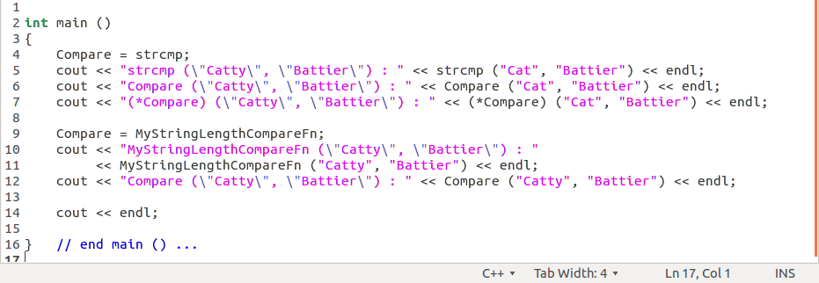
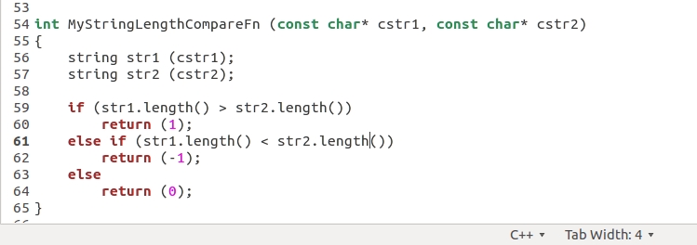
Try in lab !!! => S2c_3.cpp
Write the remaining code to run the following :

