Slide 1
CSCI251
Advanced Programming (S3a)
Getting organised I:
Pre-processing, macros, and Makefiles

Slide 2
Outline
Pre-processing: Beyond #include.
Header guards.
Debugging.
Macros.
More files and Makefiles.
Some faults: Seg. and Bus.
  They don’t really belong here but …

Slide 3
Pre-processing: Beyond #include
We have seen #include used for the inclusion of libraries.
This is dealt with using the pre-processor.
The pre-processor takes pre-processor directives and applies them prior to the object code being generated, and then linked.
Effectively the text in the program we have written is modified prior to the rest of compilation.

Slide 4
General syntax:
  # at the start, no semi-colon at the end.
Directives:
  Source file inclusion: #include
  Macro definition/replacement: #define
  Conditional compilation: #ifndef, #ifdef, #else, #endif…
Use of the preprocessor:
  Can make the code easier to develop, read, and modify.
  Can make the C/C++ code portable, via conditional compilation, among different platforms.
  The #define, #ifdef, and #ifndef directives are sometimes referred to as header guards.

Slide 5
Conditional …
Platform dependent code …
#ifdef WIN32
… code special to WIN32
#elif defined CYGWIN
… code special to CYGWIN
#else
… code for default system
#endif

Slide 6
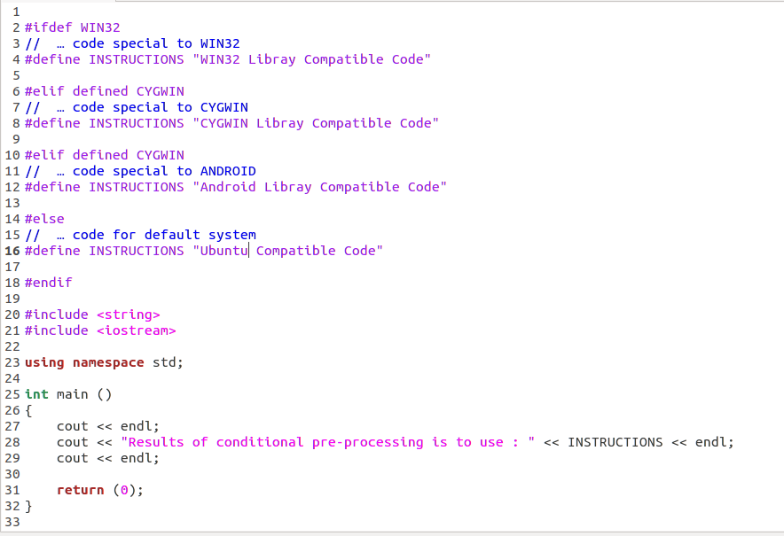
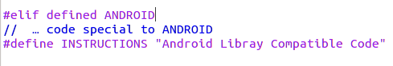
Try in lab !!! => S3a_1.cpp
What do you think is the default output?

Slide 7
Header guards
Definitions are often only allowed to be made once.
This is certainly true of classes and since classes are typically defined in header (.h) files we need to make sure we don’t include header files through multiple paths.
To do this we use #define, which generally specifies a pre-processor variable used in the text of our program prior to the rest of the compilation.

Slide 8
Combined with #ifndef and #endif we can avoid multiple inclusion …
Here’s an example from the textbook:
#ifndef SALES_DATA_H
#define SALES_DATA_H
#include <string>
struct Sales_data {
std::string bookNo;
unsigned units_sold = 0;
double revenue = 0.0;
};
#endif

Slide 9
#define macros
These are used to provide replacements throughout text.
#define MACRO replacement-text
#define PI 3.1415926
#define MAX(a,b) (((a)>(b))?(a):b))
The pre-processor replaces instances of MACRO with the specified replacement text.
  Change once, update everywhere…
  Often used for constants across our code, better practise than a global variable → we don’t store anything.

Slide 10
We would often replace macros associated with function like operations by inline functions …
  #define MAX(a,b) (((a)>(b))?(a):(b))
  inline int Max(const int a, const int b){
    if(a>b)return a;
    return b;
  }
Functions that are inline are not called, but rather the function is inserted in the code.
  Or at least we request the compiler do this.
  Some compilers so it automatically anyway…
So calls to Max would possibly be replaced by ((a)>(b))?(a):(b)

Slide 11
Seeing pre-processing
You can see the effect of pre-processing by using a flag on g++ compilation:
$ g++ -E file.cpp > ready.cpp
The file ready.cpp tends to be much larger.

Slide 12
Keyword: extern
Define once, declare as often as you need.
Files can be compiled separately, but may still reference each other.
The keyword extern is used to indicate a variable has been defined elsewhere, it’s not used in the original.
This is useful if we to use a variable in file A, when it was defined in file B.
extern int value;
This is declaring the variable exists, not defining the variable, but if we initialise the variable then the extern is overridden, it’s a definition now.
extern int value = 4;

Slide 13
Predefined macros …
The predefined macros are mostly used for debugging…
__TIME__, __LINE__, __DATE__, __FILE__, __func__
They can be undefined using #undef MACRO
Meaning:
  __TIME__ : The time the source file was compiled, a string literal of the form hh:mm:ss.
  __DATE__ : Similar but it substitutes the date, again as a string literal.
  __LINE__ : Expands to the current source line number, an integer.
  __FILE__ : The name of the file being compiled, as a string.
  __func__ : The name of the function being debugged.

Slide 14
Compilation and debugging…
We can set the value of #define pre-processor variables at compile time.
This is particularly useful for including debugging statements.
$ g++ –DDEBUG s3a_3.cpp
int main ()
{
#ifdef DEBUG
cout << __TIME__ << endl;
cout << __DATE__ << endl;
cout << __LINE__ << endl;
cout << __FILE__ << endl;
cout << __func__ << endl;
#endif
cout << endl << “Hello World” << endl;
}
Try in lab !!! => S3a_2.cpp
What do you think is the output w/o
–DDEBUG option?

Slide 15
You could set the DEBUG variable on in the code too but it’s tidier using the command line compilation time version.
You can include a line like …
cout << TEST << endl;
… in your code and define TEST at compile time.
$ g++ -DTEST=5 prep.cpp

Slide 16
Be assertive
The function-like pre-processor macro assert is used in defensive programming.
  It’s accessed using the cassert header.
  assert (expr);
It is typically used to check for conditions that cannot happen…
… more on defensive programming soon.

Slide 17
#include <iostream>
#include <cassert>
using namespace std;
int main()
{
#ifndef NDEBUG
cout << "We are in debug mode" << endl;
#endif
assert( 5 > 3);
// assert( 3 > 5);
cout << "All is well" << endl;
return 0;
}
Try in lab !!! => debug-test.cpp
(refer to next slide)
What do you think is the output :
w/o –DNDEBUG option?
w –DNDEBUG option?
If the expr given to assert is false, and we are in debug mode, assert writes a message and terminates the program.

Slide 18
The effect of assert depends on whether we are in debugging mode.
How do we know?
  After all we defined a macro for it before.
We do something similar but use the pre-processor variable NDEBUG, which assert references.
If NDEBUG is undefined we are in debug mode, so assert does it’s checks.
But if NDEBUG is defined, assert does nothing.
$ g++ -DNDEBUG debug-test.cpp

Slide 19
Personalising with your own message …
You can something like one of these things …
assert( 3 > 5 && “This is a test”);
assert((“This is a test”, 3 > 5));
… but commenting probably makes more sense because the compiler tells people where to look anyway.
assert ( 3 > 5); // This is a test

Slide 20
More typical use …
You would typically expect to use assert with some sort of calculated function that you couldn’t now for sure the state of at the time.
int test;
cin >> test;
assert(("This is a test", test > 5));

Slide 21
Code management …
If we were going to be defining the value of quite a few variables at compile time, it might be useful to set up a systematic management mechanism.
Another part of managing code development involves handling multiple files.
  But this can introduce some problems…

Slide 22


main.cpp
main.o
compiler
linker
fa.cpp
fa.o
prog
fb.cpp
Step 1
fb.o
Step 2
The compiler is given a number of source files.
The compiler will check the syntax of each source file and, for each, produce an object file.
The linker is called
by the compiler and given
all the object files.
It links the objects together
with any system libraries
(resolution of symbol table)
and produces an executable.
$ g++ -o prog main.cpp fa.cpp fb.cpp

Slide 23
If fb.cpp was unchanged, we could use
$ g++ -o prog main.cpp fa.cpp fb.o
If for some reason we only wanted to produce the object file, use the -c flag.
$ g++ -c main.cpp
Fine, but if we have 50 files it’s going to be a pain having to correctly differentiate between the ones that have changed and those that haven’t, and compiling them all may be very time consuming if we just use …
$ g++ *.cpp

Slide 24
Makefiles to the rescue …
With make programming we describe how our program can be constructed from source files.
The construction sequence is described in a makefile which contains dependency and construction rules.
The makefile is itself just a text file.

Slide 25
A dependency rule has two parts, a left side and a right side, separated by a colon :
left side : right side
The left side specifies the names of targets; these are programs or system files to be built or processed.
The right side lists the names of the files of which the target depends upon, e.g. source files or header files.
If the target is older than any of the constituent parts, construction rules are obeyed.
The construction rules describe how to create the target.

Slide 26
Let’s return to our example, and note the dependencies of the source files…
  fa.cpp depends on fa.h.
  fb.cpp depends on fb.h.
  main.cpp depends on fa.h and fb.h.
Try in lab !!!
Put in sample code in fa.h, fb.h, fa.cpp, fb.cpp, main.cpp
These instructions are placed in a file called ‘makefile’
prog: main.o fa.o fb.o
g++ -o prog main.o fa.o fb.o
main.o: main.cpp fa.h fb.h
g++ -c main.cpp
fa.o: fa.cpp fa.h
g++ -c fa.cpp
fb.o: fb.cpp fb.h
g++ -c fb.cpp
Indentation
is
critical
☹
Construction rules

Slide 27
The indentation …
The dependency and command string should have tabs as the first character. ☹
This is kind of weird but if you don’t do it you get something like …
make: fatal error in reader: Makefile, line 9: unexpected end of line seen

Slide 28
Targeting different targets…
When we run
$ make
it looks for the makefile in the current directory and grabs the top target by default, but we can specify a specific target.
This is done using the target as the argument for make …
$ make fa.o
Not terribly useful here but often other functionality is written into the makefile too…

Slide 29
Comments are added using #, illustrated below for the fairly common tidying up target…
# This is a tidy up target.
clean:
rm *.o
Note there are no dependencies for clean, nothing to check.
The rm above isn’t the same as rm in Unix, it’s built into make, but it serves the same purpose.
  There are other built in commands, and you can call non built in commands too!

Slide 30
Arguments for makefiles
You can list the command which make would run, without running them using the -n option
$ make -n
If we use the -d option, as in
$ make -d
  we get information about why particular actions are taken.
You can also tell make to use a different file instead of ‘Makefile’ to express rules and commands, using the -f argument.
$ make -f filename

Slide 31
Macros in makefiles
These are much like #defines.
  But there must be spaces in the definition.
They are accessed using the $ operator, with brackets if the name is more than one character.
OBJECTS = x.o y.o z.o
prog: $(OBJECTS)
g++ $(OBJECTS) -o prog

Slide 32
Conventionally, we include two macros, one for the compiler and one for compiler flags.
CCC=g++
CCFLAGS=-std=c++11
TARGETS=x.o y.o z.o
prog: $(TARGETS)
$(CCC) $(CCFLAGS) $(TARGETS) -o prog
x.o: x.c x.h
$(CCC) $(CCFLAGS) -c x.c
y.o: y.c y.h
$(CCC) $(CCFLAGS) -c y.c
z.o: z.c z.h
$(CCC) $(CCFLAGS) -c z.c

Slide 33
Makefiles for other purposes
LATEX_ARGS=
LATEX=latex
TARGET=Tutorial
$(TARGET).ps: $(TARGET).dvi
dvips $(TARGET) -o $(TARGET).ps
$(TARGET).pdf: $(TARGET).tex
pdflatex $(LATEX_ARGS) $(TARGET)
$(TARGET).dvi: $(TARGET).tex
$(LATEX) $(LATEX_ARGS) $(TARGET)
clean:
rm *.toc *.aux *.ps *.eps *.log *.dvi
latex:
latex $(TARGET)
gvshow: $(TARGET).ps
gv $(TARGET).ps
pdfshow: $(TARGET).pdf
xpdf $(TARGET).pdf
acroshow: $(TARGET).pdf
acroread $(TARGET).pdf
dvishow: $(TARGET).dvi
xdvi $(TARGET).dvi
Note : these are examples to make OTHER things, NOT C++ program!

Slide 34
Some faults: Seg. and Bus.
Segmentation faults occur when you try to use memory which does not belong to you, typically:
  Out of bounds array references.
  Reference through un-initialized or dangling pointers, the latter being pointers to already freed memory.
int intArray[5];
cin >> intArray[10];
Compiled with g++ and we get a seg. fault at run time, CC code doesn’t care …

Slide 35
Segmentation faults are to do with memory access violations.
  You aren’t allowed to access the memory specified.
  As CC illustrates, a compiler won’t necessarily care or help.
Bus faults are similarly run time problems to do with accessing memory.
  But it relates trying to access memory that cannot be physically addressed.
  The memory is invalid for the access type specified, usually to do with memory misalignment.

