Slide 1
CSCI251
Advanced Programming (S4g)
Programming with Class:
A bit of a detour
Notes:
A reference to a textbook by Dr. Neil Gray

Slide 2
Outline
Design patterns.
Cohesion and coupling in brief.
Exception handling Part 2.

Slide 3
Design patterns
Design patterns are a means of exploiting recurring themes in code development.
  Design patterns correspond to small conceptual ideas which are used as building blocks in the larger scale design process.
They are not code themselves, rather they are concepts which can be deployed in (theoretically) any language.
We are just going to look at a couple of design patterns, and an implementation of each in C++.
  Mainly for the purpose of illustrating the relevance of keywords and access specifiers.

Slide 4
Singletons
The name is somewhat suggestive of the meaning.
Typically there is no upper bound on the number of instances of a class.
But, we can only have one instance or object of a singleton class at a time.
This class is realised by making the constructor private or protected.

Slide 5
Try in lab !!! => Place the …
class declaration in ‘Singleton.h’
class implementation in ‘Singleton.cpp’
main() in ‘SingletonTest.cpp’
class Singleton {
  private:
  static Singleton* instance;
  public:
  static Singleton* setInstance();
  static void Show(){cout << instance << endl;}
  static void TidyUp();
  protected:
  Singleton(){};
};
Singleton* Singleton :: instance = nullptr;
Singleton* Singleton :: setInstance(){
if ( instance == nullptr )
instance = new Singleton;
return instance;
}
void Singleton :: TidyUp(){
delete instance;
instance = nullptr;
}
Allow only one instance.
Invokes the private constructor
Delete the sole instance,
and sets the pointer to nullptr.

Slide 6
Try in lab !!! => Place the …
class declaration in ‘Singleton.h’
class implementation in ‘Singleton.cpp’
main() in ‘SingletonTest.cpp’
int main()
{
Singleton::Show();
Singleton *eg = Singleton::setInstance();
//eg->setInstance();
eg->Show();
eg->TidyUp();
eg = nullptr;
Singleton::Show();
}

Slide 7
Monostate
The name follows since all instances of the class share the same state.
A monostate class contains only private static data members and public non-static member functions.
The significance is that another class can be used to control changes to the monostate class, through any instance, and know that those changes will spread to all instances of the monostate class.
  The different objects of the monostate class may correspond to use of the same information in different situations/locations.
    High score table for a game…

Slide 8
#include <iostream>
using namespace std;
class Admin; // Forward referencing
class Lab{
friend class Admin;
private:
static int labCapacity;
public:
int getLabCapacity() const
{
return labCapacity;
}
};
int Lab :: labCapacity = 25;
Try in lab !!! => Place the …
class declaration in ‘Lab.h’
class implementation in ‘Lab.cpp’
main() in ‘s4g_1.cpp’

Slide 9
class Admin
{
private:
bool permit;
string passwd;
public:
Admin( string password );
bool checkPassword( string password );
void setLabCapacity( int cap );
};
Try in lab !!! => Place the …
class declaration in ‘Admin.h’
class implementation in ‘Admin.cpp’
main() in ‘s4g_1.cpp’

Slide 10
Admin :: Admin( string password )
{
if( passwd == "" )
passwd = password;
}
bool Admin :: checkPassword( string password )
{
if( passwd == password ) {
cout << "Correct password" << endl;
permit = true;
return (true);
}
else {
cout << "Incorrect password." << endl;
permit = false;
return (false);
}
}
void Admin :: setLabCapacity(int numOfStudents){
if ( permit )
Lab::labCapacity = numOfStudents;
}
Try in lab !!! => Place the …
class declaration in ‘Admin.h’
class implementation in ‘Admin.cpp’
main() in ‘s4g_1.cpp’

Slide 11
int main()
{
Lab lab1, lab2;
Admin admin1( "psd1234" );
Admin admin2( "mypas" );
cout << lab1.getLabCapacity() << endl;
cout << lab2.getLabCapacity() << endl;
if( admin1.checkPassword("psd1234") )
admin1.setLabCapacity(30);
cout << lab1.getLabCapacity() << endl;
cout << lab2.getLabCapacity() << endl;
if( admin2.checkPassword("abc111") )
admin2.setLabCapacity(40);
cout << lab1.getLabCapacity() << endl;
cout << lab2.getLabCapacity() << endl;
}
Try in lab !!! => Place the …
main() in ‘s4g_1.cpp’
25
25
Correct password
30
30
Incorrect password
30
30

Slide 12
Monostate vs singleton
Both have only one set of data.
  The monostate can have multiple references to that data though.
They differ in transparency.
  The monostate pattern is transparent, in the sense the user doesn’t need to modify their behaviour, they still create monostate class objects in the usual way.
  Creating the singleton requires non-standard behaviour.

Slide 13
Coupling between functions/modules
Coupling is the strength of the connection, or the level of dependency, between two modules.
  Tight coupling: This means there is a lot of dependence between modules, and tends to make programs more error prone.
    Makes them more difficult to write, maintain, and reuse.
    Data passing problems. More complicated, bad data.
    Chance for functions to alter information others require.
  Loose coupling: This means functions do not depend on others as much as in tight coupling.
    We can chance functions independently with greater ease, effectively saving time and money.
While loose coupling can save money and time when changes occur, this needs to be balanced against the advantages obtained by implementing specific relationships.
Wikipedia describes many types:
https://en.wikipedia.org/wiki/Coupling_(computer_programming)#Coupling_versus_cohesion

Slide 14
Cohesion within functions/modules
Cohesion: Describes how well the operations in a function relate to one another.
The best kind of cohension is Functional cohesion, where all function operations contribute to the performance of only one task.
double square(double number)
    {
    return (number * number);
    }
There are other weaker kinds of cohesion, the worst being coincidental.
Wikipedia has a list:
https://en.wikipedia.org/wiki/Cohesion_(computer_science)

Slide 15
Exception handling: Part 2
There are two uses of the term exception:
  An exception is a situation that the code is unable to deal with.
    This is in the sense of something occurring which is outside of normal expectations.
    The exception needs to be communicated and dealt with.
    These generally correspond to runtime errors, for example when the user enters invalid data.
  An exception is also an object that is passed from the problem location to the location where the problem with be dealt with, or “handled.
    This is the aspect we are going to focus on now.

Slide 16
A program is composed of separate modules, such as functions which may come from libraries. Error handling can be separated into two parts:
    The reporting of error conditions that cannot be resolved locally.
    The handling of errors detected elsewhere.
For example:
  The author of a library can detect runtime errors, but will not know what to do with them in the context of your program!
  The user of the library must know how to cope with such errors, but cannot detect them easily.
Exceptions in C++ are a means of separating error reporting from error handling, it’s not designed to replace ordinary in-function error checking/recovery.

Slide 17
Throwing Objects
Just as simple variables such as doubles, ints, and strings can be thrown via exception-handling techniques, programmer-defined class objects can also be thrown.
  These objects are called exception objects.
This is particularly useful in two types of situations:
  If a class object contains errors, you may want to throw the entire object, rather than just one data member or a string message.
  When you want to throw two or more values, you can encapsulate them into a class object so that they can be thrown together.

Slide 18
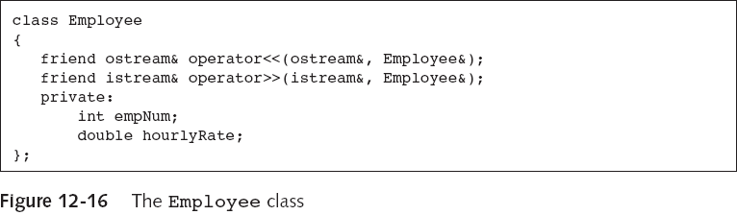
Throwing Standard Class Objects
The extraction operator for the following class has been overloaded to throw an exception.
Try in lab !!! => Place the …
class declaration in ‘Employee.h’
class implementation in ‘Employee.cpp’
main() in ‘s4g_2.cpp’

Slide 19
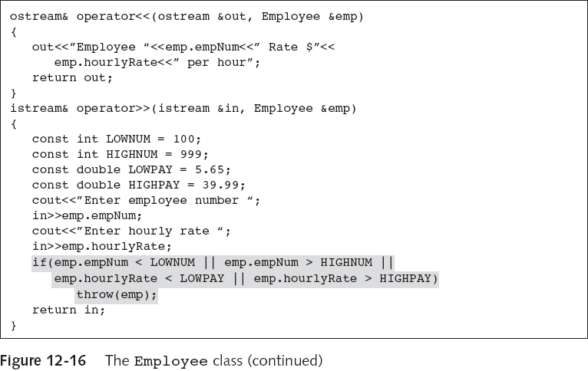
Try in lab !!! => Place the …
class declaration in ‘Employee.h’
class implementation in ‘Employee.cpp’
main() in ‘s4g_2.cpp’
If either empNum or hourlyRate is too high or too low, the entire Employee object is thrown.

Slide 20
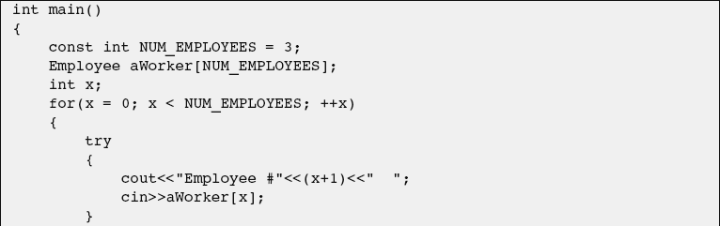
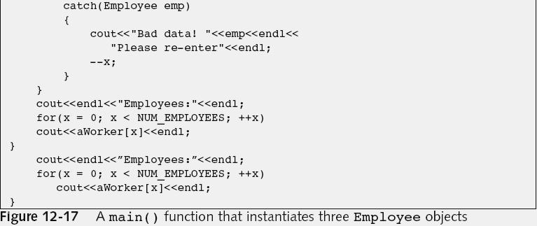
Try in lab !!! => Place the …
main() in ‘s4g_2.cpp’

Slide 21
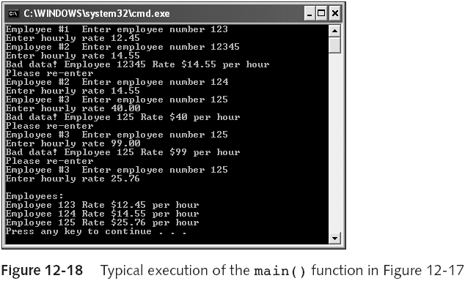
Bad data! statements appear in the catch block.

Slide 22
Here goes a class specifically for an exception, the instances are exception objects.
#include <iostream>
using namespace std;
class dividebyzero {
public:
dividebyzero();
void printmessage();
private:
const char* message;
};
dividebyzero::dividebyzero() : message("Divide by Zero"){}
void dividebyzero::printmessage()
{
cout << message << endl;
}
Try in lab !!! => Place the …
class declaration in ‘dividebyzero.h’
class implementation in ‘dividebyzero.cpp’
main() in ‘s4g_3.cpp’

Slide 23
float quotient(int num1, int num2)
{
if (num2 == 0)
throw dividebyzero();
return (float) num1 / num2;
}
int main()
{
int a, b;
cout << "Enter two numbers : ";
cin >> a >> b;
try
{
float x = quotient(a,b);
cout << "Quotient : " << x << endl;
}
catch (dividebyzero error)
{
error.printmessage();
return 1;
}
return 0;
}
Here we have a function which throws an exception of type dividebyzero.
When the exception is thrown an instance of this object is created and passed to the handler.
It must be a type whether it is a built-in or user defined.
Try in lab !!! => Place the …
class declaration in ‘dividebyzero.h’
class implementation in ‘dividebyzero.cpp’
main() in ‘s4g_3.cpp’

Slide 24
Exception specifications
Any C++ function might throw any type of object.
You can explicitly indicate the exceptions that a function cannot throw by using exception specifications, as follows:
  int dataEntry() throw()
  int dataEntry() noexcept
  Int dataEntry() noexcept( true )
This can help users of your code.

Slide 25
Ye Olde Exception Specifications
Pre C++11 you could have things like …
  int dataEntry() throw(char, double, Employee)
This could throw objects of type char, double, Employee, or an object of a child class of Employee.
If a function threw an error whose type was not listed in its exception specification, then a runtime error would occur and the program will abort.
But it was pretty much only for documentation purposes, and the compiler wouldn’t stop you if you threw different things.
So, it’s deprecated.

Slide 26
#include <iostream>
using namespace std;
void test() throw(int)
{
cout << "Hello" << endl;
throw 5;
throw string("Hello");
}
int main()
{
try {
test();
}
catch (int x){
cout << x << endl;}
catch (string y){
cout << y << endl;}
cout << "Hello" << endl;
}
We can try this
with throwing a string or int.
And changing throw(int) to
throw() and
noexcept.
Note how we just continue after the exception is caught.

Slide 27
throw() and noexcept
In C++11 throw() was deprecated so shouldn’t be used with –std=c++11, although it will still work.
  Since C++11, destructors are noexcept by default. They shouldn’t throw exceptions.
throw() is back in C++17 and is equivalent to noexcept(true). ☺
  And you should only use throw() or noexcept now.
See http://en.cppreference.com/w/cpp/language/noexcept_spec

Slide 28
The noexcept operator
New to C++11.
Returns a Boolean indicating if we can throw exceptions within a function.
So if we have …
int dataEntry() noexcept
… then we would get true from …
noexcept(dataEntry())
… which we might use in …
int moreDataEntry noexcept(noexcept(dataEntry());

Slide 29
If an exception not listed in the exception specification is thrown, the function void unexpected(void); is called, defined in <exception>, part of the standard namespace.
By default, unexpected() calls void terminate( void );
In Unix, terminate() calls the standard C Library abort().
You can change the behavior of unexpected() and terminate() by setting your own functions.
  unexpected_function set_unexpected( unexpected_function unexp_func );
  terminate_function set_terminate( terminate_function term_func );
  unexpected_function and terminate_function are types.
  The custom unexp_func needs to return void.

Slide 30
0..* catches …
The first to match is used.
So, if you need to throw both a base class object and an object that is a member of its derived class from the same function, and you want to carry out different operations when they are caught, then you must code the catch for the derived object first.
  This is because the derived object is also a base object so would against the first case.
The catch type also catches objects differing only in a const qualifier, a reference qualifier or both qualifiers:
  For example, char can be caught by char, const char, char& or const char&.

Slide 31
If you throw an argument and no catch block has a usable match, then the program terminates.
To avoid termination, you can code a default exception handler that catches any type of object not previously caught.
  Create a default exception handler by creating a catch block with an ellipsis (…) as its argument.
  It must be the last catch block listed after a try.
  A default catch block will catch any thrown object that has not been caught by an earlier catch block.
You might also code a default catch block to handle several exception types the same way.

Slide 32
Standard exceptions…
Some functions of the standard C++ language library send exceptions that can be captured if we include them within a try block.
These exceptions are sent with a class derived from std::exception.
The class std::exception is defined in the C++ standard header file <exception> and serves as a pattern for the standard hierarchy of exceptions.
For C++11, so CC –std=c++11, it’s in <stdexcept>.

Slide 33
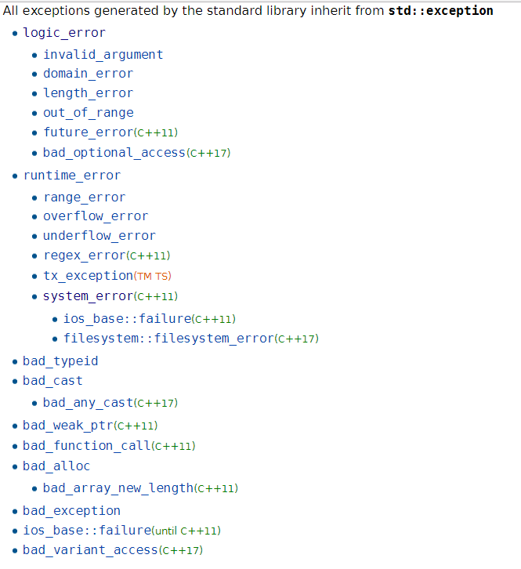
Logic: Can be detected by analysing the code.
Runtime: Cannot be Detected by analysing the code.
Domain: Mathematically invalid parameters.
From
http://en.cppreference.com/w/cpp/error/exception
The indentation indicates inheritance.
Bad_allow: Thrown by new.

Slide 34
exception & bad_exception classes
namespace std {
class exception {
public:
exception() throw() {}
// exception(const exception&) throw() {}
// exception& operator=(const exception&) throw()
// {return *this;}
virtual ~exception() throw() {}
virtual const char* what() const throw();
};
class bad_exception: public exception {
public:
bad_exception() throw() {}
// bad_exception(const bad_exception&) throw() {}
// bad_exception& operator=(const bad_exception&) throw()
// {return *this;}
// ~bad_exception() throw() {}
const char* what() const throw();
};
}
C++11: Commented
lines are removed, throw() →noexcept

Slide 35
#include <iostream>
#include <exception>
#include <typeinfo>
using namespace std;
class A {virtual void f() {}; };
int main ()
{
try {
  A* a = NULL;
  typeid (*a);
}
catch (exception& e)
{
  cout << "Exception: " << e.what() << endl;
}
return 0;
}
Exception: Bad typeid

Slide 36
Handling memory-allocation exceptions
When you try to allocate memory, there may not be enough memory available on your computer:
  If the new operator fails, the program ends abruptly.
The set_new_handler() function is an out-of-memory exception handler; to use it:
  Insert #include<new> at the top of the program file.
  Create a function to handle the error, then pass that error-handling function’s name (pointer to the function) to the set_new_handler() function:
    set_new_handler(nameOfErrorHandlingFunction);

Slide 37
#include<iostream>
#include<new>
using namespace std;
void handleMemoryDepletion() {
cout << "Out of memory" << endl;
exit(1);
}
int main() {
int num = 10000000;
set_new_handler( handleMemoryDepletion );
const int LIMIT=30;
for(int i=0; i<LIMIT; i++) {
double *dp = new double[ num ];
cout << "i is " << i << endl;
}
return 1;
}
Return type must be void
Must not take any arguments

Slide 38
Common practice …
Throw an object, catch a reference.
C++ allows throwing exceptions of any data type, but that isn’t recommended.
It’s preferable to create a subclass of exception for your program.
  Easier for OO programmers to understand.
  A commonly used way to handle errors.
  Can use: catch(exception& e)
    Better than catch(…)
    Informative message can be returned from what() tailored for your exception class.

Slide 39
Building an exception derived class
class BoundException : public runtime_error {
private:
int lower;
int higher;
public:
BoundException( int l, int h );
int getLower() const;
int getHigher() const;
};
BoundException :: BoundException(int l, int h) : runtime_error("Out of bound") {
lower = l;
higher = h;
}
int BoundException :: getLower() const {
return lower;
}
int BoundException :: getHigher() const {
return higher;
}
Try in lab !!! => Place the …
class declaration in ‘BoundException.h’
class implementation in ‘BoundException.cpp’
main() in ‘s4g_4.cpp’
Pass a string to be stored in the parent class.

Slide 40
int inputData( int l, int h )
{
BoundException error( l, h );
int tmp;
cout << "Input data in the range [" << l << ", " << h << "] : ";
cin >> tmp;
if( tmp < error.getLower() || tmp > error.getHigher() )
throw( error );
return tmp;
}
int main()
{
int num;
try {
num = inputData(-50, 50);
double sq = sqrt(num);
cout << "sqrt of " << num << " is: " << sq << endl;
}
catch( logic_error& err ) {
cout << "logic_error: " << err.what() << endl;
}
catch( BoundException& berr ) {
cout << "BoundException: " << berr.what() << endl;
}
}
#include <stdexcept> and <cmath>.
what() inherited from
runtime_error

Slide 41
Specifying our own what()
class BoundException : public runtime_error {
private:
int lower;
int higher;
public:
BoundException( int, int );
int getLower() const;
int getHigher() const;
virtual const char* what() const noexcept;
};
const char* BoundException :: what() const noexcept{
// ... operations specific to BoundException
return ( runtime_error::what() );
}
Get the string stored in the parent class

