Slide 1
CSCI251
Advanced Programming (S4h)
Programming with Class:
Runtime type identification and casting …
Notes:
A reference to a textbook by Dr. Neil Gray

Slide 2
Outline
Runtime type identification.
Three main elements:
  Operator: typeid again.
  Class: type_info.
  Operator: dynamic_cast.

Slide 3
Runtime type information/ identification (RTTI)
When you use objects of polymorphic types, so those types with at least one virtual method, C++ attaches a few things to the objects:
  Vtables to address virtual functions.
  RTTI object locators to store the actual types of objects.
Data types can be:
  Static: Determined by the compiler.
  Dynamic: Determined at runtime, stored in RTTI.

Slide 4
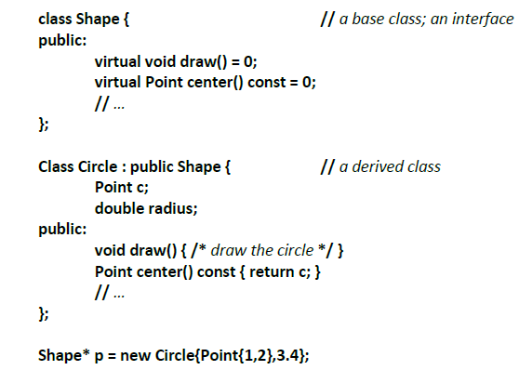
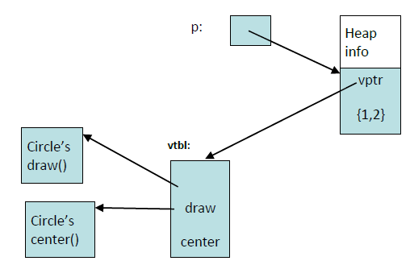
What is the cost?
From Stroustrup’s 2012 ETAPS keynote address.

Slide 5
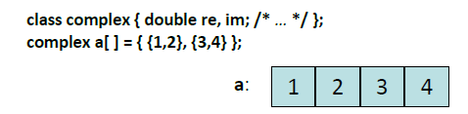
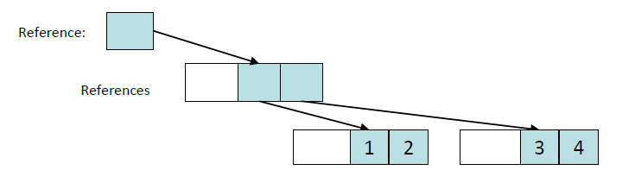
An aside …
Again from Stroustrup’s presentation…
  C++: Likely size 4*sizeof(double).
“Pure object-oriented likely cost …
  3*sizeof(reference)+3*sizeof(heap_overhead)+4*sizeof(double).

Slide 6
A Vtable example …
Try in lab !!! => Place everything in …
s4g_1.cpp
class Shape {
public:
virtual void draw() { int i=0; }
};
class Circle : public Shape {
public:
virtual void draw() { int i=0; }
};
class Rectangle : public Shape {
public:
virtual void draw() { int i=0; }
};
void drawShape( Shape *sp ) {
sp->draw();
}
A generic function to draw any shape even when more classes are derived from Shape later on.

Slide 7
int main()
{
Shape *sp1 = new Circle;
drawShape(sp1);
delete sp1;
sp1 = new Rectangle;
drawShape(sp1);
return 0;
}
Try in lab !!! => Place everything in …
s4h_1.cpp
draw() simplified to avoid the standard library.
Compile this using …
g++ -fdump-class-hierarchy s4h_1.cpp

Slide 8
Look in s4h_1.cpp.002t.class.
Vtable for Shape
Shape::_ZTV5Shape: 3u entries
0 (int (*)(...))0
4 (int (*)(...))(& _ZTI5Shape)
8 Shape::draw
Class Shape
size=4 align=4
base size=4 base align=4
Shape (0xc0ed9dc0) 0 nearly-empty
vptr=((& Shape::_ZTV5Shape) + 8u)
Vtable for Rectangle
Rectangle::_ZTV9Rectangle: 3u entries
0 (int (*)(...))0
4 (int (*)(...))(& _ZTI9Rectangle)
8 Rectangle::draw
Class Rectangle
size=4 align=4
base size=4 base align=4
Rectangle (0xc0fe07c0) 0 nearly-empty
vptr=((& Rectangle::_ZTV9Rectangle) + 8u)
Shape (0xc0eda0e0) 0 nearly-empty
primary-for Rectangle (0xc0fe07c0)
Vtable for Circle
Circle::_ZTV6Circle: 3u entries
0 (int (*)(...))0
4 (int (*)(...))(& _ZTI6Circle)
8 Circle::draw
Class Circle
size=4 align=4
base size=4 base align=4
Circle (0xc0fe0780) 0 nearly-empty
vptr=((& Circle::_ZTV6Circle) + 8u)
Shape (0xc0ed9f80) 0 nearly-empty
primary-for Circle (0xc0fe0780)

Slide 9
Example:
Shape *ptr = new Circle;
The static type of *ptr is Shape.
The dynamic type, that is the actual type at runtime, of *ptr is Circle.
There are three main elements to the identification aspect…
  Operator: typeid.
  Class: type_info.
  Operator: dynamic_cast.

Slide 10
The typeid operator
We saw this briefly in S2d.
The typeid operator can be used to identify the actual type of an object obtaining this information from RTTI., if it’s attached as it will be in a polymorphic type.
To use this we need the header <typeinfo>.
The typeid operator returns a reference to an object in the system class type_info that describes a type.
  Dynamic type for polymorphic objects.
  Static type for others.
    This is what we saw earlier, there is no RTTI available.

Slide 11
We can use typeid in one of two ways:
typeid(typename)
typeid(Shape)
… returns a reference to a type_info object containing the type of typename.
OR …
typeid(expression)
… returns a reference to a type_info object that represents:
  A dynamic type of the expression if expression is of polymorphic type.
  A static type of the expression if it isn’t polymorphic.

Slide 12
Example: Consider that X is a polymorphic type, and that Y is publicly derived from X.
We construct a X pointer pointing to a Y object.
X *pt = new Y(…);
Then …
typeid( pt ) == typeid( X* ) true
typeid( pt ) == typeid( Y* ) false
The left hand side represents the type (X*) declared for pt, not the type of object (Y) which pt points at.

Slide 13
However,
X *pt = new Y(…);
typeid( *pt ) == typeid( X ) false
typeid( *pt ) == typeid( Y ) true
The left hand side now represents the type (Y) that pt points to, not the declared data type of pt.
typeid is now looking at what type of object is being stored.

Slide 14
More on pointer problems
A base class pointer can point to a base class object without problems.
A derived class pointer can point to a derived class object without problems.
Let’s see what happens if we aim a base class pointer at a derived class object, using a static_cast.

Slide 15
class B {
public:
void f() { }
};
class D: public B {
public:
void m() { }
};
int main() {
B* p = static_cast<B*>( new D ); // casting
p->m();
}
Class D is derived from class B, but they are not polymorphic types.
Pointing the base class pointer at a derived object loses the resolution if it’s not polymorphic.
Error: m is not a member of B

Slide 16
We have a function m() in the derived D.
The base B doesn’t have the function m().
Use of the static_cast allows p to point to a D object.
The compilation error from the statement p->m();
… occurs because p is of type B*, and B doesn’t have the required function m().
We are “okay” if we don’t try and use B functionality .

Slide 17
What about: Derived pointer to base object?
It doesn’t make sense to have a derived pointer pointing to a base object, since the base object “is not” a derived object.
class B {
// Whatever
};
class D : public B {
// More whatever
};
int main() {
D* p;
p = new B;
}
Error: Cannot use B* to initialize D*.

Slide 18
#include <iostream>
#include <typeinfo>
using namespace std;
class B
{
public:
B() {}
void m(){cout << "Base " << endl;}
};
class D : public B
{
int data;
public:
D() : B(), data(1) {}
void m(){cout << "Derived " << data << endl;}
};
int main()
{
D* p = static_cast<D*>( new B );
p->m(); // calls D::m(), data incorrect
cout << typeid(p).name() << endl; // pointer to D
cout << typeid(*p).name() << endl; // D … incomplete object
}
But using a static_cast it seems we can do this …
Try in lab !!! => Place everything in …
s4h_2.cpp
Commending away class B’s method m(), still can compile and run!
Only B::B() is invoked.
data isn’t initialised.

Slide 19
Casting: Static vs dynamic
A static_cast takes place at the compilation stage and can prevent compilation errors, but this can result in meaningless runtime events in the context of the wrong object referencing.
  The static_cast does not ensure type safety.
The dynamic_cast operator provides a mechanism for testing at runtime whether an object-based cast causes problems.
  We know that a base class pointer can point to objects of any derived class.
  The dynamic_cast is useful to identify which type, which derived class, of object is pointed to by the base class pointer.

Slide 20
The dynamic_cast operator
The dynamic_cast operator uses similar syntax to the static_cast operator.
However, the dynamic_cast operator checks whether a cast is type safe, at runtime.
A dynamic_cast is only legal when applied to a polymorphic type.
So in general we have …
dynamic_cast<T*>( new P );
… where P must be a polymorphic class, but T doesn’t have to be.
The target type of a dynamic_cast, specified in angle brackets, must be a pointer or a reference.
  If T is a class, T* and T& and T&& are legal targets but T is not.

Slide 21
class C {
// No virtual methods
};
class T : public C {
};
int main() {
dynamic_cast<T*>( new C );
}
This fails at compile time because C isn’t polymorphic.
Error: The dynamic_cast operand must be a pointer or reference to a polymorphic type.

Slide 22
class C {
public:
virtual void m() {};
};
class T: public C {
// …
};
int main() {
dynamic_cast<T*>( new C );
}
The virtual function means C is now polymorphic, so this works.

Slide 23
Type safety
If we have a type X, and ptr is a pointer to a polymorphic type, then the expression
dynamic_cast<X*>( ptr )
evaluates at runtime to:
ptr if the cast is type safe
NULL (false) if the cast is not type safe nullptr for C++11
class B {
public:
virtual void f() { }
};
class D : public B {
public:
void m() { cout << "Test " << endl;}
};
int main() {
D* p = dynamic_cast<D*>(new B);
if ( p != nullptr )
p->m();
else
cerr << "Unsafe for p to point to a B" << endl;
}
Try in lab !!! => Place everything in …
s4h_3.cpp
dynamic_cast prevent unsafe data casting.

Slide 24
The basic rules for dynamic_cast
The rules are rather complicated, especially when:
  There is multiple inheritance.
  We cast to or from the type void*.
We are just going to look at some basic cases.

Slide 25
Assume class B is a polymorphic type.
Assume furthermore that class D is derived from B directly or indirectly, that is, through multiple layers of inheritance.
  Due to inheritance, D is also a polymorphic type.
The dynamic_cast from D* (up) to B* succeeds.
  This is known as an upcast. ☺
The dynamic_cast from B* (down) to D* fails.
  This is known as an downcast. ☹
The dynamic_cast from B* to B* succeeds, as does the dynamic_cast from D* to D*. 😐

Slide 26
Assume Apple and Orange are unrelated polymorphic types.
  Both have virtual functions, either declared directly or through inheritance.
Then:
  The dynamic_cast from Apple* to Orange* fails.
  The dynamic_cast from Orange* to Apple* fails.
Generally, casts involving unrelated types, other than void*, fail.

Slide 27
Why use RTTI?
We have virtual functions in a base class, and those would seem to be able to handle the polymorphic distinction between the object type.
So why would we use RTTI?
  When we want to act through a pointer or reference to a base function, but cannot use virtual functions.
  Why couldn’t we use virtual functions?
    We could but it would be awkward … an example will help.

Slide 28
In a previous set of notes we talked about the idea of not wanting to have to go back and make changes to a base class based on specialisations of it, and that’s what we would need to do here.
Virtual functions need to have the same parameter set across the class hierarchy, but that doesn’t always make sense.
  We might reach a specialisation where an additional parameter is needed, and going back to modify the original and intermediate classes isn’t ideal, nor is adding another virtual function with a different signature.

Slide 29
A warning: Operator overloading and polymorphism
Since the operator definitions have different signatures,
virtual bool operator==( Base& bs ){. . .}
virtual bool operator==( Derived& dr ){. . .}
… dynamic binding won’t work.
int main()
{
Base *bp1 = new Base(1);
Base *bp2 = new Base(2);
if( *bp1 == *bp2 ) { // uses Base::operator==(..)
cout << "Objects are equal" << endl;
}
Base *bp3 = new Derived(1);
Base *bp4 = new Derived(2);
if ( *bp3 == *bp4 ) { // uses Base::operator==(..) too!
cout << "Objects are equal" << endl;
}
}

Slide 30
A step back first, to specify the base class …
class Base {
public:
int value;
virtual bool operator==(Base& bs){
cout << "Base" << endl;
return ( value == bs.value );
}
Base(int val) : value(val){}
};
Try in lab !!! => Place everything in …
s4h_4.cpp

Slide 31
To enable dynamic binding we need to define in the derived class an additional function with exactly the same signature as in the base class.
class Derived : public Base {
int data;
public:
Derived( int a ) : Base(0), data(a) {}
virtual bool operator==(Base& bs){
cout << "Base in Derived" << endl;
Derived* dp = dynamic_cast<Derived*>(&bs);
if (dp) return ( *this == *dp );
else return false;
}
bool operator==(Derived& dr){
cout << "Derived" << endl;
return ( data == dr.data );
}
};
Try in lab !!! => Place everything in …
s4h_4.cpp
Notes:
A reference to a textbook by Dr. Neil Gray

Slide 32
int main()
{
Base *bp1 = new Base(1);
Base *bp2 = new Base(2);
// Base *bp2 = new Base(1);
if( *bp1 == *bp2 ) { // uses Base::operator==(..)
cout << "Objects are equal" << endl;
}
Base *bp3 = new Derived(1);
Base *bp4 = new Derived(2);
// Base *bp4 = new Derived(1);
if ( *bp3 == *bp4 ) { // uses Derived::operator==(..)
cout << "Objects are equal" << endl;
}
}
Try in lab !!! => Place everything in …
s4h_4.cpp
What would happen if we compared bp2 and bp4, or bp4 and bp2?

