Slide 1
CSCI251
Advanced Programming (S4a)
Programming with Class:†
Fundamental syntax and some introductory UML
†A reference to a textbook by Dr. Neil Gray
Notes:
A reference to a textbook by Dr. Neil Gray

Slide 2
Outline
Introducing classes.
Encapsulation and access specifiers.
A warning on private.
Designing classes.
The this pointer.
And with UML I guess….

Slide 3
Introducing classes
A class is a user defined data type:
  Classes provide a description for building objects.
  Classes provide prototypes or blueprints for objects.
  Classes provide a convenient way to group related data and the functions which are used to process the data.
  When you create an object from the class, you automatically create all the related fields.
Abstract data type (ADT): a type you define.

Slide 4
Objects and Classes
Parts of a technical system are produced based upon their description: blueprints.
Parts of a software system are generated based upon their description: classes.
Blueprint
Class
Object 1
Object 2
Object 3
A class is an abstraction, it is an abstract data type.
An object is an instance generated and placed in computer memory.

Slide 5
Introduction to UML…
UML (Unified Modelling Language) provides an unambiguous mechanism to describe technical systems.
  When you start thinking about coding something one activity that you might carry out is sketching down how components relate to each other, and …
  UML provides a language for this kind of sketching, and, because it is standardised, it allows others to understand what you are doing.
  We model to identify components, check if something has any chance of working before we build it, and to confirm with our clients that the system is going to do what they want.

Slide 6
UML strengths
It is formal with a strongly defined meaning.
  UML models cannot be misinterpreted, if interpreted according to the rules.
It is concise.
It is comprehensive and can describe any aspect of a software system.
It is scalable and can be used for small and massive projects.
It is an international standard.
  Current version 2.5, 2015-03-01.

Slide 7
Types of UML models
In one representation, there are three basic types of models:
  Functional view:
    Answers: What should the system should do?
    Perspective: User.
    Use cases and use case diagrams.
  Structural view:
    Answers: How must the system be implemented?
    Perspective: System architect.
    Class diagrams and object diagrams.
  Behavioural view:
    Answers: How does the system operate?
    Interaction diagrams and state diagrams.

Slide 8
Another representation reorganises the modelling into three different classes:
  Class model: Structural description.
    Class and object diagrams.
  State model: Describes evolution of objects of one class/type, by modelling transitions.
    State diagrams.
  Interaction model: Describes how objects interact.
    Use cases, sequence diagrams and activity diagrams.

Slide 9
Relating the models
The events in a state diagram relate directly to operations on objects in the class model.
  We might see the operation as a link on an object diagram but the state diagram describes the control associated with that relationship.
While state diagrams are for a single class, we might need to record references between state diagrams, basically between objects/classes.
  This is done using the interaction descriptions of the interaction model.
The state and interaction models act on the data/behaviour framework described by the class model.

Slide 10
Another representation : 4 + 1 view
How can an information system be described?
Design View
(logical structures)
Development View
(physical components)
Use Case View
(external behavior )
4+1 View Model
Process View
(timing and concurrency)
Physical View
(system and the environment)
Design view: An abstract description of parts which the system is made up – UML class, object, state and interaction diagrams.
Process view: Describes system processes – UML activity diagrams.
Development view: Describes how system parts are combined into modules – UML component diagram.
Physical view : Describes how abstract parts of the system are mapped into the deployed system – UML deployment diagrams.
Use case view : describes user-system interaction – Use Case diagrams.
Notes:
Logical view : The logical view is concerned with the functionality that the system provides to end-users. UML Diagrams used to represent the logical view include Class diagram, Communication diagram, Sequence diagram.
Development view : The development view illustrates a system from a programmer's perspective and is concerned with software management. This view is also known as the implementation view. It uses the UML Component diagram to describe system components. UML Diagrams used to represent the development view include the Package diagram.^{[2]}
Process view : The process view deals with the dynamic aspects of the system, explains the system processes and how they communicate, and focuses on the runtime behaviour of the system. The process view addresses concurrency, distribution, integrators, performance, and scalability, etc. UML Diagrams to represent process view include the Activity diagram.
Physical view : The physical view depicts the system from a system engineer's point-of-view. It is concerned with the topology of software components on the physical layer, as well as the physical connections between these components. This view is also known as the deployment view. UML Diagrams used to represent physical view include the Deployment diagram.
Scenarios : The description of an architecture is illustrated using a small set of use cases, or scenarios which become a fifth view. The scenarios describe sequences of interactions between objects, and between processes. They are used to identify architectural elements and to illustrate and validate the architecture design. They also serve as a starting point for tests of an architecture prototype.

Slide 11
4 + 1: Why use different views?
Different views complement each other.
  They show different information, or represent the same information from a different perspective.
This information redundancy is useful for:
  Error checking: The consistency can be checked.
  Clarity: A complex concept may appear significantly simpler from one of the viewpoints, or some people may find it easier to understand description in a particular format/
  Completeness: You are less likely to miss an important feature if you have to think about the system from several different perspectives.

Slide 12
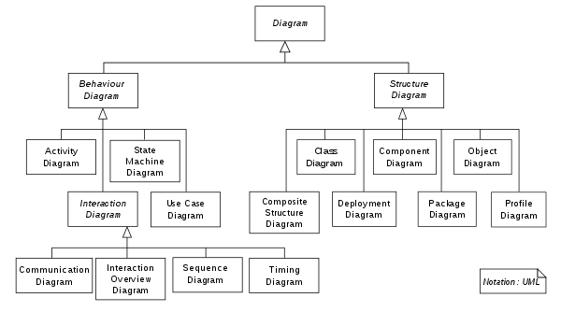
The diagrams
https://en.wikipedia.org/wiki/Unified_Modeling_Language
See also http://www.uml-diagrams.org/uml-25-diagrams.html

Slide 13
Back to C++ Classes:
Fundamental syntax
We have seen the basic syntax for structs and unions, and the really basic syntax for the C++ class is the same.
We are just getting started, and a good place to start is the difference between structs and classes mentioned earlier …
  struct SStudentType {
  int id;
  bool isGrad;
  };
  class CStudentType {
  int id;
  bool isGrad;
  };

Slide 14
We declare an instance/variable of each type, i.e. objects, as follows:
SStudentType studentA;
CStudentType studentB;
But if we try to set the id values …
studentA.id = 123;
studentB.id = 124;
… the struct object will succeed but the class object will fail.
Members of a class are private by default, whereas they are public by default for a struct.

Slide 15
The access specifiers/modifiers for data and methods have three different types:
  Public can be directly accessed from outside the object.
  Private can only be directly accessed by internal methods.
  Protected can be directly accessed by objects of subclasses, but not by arbitrary external objects.
We will look at protected later, but private and public allow us to capture the basic idea of encapsulation.

Slide 16
Encapsulating Class Components
To encapsulate components is to hide them in a container:
  Encapsulation is an example of a black box.
To access some of the hidden components an interface should be provided.
In some sense, we want users of an object to only see the “surface” of the object.

Slide 17
Public Functions on Private Data
class classname
{
public:
// assorted user-accessible functions,etc → Interfaces
private:
// data (& functions) hidden from the user
};
This is one of our primary design considerations, effectively following the principle of least privilege.
If a data member is private we can properly control it through member functions :
  A variable may have a limited range.
    Using a private function we can ensure that it always stays within that range after manipulations.
  A variable may require specific output formatting.
    Again, we can have a public member function for displaying data which uses the appropriate format.

Slide 18
Data might sometimes be public, but usually only if it’s a const, likely a static const.
This makes sense for fixed values:
  π, e, ħ …

Slide 19
Access specifiers: Code syntax
Access specifiers are mutually exclusive flags in C++, exactly one is always on and everything after one access specifier and before another has that access.
  class student {
  private:
  string name;
  int age;
  string password;
  bool verifyPassword();
  public:
  void display();
  bool login( string pswd );
  };
This is only the definition, we will get to an implementation soon.

Slide 20
Implementing Class Functions
When we construct a class, we need two parts:
  Definition section: Contains the class name, variables (attributes), and function prototypes.
  Implementation section: Contains the member function definitions.
We need to use both the class name and the scope resolution operator (::) when we define class functions in the implementation section.
  void Student :: display() {
  cout << name << " : " << age << endl;
  }

Slide 21
Typically the definition will appear in a .h header file, and the implementation in a .cpp file.
However we sometimes put the implementation into the definition.
void display() {cout << name << " : " << age << endl;}
Functions defined in the class in this this way are implicitly inline, so we don’t need the keyword inline.

Slide 22
In-class initialisers
  #include <string>
  class Thing
  {
  public:
  std::string name;
  int value1;
  int value2 = 5;
  };
Try in lab !!! => Thing.cpp
What do you think is the output when you compile with OR w/o –std=c++11 option?
In our earlier examples we didn’t initialise the values of the variables …
… and for non-const pre C++11 you cannot.
"temp.cpp", line 8: Error: A member cannot be initialized except in a constructor.
1 Error(s) detected.
But you can with C++11.
CC -std=c++11 Thing.cpp
Notes:
A reference to a textbook by Dr. Neil Gray

Slide 23
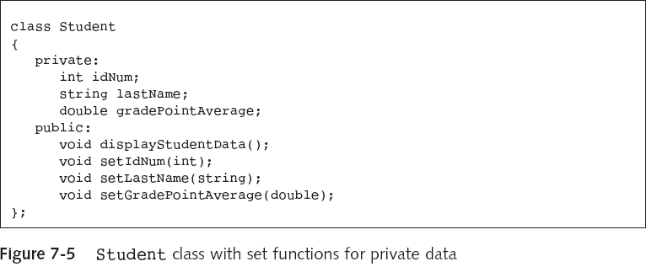
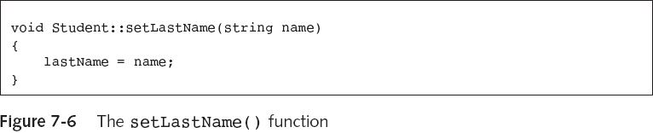
A complete sample class: From
Joyce Farrell, Object Oriented Programming Using C++, 3rd/4th Edition, Thomson Learning.
Try in lab !!! => Place the …
class declaration in ‘Student.h’
class implementation in ‘Student.cpp’
main() in ‘StudentTest.cpp’

Slide 24
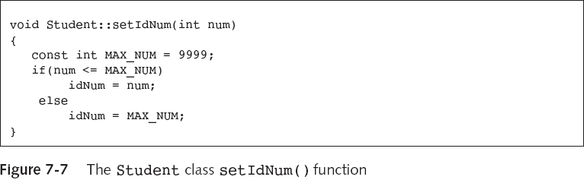
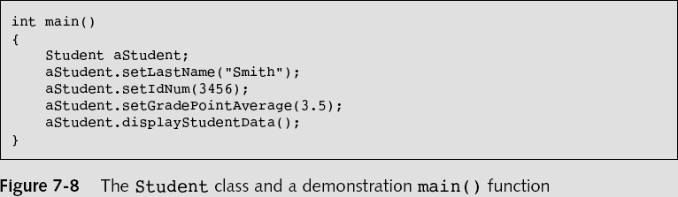
…
Try in lab !!! => Place the …
class declaration in ‘Student.h’
class implementation in ‘Student.cpp’
main() in ‘StudentTest.cpp’
We are restricting the range of IdNum.

Slide 25
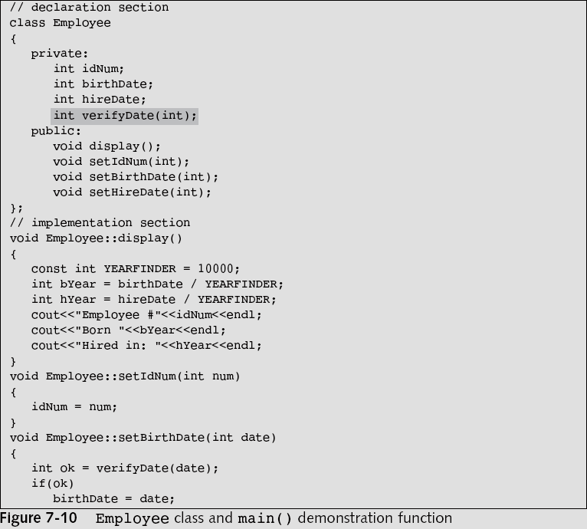
Private Functions …
Private function prototype.

Slide 26
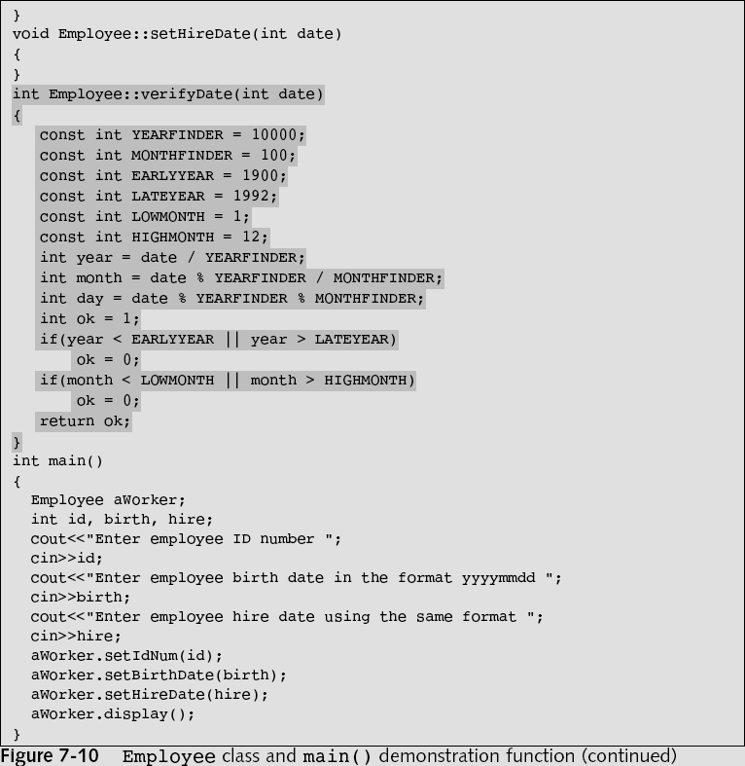
…
This function verifies dates. It is only used by class functions so can be private.
It checks that the dates agrees with various rules.
The date is entered in yyyymmdd format.
…

Slide 27
A warning on private …
Private is a compiler setting.
It doesn’t actually stop you from interacting with the location… ☹
class ViolatePrivate {
public:
int value1 = 5;
void display(){cout << value2 << endl;}
private:
int value2 = 77;
};
int main()
{
ViolatePrivate A;
cout << A.value1 << endl;
cout << A.value2 << endl;
cout << *(&A.value1 + 1) << endl;
A.display();
cin >> *(&(A.value1) + 1);
A.display();
return 0;
}
Try in lab !!! => Place the …
class declaration in ‘ViolatePrivate.h’
class implementation in ‘ViolatePrivate.cpp’
main() in ‘ViolatePrivateTest.cpp’

Slide 28
Not so const ☹
class ViolateConst {
public:
int value1 = 5;
const int value2 = 77;
};
int main()
{
ViolateConst A;
cout << A.value1 << endl;
cout << A.value2 << endl;
cin >> *(&(A.value1) + 1);
cout << A.value2 << endl;
return 0;
}
We can do something similar to change const…
Try in lab !!! => Place the …
class declaration in ‘ViolateConst.h’
class implementation in ‘ViolateConst.cpp’
main() in ‘ViolateConstTest.cpp’

Slide 29
Designing Classes
The problem of defining appropriate classes for your project is generally non-trivial.
If we need to define a class representing, for example, students, we should consider:
  What shall we call it?
  What are its attributes?
  What methods are needed to implement behaviours according to their roles?
We also need to consider what objects will be interacting with objects of the Student class, and what type of interaction is the most appropriate.
  Are Student objects used by objects of other classes?
  Are Student objects used by functions outside the class?

Slide 30

The big heavy orange cat sat on the mat…
A scenario to think about:
  What objects are needed and what are their properties?
Objects?
  Cat, mat
Cat:
  Data?
    Big → Size? → Width, Height, Depth?
    Heavy → Mass
    Orange → Colour
  Methods/Behaviours?
    Measure Size→ Test for “bigness”
    Measure Mass→ Test for “heaviness”
    Show colour
    Sitting on the mat (interaction)
Mat:
  Behaviours?
    Can be sat on
Classes: Cat, Mat, … ?

Slide 31
For class or object: Static…
To avoid data replication some attributes are shared between instances, using static.
  These are referred to in UML as having classifier scope.
Class attributes/variables :
  Define the data shared by class instances.
Class methods :
  Define behaviour of classes that may not be associated with an instance.
Instance attributes/variables :
  Define the data stored by class instances.
Instance methods :
  Define behaviour of class instances.

Slide 32
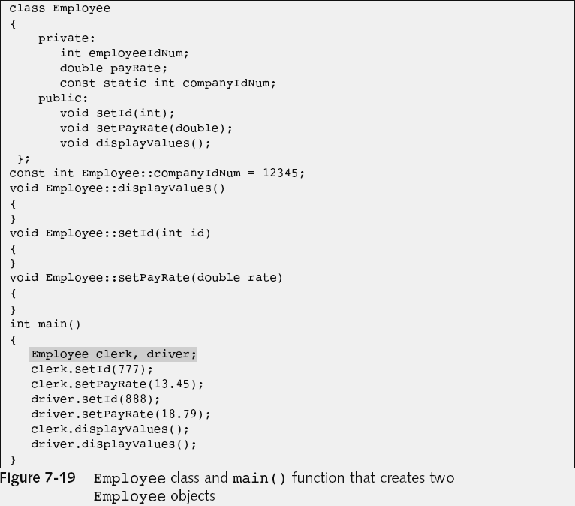
Static or not: The this Pointer
We only have one copy of each function in a class.
The this pointer holds the memory address of the current object that is using the function.
…
…
…

Slide 33
The this pointer is automatically supplied when you call a non-static member function of a class:
  For example, clerk.displayValues();
    … is actually displayValues(&clerk);
The actual argument list used by the compiler for displayValues() is displayValues(Employee *this).

Slide 34
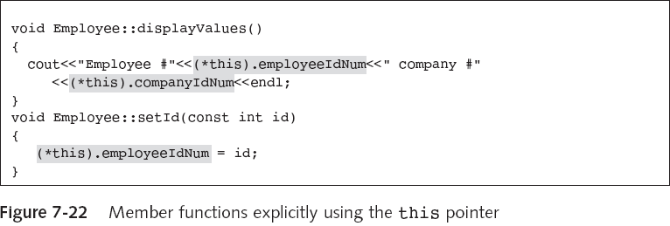
Using the this Pointer Explicitly
Why do you need the bracket?
Because this is a pointer, this.employeeIdNum isn’t and the “.” would take precedence over the *.

Slide 35
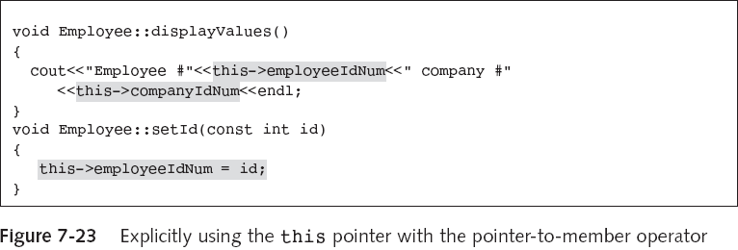
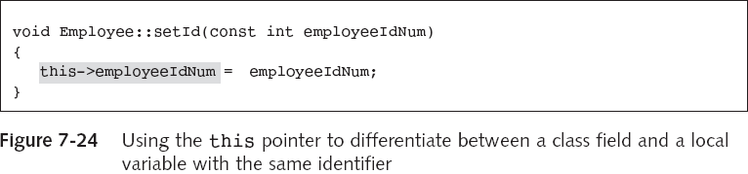
Using the Pointer-to-Member Operator
Above is another way of accessing a field of a class.
Below we use this to automatically identify context.

Slide 36
What is the -> operator?
In the previous example we used the -> operator (pointer-to-member operator) to access member functions of the entity at a particular address, as specified by a pointer.
(*this).number and this->number are equivalent.
In general for a pointer X we have (*X).x and X->x.

Slide 37
Back to UML: Diagrams
Class diagrams contain classes and relationships between them.
  They specify attributes sufficient to describe any state of the system.
    We need this for the state model
  They specify methods sufficient to implement system behaviour.
    We need this for the interaction model.

Slide 38
The most basic class symbol, so representation of a class, is a box with the class name.
  It is used when class properties are not important, usually at the initial stages of system design.
Adding in more details is likely later …
  Attributes, or data members.
  Operations, or methods.
C++
class name
Person
class Person
{
. . .
};
lastName: string
age: int
height: float
attributes
getName(): string
setName(nm:string): void
getHeight(): float
getAge(): int
The level of detail depends on who the diagram is intended for.
Class symbols, i.e. these boxes, are the building blocks of class diagrams.
operations

Slide 39
We can include visibility prefixes corresponding to the access specifiers.
Person
- name: string
- age: int
- height: float
'+' public member
'-' private member
'#' protected member
'/' derived member
'~' package member
+ getName(): string
+ setName(String): void
+ getHeight(): float
+ getAge(): int
+ setAge(int): void

Slide 40
We can identify whether members have class/classifier scope using an underline.
We can define stereotypes using <<Stereotype>>.
  See http://www.uml-diagrams.org/class.html.
Person
<<Data Class>>
Person
name: string
fixed: string
- age: int
height: float
name: string
fixed: string
- age: int
height: float
+ getName(): string
+ setName(String): void
+ showfixed() : void
+ getHeight(): float
+ getAge(): int
+ setAge(int): void
+ getName(): string
+ setName(String): void
+ showfixed() : void
+ getHeight(): float
+ getAge(): int
+ setAge(int): void

Slide 41
We can also represent constraints using { }, …
  … such as the implementation language being C++.
  … or an attribute being constant.
<< Data Class >>
Person
{C++}
class Person
{
private:
string name;
int age;
float height;
const int id = 25;
public:
string getName(){…}
void setName(String){…}
float getHeight(){…}
};
-name: string
-age: int
-height: float
-id: int {readOnly}
+getName(): String
+setName(String): void
+getHeight(): float

Slide 42

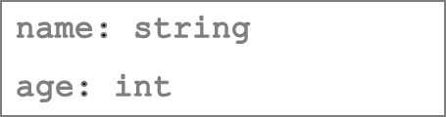
Object Diagrams
The building block is the object symbol, each based off a class symbol.
A class with attributes
object name class name underline
Jack : Person
A specific value for each attribute
name = "Jack"
age = 20
Peter : Person
Simplified representation
Object diagrams can represent a 'snapshot' of the system at a given moment, …
… although we may leave out the attributes to obtain a time-invariant object symbol.

Slide 43
To emphasise the difference, we need to jump ahead a bit … for an example anyway.
Class
Diagram
rightDiner
1
1
leftChopstick
0..1
InUse
0..2
Philosopher
Chopstick
ChopstickUser
leftDiner
1
1
rightChopstick
Object
Diagram
Phil2: Philosopher
Chop1:Chopstick
Chop2:Chopstick
Phil1: Philosopher
Phil3: Philosopher
Chop4:Chopstick
Chop3:Chopstick
Phil4: Philosopher

Slide 44
get() and set() ?
Why didn’t we include the get and set member functions on the previous slide?
  The stereotype <<Data Class>> should include these methods.
  We often list only the “more important” member functions and data elements.
We can omit those identifiers which have no significance in the view of the system we are modelling.

Slide 45
Continuing …
We will look more at class diagrams more later, once we see class relationships.
For now we will return to C++ stand alone classes and delve into the organisation of them some more.

