Slide 1
CSCI251
Advanced Programming (S5d)
Generic Programming:
The Standard Template Library (STL)
Notes:
A reference to a textbook by Dr. Neil Gray

Slide 2
Outline
What is STL?
The building blocks.
Why/when should you use STL?
Why/when shouldn’t you use STL?

Slide 3
What is STL?
The Standard Template Library for C++.
It’s an evolving standard containing the result of many years research into generic programming.
  So making use of compile time polymorphism rather than the run time polymorphism we have in object oriented programming.
It’s used to provide reusable and widely adaptable solutions, that are never-the-less efficient.
  STL contains various building blocks.

Slide 4
In object oriented programming we attempt to tightly bind data and the operations on the data.
In generic programming we attempt to decouple them.
We put the data into containers and use the iterators as an interface to use standard algorithms on data.

Slide 5
The building blocks
STL contains six major kinds of components, implemented using templates:
  Containers.
  Iterators.
  Generic algorithms.
  Function objects.
  Adaptors.
  Allocators.

Slide 6
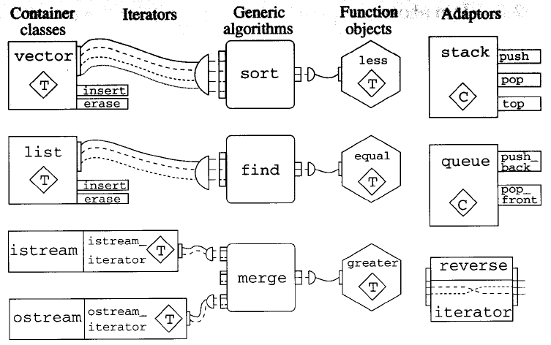
Not every algorithm and iterator can be connected.

Slide 7
Performance vs memory size
Since STL is based on function and class templates it can process all built in and user defined data types.
Each version of a component generated from a template becomes specialized for a particular data type and therefore can be as efficiently as C++ code written directly for this data type.
  Note that if many different data types are used, a large number of specialized components may result in substantial executable size expansion.

Slide 8
Why/when should you use STL?
Code reuse, the code has already been written and tested.
Since it’s in the standard, you can expect portability too.
You also get guarantees about the performance of particular parts of STL.
  STL aims to do as well as you could if you crafted non-templated code.

Slide 9
STL is great if you are doing operations where existing STL algorithms and containers best suit your problem.
  The different containers, we will see soon, provide operations at different costs.
If you aren’t necessarily too concerned about precisely optimising the performance but want your code to follow standard conventions and be portable, STL may be the way to go.
The textbook notes: “Modern C++ programs should use the library containers rather than more primitive structures like arrays.”

Slide 10
Why/when shouldn’t you use STL?
STL aims to do as well as you could if you crafted non-templated code.
  But STL doesn’t cover everything, and having generic implementations means it will sometimes be possible to tailor things more efficiently.
  There may be operations you need to do more efficiently than you can with the existing structures.
In CSCI203/CSCI803 you will see scenarios that don’t use the basis structures you deal with.
If STL doesn’t fit your problem, it’s probably best not to force it.
  We will see in a couple of slides an example of sequential container selection.

Slide 11
STL Containers
There are two types of containers:
  Sequential containers, in which the programmer controls the order in which elements are added and accessed, and the position of elements in determined when they are inserted.
    The elements are organised linearly.
  Associative containers, in which element are stored and linked on the basis of a key value.
    The elements are not necessarily organised linearly.

Slide 12
Sequential containers: Section 9.1
Container | Notes
vector | Flexible-size array. Supports fast random access. Inserting/deleting other than at the back may be slow.
deque | Double-ended queue. Supports fast random access. Fast insert/delete at front or back.
list | Doubly linked list. Supports only bidirectional sequential access. Fast insert/delete at any point.
forward_list | Singly linked list. Supports only sequential access in one direction. Fast insert/delete at any point.
array | Fixed-size array. Supports fast random access. Cannot add or remove elements (positions).
string | Specialised, not fully templated. Similar to vector but for characters. Fast random access. Fast insert/delete at the back.
C++11
C++11
Random access → Access elements in an arbitrary order. Contrasts with sequential access where you need to go through other elements to reach the one you want.

Slide 13
Section 9.1: Choosing a sequential container …
Default: vector.
  Use it unless you have a good reason not to.
Lots of small elements and space overhead matters? Avoid list and forward_list.
Need random access to elements: vector or deque.
Insert or delete elements in the middle: list or forward_list.
Insert or delete elements only at the front and back: deque.
More complex scenarios:
  Insert elements in the middle only while reading input, and subsequently needing random access.
    Possibly just use vector anyway with elements to be added at the end, following by a call to sort it once the input is finished.
    Or, consider using a list for the input phase and then copy the list into a vector.
  …

Slide 14
#include <iostream>
#include <vector>
using namespace std;
int main()
{
size_t size;
cout << "Enter the size of the container: ";
cin >> size;
// get space for size integers and initialize them to 0
vector<int> intArray( size );
for(int i=0; i<size; ++i)
intArray[i] = i;
}
intArray:vector<int>
The variable size is taken care of.
No need to use dynamic memory allocation.

Slide 15
Associative containers
Sorted: Elements ordered by key:
Container | Notes
map | Associate array; holds key-value pairs.
set | Container in which the key is the value.
multimap | map but with a key can appear multiple times.
multiset | set but with a key can appear multiple times.
Unordered Collections (C++11):
Container | Notes
unordered_map | map organised by a hash function.
unordered_set | set organised by a hash function.
unordered_multimap | Hashed map; keys can appear multiple times.
unordered_multiset | Hashed set; keys can appear multiple times.

Slide 16
Iterators
To understand the overall picture of STL, we need to look at the different categories of iterator required for particular generic algorithms, the next STL building block.
Valid operations
Input
Output
== != * ->
++
--
+ += - -= > >= < <= []
Forward
Bidirectional
Random
access

Slide 17
The iterators that satisfy the requirements of output iterators are sometimes referred to as mutable iterators, while those that don’t are referred to as constant iterators.
C++17 adds a sixth kind of iterator, the Contiguous Iterator.
  I think it’s supposed to provide some optimisations above random access iterators in the case where the container elements are stored contiguously.

Slide 18
#include <iostream>
#include <vector>
using namespace std;
int main()
{
vector<int> c;
c.push_back(1);
c.push_back(2);
c.push_back(3);
c.push_back(4);
for(int i=0; i<4;++i)
cout<< "c["<<i<<"]="<<c[i]<<endl;
vector<int>::iterator p = c.begin();
cout<<"The third entry is "<<c[2]<<endl;
cout<<"The third entry is "<<p[2]<<endl;
cout<<"The third entry is "<<*(p+2)<<endl;
cout<<"Back to c[0].\n";
p = c.begin();
cout<<"which has value "<<*p<<endl;
c[2] is just for vector, array
and arrays...
Try in lab !!! => Place …
main() in s5d_1.cpp

Slide 19
cout<<"Two steps forward and one step back:\n";
p++;
cout << "&p : " << &p << ", &(*p) : " <<
&(*p) << ", *p : " << *p << endl;
p++;
cout << "&p : " << &p << ", &(*p) : " <<
&(*p) << ", *p : " << *p << endl;
p--;
cout << "&p : " << &p << ", &(*p) : " <<
&(*p) << ", *p : " << *p << endl;
return 0;
}
$ ./a.out
c[0]=1
c[1]=2
c[2]=3
c[3]=4
The third entry is 3
The third entry is 3
The third entry is 3
Back to c[0].
which has value 1
Two steps forward and one step back:
&p : 0x7ffe46a51c30, &(*p) : 0xe84c24, *p : 2
&p : 0x7ffe46a51c30, &(*p) : 0xe84c28, *p : 3
&p : 0x7ffe46a51c30, &(*p) : 0xe84c24, *p : 2
Try in lab !!! => Place …
main() in s5d_1.cpp

Slide 20
Reverse iterators …
Use rbegin() and rend().
#include <iostream>
#include <vector>
using namespace std;
int main()
{
vector<char> c;
c.push_back('A'); c.push_back('B'); c.push_back('C');
cout<<"Forward:\n";
vector<char>::iterator p;
for (p=c.begin(); p!=c.end(); p++) cout<< *p << " ";
cout<<endl;
cout<< "Reverse:\n";
vector<char>::reverse_iterator rp;
for(rp=c.rbegin(); rp!=c.rend(); rp++) cout<< *rp <<" ";
cout<<endl;
return 0;
}
Try in lab !!! => Place …
main() in s5d_2.cpp

Slide 21
Stream iterators
Two useful stream iterators:
  istream_iterator<type> isIterator(istream&);
  ostream_iterator<type> osIterator(ostream&);
  ostream_iterator<type> osIterator(ostream&, char* delimit);

Slide 22
Try in lab !!! => Place …
main() in s5d_3.cpp
#include <iterator>
int main()
{
double value1, value2;
cout << "Please, type 2 numbers (seperated by white space) : ";
istream_iterator<double> eos; // end-of-stream iterator
istream_iterator<double> iit (std::cin); // stdin iterator
if (iit!=eos) value1 = *iit;
++iit;
if (iit!=eos) value2 = *iit;
cout << value1 << " * " << value2 << " = " <<
(value1*value2) << '\n';
return 0;
}

Slide 23
Generic algorithms
Algorithms are applied to containers through the iterators that are available to traverse containers.
Most of the algorithms take one of the following four forms:
alg(beg, end, other args);
alg(beg, end, dest, other args);
alg(beg, end, beg2, other args);
alg(beg, end, beg2, end2, other args);
The arguments dest, beg2, and end2, are used to reference a destination, or a second input sequence.
  Algorithms makes assumptions about the sizes of those.

Slide 24
Algorithms don’t add elements to a sequence, and generally we need to avoid using iterators in a setting where during the iteration a container is resized.
Generally the algorithms are generic, but the containers list and forward_list define some algorithms as members.
  This is to get better performance for the algorithms that generically make use of random-access iterators:
    Sort, merge, remove, reverse, and unique.

Slide 25
Algorithm categories
Check out: http://en.cppreference.com/w/cpp/algorithm
Non-modifying sequence operations:
  e.g. find.
Modifying sequence operations:
  E.g. copy.
Partitioning operations:
Sorting operations:
Binary search operations (on sorted ranges):
Set operations (on sorted ranges):
Heap operations:
Minimum/maximum operations:
Numeric operations:
Operations on uninitialized memory: (mostly C++17)
C library:

Slide 26
Complexity
The details on the algorithms at http://en.cppreference.com/w/cpp/algorithm indicate their complexity.
For example:
  next_permutation
Complexity: At most N/2 swaps, where N = std::distance(first, last).

Slide 27
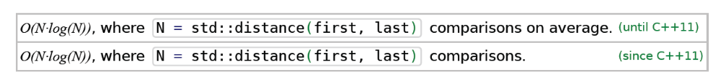
Sorting …
Sorting is pretty significant as an activity.
C++11 provides improved reliability …

Slide 28
Try in lab !!! => Place …
main() in s5d_4.cpp
#include <iostream>
#include <algorithm>
#include <vector>
using namespace std;
int main()
{
// using std::find with vector and iterator:
int myInts[] = { 10, 20, 30, 40 };
vector<int> myVector (myInts,myInts+4); // vector of above ints
vector<int>::iterator it; // vector iterator
it = find (myVector.begin(), myVector.end(), 30);
if (it != myVector.end())
cout << "Element found in myVector: " << *it << '\n';
else
cout << "Element not found in myVector\n";
return 0;
}
myVector:vector<int>

Slide 29
Try in lab !!! => Place …
main() in s5d_5.cpp
#include <iostream>
#include <map>
#include <algorithm>
#include <string>
using namespace std;
int main()
{
map<string, long> directory; // declare a map container
directory["Alice"] = 9234567; // add key,value pairs
directory["Bob"] = 9876543;
directory["Carol"] = 8459876; // And so on ...
// Read some names and look up their numbers:
string name;
do
{
cout << endl << "Enter name to search (-1 to exit) : ";
cin >> name;
if (directory.find(name) != directory.end())
cout << "The phone number for " << name
<< " is " << directory[name] << endl;
else if (name != "-1")
cout << "Sorry, no listing for " << name << endl;
} while (name != "-1");
return 0;
}
directory is of type : map<string,long>

Slide 30
Function objects
We have come across these before.
Objects that are instances of classes that have an overloaded operator(), the function call operator, are considered to be function objects.
In the context of STL there are some specific templated function objects classes that are used.
There is a list at: http://en.cppreference.com/w/cpp/utility/functional

Slide 31
A few common templated function object classes
These are all in the header <functional>
less: Implements x < y.
equal_to: Implements x == y.
greater: Implements x > y.
These provide a passable means of accessing those operations generically, so for use in a generic algorithm.

Slide 32
We can, for example, take a container specified by iterators, and apply sort using a random_access iterator and a function object less.
The less tells you how to do the individual comparisons within the sort.

Slide 33
Adaptors
There are adaptors for containers, iterators, and functions.
The textbook says: “Essentially, an adaptor is a mechanism for making one thing act like another.”
There are three sequential container adaptors:
  Stack: FIFO.
  Queue: LIFO.
  Priority_queue: Prioritises based on, by default, <.

Slide 34
As an example; the stack adaptor turns a sequential container, other than array or forward_list, and makes it operate like a stack.
Iterator adaptors include such things as reverse_iterator, move_iterator, …
http://en.cppreference.com/w/cpp/iterator#Iterator_adaptors
And stream iterators …

Slide 35
Allocators
The library class allocator is used to allocate unconstructed memory.
It provides us with the means to separate the allocation of memory from the construction of objects in that memory.
From: http://en.cppreference.com/w/cpp/concept/Allocator
“Encapsulates strategies for access/addressing, allocation/deallocation and construction/destruction of objects.”

